Slide 1
Summary week 23 Luminosity production
Bernhardt Holzer, Jorg Wenninger

Slide 2
Sunday
23:50 Fill 2718 dumped by OP after almost 16 hours of stable beams.
Refilling…
01:50 Fill 2719 in Stable Beams… for 3 minutes.
Dumped by vacuum spike in Pt3 ~ 1E-6 - Q6.L3.
‘Normal’ losses when going into collisions.
02:20 Vac. expert increased interlock level to 4E-6.
03:00 Refilling…
04:07 Fill 2720 in Stable Beams … for 30 minutes.
RF dump, crowbar on M2B1, circulator arc.
Waiting for MKI8 temperatures to cool down…

Slide 3
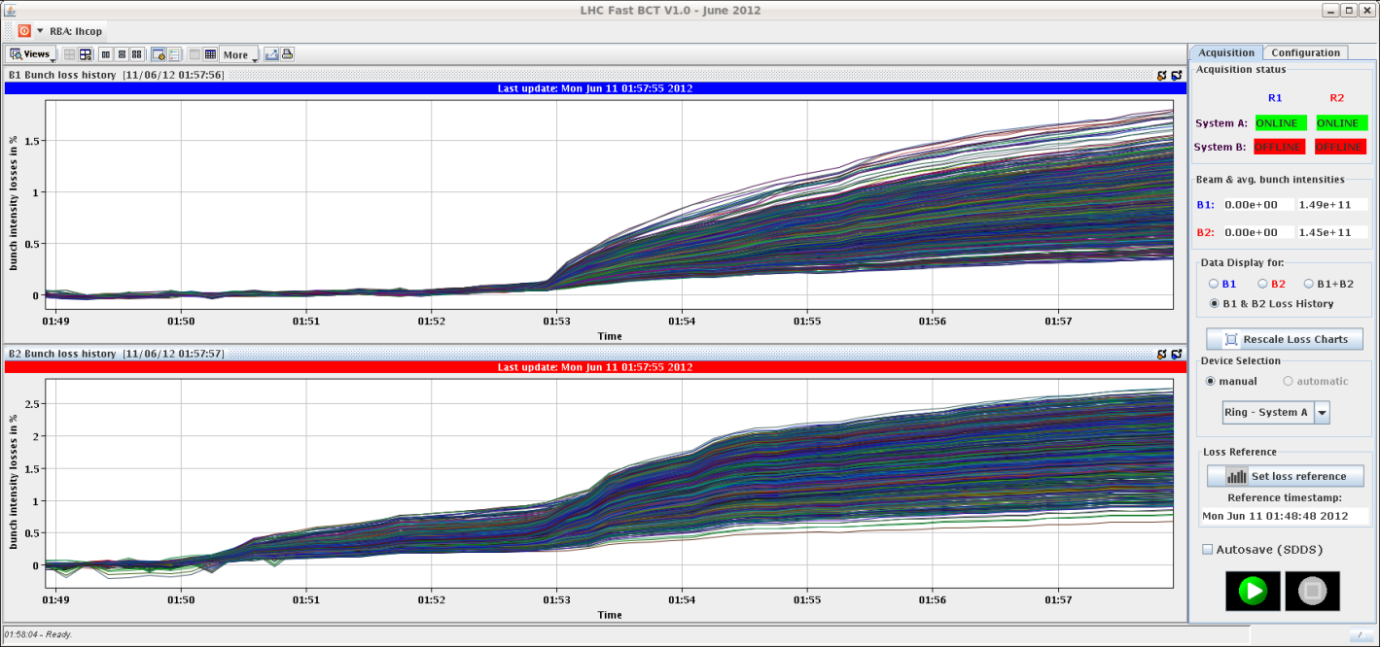
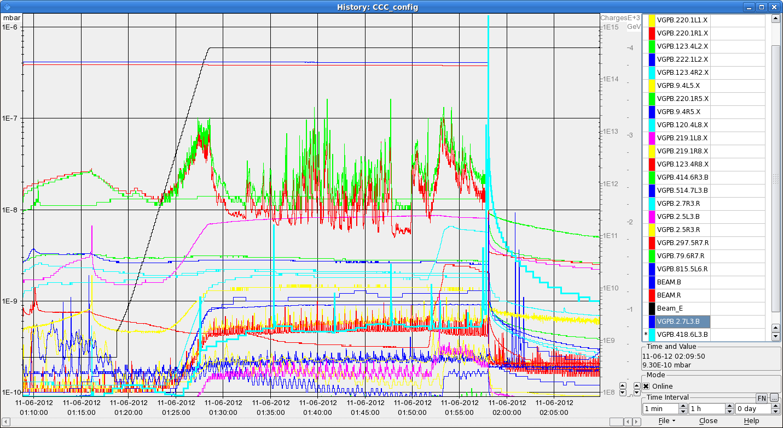
Vacuum spike
Few %

Slide 4
Monday morning
08:10 Beam dumped in the ramp by OP – OFB did not start and kept injection orbit.
Try again…

Slide 5
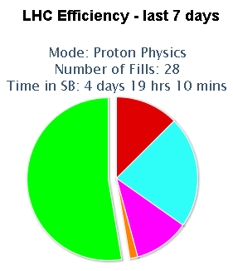
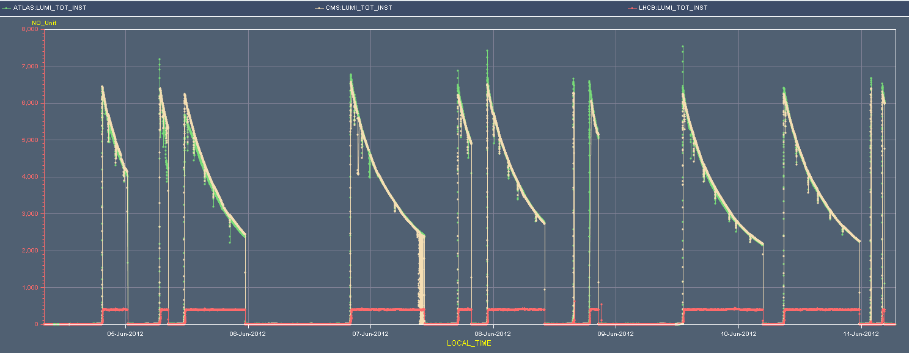
Overview of an excellent week
Intensity per bunch : ~1.5E11 p/b
Initial L : 6.2 - 6.7x10³³ cm⁻²s⁻¹
52%
Luminosity
LBDS
TSU
Access,
PSB RF

Slide 6
Fills of the week
Fill | Day | L (h) | Int L (pb-1) | Dump
2698 | Mo | 5:00 | 89 | Vacuum
2700 | Tu | 1:40 | 33 | QPS on RCBXH2.L1
2701 | Tu | 11:49 | 160 | OP
2710 | We | 14:26 | 200 | PM56 door/loss of patrol
2711 | Th | 2:39 | 51 | FMCM, electrical perturbation
2712 | Th | 10:30 | 160 | Adjust mode, electrical perturbation
2713 | Fr | 0:06 | 6 | SIS due to CMW communication problem
2714 | Fr | 1:43 | 37 | OP → LBDS TSU issue
2717 | Sa | 15:40 | 160 | Electrical circuit breaker RF klystron B2
2718 | Su | 14:50 | 199 | OP
2719 | Mo | 0:03 | - | Vacuum Pt3
2720 | Mo | 0:30 | 11 | RF crowbar M2B1
Integrated luminosity 1106 pb⁻¹

Slide 7
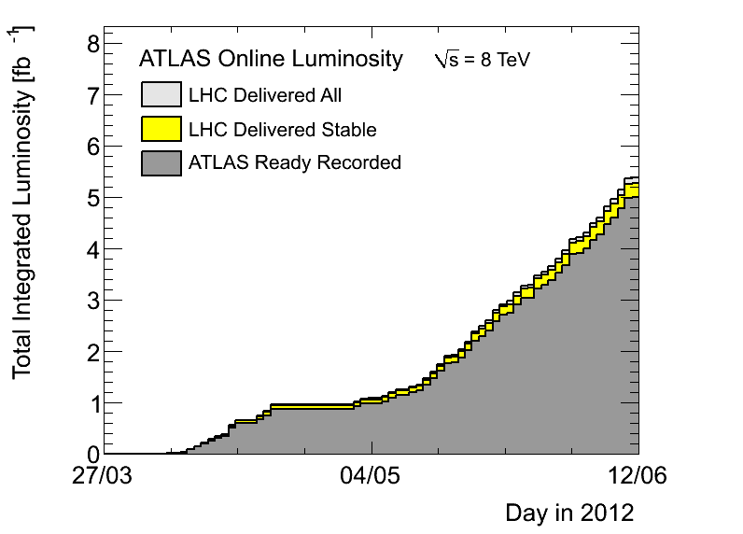
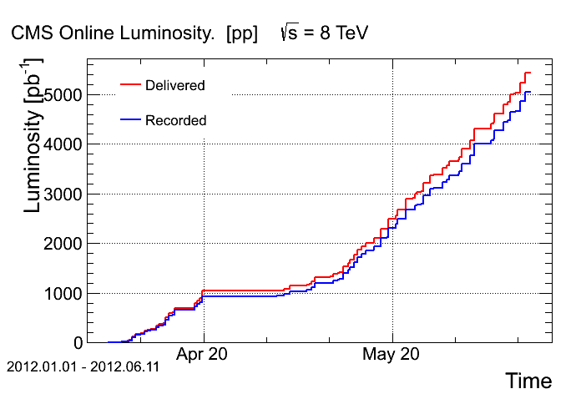
Integrals – well over 5 fb-1

Slide 8
Main faults
There were many small problems, with max 2.5 hours time lost.
Water cooled cabled RQ10.R1, heater PS on current lead RQ7.R1, vacuum Pt5 & Pt3, access door PM56, klystron circuit breaker…
Two main items:
PSB RF:
lost ~7 hours on Wednesday (beam quality, repair).
LBDS TSU (Trigger Synchronization Unit):
lost ~11 hours Friday night, but this time includes a very useful low intensity machine cycle for measurements (see later).

Slide 9
Faults : rare event
On Thursday morning beam dump due to patrol loss / access door in PM56 – during the end of fill MD.
The door (YCPS01=PM45) opened because it was not properly closed (but seen closed by the LASS contacts). Probably the effect of a pressure change…
This situation can actually be detected, but no info in the CCC.
OP should get a simple view to detect such situations.
Another door in Pt2 was in the same state → went in to close it.

Slide 10
Faults & problems : controls
Problems with the orbit FB service unit (OFSU) are back (no version change !). No beam loss, but frequent restarts needed, tasks failing…
Friday PM: FCG gateway blocking / delayed subscriptions (> 1 minute) when an application (lumi scan) that subscribed to several properties got disconnected by CMW. The blocking is not understood.
Consequence : beam dump triggered by SIS due missing orbit corrector data after 40 second timeout.

Slide 11
LBDS TSU issue
Friday around 18:30 V. Mertens informed us that an error had been identified within the LBDS that would render the LBDS inoperable: no dump executed.
20:00: E. Carlier’s team had designed a simple surveillance system to react in time on such a failure. In a meeting in the CCC it was decided to:
dump the current beam,
implement and test the surveillance system,
run the machine through the cycle with low intensity to exclude evident side-effects (duration ≥ 3 hours).

Slide 12
LBDS TSU issue
V. Mertens
During the preparation for a review on “LBDS powering” on 20 June … (triggered by asynch. dump), an error source was identified on the LBDS test bed which would (if this error would occur) render the LBDS inoperable (→ NO dump when requested)
Trigger Synchronization Units (redundant TSUs, powered by redundant PS) are installed in one crate.
Loss of +12 V, e.g. by short circuit on a card, would make all output stages unusable.
Power failure will be detected but, due to the loss of 12 V, not be transmitted further down into the LBDS (power triggers/pulse generators).

Slide 13
LBDS TSU continued
V. Mertens
Simple (yet functional) fix was build and applied by midnight Friday.
Detects 12 V loss and injects trigger into re-triggering system (i.e. behind TSUs).
If 12 V loss in TSU crate → asynchronous dump (synchronization units not working).
Note:
Potential error source existed since beginning.
Would have been – and will be – eliminated by new layout / design of TSU system in LS1.
Upcoming:
Review of LBDS powering (June 2012).
Review of first years of operational experience (October / November 2012).

Slide 14
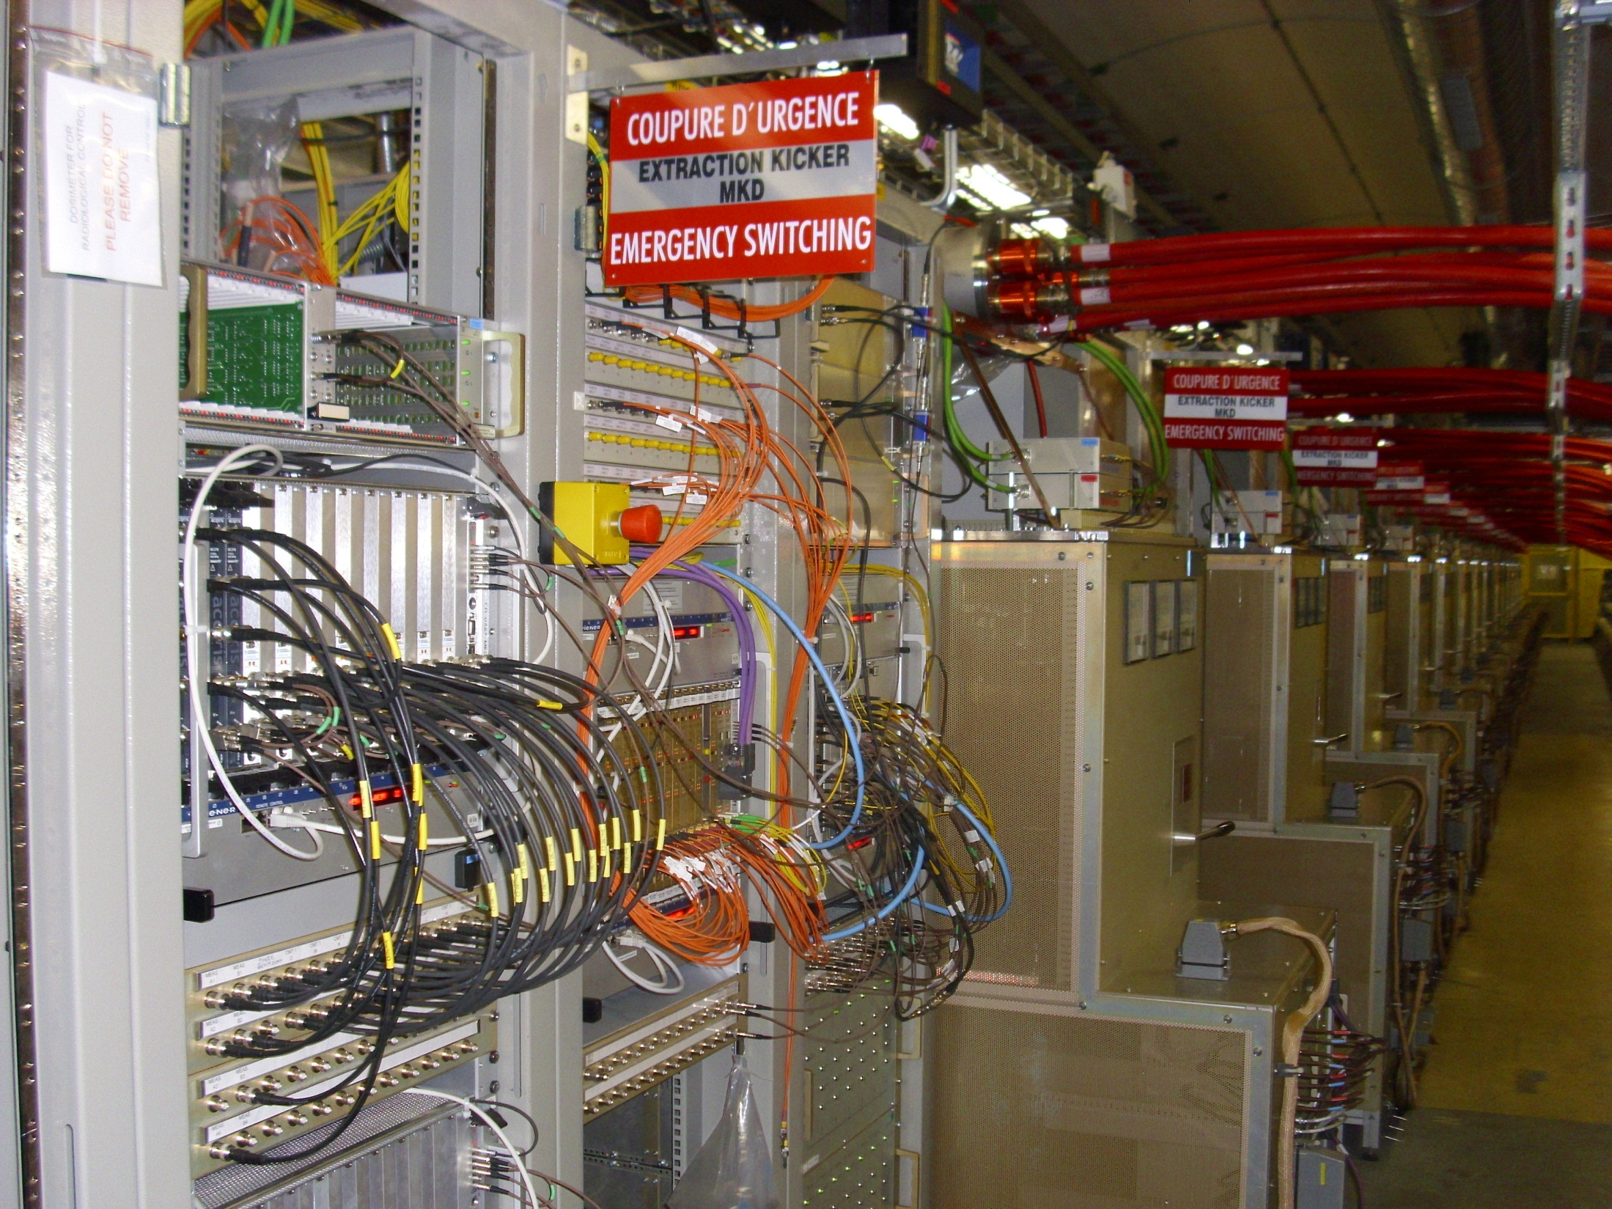
trigger and other general LBDS electronics
LBDS Beam 2 (UA67)
15 + 1 pulse generators
TSU
Fixing a (potentially fatal) safety problem
V.Mertens for E.Carlier, N.Magnin, A.Patsouli

Slide 15
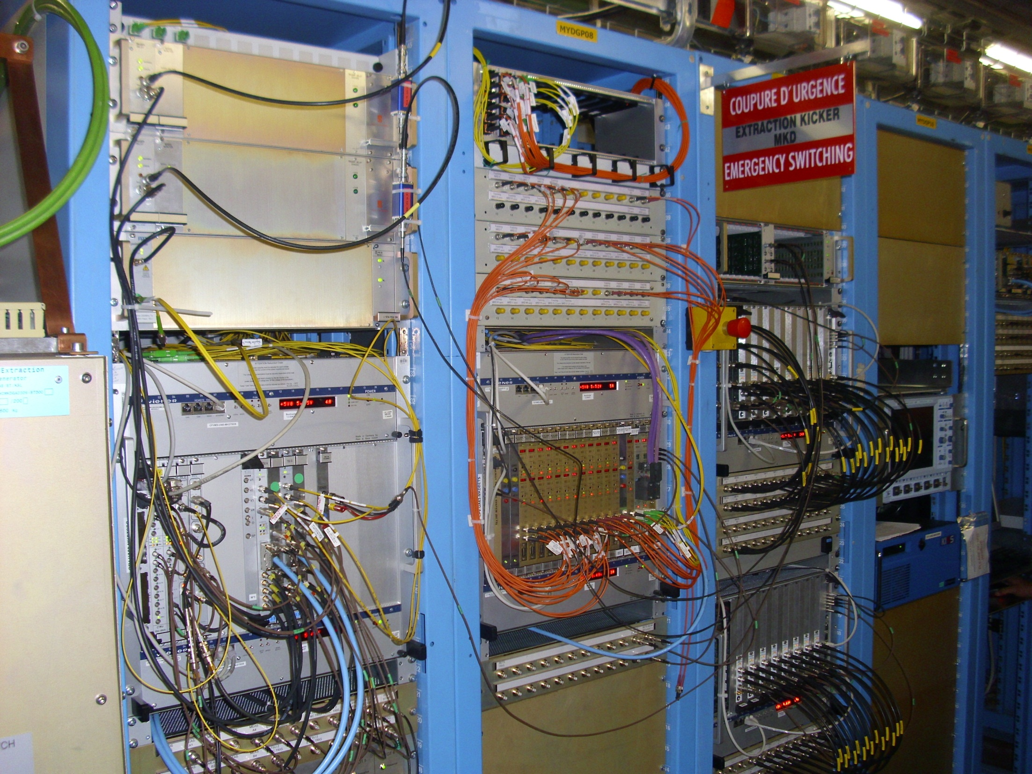
LBDS Beam 1 (UA63)
trigger injection into re-triggering system
pulse generation on detection of 12 V loss
TSU
BETS
Fix will be improved in TS2 (surveillance of 12 V surveillance, …)
Splitting of TSUs probably too involved for short stops
New TSU layout/design in preparation, to be implemented in LS1
(taking latest information into account)

Slide 16
A happy end…
Thanks to the prompt reaction of E. Carlier’s team from TE/ABT the solution was installed the same evening…
… and the LHC was back with high intensity the next morning !

Slide 17
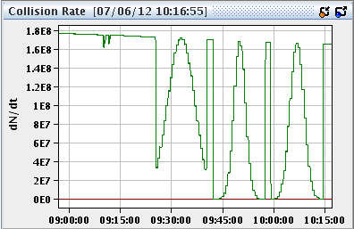
Luminosity, CMS VdM & filling scheme
On Tuesday we reverted back to the filling scheme with 3 non-colliding bunches for ATLAS/CMS.
On Wednesday CMS and ATLAS changed their online luminosity calibration: CMS -2.2%, ATLAS +0.25%.
Thursday: VdM scan for CMS, standard ADT gain.
One scan with ±3 sigma TOTAL separation.
Two scans with ± 6 sigma TOTAL separation.
No losses.

Slide 18
Tune activity during the VdM scans
T. Pieloni, X. Buffat

Slide 19
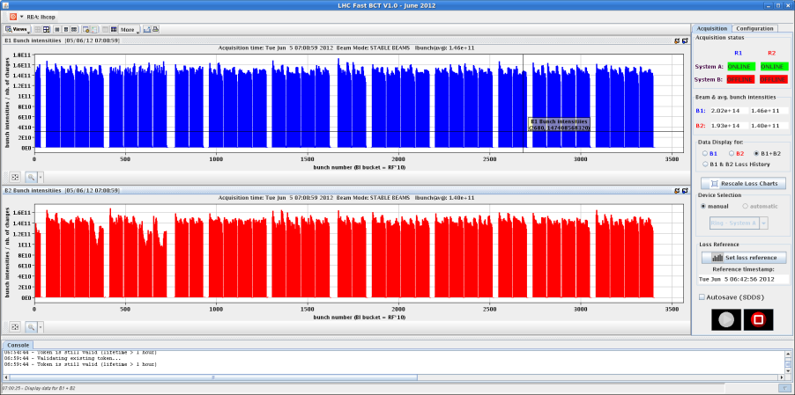
Losses in collision
Losses when going into collision were observed in 2 fills.
In the second case, the beams were dumped by BLMs in IR7 due to heavy losses on many B2 bunches.
Case 1 : Fill 2700, B2 losses

Slide 20
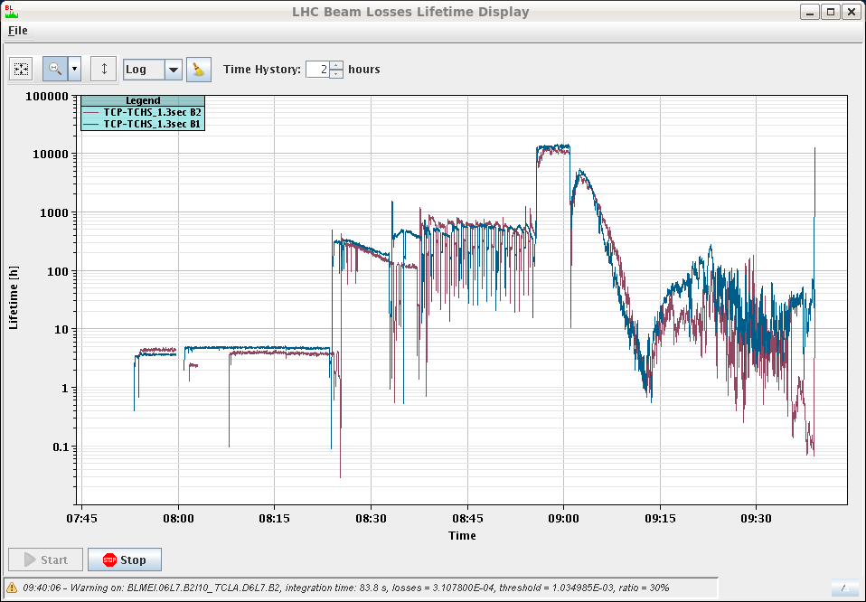
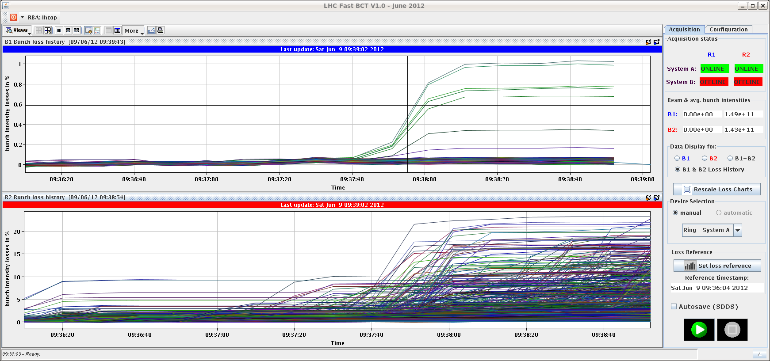
Losses in collision
Case 2: fill 2716 was lost when going into collisions.
Heavy losses on B2, starting already before colliding.
Large(r) bunch int. spread.

Slide 21
ADT gain tests at end of fill (1)
Thursday morning: test with reduced ADT H gain.
Separation in IR1 & IR5.
Increased activity on tune with reduced ADT gain and with separation.
Activity on the batches of 72 bunches (B1 &B2) on the ADT side, losses on a few isolated bunches of B1.

Slide 22
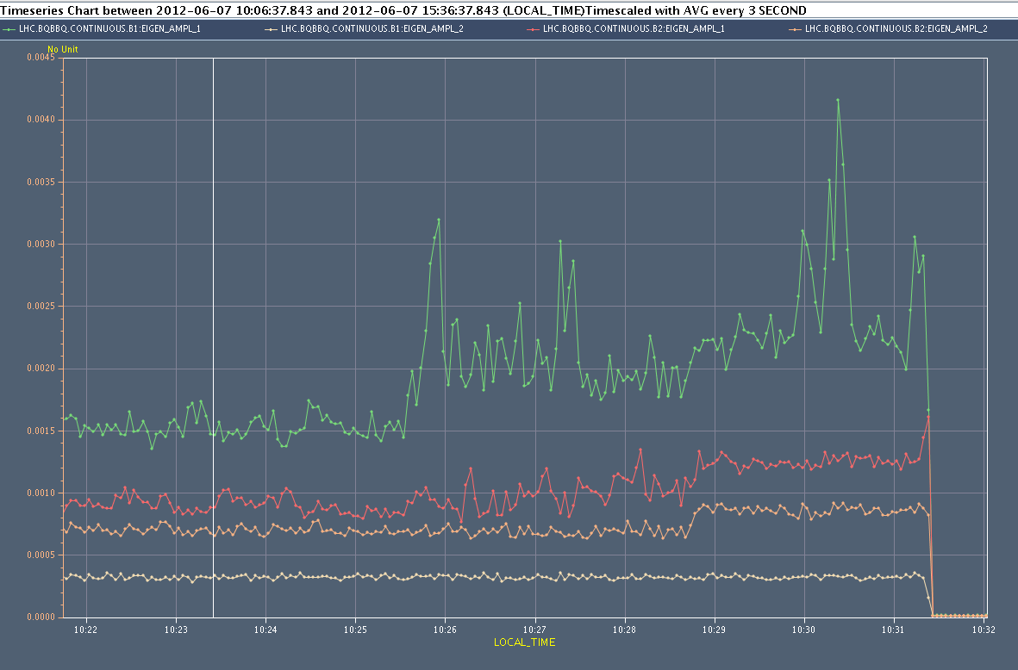
ADT test (2)
BBQ activity
ADT gain
Separation

Slide 23
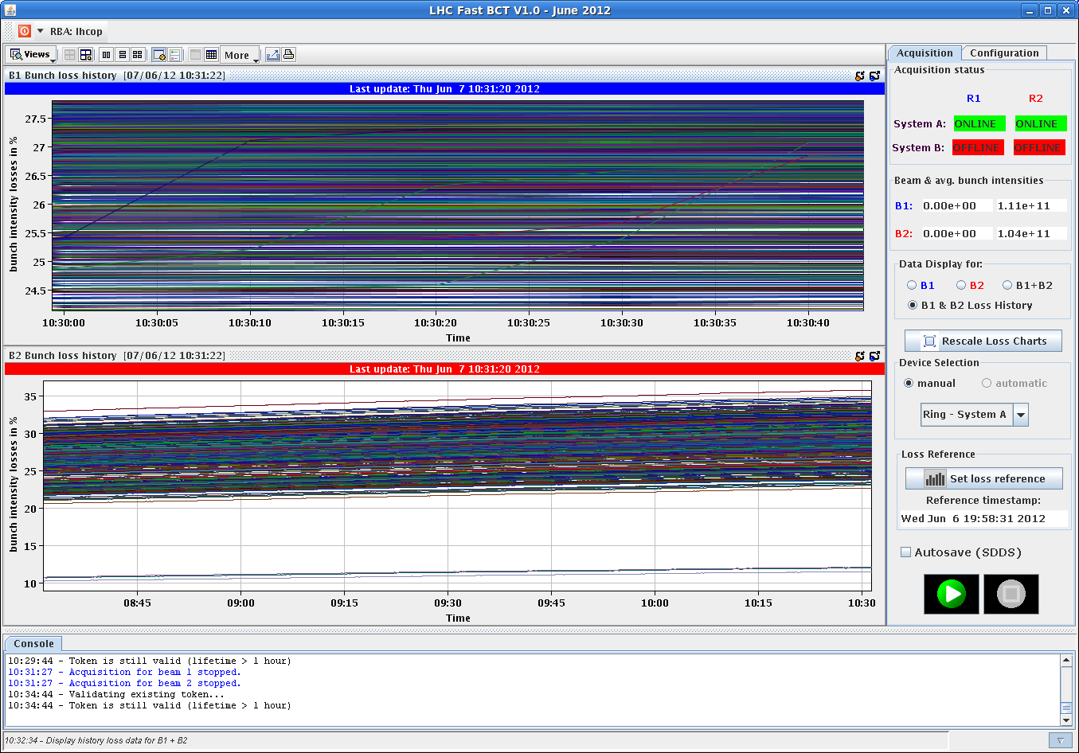
ADT test (2)
Losses, B1

Slide 24
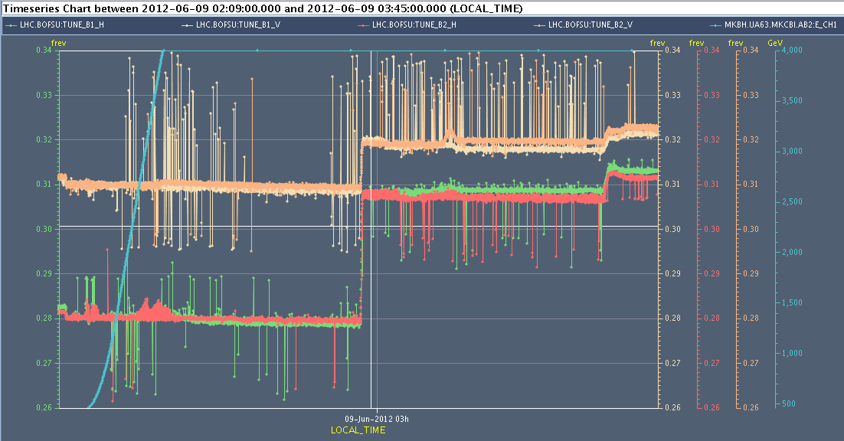
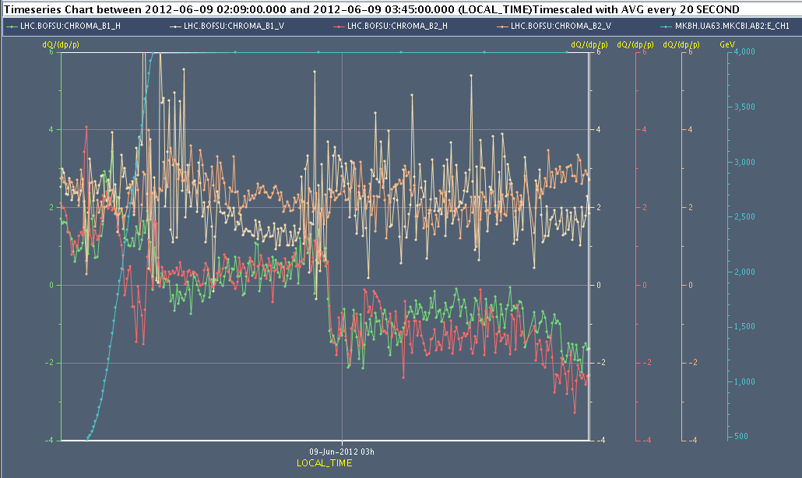
Measurement cycle
Low intensity cycle following TBDS TSU intervention was used to check tunes and chromaticity with probe bunches.
Horizontal Q’ was found negative, around -1 in squeeze + collisions.
Q’ trim to around +1 for squeeze/collisions on Saturday morning.
Q
Q’

Slide 25
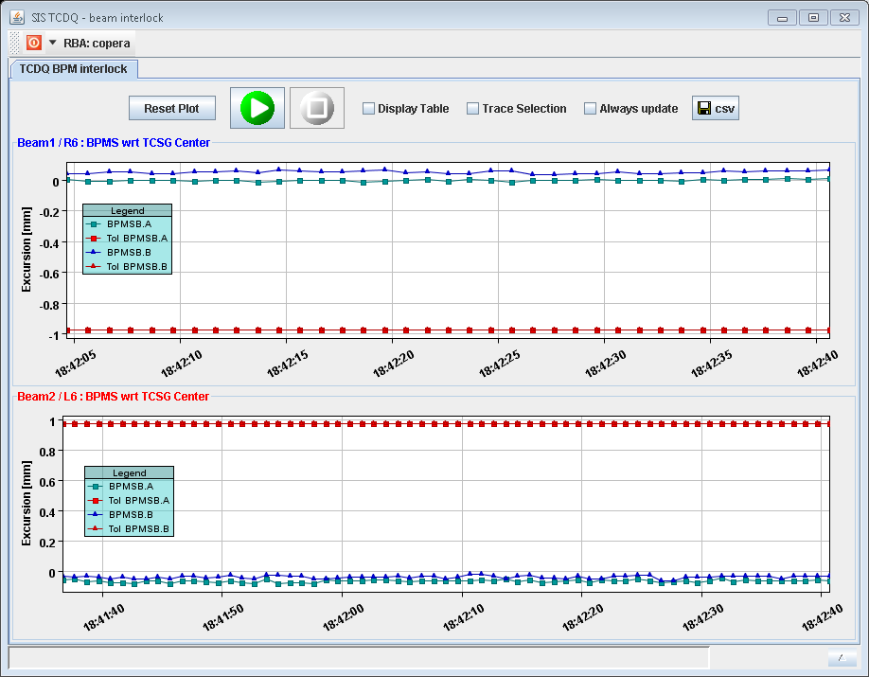
TCSG IR6 alignment check
A systematic drift of the average position of B2 BPMs in IR6 (wrt collimator alignment reference) lead to dumps by SIS in previous weeks.
A TCSG6 re-alignment on Monday confirmed that the REAL beam position is correct (center shifts of 8 um (B1) and 160 um (B2)).
BPM reference positions have been reset to the readings.

Slide 26
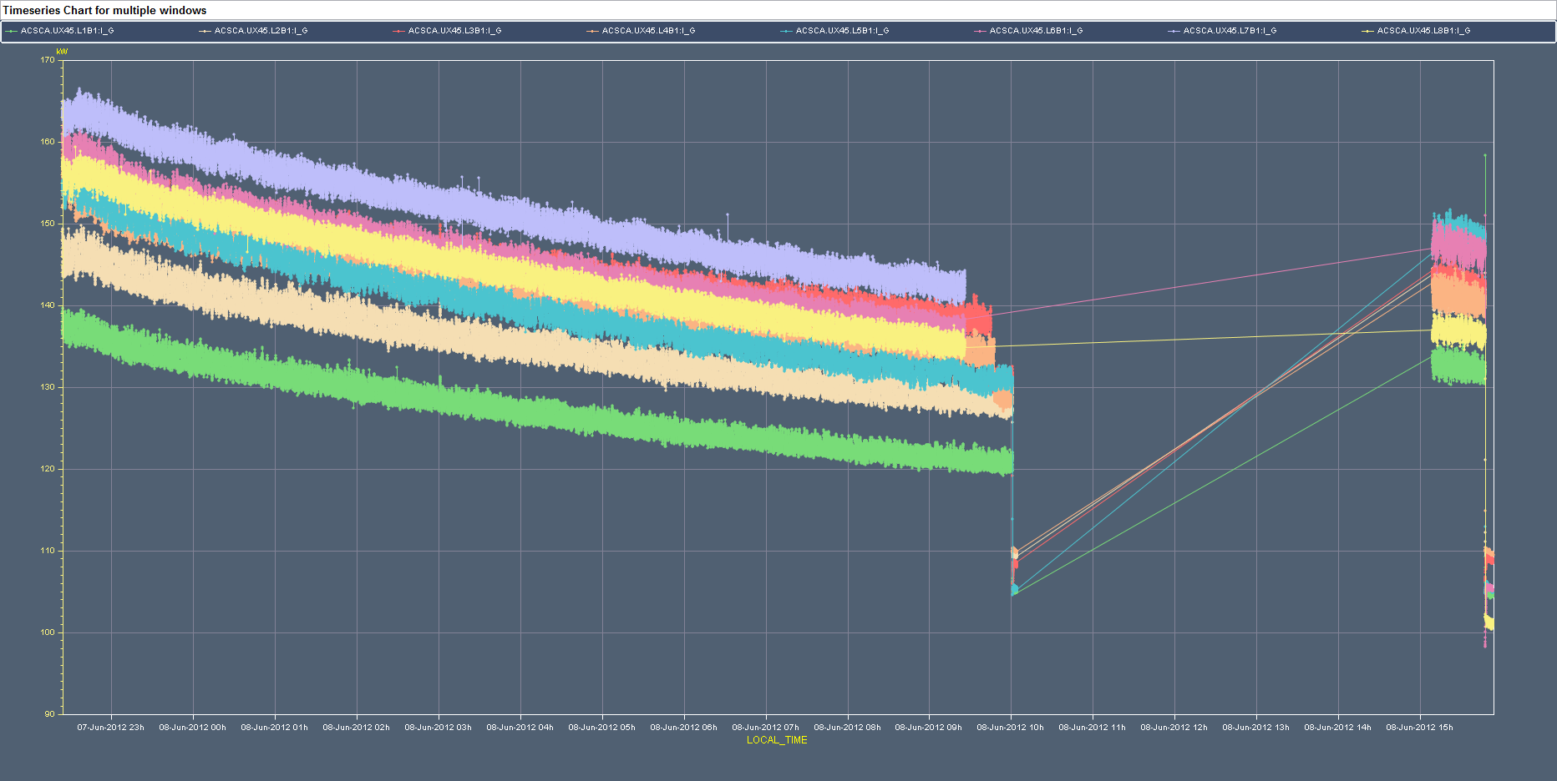
RF cavity fine tuning
Friday morning our RF colleagues used an end of fill to fine tune the cavities.
Clear reduction of the klystron forward power.
Tuning

Slide 27
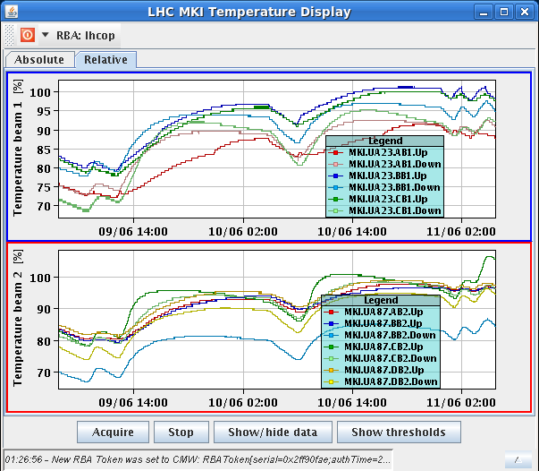
Injection kicker heating
In the past week we heated the MKIs, and the temperature limits could be increased by 1-2 degrees on some magnets / probes.
But the problem has come back this morning. Filling delayed due to MKI8 temperature.
This morning

Slide 28
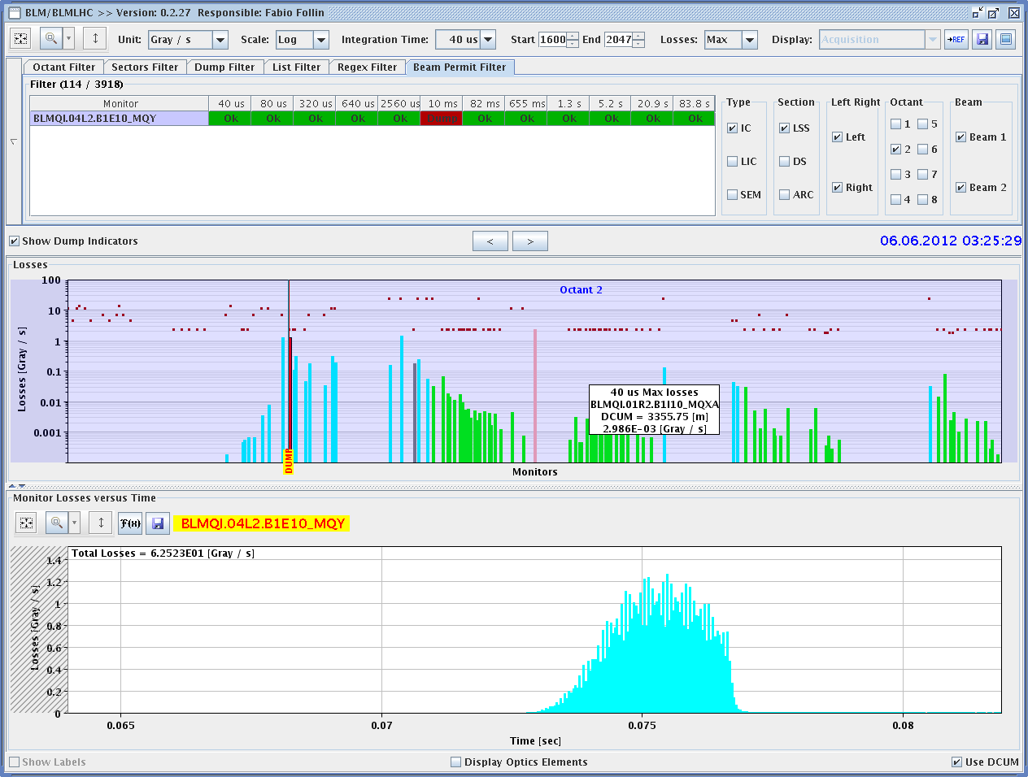
MKI2 UFO dump – rare injection event
UFO dump at injection Wed 3:30 AM, ~300 ms after injection,
with 144+12 bunches in the machine.
BCT

Slide 29
For discussion – Leap second
Saturday 30th June at 23:59:59 a leap second will be added to the UTC time.
This will shift NTP time distributed over the network from the UTC time distributed by the timing systems (all machines).
A stop of all machines is required to adjust the timings systems.
Question from timing team:
Can the re-synch be done Mo 2nd July (all machines) or does it have to be done in the night of 30th June?
Clearly the logging from difference source will be out of step.
Probably okay, but should be ready for ‘emergency’ intervention .. just in case.

Slide 30
Pending
Impact of TETRA on hump / beam.
30 mins at injection with probe bunches.
SPS Q20 extraction tests to TI2/8 downstream TED.
During LHC downtime –injection OK from ALICE/LHCb needed.
Access:
TCLIB.6R2.B1 electronics and LVDT sensor.
MAD PM15: motors of inner doors not working (at least 4 hours).
RQTL11.R7B2 temp DFBAN spikes (~3 to 5 hours).
BI in Pt4 (3-4 hours, working hours).
MKA test in Pt4 (1-2 hours).
TOTEM vacuum gauge (3 hours).
MCBV18.L4B1 and RCO.A12.B1 to be repaired.

