Slide 1
Summary of week 22
Machine Coordinators: G. Arduini, M. Lamont Main aim: Luminosity production

Slide 2
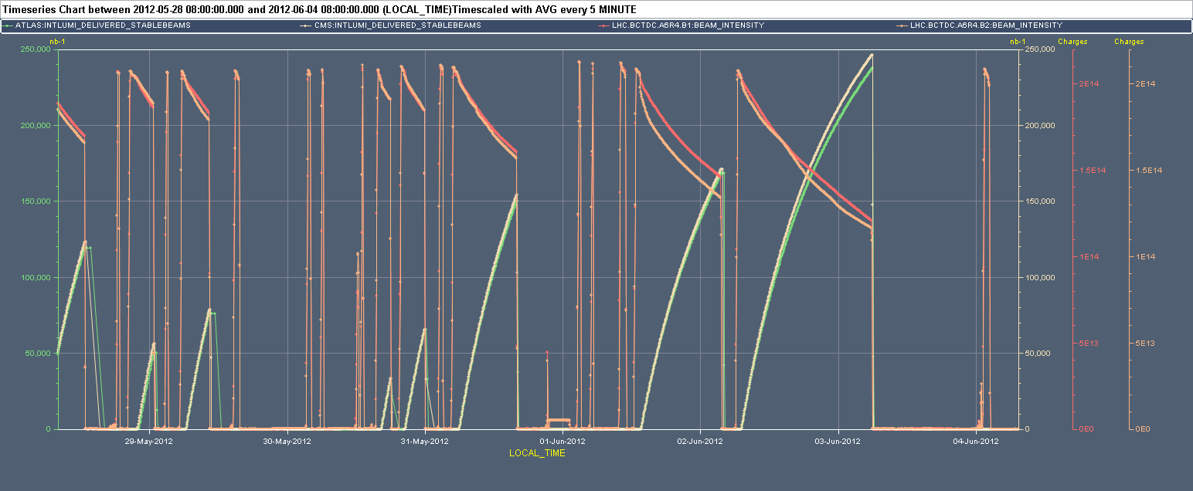
Week 22
PC, QPS, RF, OFSU
LHCb polarity change
QPS, Vacuum

Slide 3
Last 24 hours
After a very good fill…the desert:
07:00-12:30: Access for QPS main circuits Sector 67 (WorldFIP repeater connector). In the shadow investigations on TCTH.4R5.B2 failing to move.
12:30-13:30 Pre-cycle
13:30-14:30 Problem with TCLIB.6R2.B1. LVDT disabled
14:30 Injecting
15:00-15:30 BLM power supply in TI2 interlocking extraction
15:30-17:48 Access for QPS problem (WorldFIP communication) on Q17.L5
18:07–21:45 Access for vacuum controls preventing to open to vacuum valves in point 5
20:46-23:00 Access for QPS problem (WorldFIP communication) on Q17.L5 AGAIN!! Card replacement did not solve the problem. OK after serveral resets of the old card….
00:20 Finally injecting…

Slide 4
Last 24 hours
Large emittance on the 12 bunch train while injecting. Dump and refill
02:18 Problem with TCT collimators in point 2 armed but not executing the functions during the collision process
02:25 Beam dump due to loss of communication with BLM crate in point 3 (SW intlk)
05:27 Trip of sector 12. RQ6.R1 (QPS) while at pre-injection plateau
Precycling
During pre-cycle problem with LBDS.B2 (power supply). Access required

Slide 5
Fills of the week from 28/5 – 08:00
Fill | Day | Nb | L (h) | Int L (pb⁻¹) | Dump
2671 | Mon | 1380 | 4.8(7.3) | 71.3(121.3) | BPM LSS6 (SW Intlk.)
2673 | Mon | 1380 | 2.8 | 53.2 | Trip of RCBXV2.R1 (QPS)
2675 | Tue | 1380 | 4.1 | 77.4 | RQ7.R1 (QPS – SEU)
2683 | Wed | 1380 | 1.6 | 33.0 | ALICE BCM (UFO?)
2684 | Wed | 1380 | 3.4 | 65.7 | RF trip
2686 | Thu | 1380 | 10 | 152 | OP dump
2691 | Fri | 1380 | 14 | 169.6 | ROF/ROD/RSD2 trip (QPS SEU)
2692 | Sat | 1380 | 22.8 | 241.8 | FMCM RD1.LR1 (thunderstorms)
Total |  |  | 63.5 | 864
Stable beams ~ 63.5 hours in total (37.7 %)

Slide 6
Main faults
Cryo Pt8
 | Hours | Faults
Mon 28.5 | 2.5 | ATLAS access
Tue 29.5 | 10.5 | Recovery from Sector 12 trip (2.5 h), Octupoles PC in S67 and S81 and QH PS in Sector 67 (5.5 h), RF controls (2.5 h)
Wed 30.5 | 6 | RF longitudinal blow-up (4 h) +OFSU (2h) investigations
Thu 31.5 | 3 | Accesses: CMS (1 h), QPS, Cryo, ALICE, BIC, RQS.A67.B1 replacement (2 h)
Fri 1.6 | 1.5 | RQTF.A81.B2 replacement
Sat 2.6 | 0
Sun 3.6 | 16 | Accesses: QPS Sector 67 (6.5 h), QPS Sector 45 (4.5 h), Vacuum controls (3.5 h) Collimator (TCLIB.6R2.B1 – LVDT – 1 h), TI2 BLM Power supply (0.5 h)
Mon 4.6 | 6 | Collimator controls, LBDS power supply
Total | 45.5

Slide 7
Main faults by system
System | Time [h] | Comments
QPS | 13 | WorldFIP connectors, resets of old QPS
PC | 9.5 | Radiation damage on auxiliary power supplies?
RF | 6.5 | CPU replacement, Failure of long. blow-up not understood. Not appeared since.
Collimators | 5 | Controls+LVDT failure
Vacuum | 3.5
Experiments | 3.5
OFSU | 2 | Not understood. Added monitoring. Not appeared since.
LBDS | 2 | Power supply
Injectors | 0.5 | Could have been longer….(SPS interlock problem)
Total | 43.5

Slide 8
Lost ramps
Event Timestamp | Beam Energy [MeV] | Fill Number | Comment
28-May-12 18:47:48 | 3492360 | 2672 | BPMS out of limits - drifting readings
29-May-12 03:16:28 | 1497360 | 2674 | OFSU crash – 240 CMW applications from LabView applications
30-May-12 06:19:48 | 3180240 | 2678 | Longitudinal blow-up B1 didn't work. Collimator temperature interlock (TCTVB.4L8)
30-May-12 13:16:47 | 450120 | 2681 | OFSU crashed just after mode change
01-Jun-12 03:09:07 | 3999960 | 2688 | RQTF.A81B2 tripped after the end of ramp. Clean dump.
01-Jun-12 05:20:52 | 513720 | 2689 | Same power converter tripped as for previous fill. RQTF.A81B2 tripped after starting the ramp at 514 MeV. Losses on TCDQ very low (due to the low energy and the ramp). Clean dump.
c/o Post-Mortem DB

Slide 9
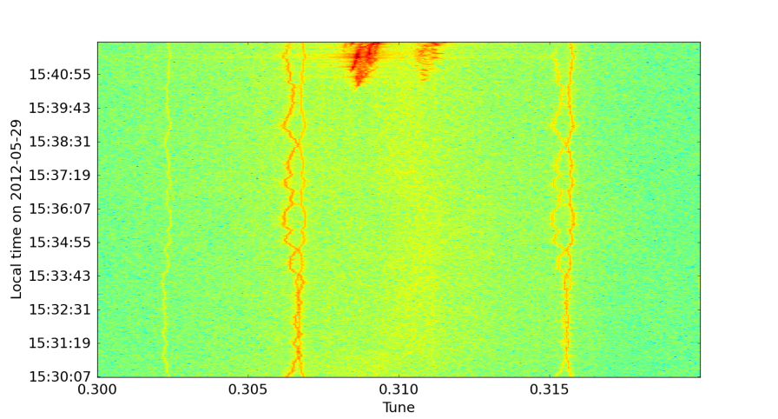
Losses in adjust
Event Timestamp | Fill Number | Mps Expert Comment
29-May-12 15:42:19 | 2676 | beams dumped due to trip of ROF/ROD.A81.B1 (ROF.A67.B1 was also not available since 15/5) leading to instabilities at the end of the squeeze
01-Jun-12 01:17:29 | 2687 | Test ramp with low intensity after LHCb polarity change. Clean dump.
01-Jun-12 11:01:40 | 2690 | Incoherent beam losses for beam 2, during 4 sec with 75 kW the beams were dumped, by the BPM in IR6 at MQY.4L6. Clean dump. Probably not optimum tune. Beam 1 was ok. Clean dump
04-Jun-12 02:25:30 | 2695 | BLM HV SW intlk – loss of communication
c/o Post-Mortem DB
2676

Slide 10
Losses during squeeze
Event Timestamp | Fill Number | Comment
30-May-12 04:07:06 | 2677 | QPS trigger intercepted by PIC. Clean dump.
31-May-12 03:10:39 | 2685 | Corrector trip intercepted by PIC, small ~ 30 um rms orbit change for a short time before dump. Clean dump.
c/o Post-Mortem DB

Slide 11
Week 22 - summary

Slide 12
Performance

Slide 13
Performance

Slide 14
Performance

Slide 15
Performance

Slide 16
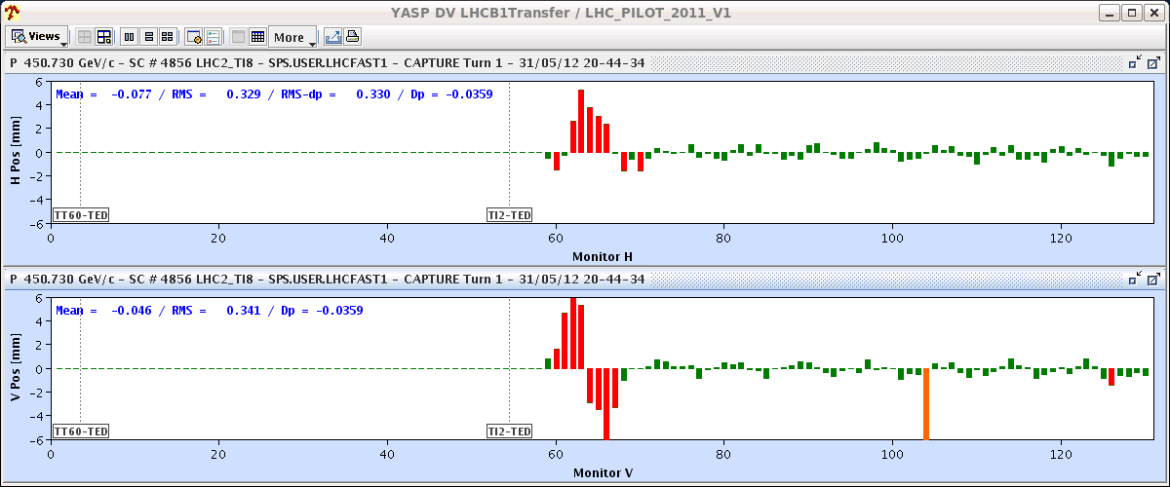
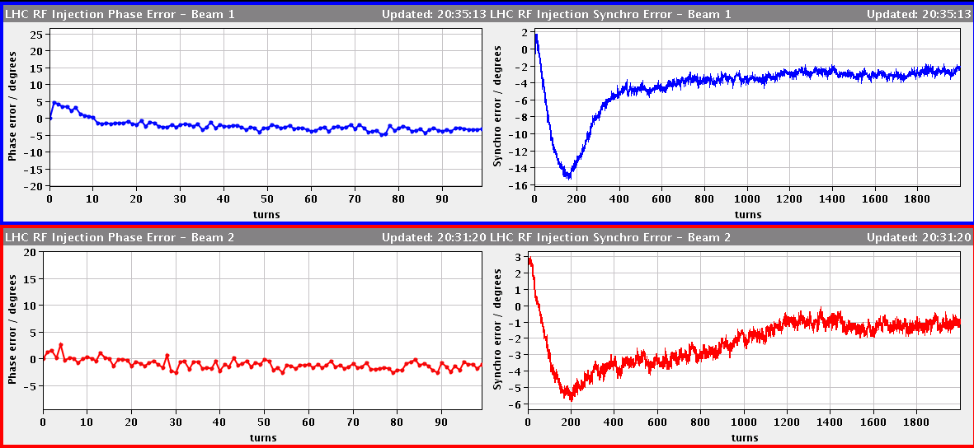
Energy matching
trims of -2.5x10⁻⁴ on B1 and -1x10⁻⁴ on B2.
Tunes trim in parallel
Check 144b injection – looks good
Incorporate into ramp – phase tweaked by Philippe
First turn B1
Synchro Loop

Slide 17
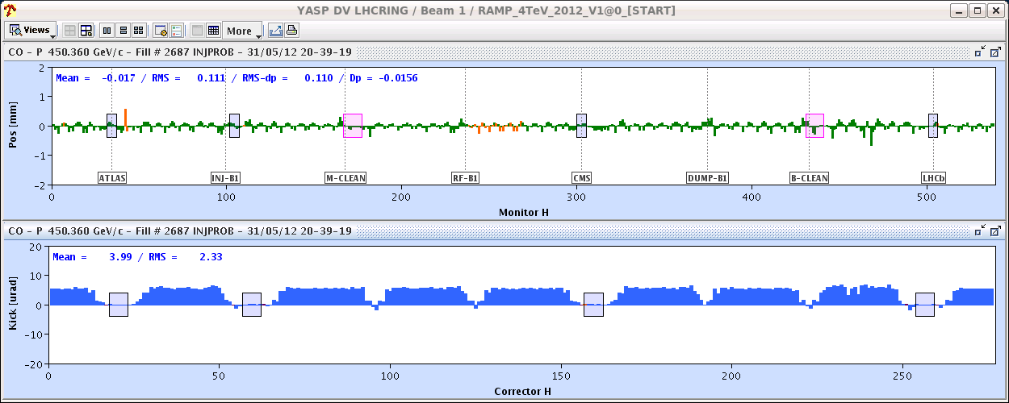
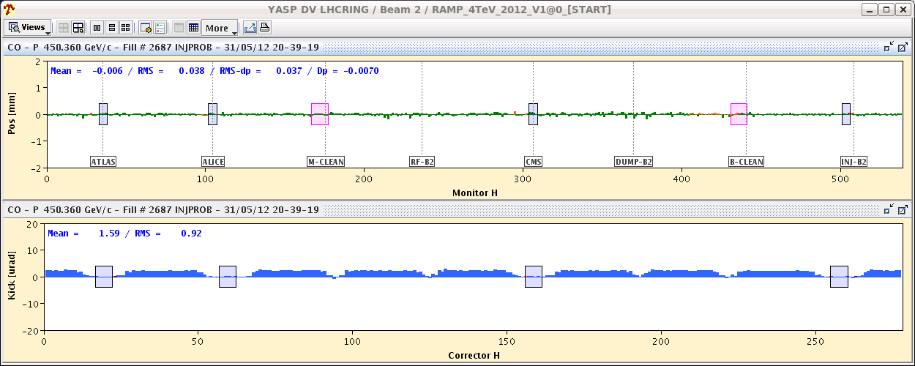
Energy Matching

Slide 18
ADT results
Wolfgang Hofle, Daniel Valuch
ADT damping time 4 TeV measured by kicking non-colliding batch and colliding batch (12 bunch batches). Damping time as expected 30-70 turns approximately for centre of batch with faster damping for the colliding bunches with beating of sigma/pi modes as expected, pending detailed analysis.
Gains
V normalised gains at 0.04
H normalised gains at 0.08 --> increase from 0.04 to 0.08 in collision beam process does not change much anymore the damping time as we are saturating the gain knob just above 0.04 ➔ corrected yesterday
At 4 TeV:
maximum available is for H.B1 a normalised gain of 0.05
H.B2 a normalised gain of 0.0402
V.B1 a normalised gain of 0.05
V.B2 a normalised gain of 0.09
Stronger damping possible for V.B2 is mainly a result of higher beta functions compared to the others.

Slide 19
LHCb polarity switch
Procedure to verify the LHCb settings implemented with test ramp with 3x12 bunches
Offset of 50 μm found in the horizontal plane and corrected
Still not completely transparent:
1 fill lost likely for independent reasons (wrong tune settings due to problem with the tune feedback during the ramp)
Losses on some bunches when going in collision due to residual separation at the end of the collision process in IP5 28 μm (~1.5 sigmas full separation V) and In IP1 by 14 μm (full separation H)
Procedure to be further improved

Slide 20
LHCb polarity switch
L_{ATLAS}
L_{CMS}
BBQ-B1H
BBQ-B2H
Instability developing in collision (B1 H). Managed to optimize point 5 and 1 and to go in stable beams. Results of optimization incorporated.

Slide 21
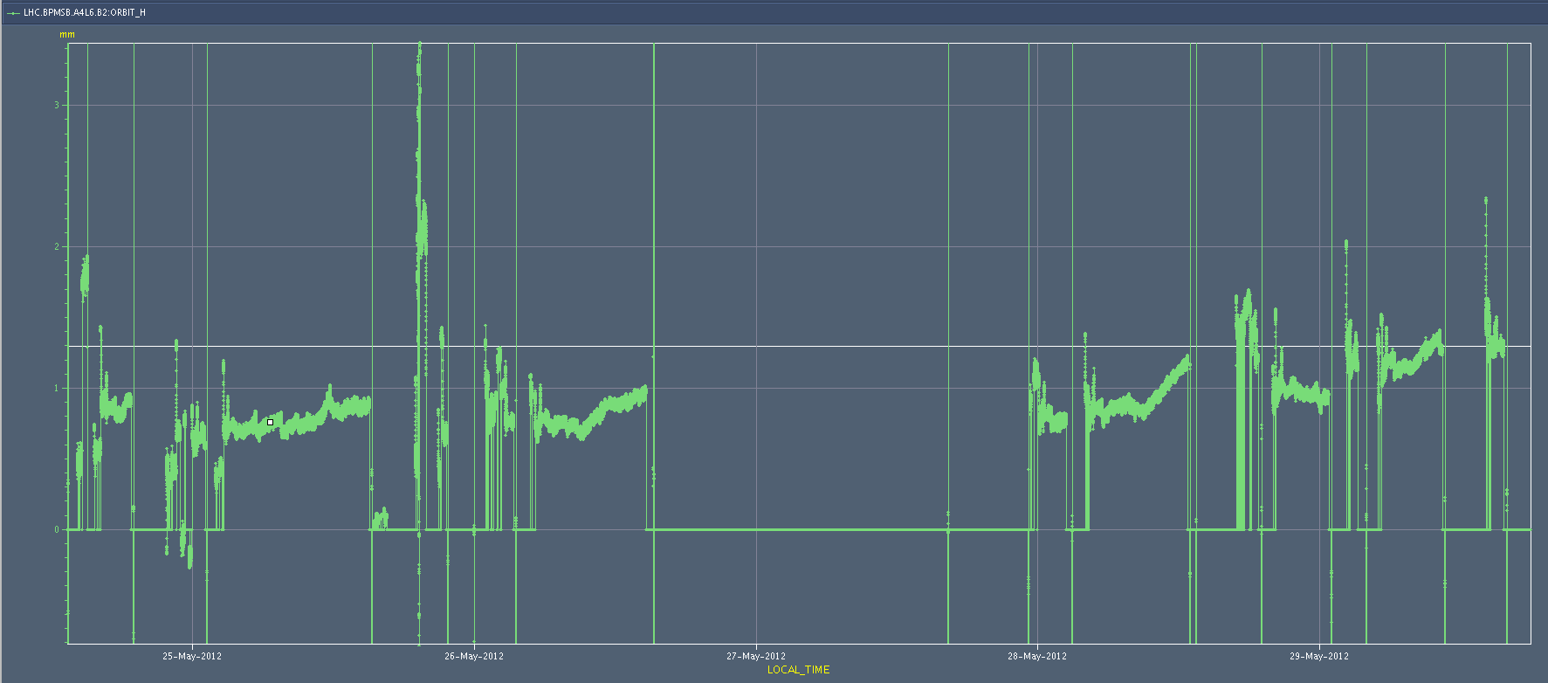
BPMSB.A.L6.H
Drift in the position reading, not compatible with corrector settings in that area ➔ Instrumental error
Offset adjusted in the reference for position interlock at TCSG
TCSG alignment to be verified for Beam 2

Slide 22
Plan and Pending
Plan:
TCSG alignment verification in point 6 (B2) (1 hour)
Physics
Pending:
Scan up to 3 sigma (CMS). Propose to do that with reduced damper gain at the end of the fill.
Verification of impact of TETRA and GSM transmission on the tunnel (30 mins with pilot beam at injection)
Accesses:
TCLIB.6R2.B1 electronics and LVDT sensor
MAD PM15: motors of inner doors not working
RQTL11.R7B2 temp DFBAN spikes affecting cryo start but not CM (~3 to 5 hours)

