Slide 1
Mon/Tue 28/29.05.12
12:46 Dump of stable beams:
Software interlock on BPMS TCDQ/TCS checks. Position was slightly outside tolerance (~ few um).
ATLAS access
Leak in tracker
Injection. 18:47: Beam dump during ramp:
BPMS4L6.B2 triggered as the threshold came down during the ramp.
Injection.
21:58 Stable beams. 6.3e33.
00:46 Beams dump by spurious QPS trigger RCBXV2.R1.
PE piquet: exchange card DQQDG on RCBXV2.R1 at next occasion.
Injection. 03:16 Beam dump during ramp:
SIS interlock triggered due to problems with OFSU. Controls…
06:25 Stable beams. 6.5e33.

Slide 2
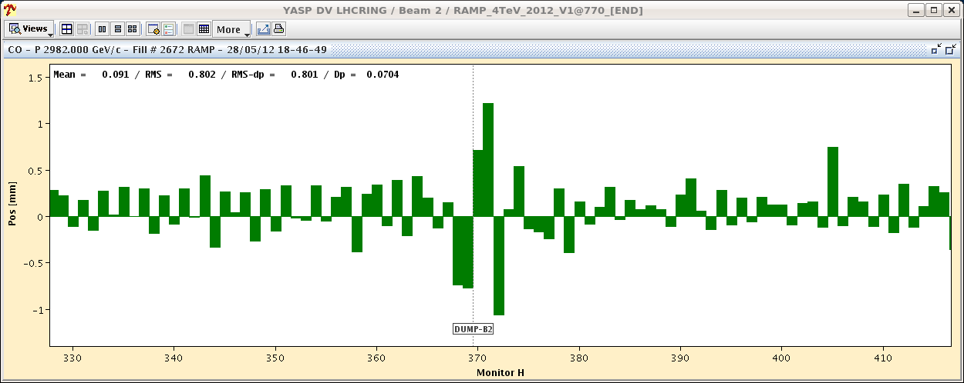
BPMS Interlock

Slide 3
Report Week 21 (Monday – Monday)
R. Assmann, E.B. Holzer
Performance achievements:
Peak luminosity: 6.63 × 10³³ cm⁻² s⁻¹
Integrated luminosity: 0.92 fb⁻¹
Fraction of time in stable beams: 38% (64.3 h)
Highest production in 1 fill: 205 pb⁻¹ in 19.6 h
Average length stable beams: 6.43 h / fill
Peak production rate in SB: 20.8 pb⁻¹/h
Average production rate in SB: 16.8 pb⁻¹/h
Present LHC potential (“ideal” 3h turn-around, 6.4h/fill, no stops):
17.9 average fills per week (2.6 fills per day)
68% in stable beams
1.93 fb⁻¹ / week!?
Of course, we have failures and are therefore only at about 50% of this potential…

Slide 4
Integrated Lumi (CMS here…)

Slide 5
Peak Lumi (ATLAS here…)

Slide 6
Records…

Slide 7
Reasons for Beam Dumps in Week 21
Dumps of stable beams or in adjust mode:
3x: OP dump
2x: Beam losses
Trip inner triplet R1
Collimator PXI power supply
BPM IR6
RB.A45 QPS trip
SIS BLM HV interlock (communication problem between BLM CPU and CMW)
Trip RQTX2.L8 (Free wheel diode fault)
Higher intensity not the driver for beam dumps. Most dumps due to “random” equipment failures or machine drifts (see also Monday experience in week 22)!

Slide 8
Problems, Accesses, Repairs
Cryo (~31 h):
Refrigeration unit (QURC) down point 8. Reset magnetic axle bearing.
Switching temperature probe DFB L7.
Collimation:
TCL.5R1.L1: Multiple problems, resolver disabled finally.
TCDD: PXI power supply exchange
BPM IR6 interlock: Beam studies, attenuation fix.
Experiments:
ATLAS: multiple accesses, gas leak. LHCb, ALICE in shadow.
TOTEM interlock for injection: bypass, interlock disabled for weekend
Magnets:
Trip of IT.R1 & validation (spurious signals in PM)
IR8 triplet problem: cable voltage tap
Fire detection equipment at point 1
Vacuum: pumping group repair at 14R4

Slide 9
Cryo Problem
Recovery long (~31h) due to only having 1 operational compressor in IR8.

Slide 10
Machine Analysis
BPM interlock limits (3 h beam time)
Tune scans (parasitic to stable beams)

Slide 11
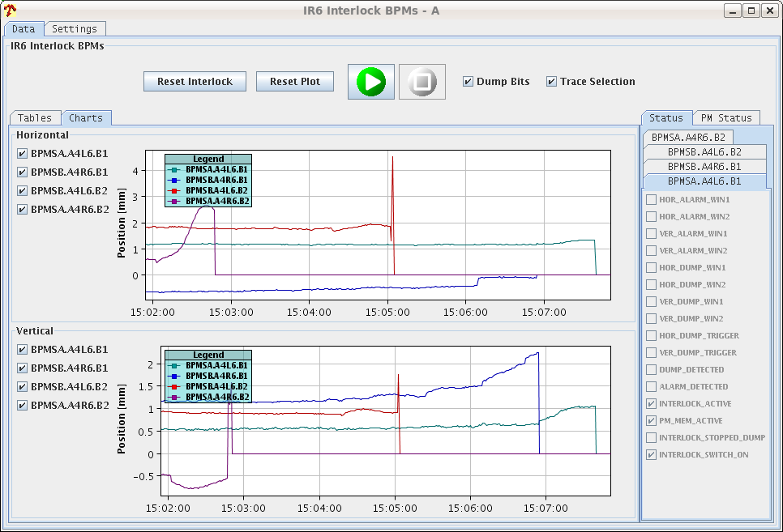
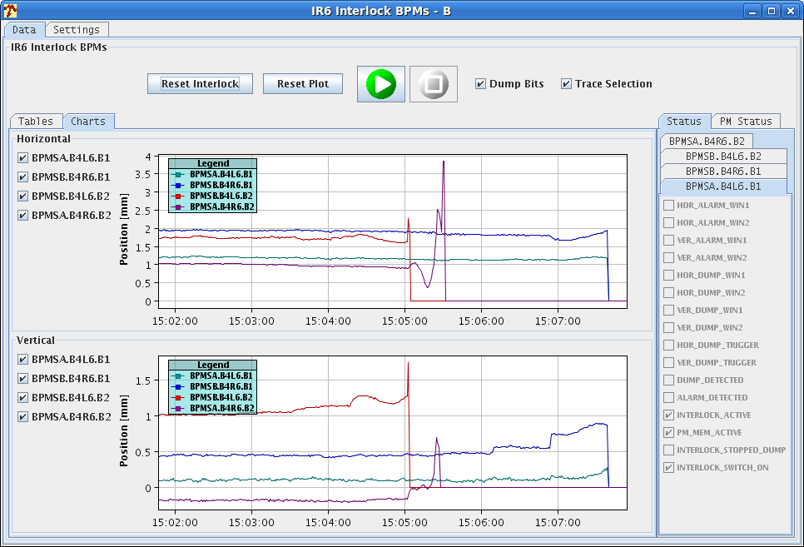
IR6 Interlock BPM Scraping Tests (Rhodri)
B1
2.3e10
B2
1.1e10
B1
2.3e10
B2
2.2e10
B2
6.2e10
B1
3.6e10
B2
2.2e10
Beam1 - everything looks fine, with limit at 3.6e10
Beam2 - attenuation levels for both BPMSA in 6R seem to be incorrect
One triggers too early (6e10 - level observed for dump Wed night)
One triggers too late (1.1e10 - i.e. can trigger on probes at injection)
Attenuation had been increased on the wrong channel.

Slide 12
IR6 BPM Tests Continued…
Attenuation issue had been fixed on Friday.
Interlock BPMS B2 tests – all found OK
Scraping B2 with TCP.D6R7.B2 (sensitivity test)
BPMSA.B4R6.B2 decreased from 6e10 to 4e10 BPMSA.A4R6.B2 increased from 1.1e10 to 3e10
Probes should now be invisible to the system when in low sensitivity.
Margin for single bunch loss with physics beams increased. Should now be OK down to 4e10.
These limits can probably still be optimised to bring the limits on all interlock BPMs to between 2-3e10. Requires access to UA67.
OP should still check bunch counts with the machine full to verify correct functioning with multi-bunch fills.

Slide 13
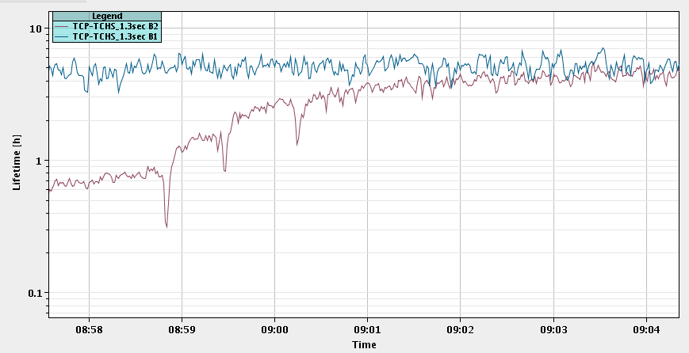
Adjusting Tune B2 H at Start Stable Beams
Lifetime B1
ΔQ_{h} = + 0.001
ΔQ_{h} = + 0.001
Lifetime B2
ΔQ_{h} = + 0.001
Tune dependence at start of fill!
Watch tune feedback actions!
So far: No trim into process!
Q2h adjustment

Slide 14
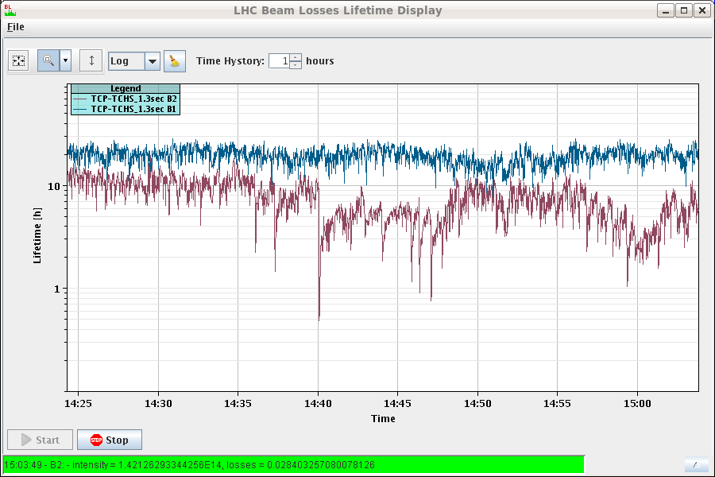
Tune Scan (End of Stable Beams Fill 2663)
14:30 – 15:00 tune scan B2
in H and V (0.001steps)
ΔQ = + 0.003
ΔQ = – 0.008
Lessons:
Standard WP gives good lifetime.
A broad plateau around standard WP.
At end of stable beams: almost 3 times more room in negative direction than in positive direction (for factor 5 reduction in lifetime).
Needs careful analysis: Extrapolate back to start of stable beams.
Standard WP
-0.008
+0.003

Slide 15
Machine Optimization
Energy matching of injected beams by RF frequency shifts (up to ± 25 Hz) → reduction of uncaptured beam loss
Problem of dumps when loosing a few bunches:
Change of filling scheme: No private IR8 collisions.
Fix of attenuation for IR6 interlocked BPM: threshold to 4 × 10¹⁰ p
Increase of bunch intensity: 1.45 × 10¹¹ p → 1.50 × 10¹¹ p
+3.5 % in bunch intensity, resulting in + 7.0% in peak luminosity

Slide 16
Capture Losses Conclusions (Philippe)
With the nominal (1.5 ns long) bunch we expect 0.6 % capture loss for 1E-4 Dp/p and 200 ps phase error (see LHC_RF.pdf).
The offset in energy can be further reduced by matching the two rings (calls for a fine-tuning of dipole correctors). This is not fully justified as we see similar capture losses in B1 and B2 while B2 is better matched. To be checked.
The dispersion in bunch length (and phase – not shown here) is a limitation in the SPS, related to the increased bunch intensity:
Keeping the tight max-bunch-length, there is no more injection…
Relaxing these to accept 1.85 ns long bunch result in more capture losses.
We are at the limit for capture with the nominal (1.5 ns long!) bunch. If we wish to keep working reliably at high bunch intensity (with some bunches 1.85 long and phase variation along the batch) we need a discussion including the injectors (at least SPS RF).
Temporary fix: Adjust RF frequency at injection to optimize capture!

Slide 17
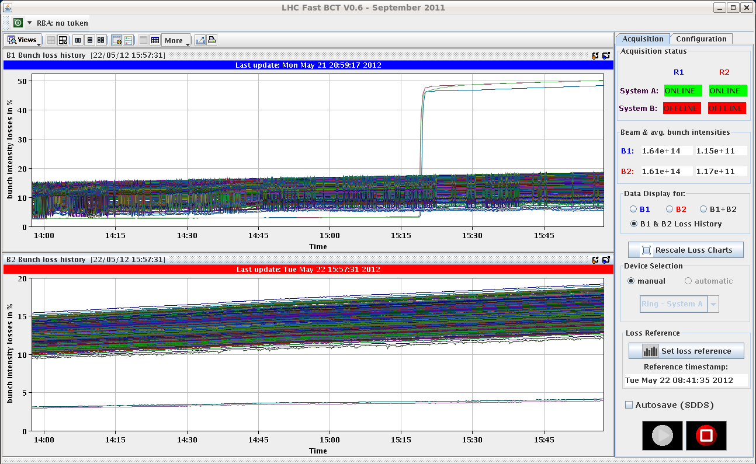
Problem bunches with only IR8 collisions
Beam 1
IR8 bunches
Losses
Losses
Beam 2
Time
Decision: Temporary remove these 3 bunches from collision scheme!

Slide 18
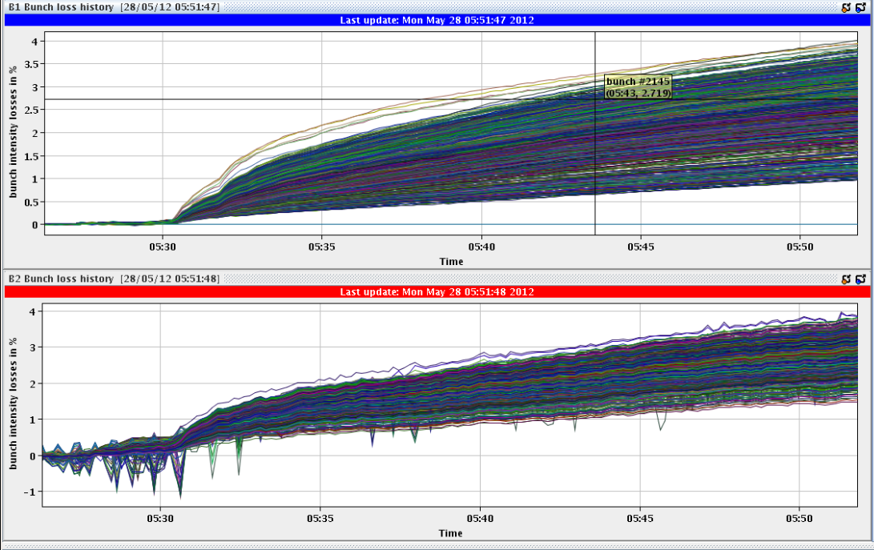
Losses Often Very Good Now. Example: Fill 2671
Collisions

Slide 19
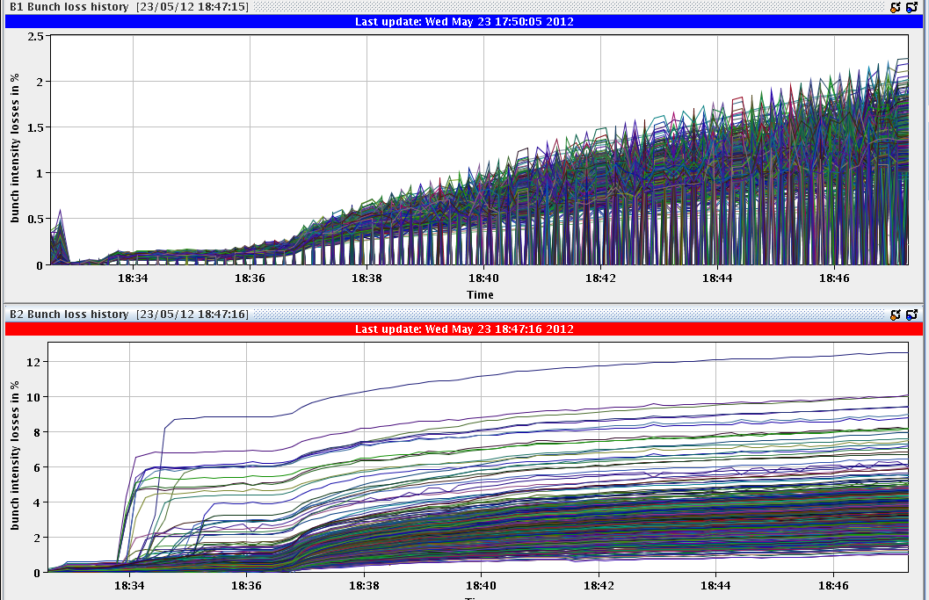
Sometimes losses one beam (beyond IR8)
Start collision process
Collision
Losses
Losses
Time
In good cases (most): a few % of intensity lost (upper)
Occasionally: some bunches unstable, loosing 10 % (lower) or more

Slide 20
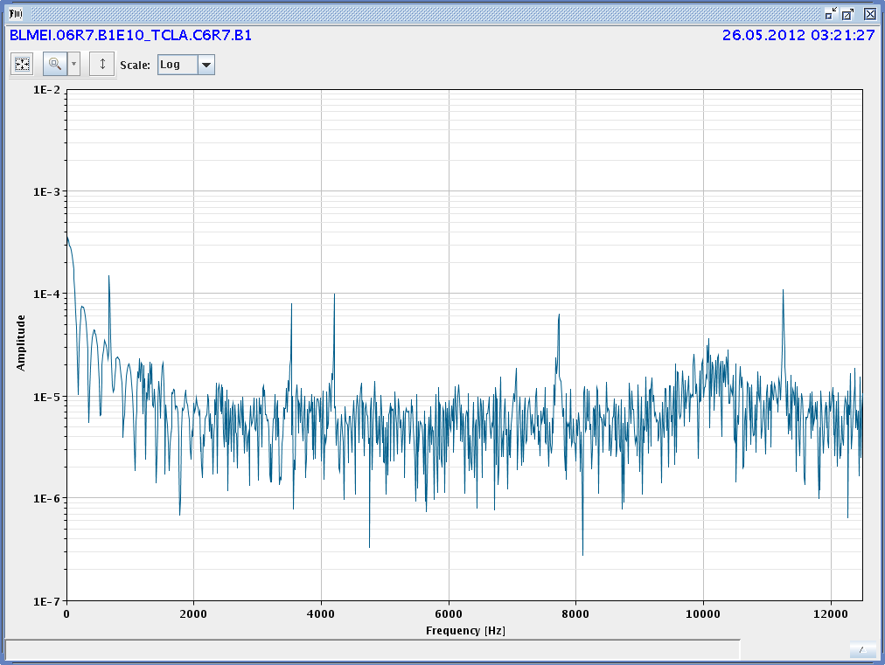
Excitation Seen on B2H → Coherent
G. Arduini
Frequency spectrum B1 losses → instability
R. Schmidt

Slide 21
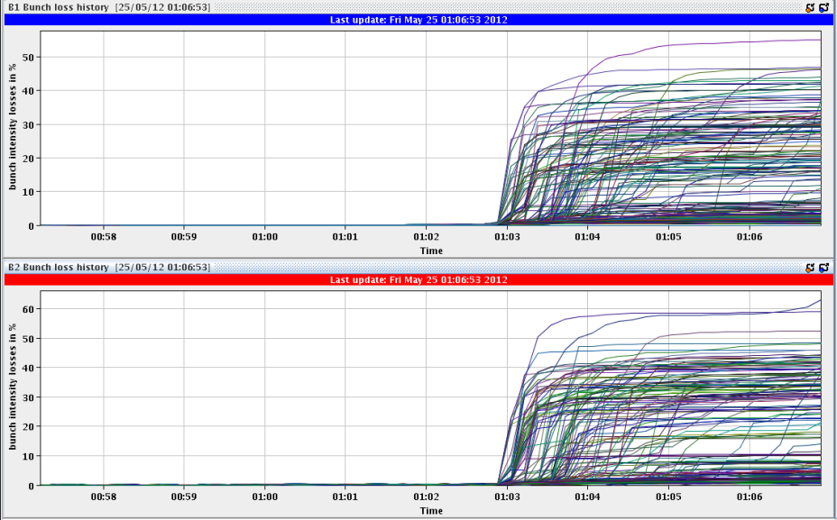
Fill 2662: Losses both beams at start SB…

Slide 22
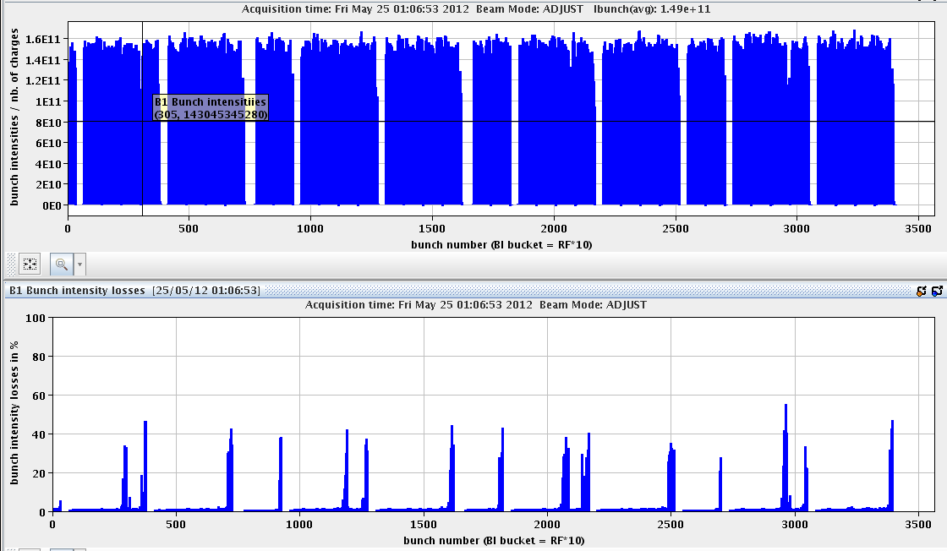
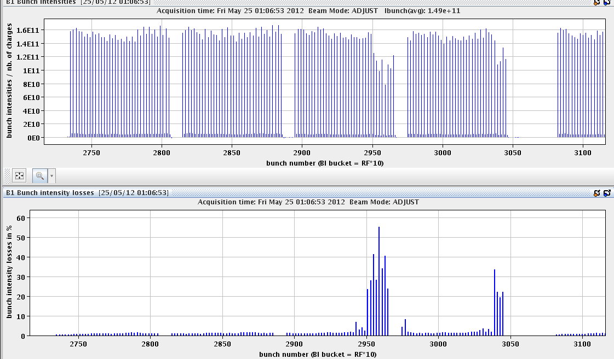
Fill 2662
B1 and B2 similar loss pattern
At end of batches!

Slide 23
Lessons on Instabilities
Instabilities seen even after IR8 private collisions have been removed.
Mechanism not yet fully understood.
We know:
Coherent instabilities.
Appearing when going into collisions or just at start of stable beams.
Can be on single beam or both beams.
Seems to affect bunches at the end of the batch.
Seems to appear more often at higher bunch intensities.
Affected bunches self stabilize after some intensity has been lost (10% - 50%).
Seem not to be tune WP driven.
Transverse damper must be analyzed: effective or less effective at the end of the batch?

Slide 24
Follow-up
Various small issues:
RB.A67: One quench heater is discharging (half nominal value); needs a non-urgent intervention (MB.C19.R6)
OFSU issue (“FETCH ALL OPTICS TO OFSU” failed, “calc optics function” failed, stopped at flat top and did not restart automatically)
Several latches on MKI rise time for beam 1 during injection
Several small issues in lumi optimization
Energy matching:
Injections done with off-centered orbit (~ +15Hz), very clean.
Must do proper energy matching at some point.
LHCb polarity change.
IR6 BPM:
Going to 2e10 threshold in bunch intensity for beam dump?
Follow-up discussion octupole sign.
➔ Mike and Gianluigi for this week…

