Slide 1
Sunday 27.5.
Cryo recovery Pt 8 (sector 78 and 81)
Pt 5 reset of cryo PLC
Problem switching RF module M1B2 to stand-by – cured itself; intermittent controls problem suspected
task "FETCH ALL OPTICS TO OFSU" failed (as yesterday already); retarted the OFSU
19:00 Opened all vacuum valves, had to restart a Gauge in IR8 (triplet) that probably tripped due to a pressure interlock. This unblocked the valve that had remained closed.
22:00 cryo recovered. Pre-cycling.
22:42 – 23:14 RF module 2B2 tripped – restarted by piquet
23:14 injecting again

Slide 2
Fill 2670
1:13 - 2:27 stable beams Fill 2670
BLM B2 up to 36% of threshold at 1.5m IP6 (MQY 4L6) and IP7
1.5e11 average bunch intensity
Peak lumi: 6.6 10³³ cm⁻²s⁻¹
Integrated lumi ~ 27 pb-1
Emittance in collision ~ 2.2 μm rad
2:27 Fill 2670 dumped by power converter problem of RQTX2.L8 (Free wheel diode fault)

Slide 3
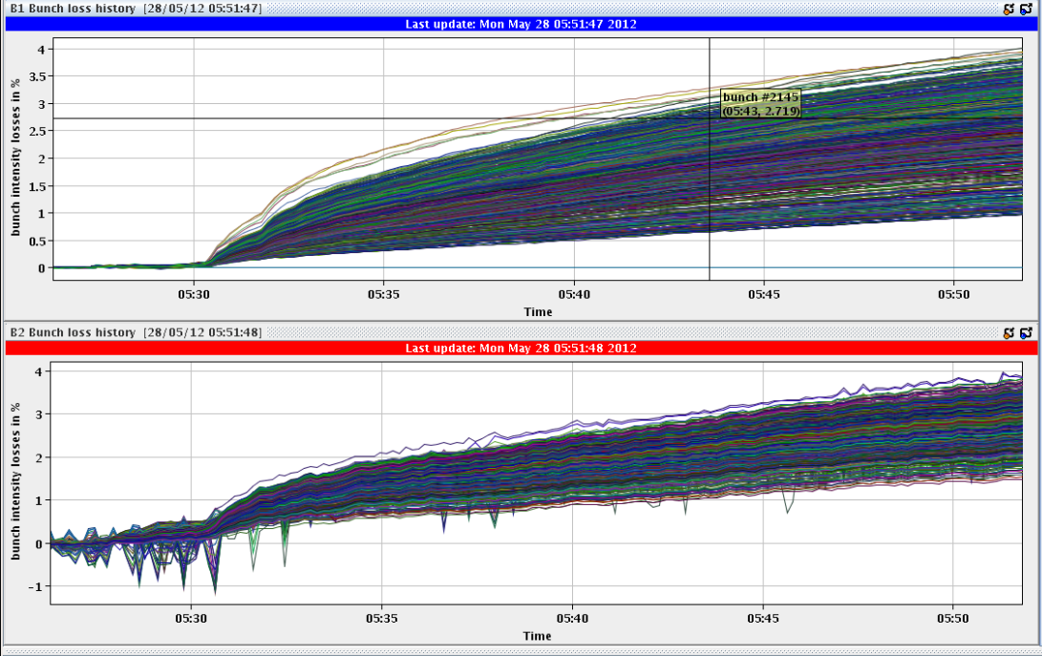
Monday 28.5.
5:33 stable beams Fill 2671
1.5e11 average bunch intensity
Peak lumi: 6.4 10³³ cm⁻²s⁻¹
Emittance in collision ~ 2.3 μm rad

Slide 4
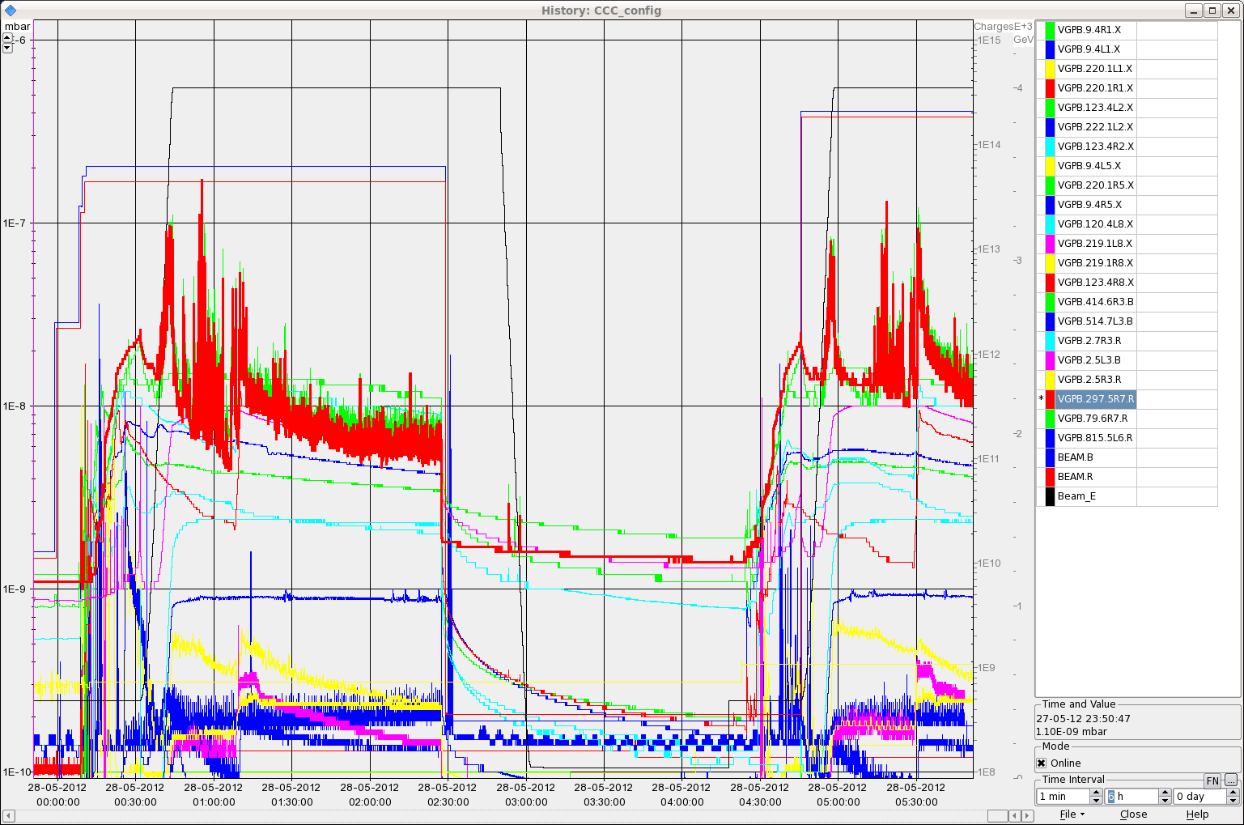
Vacuum last 2 Fills

Slide 5
Varia
RB.A67: One quench heater is discharging (half nominal value); needs a non-urgent intervention (MB.C19.R6)
A couple of OFSU problems (“FETCH ALL OPTICS TO OFSU” failed, “calc optics function” failed, stopped at flat top and did not restart automatically)
Several latches on MKI rise time for beam 1 during injection
Optimize procedure is still done with the BRAN, especially for IP1 as the application got stuck when using the ATLAS DIP signal
Both injections done with an off-centered orbit (~ +15Hz), very clean for losses and injection oscillation
Program:
Luminosity production with 1.5e11 ppb
Summary of the week on Tuesday

