Slide 1
Tuesday 22.5.2012

Slide 2
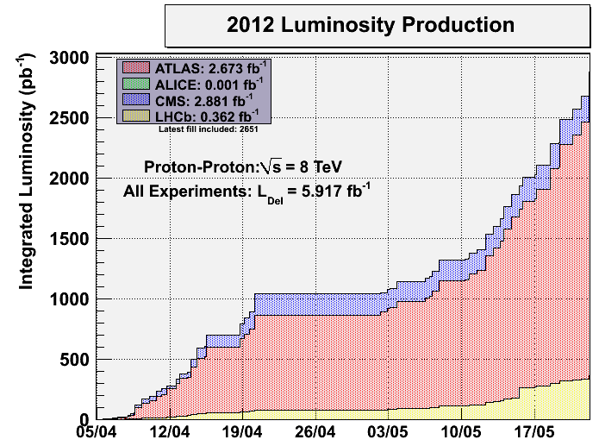

Slide 3
Tuesday
6:30 injection beam after collimator problems sorted out
7:17 dump by interlock BPMs: pilot being excited by the injection cleaning → Switched off injection cleaning for the third injection for the next fill.
8:48 – 4: 24 stable beams fill# 2651
5.8 10³³ cm⁻²s⁻¹ peak Luminosity
1.43 10¹¹ average bunch intensity at injection – rather big variations
Delivered 205 pb-1 average to Atlas and CMS in 19:35 hours

Slide 4
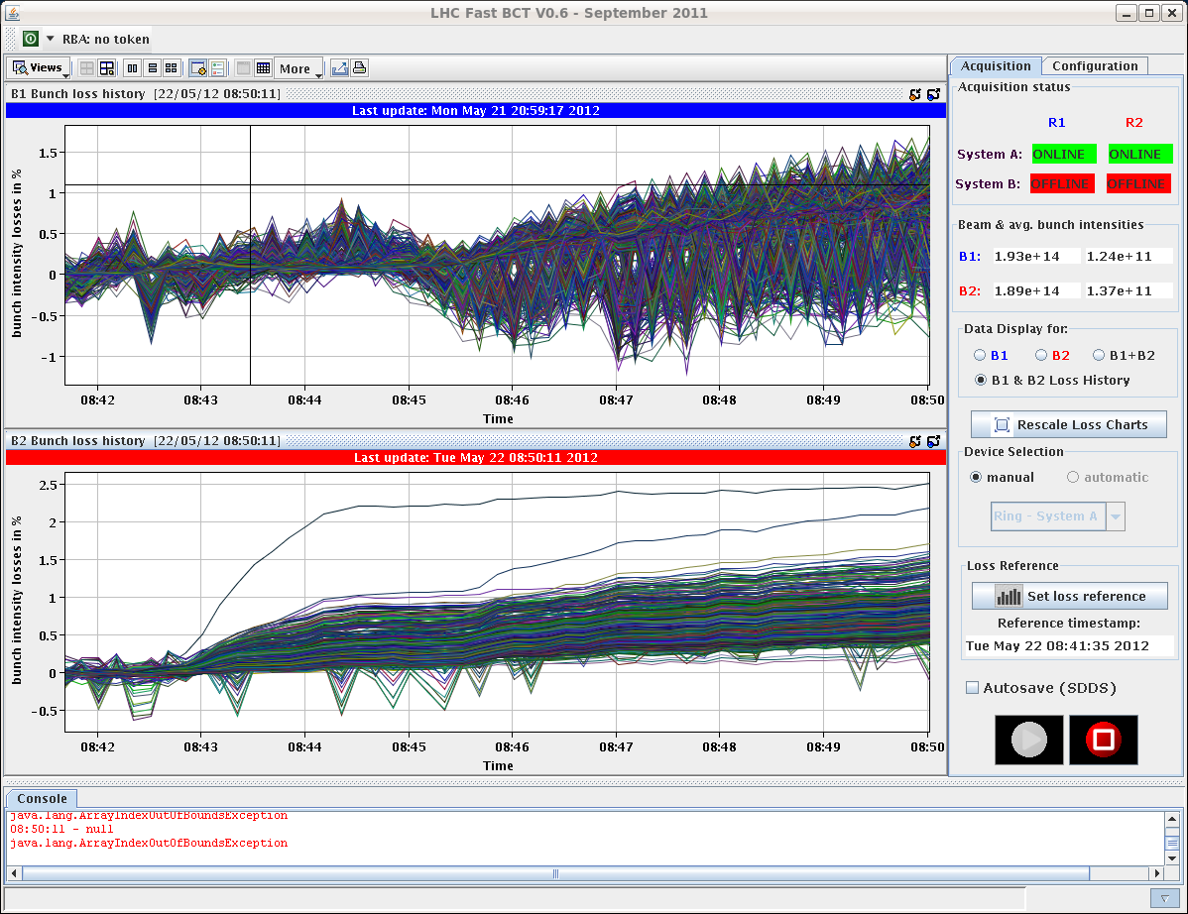

Slide 5
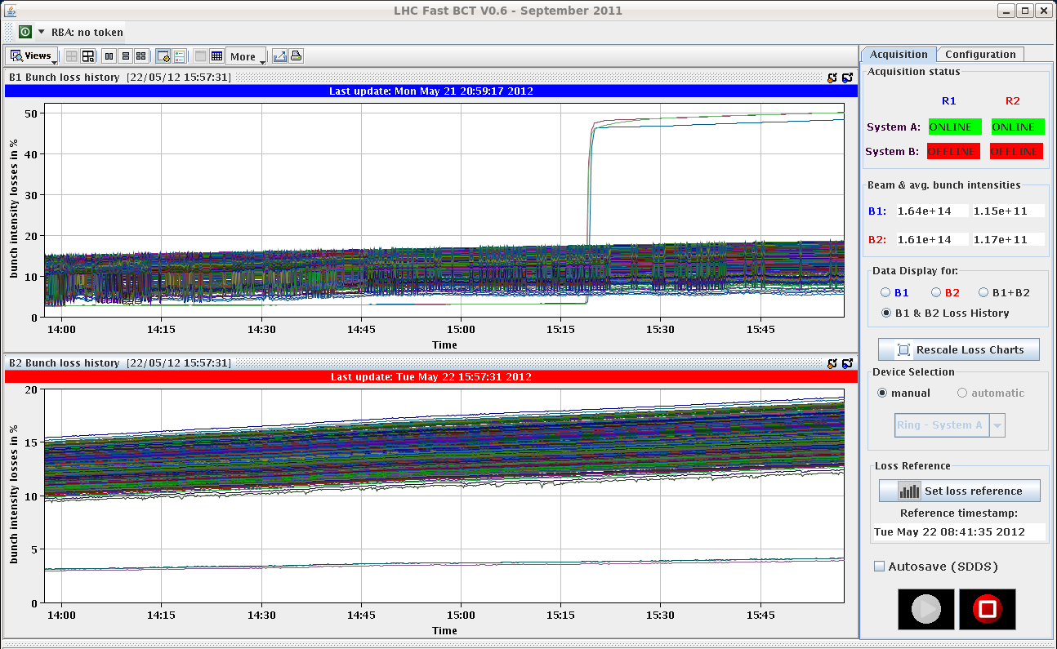
15:18 the B1 bunches #1, #2 and #4 all of a sudden experienced a sharp loss (collisions in IP8 only)

Slide 6
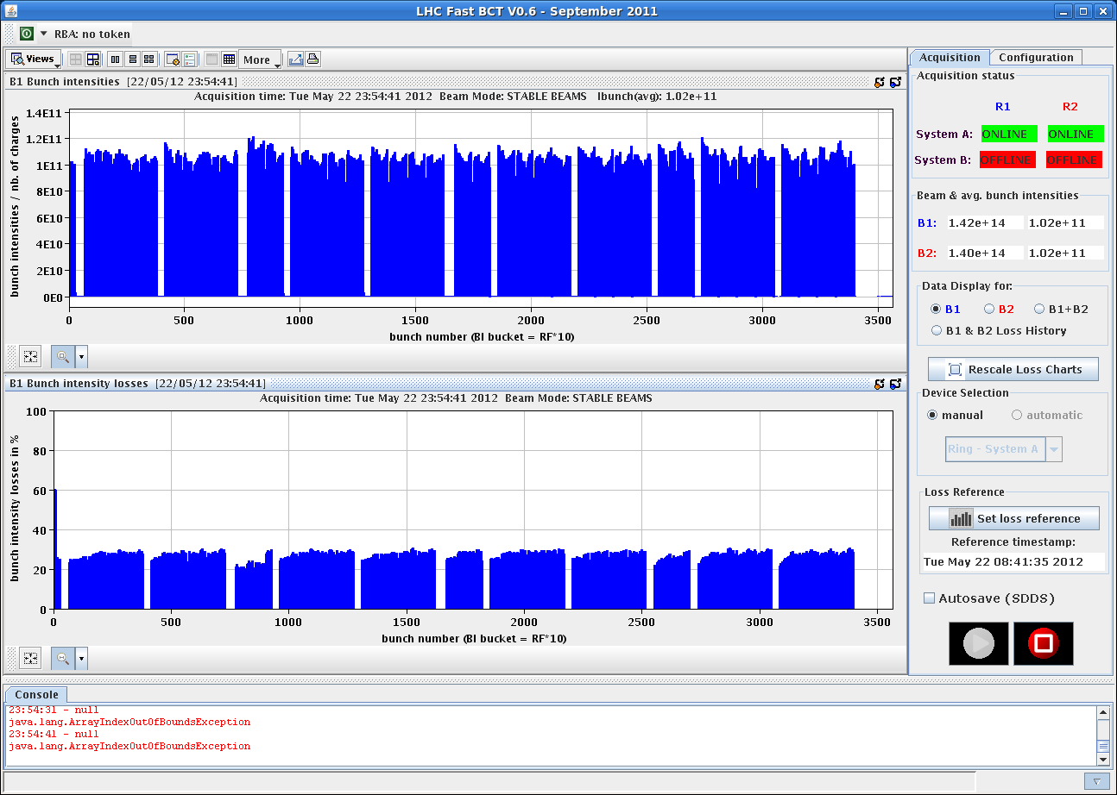
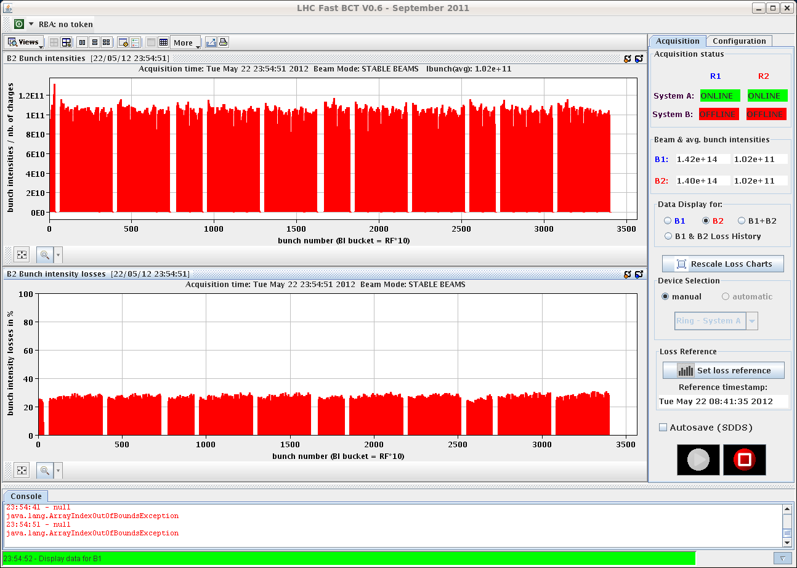
Bunch intensities and losses after 15 h collisions

Slide 7
Wednesday Morning
4:24 beam dumped by operator
6:00 re-injecting lengthened by issues with the SPS bunch length
8:00 filling again

Slide 8
Varia
The request for abort gap cleaning was changed from 5e9 to 1e10 for beam 1 only.
BSRT and especially the AGM: closing of application should not affect operation
Take Soft Start data immediately after a beam dump at full energy when the MKIs are close to or above the MKI temperature interlock threshold
Take measurements (manual at the time being) head-tail monitor – investigate automatic triggering, possibly on BBQ amplitude
Vacuum will need an access to repair a pumping group in S45 (not urgent)

