Slide 1
Mon 21.05.12
Access for switching temperature probe DFB L7.
Problem had been due to a bad contact of a connector.
In shadow: Access for fire detection equipment at point 1.
ATLAS access. Problem not fixed.
12:26 Injection.
13:41 Stable beams. 5.9e33 lumi. 123MJ. Low losses in intensity.
20:59 End of fill. Trip of IT.R1.
Validation of inner triplet in R1 needed due to spurious signals in PM.
ATLAS intervention.
23:33 Triplet check complete.
Signals are normal and observed spike is due to a slight current imbalance between the Q1 and the Q3 of the triplet.
Proceed.

Slide 2
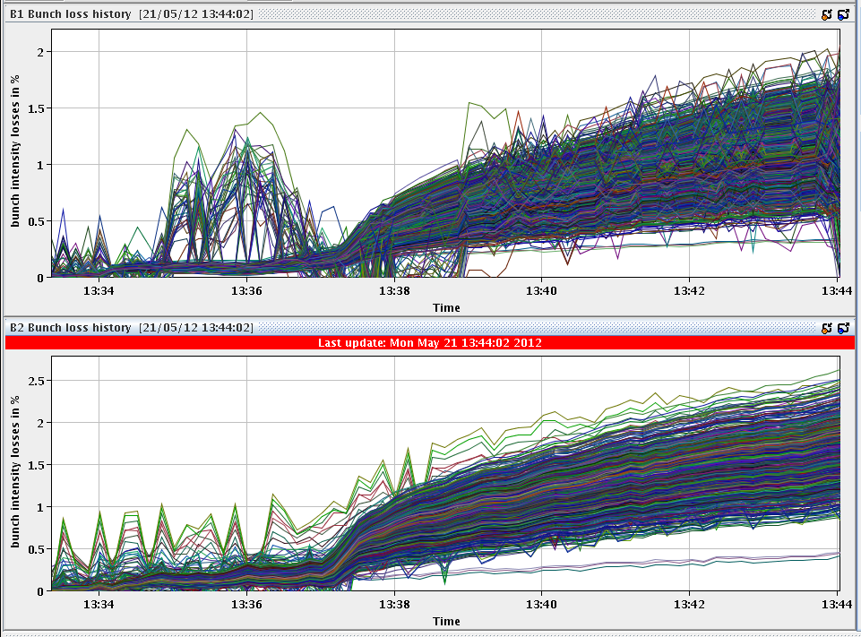
Stable beams

Slide 3
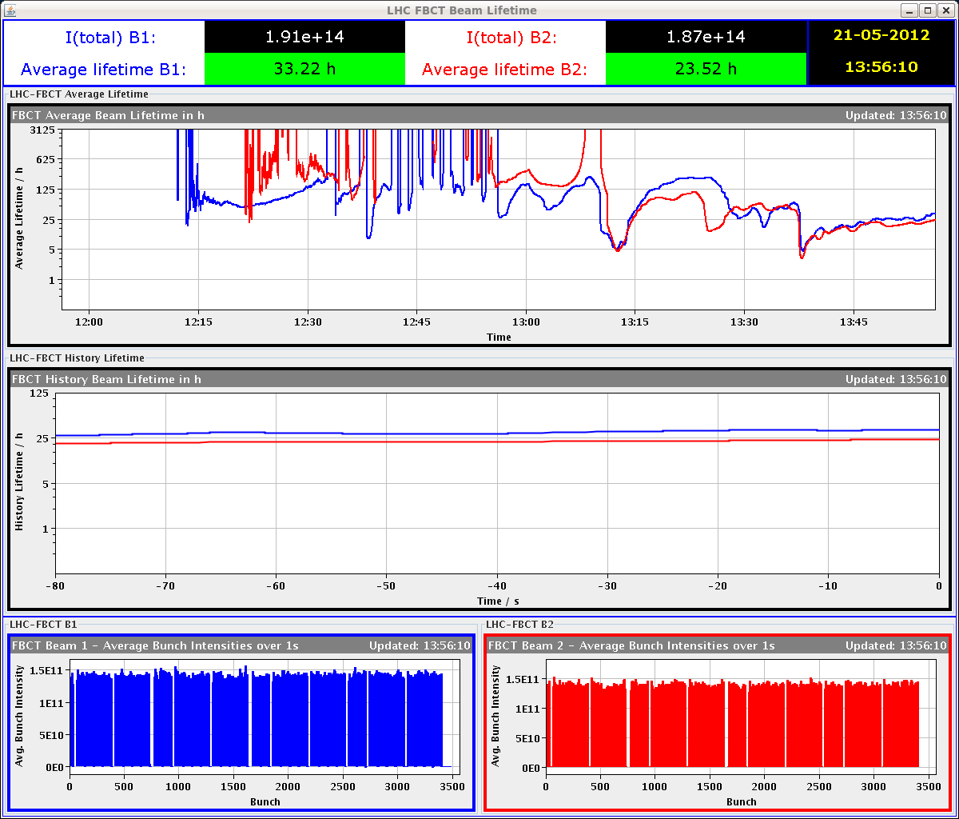
Lifetimes

Slide 4
Trip

Slide 5
Tue 22.05.12
00:42 Collimator issues: RBAC access problem.
01:09 FBCT issue: reboot.
01:27 Interlock from TCL.5R1.B1: missing steps.
02:49 Again FBCT issue: reboot.
03:05 Injection
04:03 Interlock from TCL.5R1.B1.
06:19 Injection.
08:09 Ramp.

Slide 6
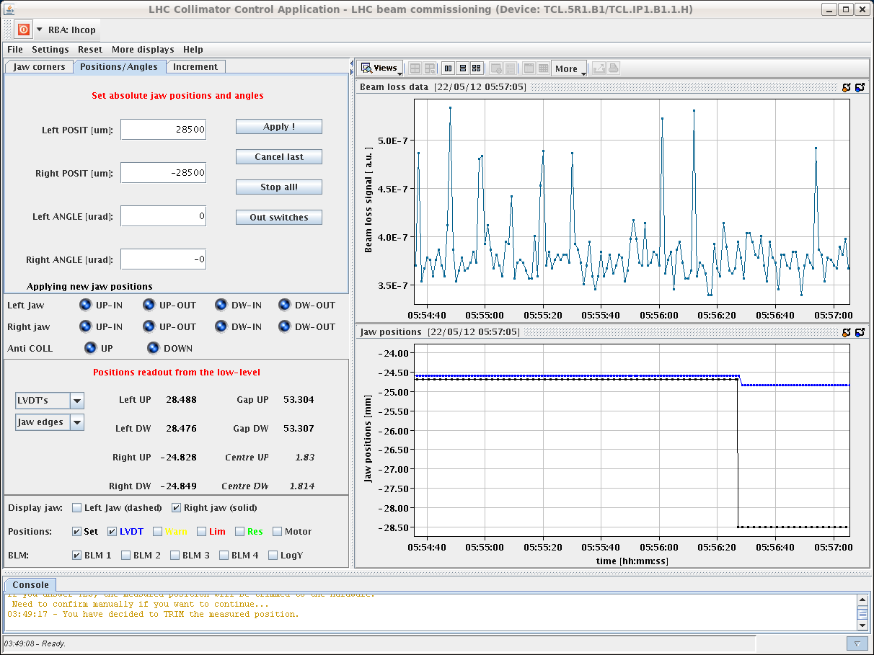
TCL.5R1.B1 Problem – To be followed…

Slide 7
Planning Ahead
Delivering luminosity

