Slide 1
LHC Status Wed Morning 16-Mai
Bernhard Holzer, Jan Uythoven
Status yesterday morning
Plan
Finish access for PO, ROFA67.B1 – until at least 9:30 & pre-cycle
Scraping at injection to reduce losses in squeeze
Physics
Outstanding
Continue investigations beam quality from injector chain
Orbit in collision needs to be corrected and trims incorporated (in particular point 5)
Possibly LHCb polarity change on Wednesday’

Slide 2
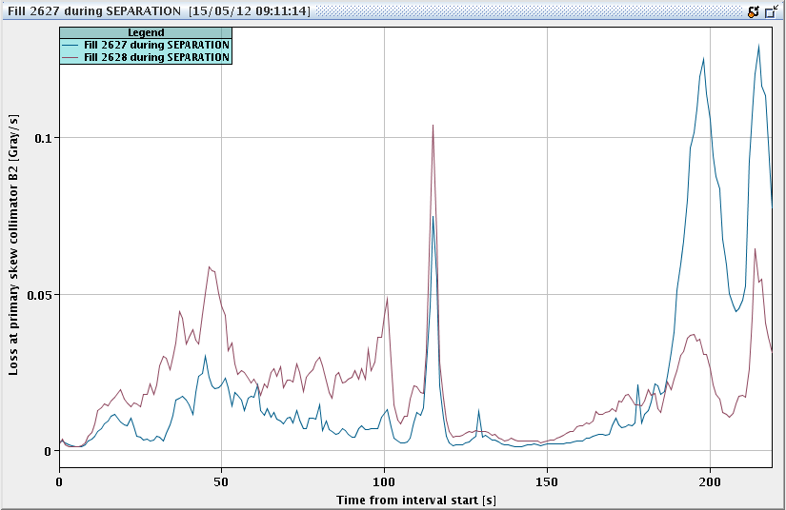
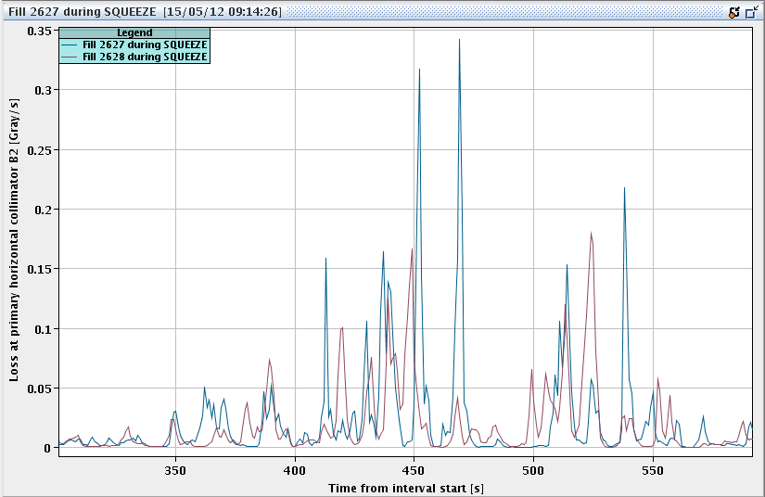
Tue Morning
07:17h Access for ROFA67 octupole power converter change
BUT: The elevator at PM65 is in maintenance until Friday.
octupole repair postponed , no scaling !
09:07h Analysis of lossses during last fills: fill 2627 versus 2628
09:24h Start pre-cycle, prepare new injection

Slide 3
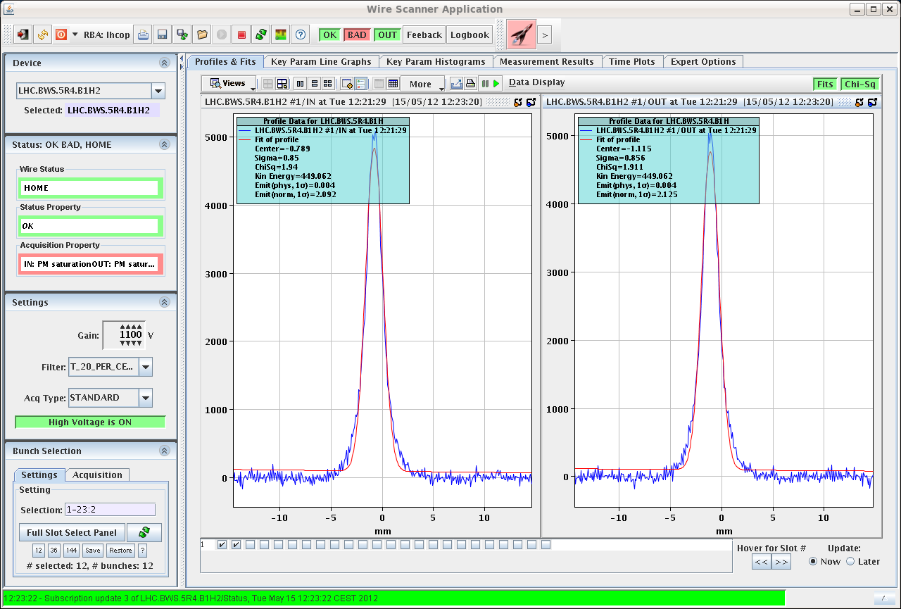
Tue Morning
11:33h Communication problem with XPOC and Post Mortem.
Unable to re-arm LBDS -> Roman !
12:00 injection physics beam
emittances: B1H 2.1
B1V 2.1
B2H 1.7
B2V 2.2
... in parallel:
stability tests for BPMSW.1L5
(medium / long-term stability)
Eva, Ralph S.

Slide 4
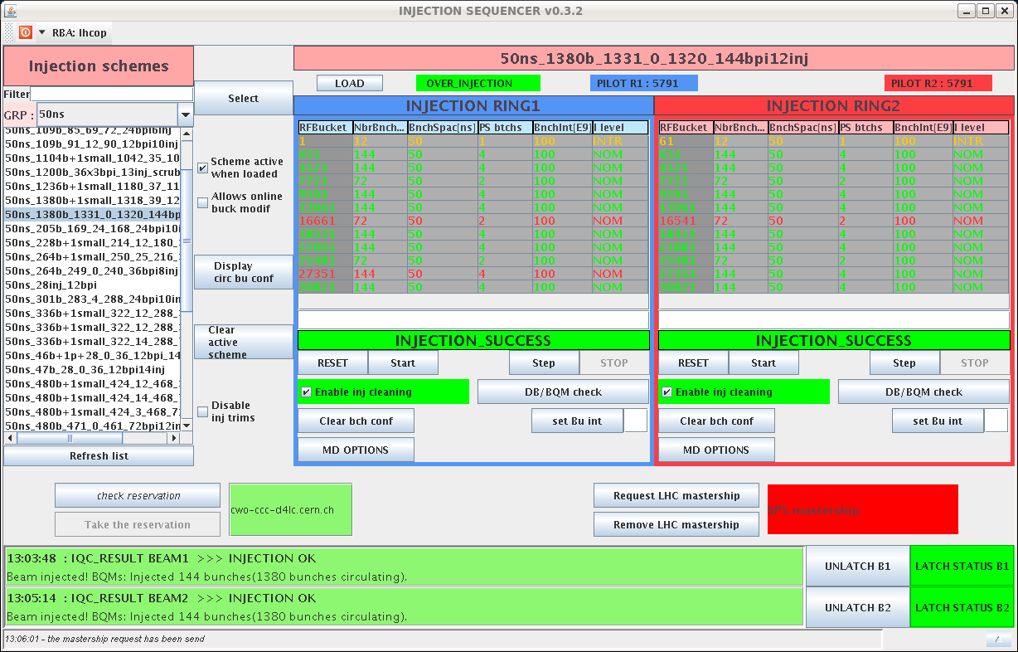
Tue Morning
13:12h injection completed,
IQC = green !!
13:15h start scraping
put main colli h & v to 4.3 σ
estimated intensity loss: 0.5 ...1 %

Slide 5
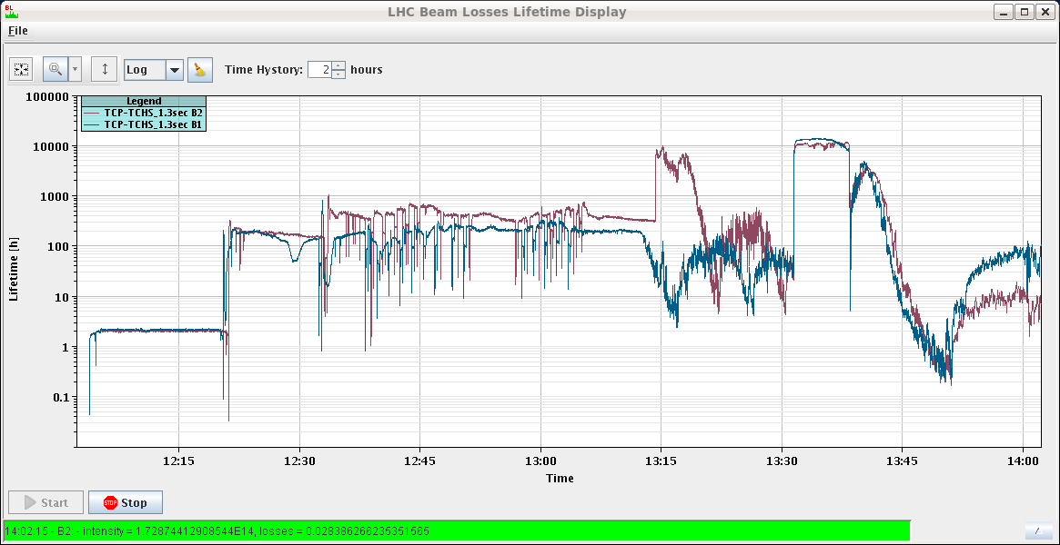
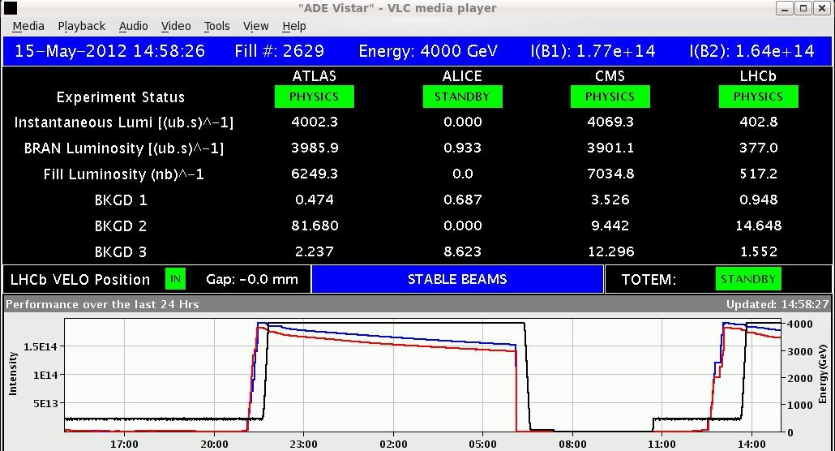
Tue Morning
lifetime during scraping
τ ≈ 10h
-> not too mainy particles in the
tails
13:38h ramp: losses at warning threshold 32%
squeeze: losses = 0%
14:58h stable beams

Slide 6
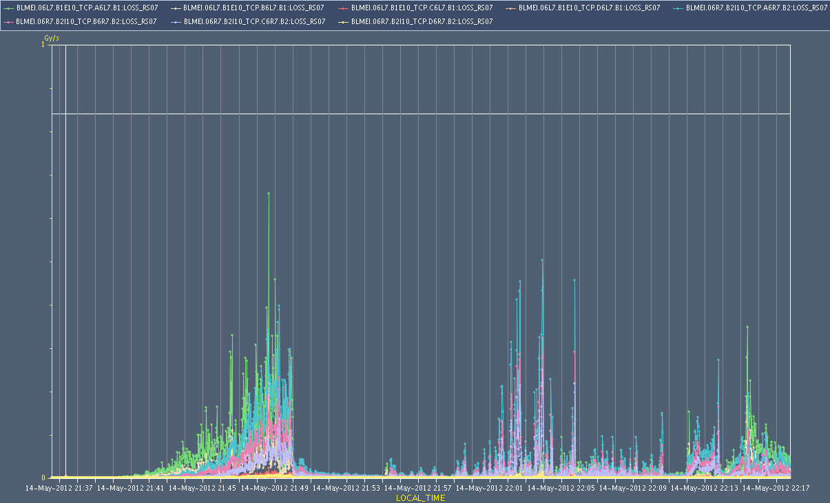
Tue Late
Mike: Analysis of Losses at primaries ramp, squeeze, adjust during last 3 fills
nota bene: first fill: SPS septum still pulsing

Slide 7
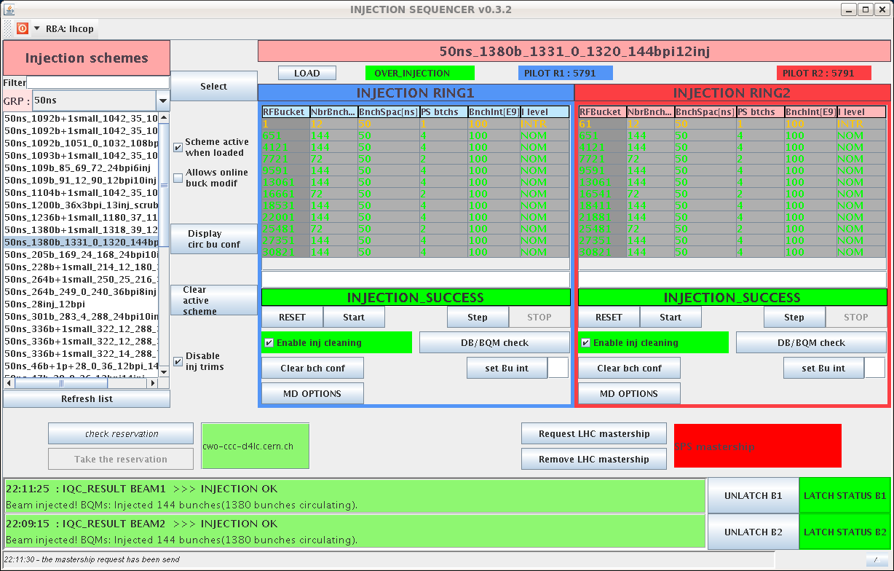
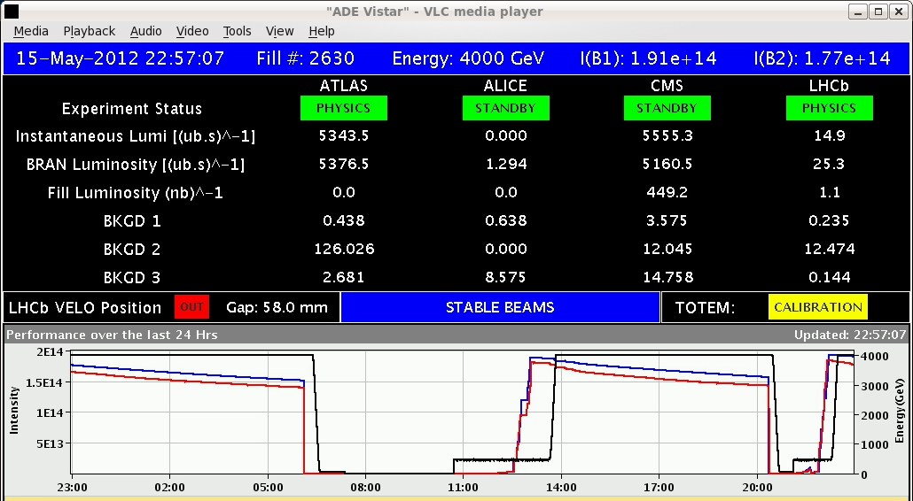
Tue Late
20:22h beam dump, precycle, injection
again: nice & clean
22:55h stable beams

Slide 8
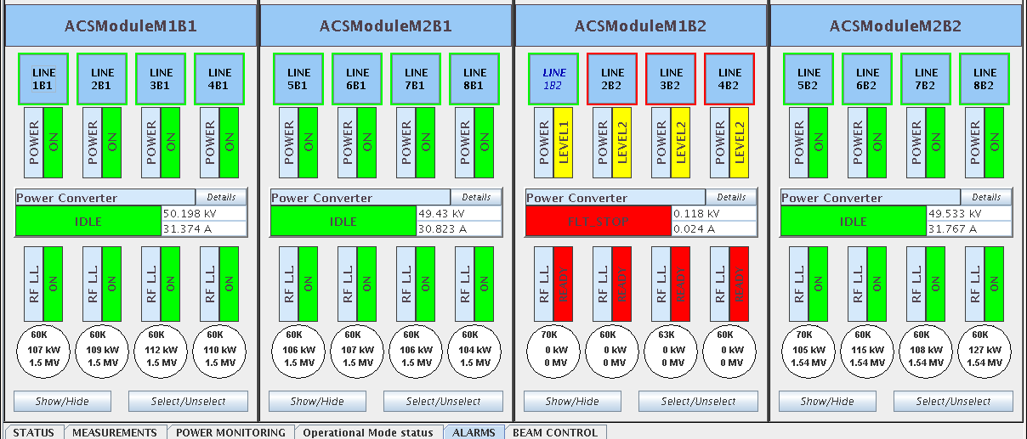
Tue Night
stable beams
injection interlock for MKI 2, magnet C Down reached!
03:05h beam dump RF fault
04:25h / 06:09h new injection for physics ... and again ...
beam dump RF fault

Slide 9
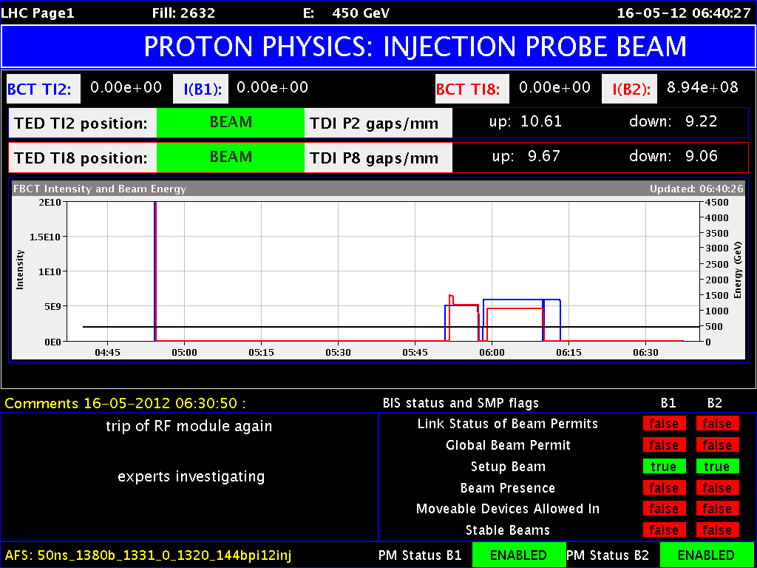
LHC Status Wed Morning 16-Mai
Bernhard Holzer, Jan Uythoven
Status
Finish access for PO, ROFA67.B1 – until at least 9:30 & pre-cycle
Scraping at injection to reduce losses in squeeze
Physics
Outstanding
Continue investigations beam quality from injector chain
Orbit in collision needs to be corrected and trims incorporated (in particular point 5)
Understand & Repair RF problem
Possibly LHCb polarity change on Wednesday
a personal remark ....
✔
✔
✔
✔
✔

