Slide 1
Wednesday 16th May
03:05 beam dump, RF fault crowbar problem on module M1B2
06:09 Another crowbar at injection.
Access for RF; problem Beam Imminent Warning point 6
12:30 Machine closed. Again RF crowbar while arming the BIS loop. Diagnostics revealed that there was a problem on a HV cable between the power supply and the klystron of line 3B2. The cable was replaced.
14:50 Cannot close because of problem again with Beam Imminent Warning point 6.
15:40 BIW problem solved.
16:10 SPS main power supply down
18:35 SPS is back
20:55 Stable beams fill #2632, initial lumi 5.0e33. LHCb negative polarity
21:03 Beams dumped on BPMS interlock.
21:41 BIS interlock from SR2.INJ1.1 In 8: Coll Motors. Known problem.
01:11 Fill #2633 dump in squeeze arc circulator load channel Ad1B
03:16 Fill #2644 Stable beams, lumi 5.2e33 cm-2s-1
04:38 Dumped by interlock on BPMS
06:48 Fill #2635 Stable beams, initial lumi 5.5e33 cm-2s-1
.

Slide 2
15:30 hours without beam
RF crowbar due to problem on a HV cable between the power supply and the klystron of line 3B2. The cable was replaced.
Needed to install diagnostics and trip to happen again.
Local tests running at higher than nominal voltage did not reveal the problem
Beam Imminent Warning in IP6
Needed access twice...
SPS main power supply down

Slide 3
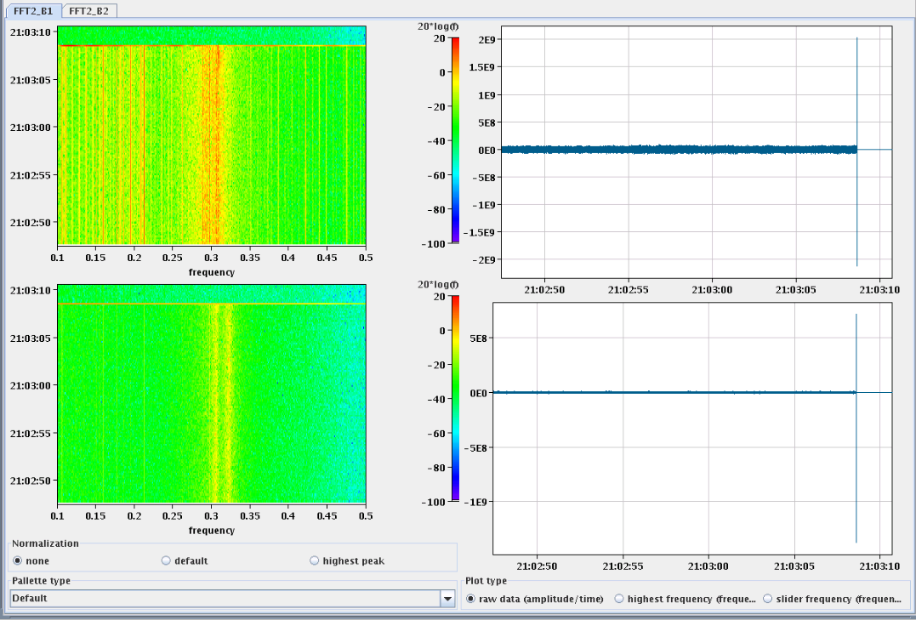
Fill #2632
LHCb polarity flipped to negative.
Beams in physics. Atlas and CMS optimised: 5.0e33
LHCb ramping up in lumi: beams dumped due to BPMS interlock. Cause not known
Beams seem to be stable just before the dump
B1
B2

Slide 4
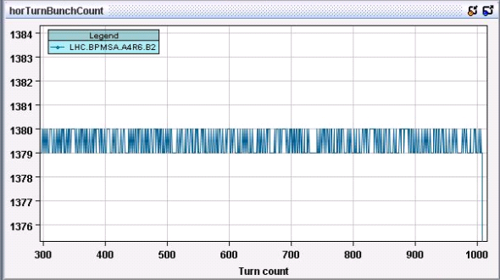
BPMS dump
It seems as if the channel BPMSA.A4R6.B2-H, did not see 1380 bunches all the time, but 1379 many times.
So every time we are measuring one bunch less, the ADC has an incorrect reading... And this is counted as beyond the limits.
My doubt is in fact why the beam was not dumped much before, because I can not see a clear regime change on the last 1000 turns.
Eva Calvo Giraldo

Slide 5
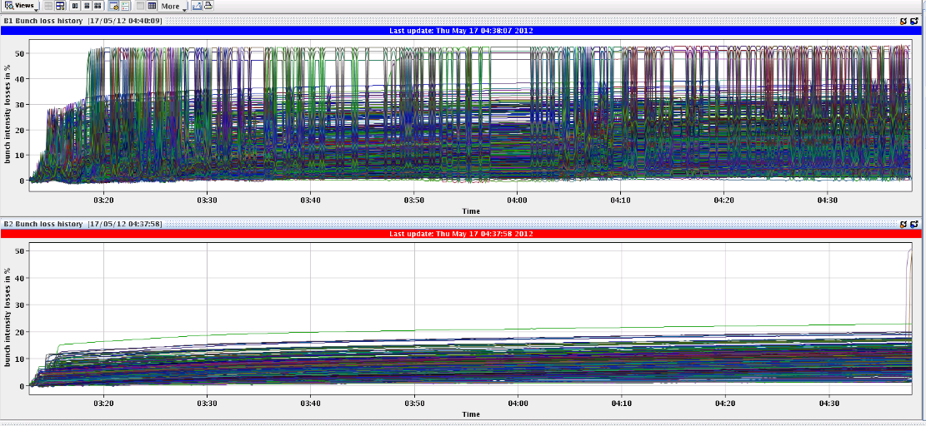
Fill #2634
The emittances of some bunches of B1 are really exploded, already at beginning of the fill
Just before the dump, we lost 50% of bunches 22761 and 22781: bunches which only collide in IP8. Few minutes before, we had done an optimization of ATLAS and CMS.
B1 already lost intensity on IP8 bunches
B2 just started to loose as well

Slide 6
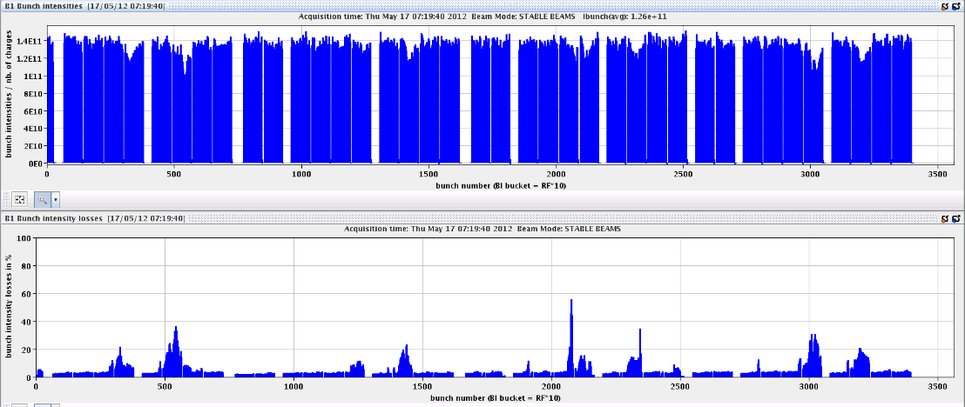
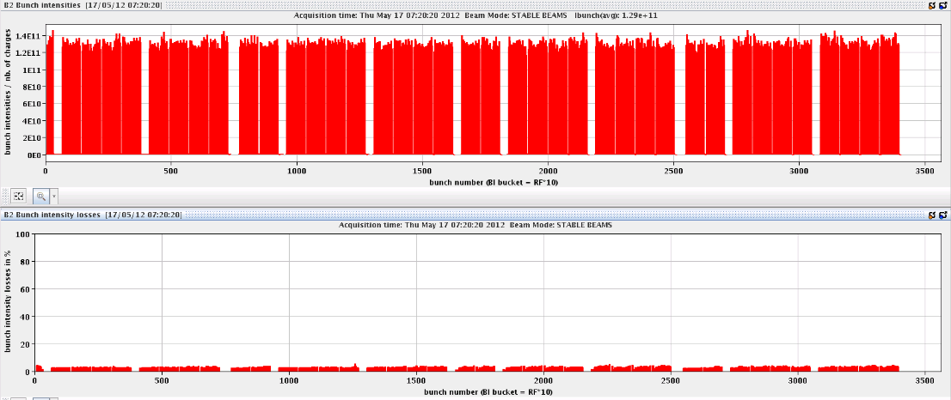
This fill #2635
bunch intensity drops to 6e10. The bunch numbers are 2075,2077,2079, which are bunches with head-on collisions only in IP8. BPMS ok up to 4e10

Slide 7
RF – B1 not in prime shape
Bunch length problem at injection since few weeks: B1 always blowing up more (noticed by S.Claudet some time ago).
Last fill blow-up B1 during ramp not very good.
Frequent request for abort gap cleaning B1

