Slide 1
Thursday 10th May - morning
Fill 2605, 480 bunches into stable beams at around 9:15
no issues
10:40 Progress through experimentation
Atlas separated to ~1.7 sigma
Nothing seen
CMS separated to …
Nothing se…. eek… beam dump
Large losses on two bunches of beam 2
Access during ramp-down
RF, Atlas
Regulation of Alice dipole power converter problem

Slide 2
Investigations following the RF problems on cavities 1B1,3B1,8B2 last night
For 1B1 and 3B1, the problem was a "weak" level of the 20 MHz clock used in the electronics.
The level was just below the threshold used to generate an OK status. Although processing was not impaired, it prevented from switching the Line ON as the status is checked during the switch-On sequence and leads to abort if in fault. We have increased the RF level. That called for an access in UX45 around 12:00
For 8B2 the problem is not understood.
We took advantage of the access to change one module but we do not think it was the problem. The symptom is more typical of a controls problem as it was solved by rebooting the front-end last night. It could however be caused by the communication with the RF modules in the VME crate. Being followed up off-line...
Greg and Philippe

Slide 3
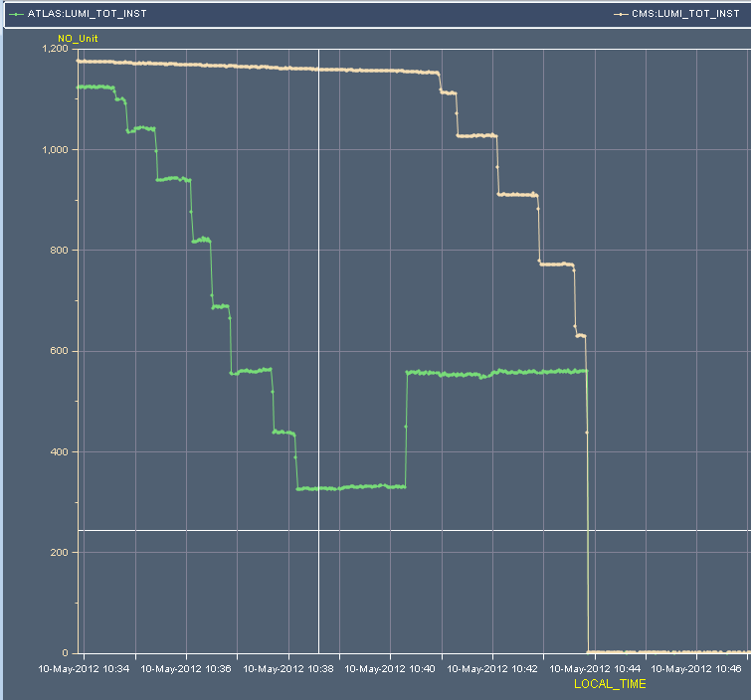
~1.7 sigma
~1.5 sigma
5 microns

Slide 4
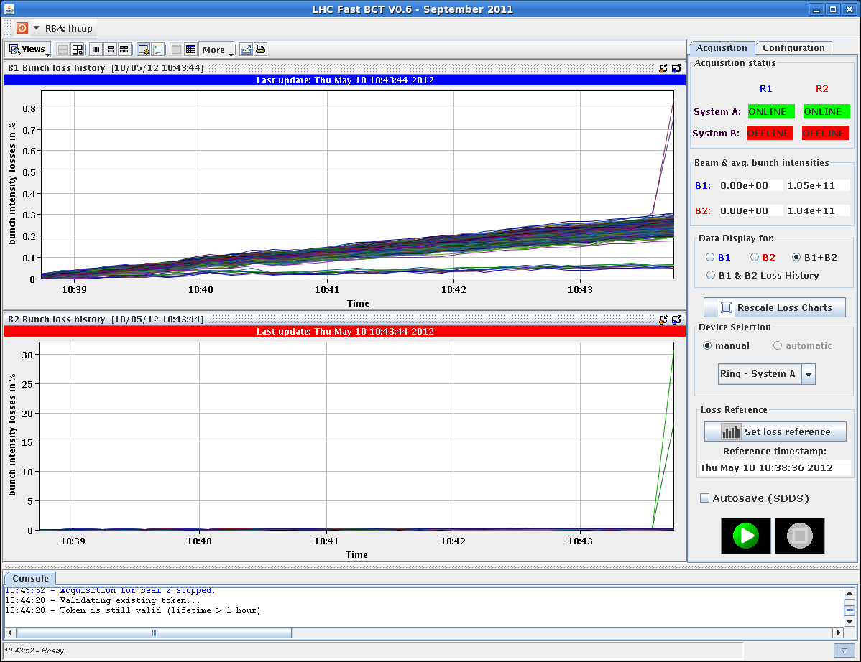
Two bunches
Issue with instabilities when beam are separated by 1-2 sigma, feed-forward of (effective) correction had lead to separation at this level going into collision…

Slide 5
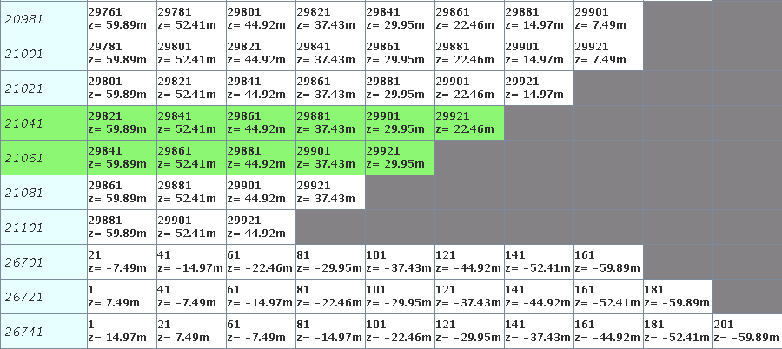
Two bunches
21041 and 21061 (or 2104 and 2106 in BI lingo)
Head-on on in IP1 & 5 only
Of 480 bunches 471 collide in 1&5, 461 of which in LHCb as well
N-3, N-2 in train where N=72…
LRE: {16,15} in IP 1, {11,10} in 5, {6,5} in 8,

Slide 6
Thursday 10th May - afternoon
13:00 Access finished
Injection somewhat dirty – steering required…
Leading into a booster interlock problem and…
PS quadrupole problem and…
CMS ramping down to 3 T
16:40 Fill with 1380
17:30 Stable beams fill 2608
Initial luminosity ~3.9e33 cm-2s-1
Apologies to LHCb again… spiked ‘em
CMS low to start … some concern
Dumped after ~30 minutes by a UFO at the MKI2.

Slide 7
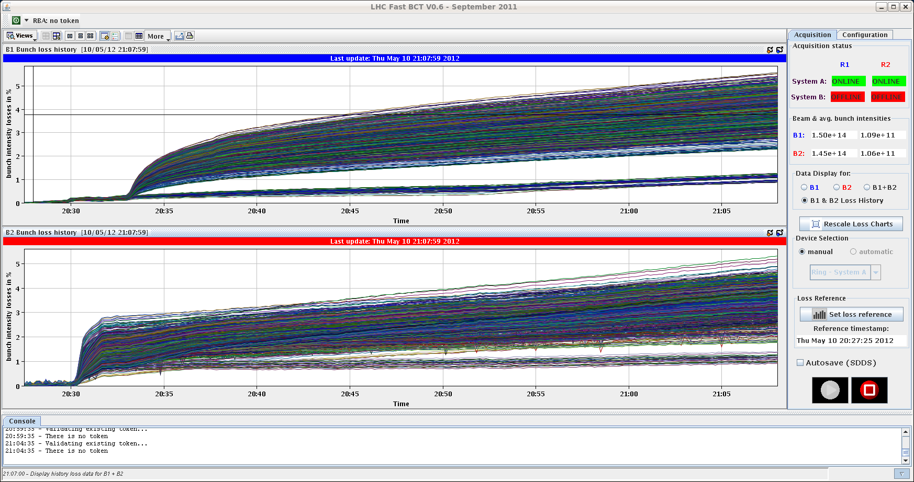
Thursday evening
20:40 Back in stable beams
Interesting B2 lifetime dip, lost some B2 at start of collision BP
Initial luminosity ~3.7e33 , ~1.1e11

Slide 8
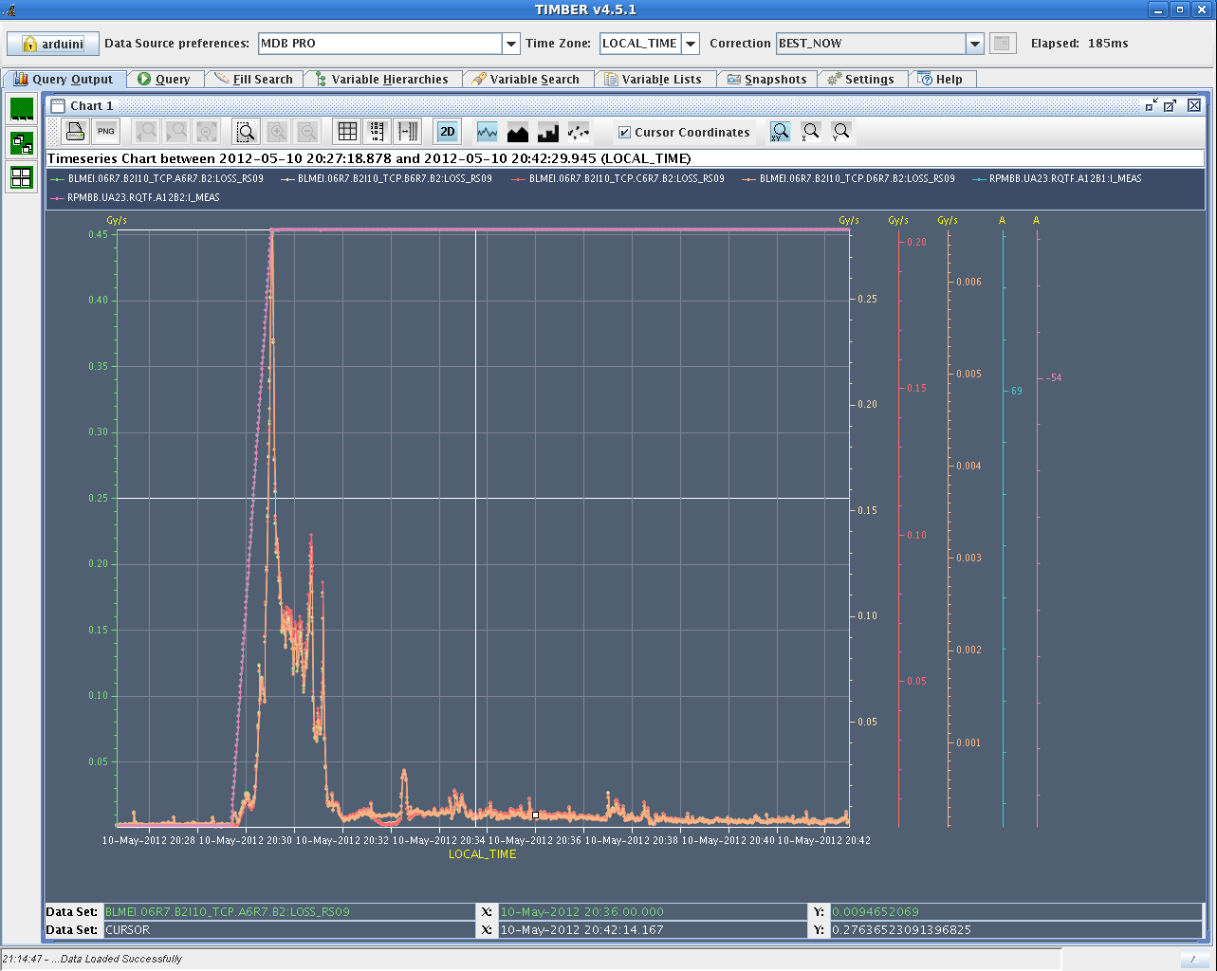
Tail cleaning by working point movement(?)

Slide 9
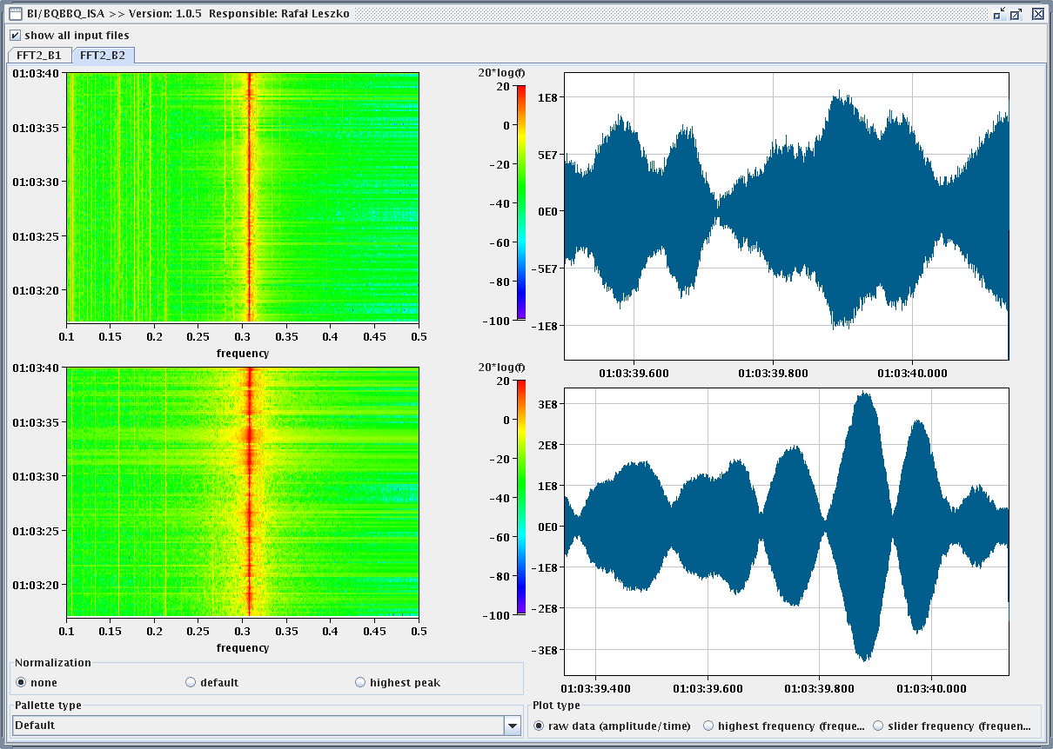
Friday early morning
2609 dumped by BLMs
BLM at point 7 triggered the dump. It seems the beams became instable. 4 ADT modules went down around 20 minutes before
Vacuum and ADT piquet in action
The 2 gauges VGPB_277_5R4_R and VGPB_286_5R4_B (ADT interlock) went OFF at 01.01.18 as the value spiked up to 10E-3

Slide 10
Just now
05:00 Re-injecting
Steering required again…
06:30 Unable to load ramp to some RF FGCs
“Over the past 1.5 hours we have seen periods of several minutes in which about half the channels have lost communication, but only one at a time. Andy has noted that the affected channels (Mask 0x4503) are spread across more than one equipment crate so the FGC is the likely common point. I have reset the statistics counters but as of now, no new errors have been reported in the past 45 minutes. When that happens it will help to narrow down what might be the cause.
At the next access, I would recommend that the RF piquet swap the FGC for the hot spare.” Quentin King
This problem must be related to the sick cfv-ux45-acsc8b2t crate. As a function chain in a faraday cage makes a daisy chain through 4 cavity controllers, (8 crates: 4 feedback + 4 tuning) the consequence is that when one crate is malfunctioning there will be a general problem on the link. John Molendijk

Slide 11
Program for the day
1380 @ 1.3e11

