Slide 1
Summary of week 19
Machine Coordinators: G. Arduini, M. Lamont Main aim: Luminosity production

Slide 2
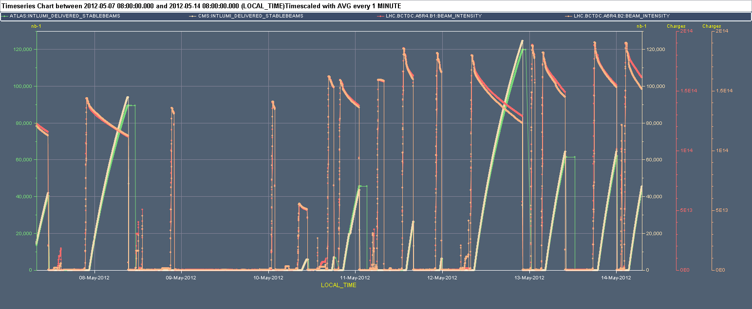
Week 19
1380
1092
480
Cryo. Pt. 8
Mix of performance and machine availability issues

Slide 3
Last 24 hours
04:25 Stable beam #2623 1.23e11 ppb, 4.13e33 cm⁻²s⁻¹.
08:15 cold compressor off in point 2...(Cooling problem)
09:50 Beam dumped by operations - cryogenics recovery
15:00 Cryo back, pre-cycle etc.
18:54 Stable beams #2624. 1.28e11 ppb, 4.34e33 cm⁻²s⁻¹
00:03 UFO at BLMQI.06R8.B2E10_MQML. Beam dump
Re-steering required for TI2
03:28 STABLE BEAMS #2627. 1.27e11 ppb, 4.11e33 cm⁻²s⁻¹

Slide 4
Fills of the week
Fill | Day | Nb | L (h) | Int L (pb⁻¹) | Dump
2593 | Mon | 1092 | 4.6 | 41.1 | Electrical network, FMCM
2596 | Mon | 1092 | 10.6 | 91.8 | OP
2605 | Th | 480 | 1.3 | 5.5 | End of fill test
2608 | Th | 1380 | 0.5 | 6.8 | UFO
2609 | Th | 1380 | 4.5 | 44.5 | ADT vac. Gauge trip
2616 | Fr | 1380 | 1.9 | 26.0 | Vacuum crate PS failure
2617 | Fr | 1380 | 0.4 | 5.9 | Q7.R1 trip (SEU?)
2621 | Sat | 1380 | 13.3 | 120.5 | OP
2623 | Sun | 1380 | 5.4 | 62.3 | Cryo pt. 2
2624 | Sun | 1380 | 5.2 | 63.3 | UFO
2627 | Mon | 1380 | 4.5 | ~55
 |  |  | 52.2 | 523
Stable beams ~ 52.5 hours in total (31.1 %)

Slide 5
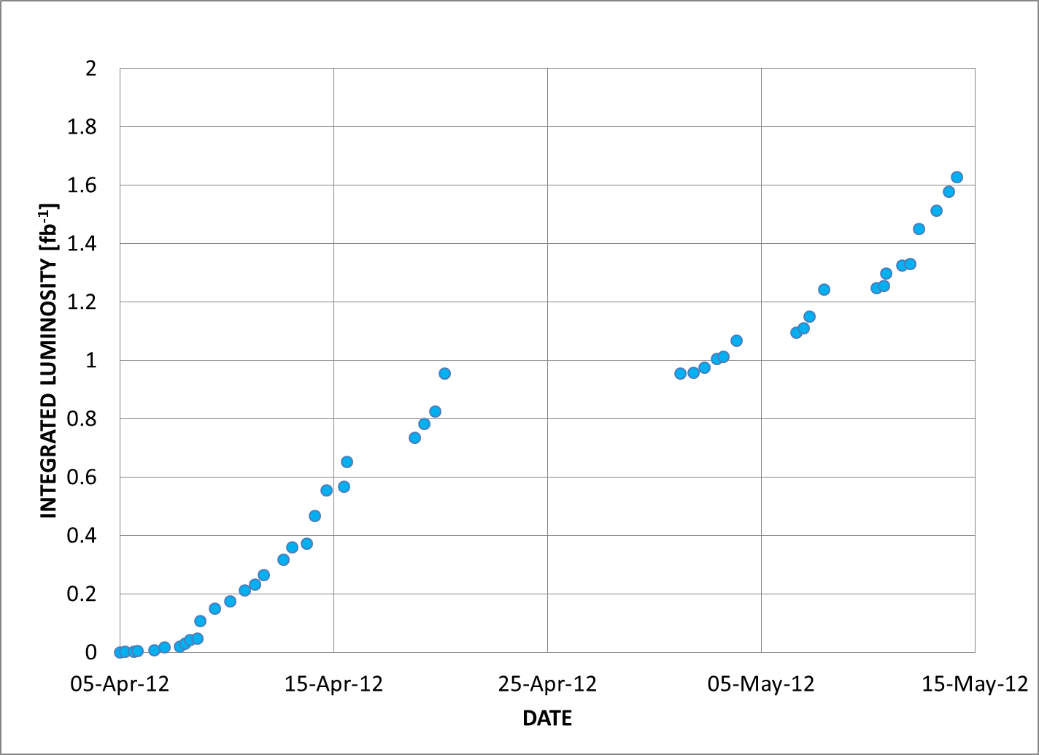
Integrals

Slide 6
Main faults
Cryo Pt8
 | Hours | Faults
Mon 7.5 | 3 | Injectors, RF control, BPM LSS6
Tue 8.5 | 8 | Injectors, RQTL11.L5B1 (PC), Cryo Point 8
Wed 9.5 | 24 | Cryo point 8/Electrical problem in P1 (18kV/400 V transformer)/ALICE dipole/RF controls
Thu 10.5 | 4.5 | RF controls, BLMs controls, Injection
Fri 11.5 | 15 | RF controls, injection, Vacuum crate failure , QPS connector
Sat 12.5 | 7.5 | Recovery from Fast abort sector 12 (dump resistor cooling), access for RCBCV9.L5B1 repair, injection losses due to different cycle in the SPS
Sun 13.5 | 5.5 | Cryo compressor point 2 – Cooling water problem
~ 67.5 hours in total (40 %)

Slide 7
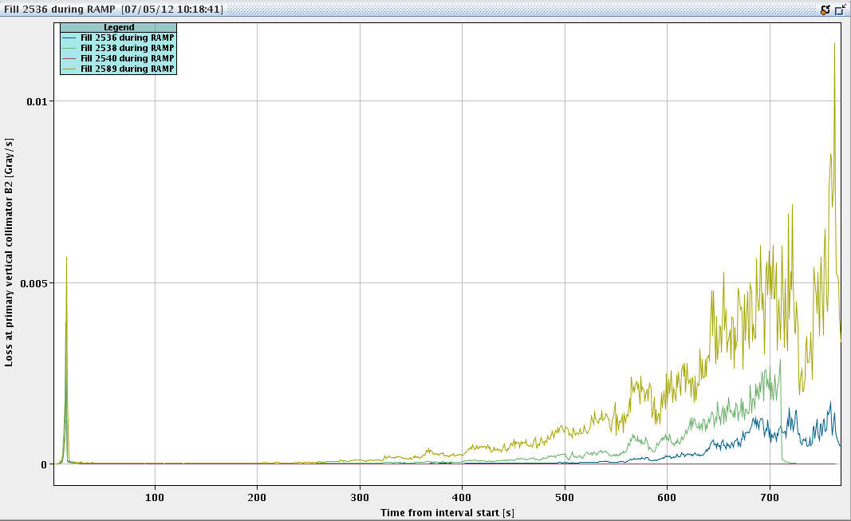
Losses at the end of the ramp and squeeze (B2)
Deterioration started already before technical stop and continued after technical stop. Effects visible already during the ramp
Fill 2536 – Before technical stop
Fill 2538 – Before technical stop (dump during ramp - HV)
Fill 2589 – After technical stop

Slide 8
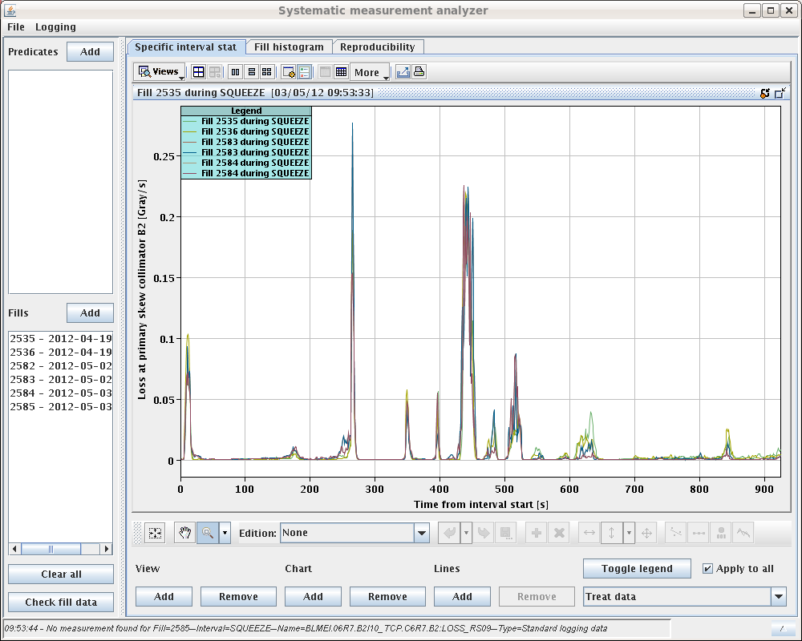
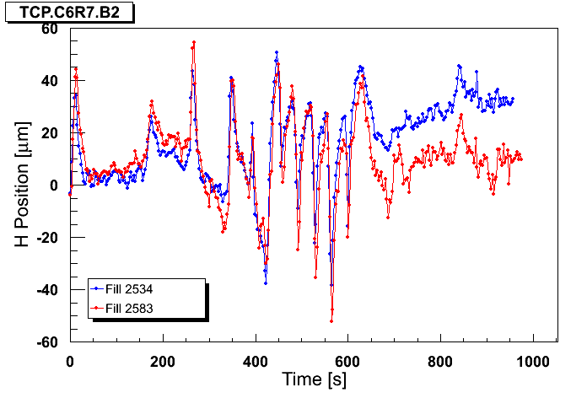
Orbit and losses in the squeeze
B2: Losses and H TCP orbit well correlated. Less evident for V-plane
J. Wenninger

Slide 9
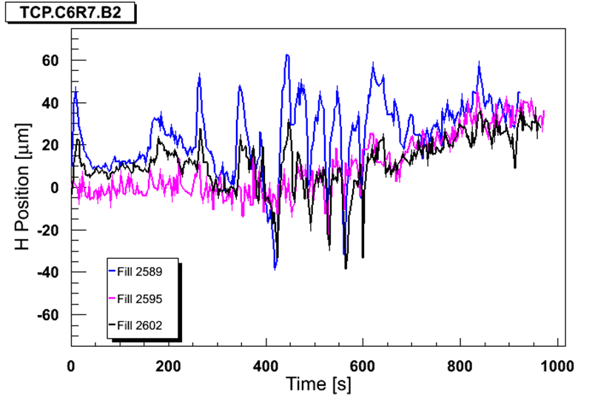
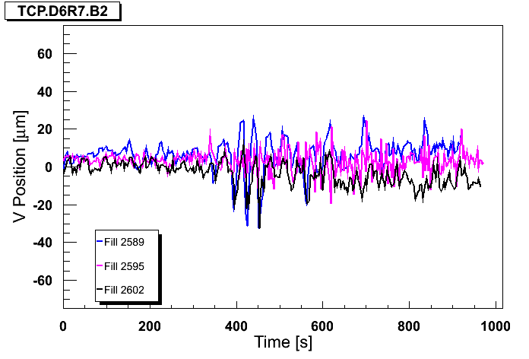
Orbit FF – squeeze – beam 2
R. Steinhagen, J. Wenninger
60% correction applied
Sigma H at TCP ~300 microns
TCP ~5.1 sigma

Slide 10
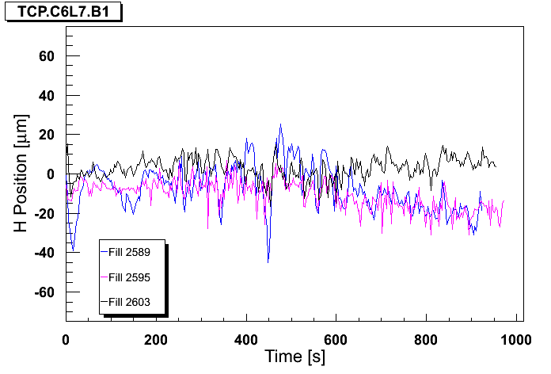
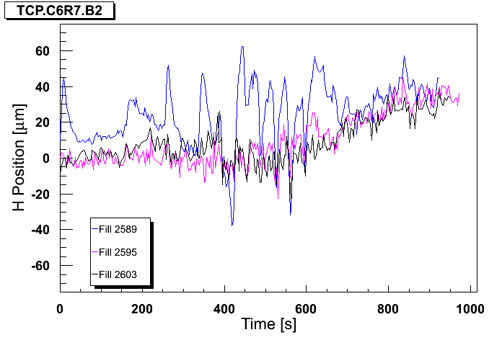
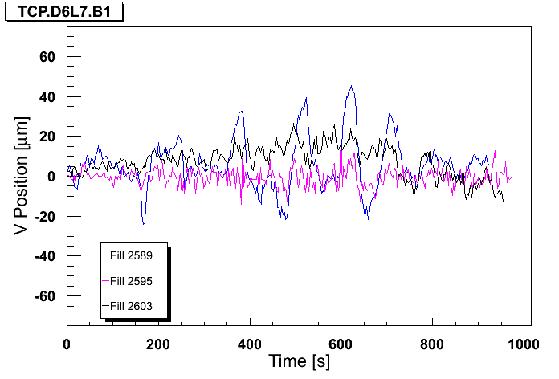
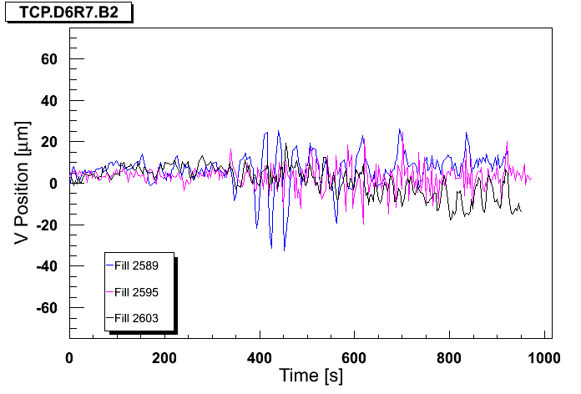
High gain OFB test
Blue : before high BW, Magenta: OFB BW x10, Black: after 100% FF
B1H
B2H
J. Wenninger
B1V
B2V

Slide 11
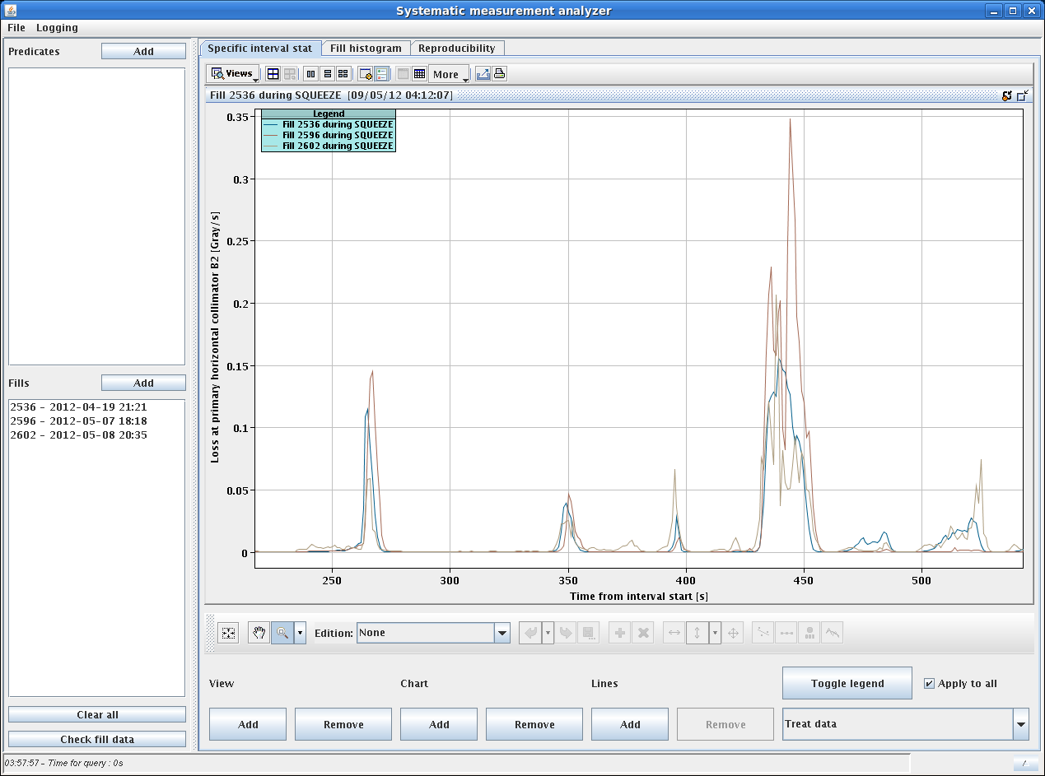
Losses in squeeze at TCP
Improved but still spikey

Slide 12
Losses during ramp and squeeze
Increased losses on Beam 2 observed already before TS
Worse after technical stop:
Related to larger tails and larger emittance at higher energy
Mostly appearing between 2.5 and 2 m
Correlated with (small) orbit distortions at TCPs and (small) relative offsets beam/collimator centre adding up for B2 in particular
Losses enhanced by reduced gain of the transverse feedback on 12 bunches
Actions:
Verifications in the injector chain
Transverse damper modulation off
Collimator set-up at top energy checked
BLM thresholds increase + review of the thresholds (rMPP/LMC)
OFB higher bandwidth in squeeze and feed-forwarded
Investigations on the optics and collective effects expected during the squeeze from 2.5 to 2 m ➔ LMC
Scraping of tails at low energy ➔ to be done

Slide 13
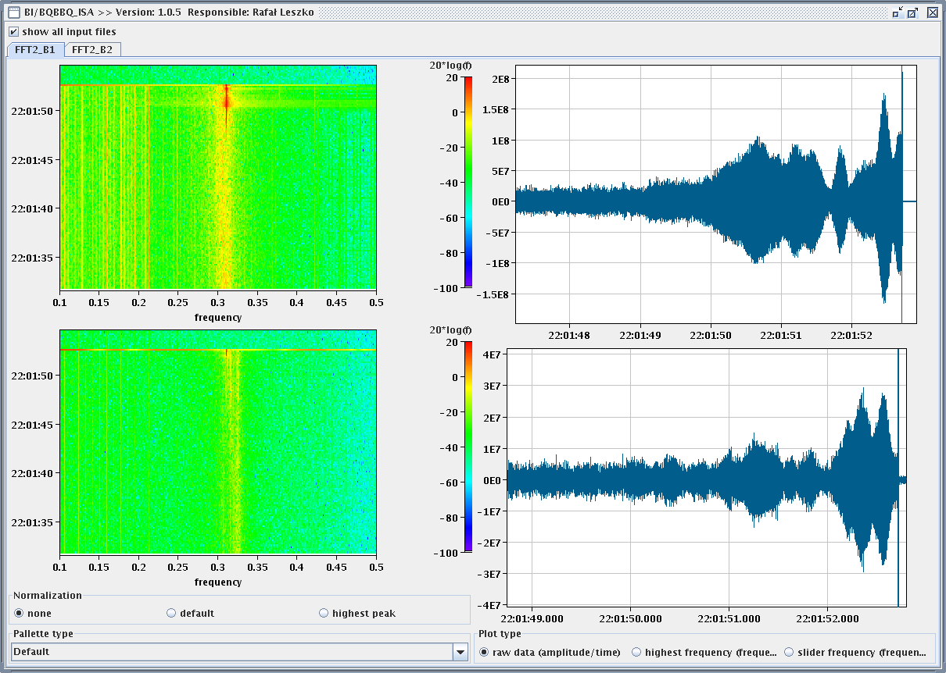
Instability – B1 H
Occurring when CMS in collision and ATLAS not yet fully head-on. Lifetime good up to that point.

Slide 14
Instability
Instability at the end of the collision process (separation bumps collapsed). Residual separation of ~2.1 σ in IP1 and ~1.2 σ in IP5 and 3.2 σ in IP8 (estimated from luminosities at the moment of the dump). The separation in IP1 and 5 is likely the effect of the orbit correction during the squeeze.
B1H osc. Ampl.
L_{CMS}
L_{ATLAS}
L_{LHCb}

Slide 15
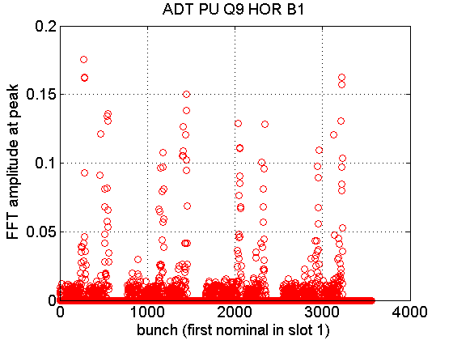
Instability Damper pick-up signals
Thanks to W. Höfle!!

Slide 16
Actions
Went back to low number of bunches but with 50 ns spacing to get as much as possible same orbit
Luminosity scan to determine collision offsets and correct them ➔ incorporated for next fill
Analysis of data ongoing
IP1 - H
IP5 - V
IP5 - H

Slide 17
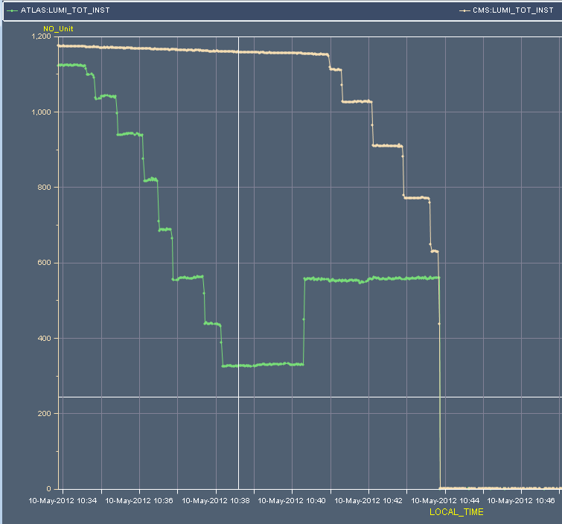
Instability
~1.5 sigma
~1.7 sigma
5 microns

Slide 18
Status
Losses:
Still losses during the ramp (not negligible)
Reduced during the squeeze (particularly between 2.5 and 2 m and more recently at ~1.5 m) although spikey.
Warning levels reached:
at the end of the ramp (TCSG/TCLA in point 7: 80 s running sum to 50 % of threshold)
During the squeeze between β*= 2.5 and 2 m and at 1.6 m (TCSG/TCLA in point 7: 1.3 s running sum to 56% of threshold)
Instability: can be controlled by the transverse feedback provided small offsets (< 1 σ) at the end of the collision process.

Slide 19
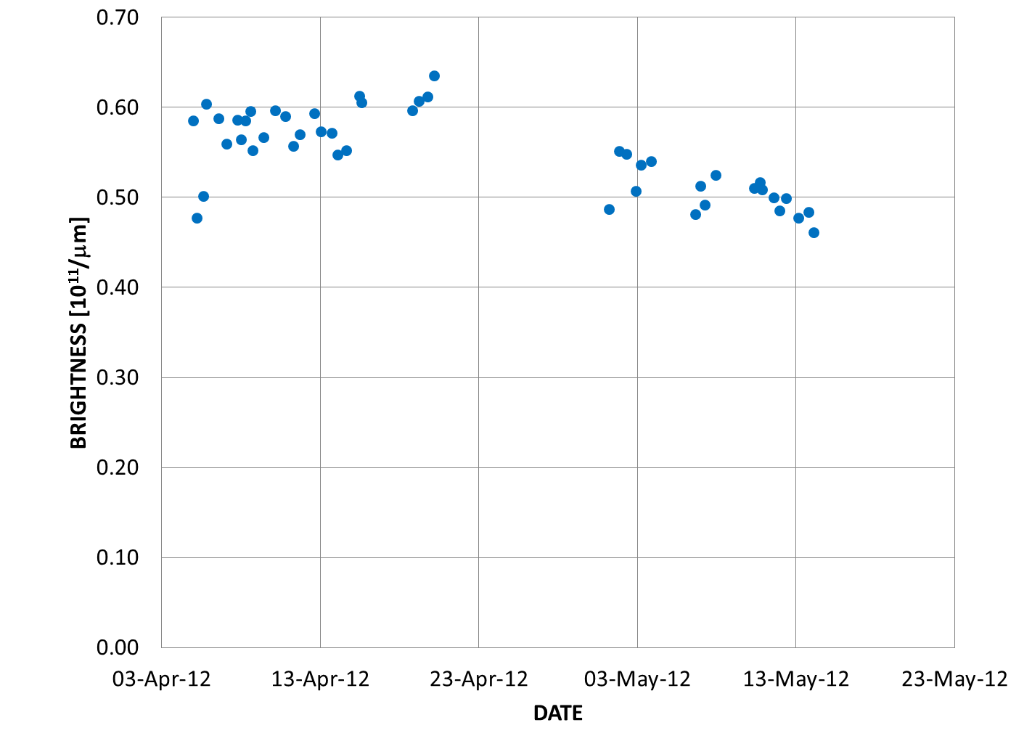
Performance
Loss of brightness ~20% during technical stop ➔ checking LHC and injectors. Eemittance comparison through the chain to understand the origin. Concentrating particularly between PS and SPS.
Need chirp to measure the tune during the ramp

Slide 20
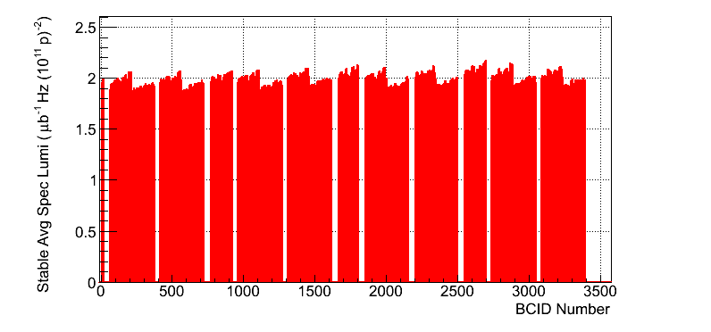
Performance
Fill 2536 – Before technical stop
Fill 2624 – Now
c/o ATLAS

Slide 21
Pending
Beam quality from the injectors
Injection delicate: heavily relies on quality of the beam form SPS. Collimator aperture opened form 4.5 to 5 σ in both injection lines.
Orbit in collision needs to be corrected and trims incorporated (in particular point 5)
TDI jaw deformation ➔ check to be done after long high intensity fill

