Slide 1
Summary week 18 Intensity ramp up & production
Barbara Holzer, Jorg Wenninger

Slide 2
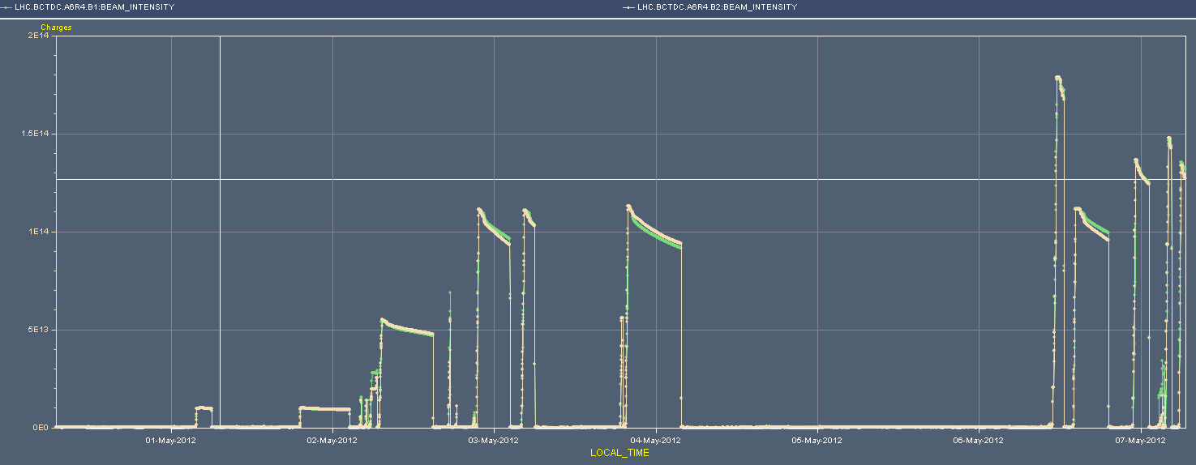
Overview of the week
Luminosity
CMS low
pileup
Length
Scale
IT.L8
Cryo Pt8
1380
1092
Intensity
852
480
84

Slide 3
The short week-end - Sunday
08:40 Cryo S78 back. Precycle.
Filling for 1380b. LINAC2 RFQ problems, poor(er) beam quality, injection lengthy. 1.3E11 p/b.
11:30 Start of ramp. High vacuum in IR2 and IR4.
Surviving squeeze – losses to 60% of dump thresholds
Lost beam at the end of collision BP. Dumped on BLM at Q4.L6 (B2) on 5 sec RS.
Leakage from IR7…
Losses while going into collisions.
Discovered that the orbit B2 H was shifting when going into collisions (100 um) → came from an orbit correction earlier in the week.
Corrected drift offline.

Slide 4
Losses 1380b at 4 TeV

Slide 5
Q4.L6 dump

Slide 6
Sunday afternoon
Decide to go back to 852b to gain some margin wrt dump levels.
Squeeze with 852b – up to 50% of dump level on Q4.L6.
15:40 Stable beams fill 2590, 852b.
19:10 Dump trip of PC RQTL11.L5B1.
Back at injection but trouble with TDI.
TDI ‘too hot’, LVDTs off.
Waiting for ~2 hours, limit changed by 30 um to speed up.
Refilling with 1092b.
Ramp and squeeze – losses as usual.
00:00 Stable beam fill 2592, 1092 b, 3.2E33 cm-s-1.

Slide 7
TDI LVDT converging slowly

Slide 8
Sunday Night
01:15 Dump by FMCM, electrical network glitch.
Refill, but with higher bunch charge ~ 1.4E11.
04:30 Beam dumped in the squeeze, losses on Q4.L6.
Yet again… 1092b.
Survived the squeeze by miracle – 94% of dump threshold on Q4.L6.
06:40 Stable beams fill 2592, 1092b, 3E33 cm-s-1.

Slide 9
Vacuum with 1092 b (dumped in squeeze)

Slide 10
Fills of the week
Fill | Day | Nb | L (h) | Int L (pb-1) | Dump
2574 | Tu | 84 | 0:32 | 0.3 | Electrical network
2576 | Tu | 84 | 6:17 | 2.2 | OP
2580 | We | 480 | 6:47 | 26 | OP
2583 | We | 852 | 3:52 | 30 | RF, SEU??
2584 | Th | 852 | 0:52 | 7.3 | IT.L8 current lead T
2587 | Th | 852 | 7:13 | 53 | OP – cryo stop Pt8
2590 | Su | 852 | 3:50 | 25 | RQTL11.L5B1 trip
2591 | Su | 1092 | 1:15 | 14 | Electrical network, FMCM
2593 | Su | 1092 | > 1
Fills are too short..
Intensity per bunch limited to 1.3E11 p/b.
Integrated luminosity only ~150 pb-1.

Slide 11
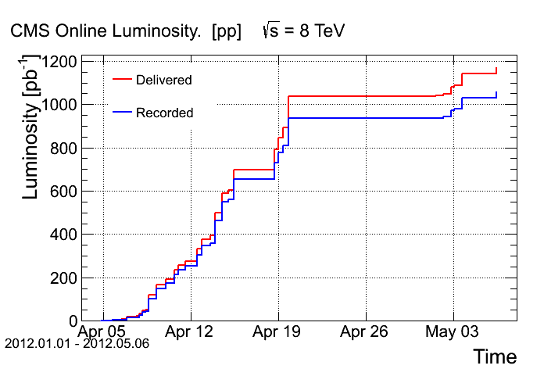
Integrals
Total ~ 1.1 fb-1

Slide 12
Main faults
 | Hours | Faults
Mo 30.4. | 4 | BLM hardware/software.
Tue 1.5. | 2 | PS.
 | 8 | Electrical glitch, 400kV, Pt 2 cold compressor off. Compensator restart tripped the cold compressor again, just after cryo recovery.
 | 1.5 | PS.
Wed 2.5. | 2 | Injectors.
Thu 3.5 | 8 | RQX.L8 trip, current lead T - Lost cryo Pt8. BI BPM hardware.
Fri 4.5. | 52 | Cold compressor Pt8 (twice).
Sun 6.5 | 2 | TDI
Cryo Pt8
~ 80 hours in total

Slide 13
Squeeze and collisions
During the TS the orbit corrector functions of the squeeze were smoothed (‘de-spiked’) in between 3m and 1m.
Hope to reduce losses in that part of the squeeze.
After the TS, tune and chromaticity were corrected in the squeeze.
The tune was actually lowered a bit towards the end (~0.002).
The low intensity squeezes looked OK, but from 852b onwards we observed losses up to 60% of dump threshold on TCLAs in IR7 and very similar levels on Q4.L6 (and Q5.L6) – dominated by B2.
Similar to pre-TS, but a factor > ~2-3 higher.
Losses amplified by vacuum spikes?

Slide 14
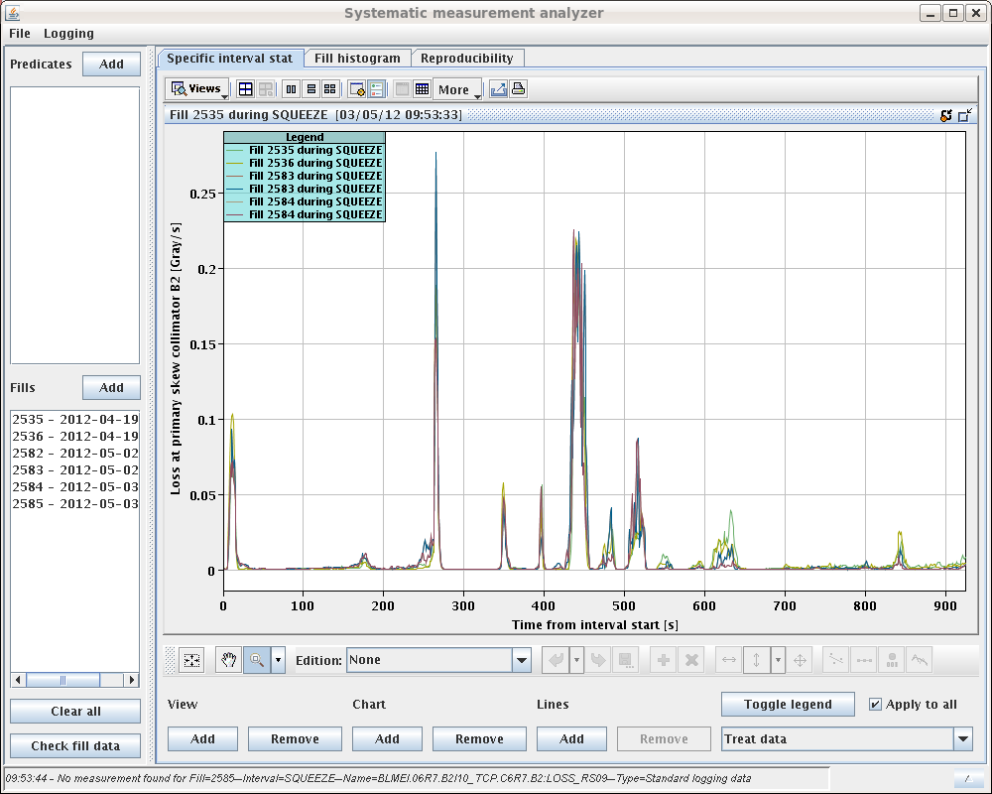
Losses in squeeze
‘Qualitatively’ similar before and after TS, higher after TS.
M: Losses at/close to a matched point.
I : Losses between matched points.
Losses @ TCP B2
M
I
2.5m →2m (I/5)
I
I
M
M
I
M

Slide 15
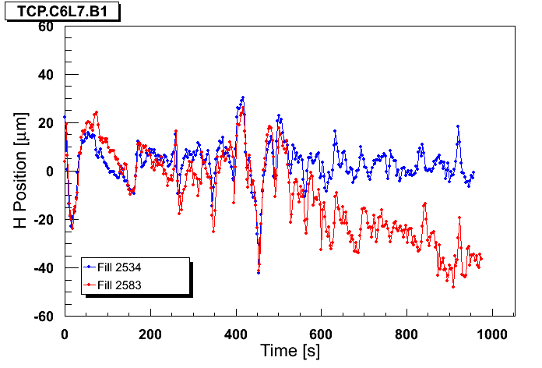
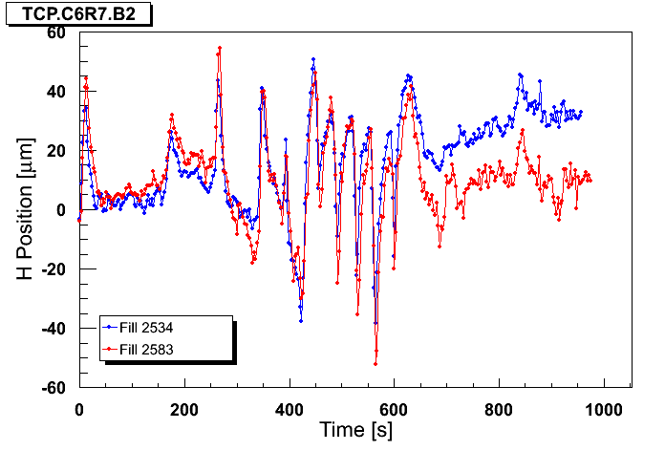
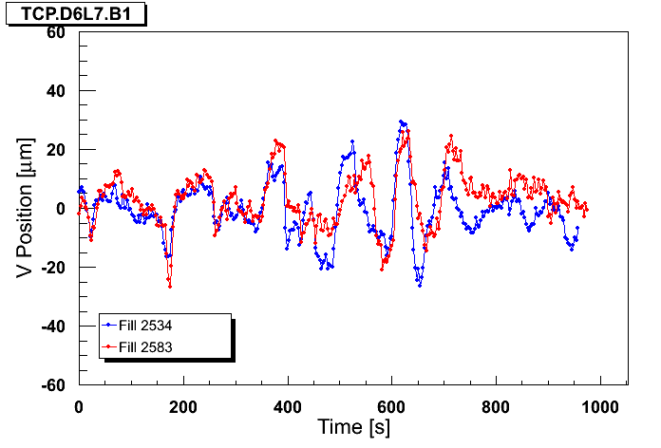
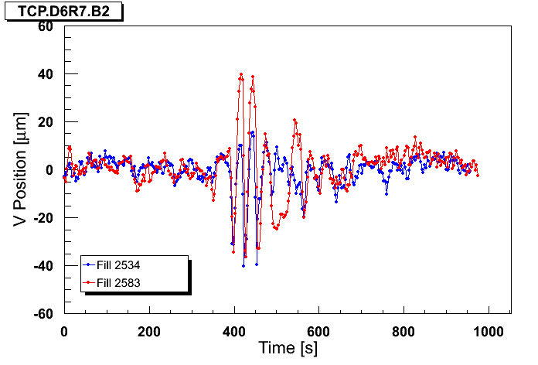
TS function cleaning
Blue : ref fill before TS1, Red : fill after TS1
B1H
B2H
B1V
B2V

Slide 16
Orbit
B2: Losses and H TCP orbit well correlated

Slide 17
Orbit
Correlation with V orbit not ‘strong’

Slide 18
Transient beta-beat
Transient beta-beat (from the model !!) too small to explain losses – 2% only (and not at right time).
Beta versus squeeze time for BPM close to TCP B2.
β_{x} (m)
β_{y} (m)

Slide 19
Reverting…
On Friday it was decided to revert both tune in collision and orbit functions in the squeeze to pre-TS settings.
Possibly small improvement, but change is not very significant.
The BLM thresholds (MF) were increased by a factor 2:
BLMEI.06L7.B2I10_TCLA.C6L7.B2
BLMEI.06L7.B2I10_TCLA.D6L7.B2
The symmetric monitors on the right side had their monitor factors increased from 0.1 to 0.2 already on 13.4.2012.
But the loss levels reached again 60% of dump threshold in the squeeze with 1380b (> factor 2 wrt pre-TS), and dumped with 1092b.
Now the Q4.L6 BLM tends to become the most critical BLM. Dumped will going into collisions with 1380b, and in the squeeze.

Slide 20
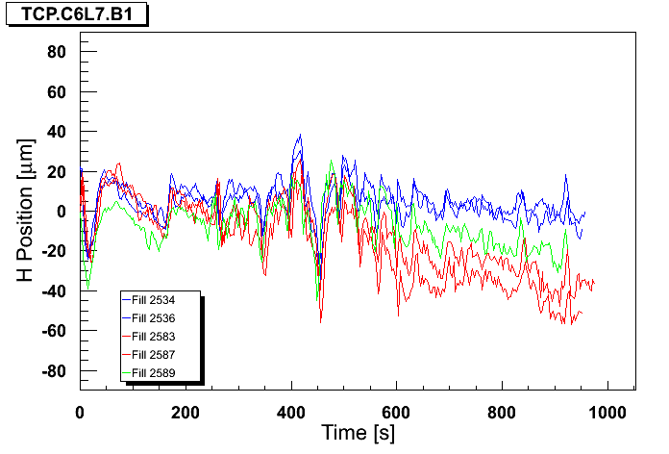
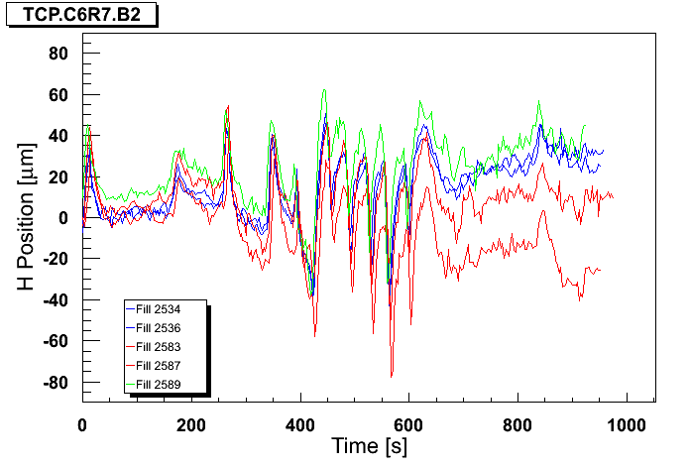
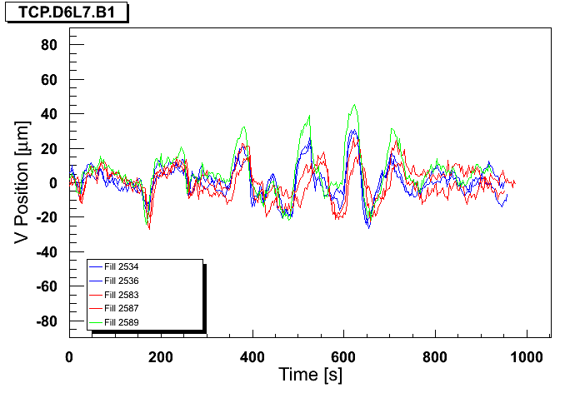
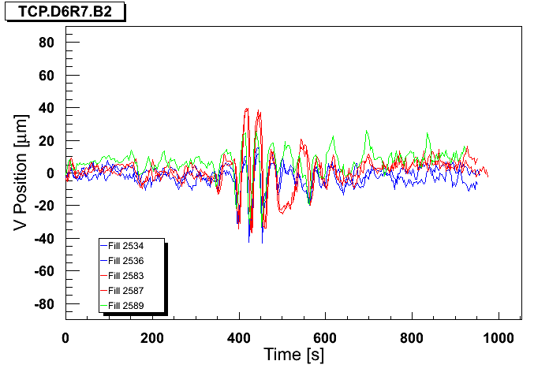
Back to pre-TS
Blue : ref fill before TS1, Red : fill after TS1, Green : revert
B1H
B2H
B1V
B2V

Slide 21
Problem…
We seem to have more beam in the tails, since moving back to pre-TS settings did not recover losses < 30% with 1380b.
Note that we operate with higher ADT gain in the squeeze (x2). Could try to go back as a test…
Observations from the squeeze and collisions (orbit correction etc) indicate that:
Orbit shift of 50 um at TCP → > 30% of BPM dump threshold.
Orbit shift of 100 um at TCP → high risk of beam dump by BLMs.
For losses on time scales of few seconds.
Corresponds to 5-10% of collimator ½ gaps.
We have no margins !

Slide 22
LHCb polarity change
After the TS the polarity was switched from + to – (PC).
Flipped back to + for first 852b fill.
Test with 2 bunches per beam indicated shift of beam position for head-on collision by ~60 um / beam.
No problem for collimators.
With – polarity the net H crossing angle before collapse of the external crossing bump is very small ~16 urad.
Observed main-sat collisions while bringing the beams into collision and during the crossing angle gymnastics.
No problem as total lumi very small, possible to reduce a bit by H separation.
Settings for both polarities established (change only by experts).

Slide 23
LHCb polarity -
V crossing
V sep
collapse
External H
crossing collapse
BRAN
Luminosity ~10²⁹ cm⁻²s⁻¹

Slide 24
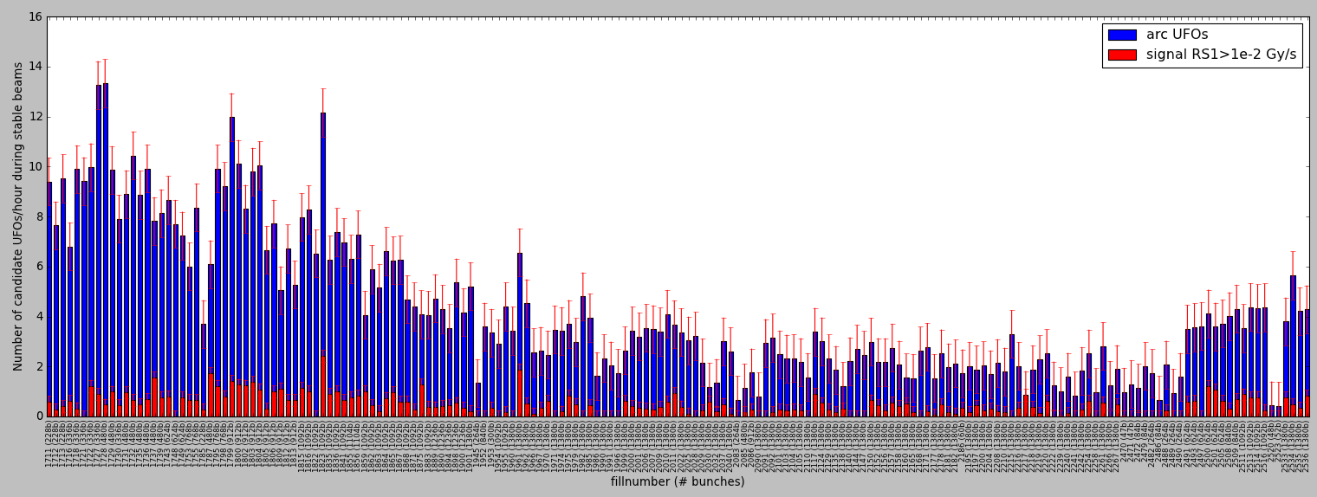
UFO Rate
2011: Decrease of UFO rate from ≈10 UFOs/hour to ≈2 UFOs/hour.
2012: About 2-3 times higher UFO rate than during October 2011.
TS #2
(09. – 13.05.2011)
TS #3
(04. – 08.07.2011)
TS #4
(29.08 – 02.09.2011)
Ion run Winter TS, etc.
(31.10.2011 – 05.04.2012)
1380 bunches
1380 bunches
2011
2012
25ns, 60b
5696 candidate arc UFOs (≥ cell 12) during stable beams since 14.04.2011. Fills with at least 1 hour stable beams are considered. Signal RS04 > 2∙10⁻⁴ Gy/s.

Slide 25
Collimators & Co
Collimator loss maps were performed on flat top and in collision with corrected TCTV functions (in IR1 and IR2).
All loss maps are OK.
Vertical B1 loss map quality not good due to low intensity – in the list of TODOs.
TCT positions for the 2 polarities of LHCb consistent within 0.5 sigma.
TDI alignment was checked with cold TDI – OK.
TDI check with warm TDI to be done.
Sunday evening had to wait 2 hours for TDI to cool-down after 4 hours SB with 852b.

Slide 26
Interlock BPMs in IR6
After removing attenuators during the TS, frequent spurious dumps on channel BPMSA.B4R6.B2.
On Thursday the 6db attenuator was put back on this channel.
All interlock tests have been re-done.
Since then, we have observed a coupled of spurious dumps.
Once when switching sensitivity.
Once with 24 b in the machine (Sunday) – everything looked quiet.

Slide 27
Tune and ADT
Gain modulation of the ADT was tested this week.
Reduced gain on first 12b bunches for Q diagnostic.
The gain of the 12b was reduced wrt before TS, while the gain was increased on other bunches.
Tune signal quality was not sufficient.
We are back with the pre-TS gain for the start of ramp.
We have kept a factor 2 higher gain in the squeeze.

Slide 28
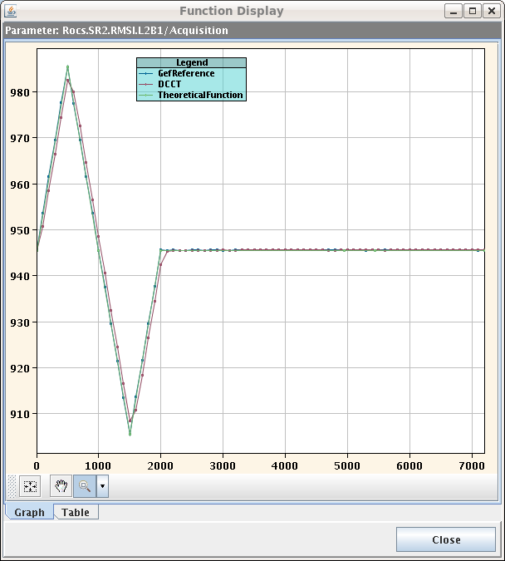
Injection - MSI
MSI cycling on SPS probe cycle in place.
Hope to make the field more reproducible.
Fine steering if the injections to be done..
Not very clean at the moment. Related to the loss problems?

Slide 29
For the next MDs…
Saturday, in the shadow of the cryo recovery for S78, optics tests:
High-beta re-checked to 1km – OK , no PC trips.
ATS checked to 0.1 m – OK, no PC trips. A few PCs in 78 that participate in the ATS part of the squeeze (< 0.4 m) could not be tested, but not expected to be the critical ones.

Slide 30
Next
Understand / solve our problems with losses.
Gain margin for the squeeze:
High gain FB test, and if OK feed-forward of trims.
Analysis of losses and BLM thresholds. Influence of vacuum?
Injected beam quality?
Test with lower ADT gain? last known change wrt pre-TS.
Pre-scrapping of halo in the ramp?
Loss maps in collisions.
Warm TDI alignment check.
Given the sensitivity on orbit we should consider using the OFB also for collisions…
Settings and sequences are ready.
RF batch by batch blowup at injection (RF request).

