Slide 1
Fri 20.04.12
04:52 Stable beams fill #2536
initial lumi 5.6e33 cm-2s-1 (average CMS and ATLAS)
14:40 Programmed dump, end of fill.
15:35 Injecting, but problem on TDI position.
investigate with beam measurements

Slide 2
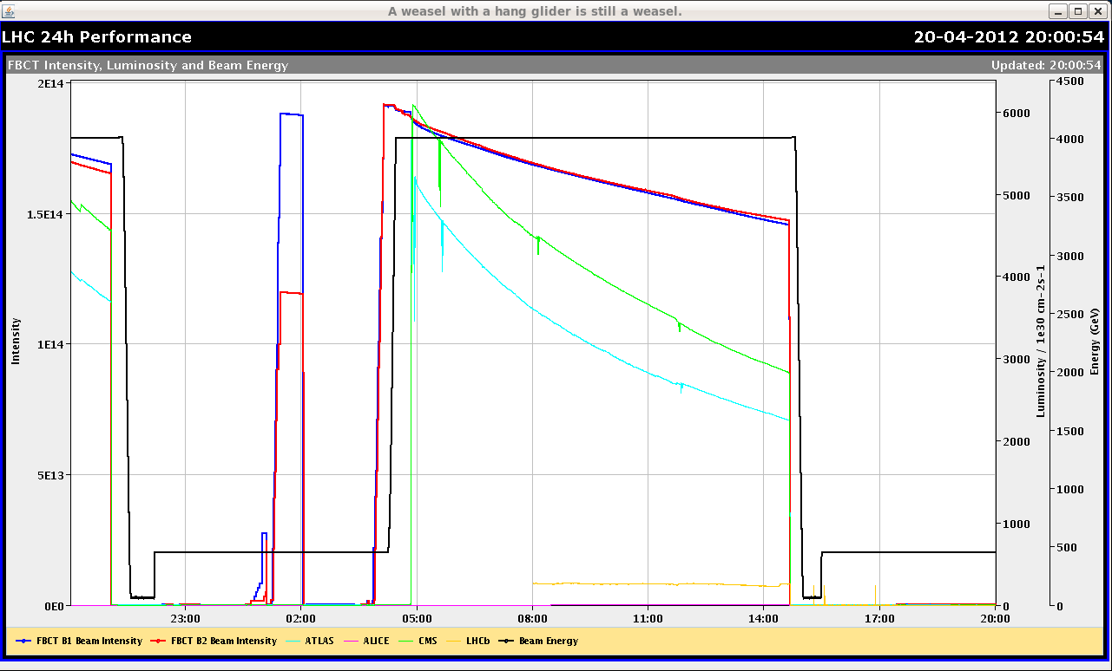
Luminosity Fill Friday

Slide 3
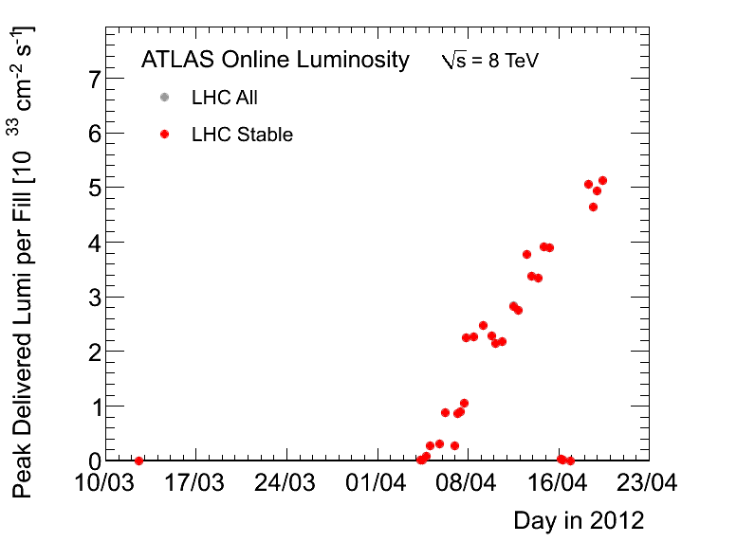
Peak Luminosity

Slide 4
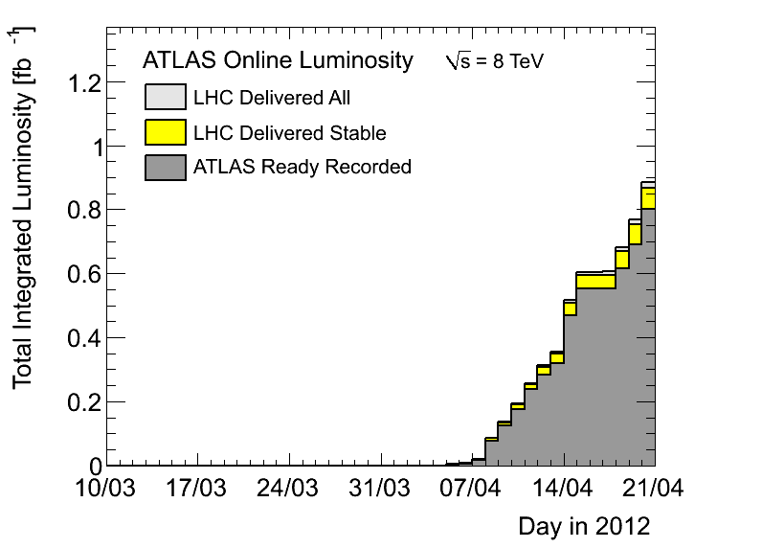
Integrated Lumi

Slide 5
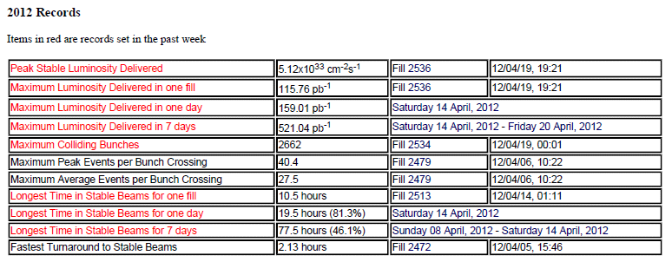
ATLAS 2012 Records

Slide 6
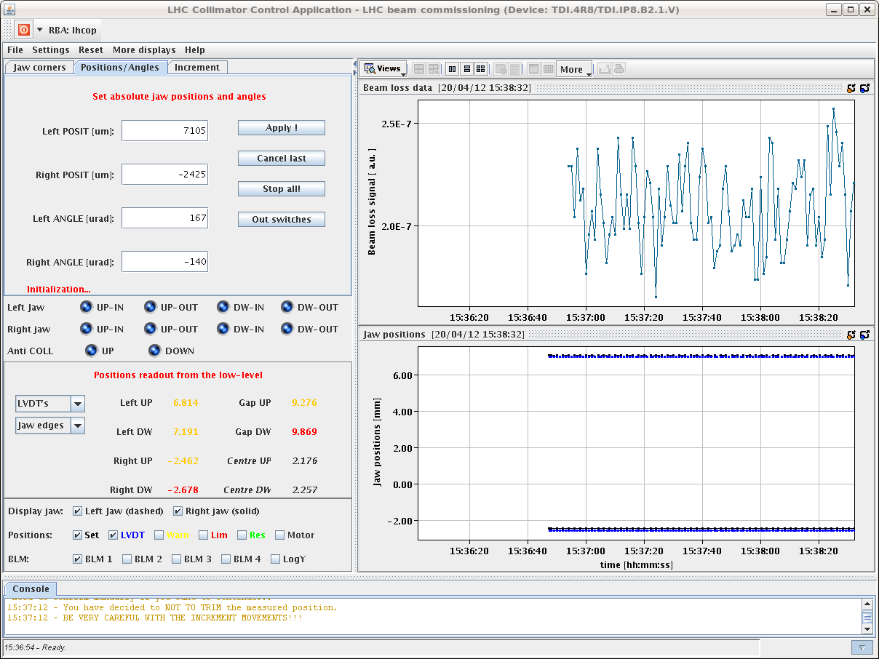
TDI Interlock Issue

Slide 7
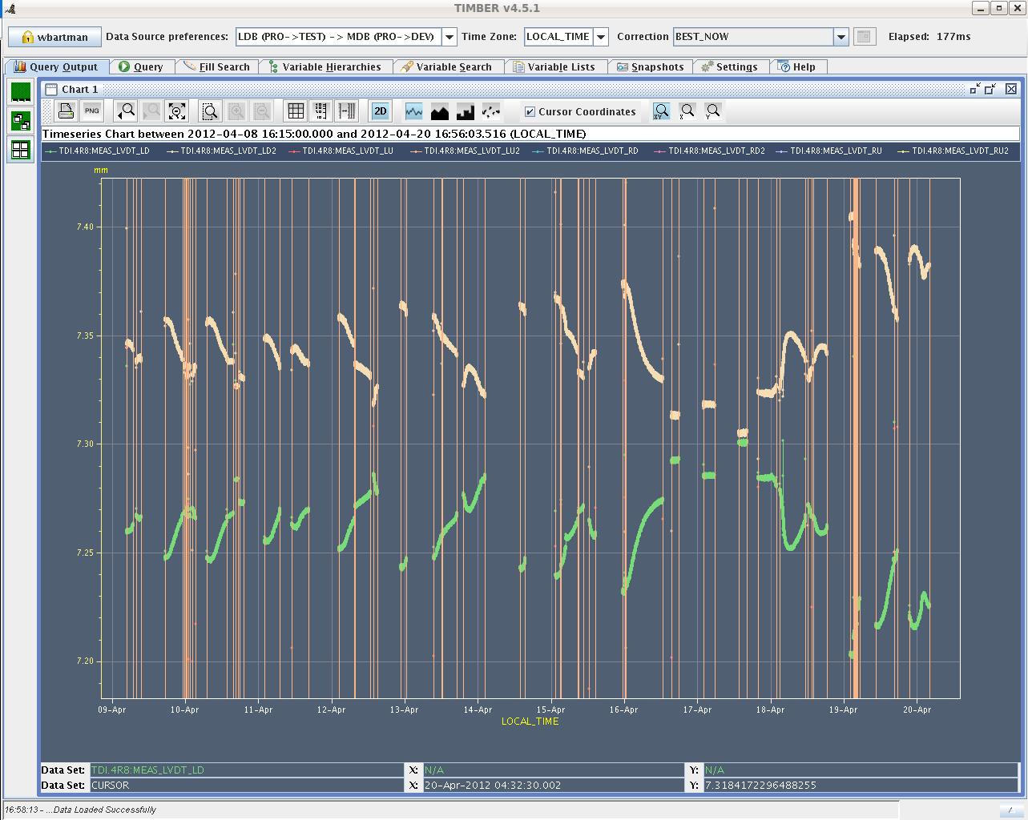
TDI LVDT Variations

Slide 8
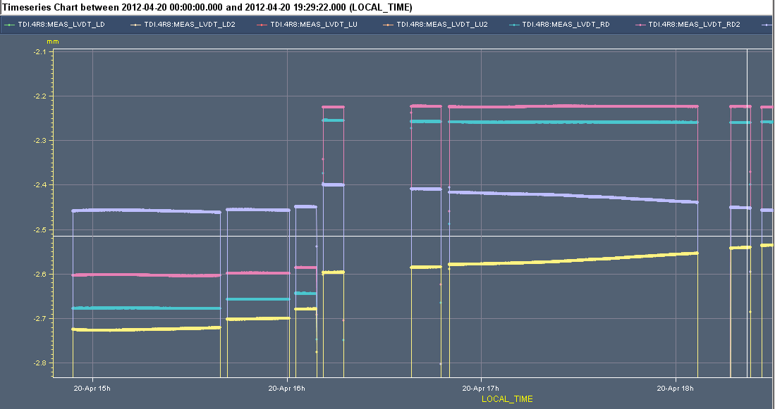
TDI Jumps in Position

Slide 9
TDI Problem: How to End Up at Wrong Pos?
Y
STOP
Limit
LVDT
Wrong position
LVDT
Motor
Motor
Normal: Small difference
Abnormal: Big difference
→ TDI can end up wrong!

Slide 10
TDI I
Problem:
drift of the LVDTs of TDI in point 8 outside position thresholds
Suspect deformation of the jaw induced by heating during injection:
the two LVDTs located at the 2 sides of each motor measure a symmetric offset corresponding to a tilt of the rod connecting the motor to the jaw.
LVDT reading jumping by up to 400 um when moving to parking and back to injection again
understood: motors stop driving the collimator to injection position when there is an error on the inner limit

Slide 11
TDI II
Check position of the TDI jaws with respect to the beam (nominally at 6.8 sigma) with pilot bunch
Opened vertical TCSG in point 7 in order not to intercept the beam
Used the transverse damper to blow up the beam until seeing losses at the vertical TCP in point 7 (losses at the TCP before than at the TDI ==> hierarchy still respected)
Moved the TCP away from the beam with 0.1 sigma steps (continuous beam blowup with damper)
Monitored losses at the TCP and TDI
Position of the TDI in sigma corresponds to the TCP position (in sigma) when losses at the 2 collimators are at the same level (then TDI losses higher than at the TCP)
We found:
B2 both jaws at 6.4 sigma instead of 6.8 sigma
B1 left (upper jaw) at 6.2 sigma and right (lower) jaw at 6.8 sigma

Slide 12
TDI III
Check angle of the TDI:
We repeated the same measurments we did on March 26th (see logbook of that date) to verify if any change in the angle occured as a consequence of the warmup
We found the same values within the measurment error (see plots in attachment)
We believe that there is a deformation of the jaws towards (safer side) the beam as a consequence of warmup during injection (max. 0.6 sigma), we do not measure any significant variation in the angle and centre.

Slide 13
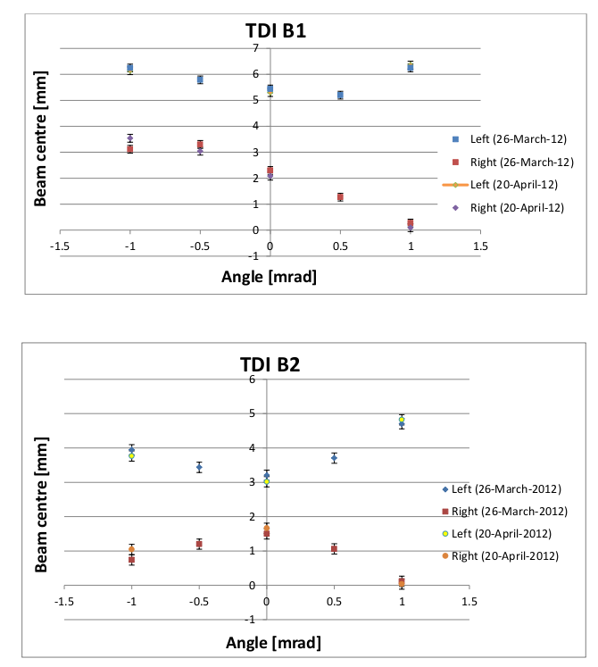
TDI Angular Alignment

Slide 14
TDI IV
If the problem reoccurs:
cycle the TDI to parking
if doesn't move anymore (hit inner limits) load the parking thresholds for TDI and cycle again
repeat several times and wait for possible cooldown.
Problem not solved for the longer term
Especially have to understand situation when TDI is heated up and LVDT’s are drifiting
Protection functionality guaranteed or not?

Slide 15
Fri/Sat 20/21.04.12
23h00 Injection for physics 1380b
00h33 Interlock during ramp
IR7 HV interlock from BLM system (HV overload due to beam losses)
No BLM at dump threshold
Christos looked and found that the HV drop lasted for more than 1 minute and is certainly due to high losses in IR7.
Losses starting at 00:28 and continuously invcreasing until the dump. Not very high losses but lasting long enough.
01h46 Injection. Reduced intensity.
02h46 Interlock during ramp
IR7 HV interlock from BLM system (HV overload due to beam losses)
No BLM at dump threshold
Same as above
05h12 Pilot ramp for tune measurement.
Losses at start of ramp

Slide 16
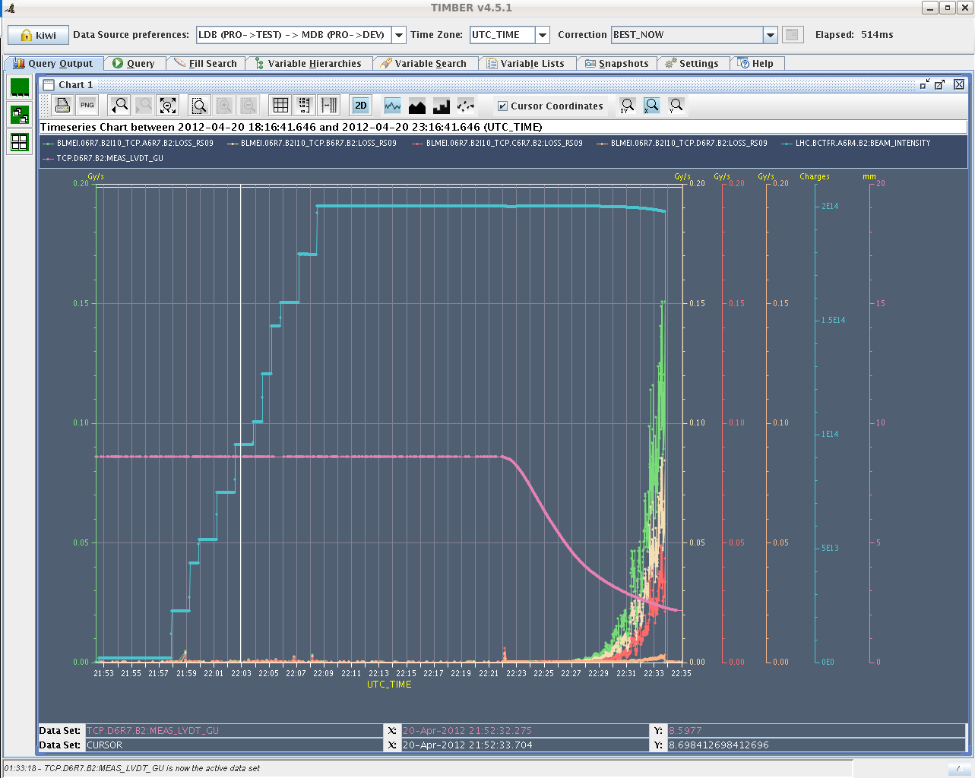
IR7 Modest Losses → HV Interlock

Slide 17
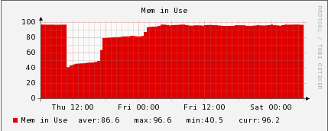
Other Issues Sat AM
Had problems with cfv-ua47-bq frontend, and had to reboot it as the continuous tune viewer froze, and the OFB would not turn on ... Fortunately this was at injection.
In YASP we again see (only at injection) momentarily missing BPM readings (crate by crate).
Checked the BPMs in daimon and all appeared OK.
However, we checked cs-ccr-colsa for CPU load and memory use, and observe that after the intervention on Thursday at 11:00, the memory use has again grown to ~95%, which does not seem normal.

Slide 18
Planning Ahead
Sat 06:00 Start of LHC MD #1
Mon 06:00 Start of LHC technical stop (new software for orbit feedback)

Slide 19
2012 MD#1
Sat
06:00 – 07:00 end of fill study (tune scan, …)
09:00 – 13:00 450 GeV: Longitudinal impedance
13:00 – 17:00 450 GeV → 4 TeV: ADT (no fast blow up)
19:00 – 00:00 450 GeV → 4 TeV: Collimation
Sun
02:00 – 07:00 450 GeV → 4 TeV: Aperture
09:00 – 17:00 450 GeV: RF batch by batch blow-up
17:00 – 23:00 450 GeV → 4 TeV: BI (emittance cross calibration with ADT blowup)
01:00 – 06:00 450 GeV → 4 TeV: ADT (tune compatibility)

