Slide 1
Mon 16.04.12
06:30 prepare injection for VdM scans.
08:17 Injection.
Programmed dump at injection, due to low bunch intensities for VdM scan (several bunches at 5e10, which is too close to the BPMSW threshold of 4e10).
Alice solenoid tripped (low gas/water pressure in the solenoid), ramping back up.
Refill.
12:44 Ramp fill for vdM scan.
13:41 Stable beams.
14:05 vdM scan starting.
14:21 RCBV17.R7B1 tripped.
Was caught by the SIS. The orbit was growing and we would have dumped on the excursion otherwise.
No error in the PIC history buffer for this circuit.

Slide 2
Mon 16.04.12
At collision settings without beam:
Daniel Valuch updated abort gap cleaning parameters.
14:59 Rampdown.
Preparing for access for ALICE.
16:43 Injection.
17:57 Ramp fill for vdM scan.
18:34 Stable beams.
vdM scans starting.
Parasitic: Tests to correct orbits better by Joerg W.

Slide 3
vdM Scan ATLAS

Slide 4
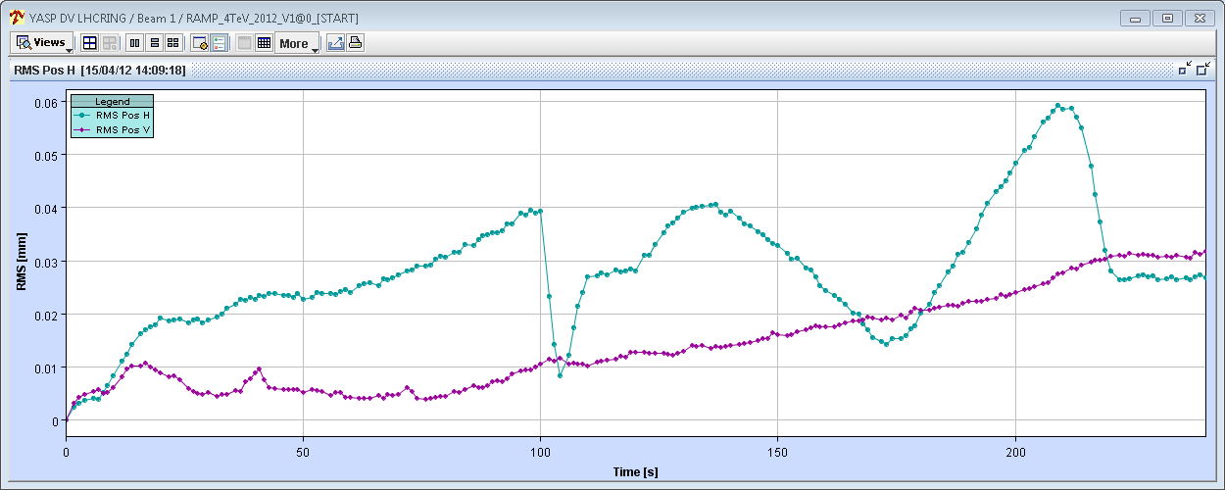
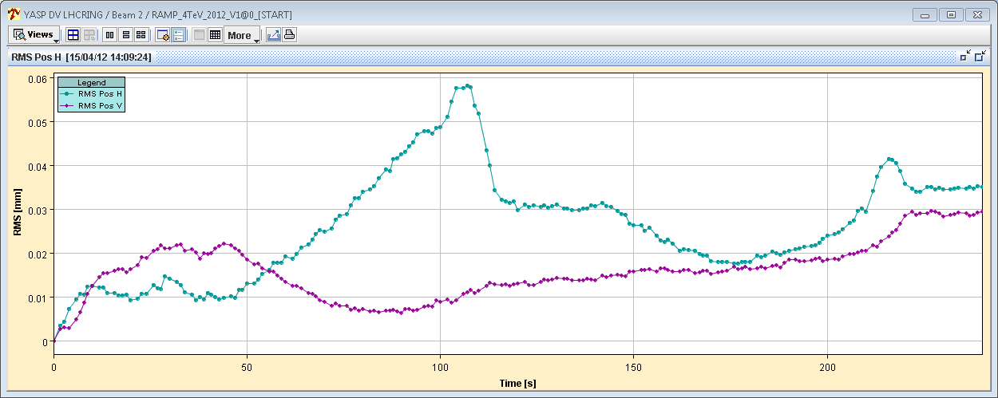
Orbit change in IR7 during collision BP
Before feed-forward
B1
50 μm
B2
50 μm
J. Wenninger

Slide 5
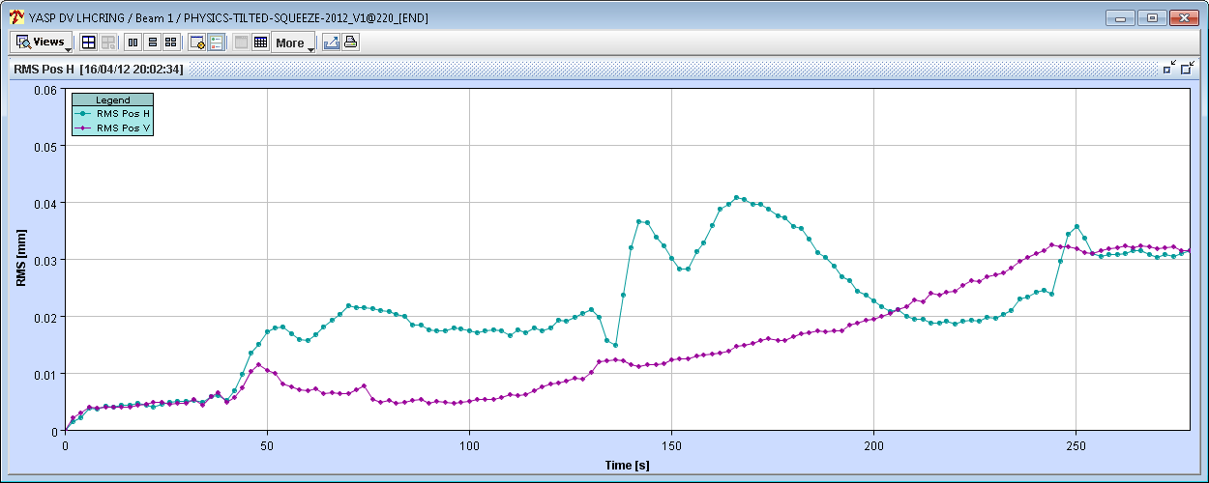
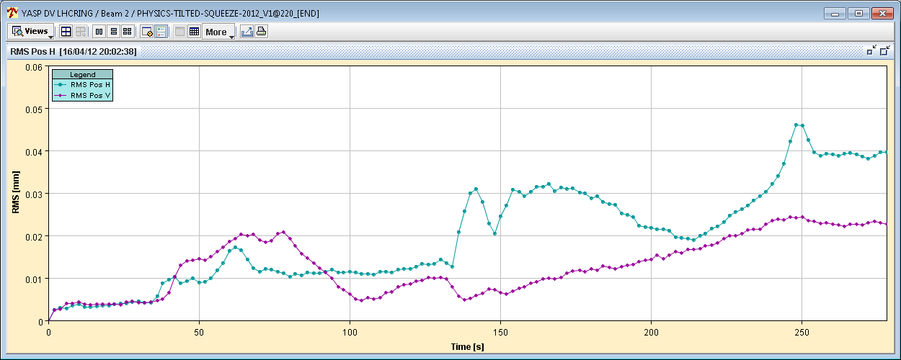
Orbit change in IR7 during collision BP
After feed-forward
50 μm
50 μm
J. Wenninger

Slide 6
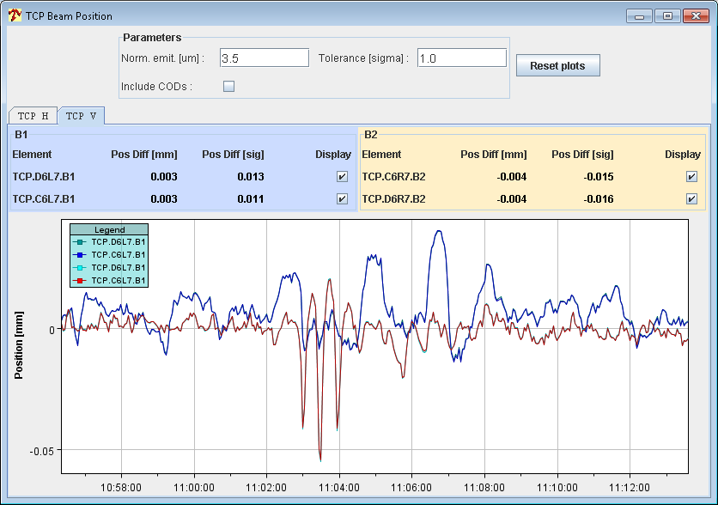
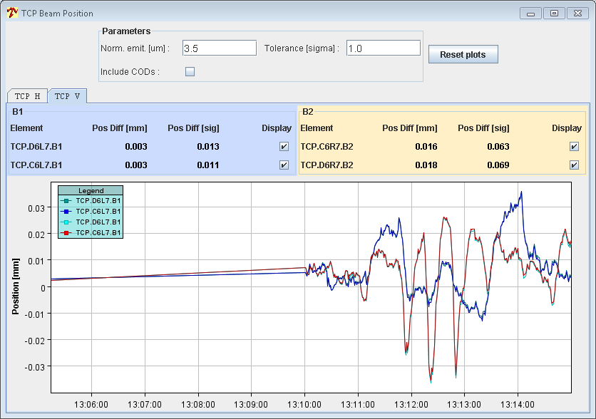
Orbit spikes during squeeze (3→2 m)
Amplitude of beam excursion spikes at B2 TCP (V plane) have been reduced by ~30-40%.
Tricky to correct – may try to flatten all corrections between 3m and 1.5m and restart on new basis (after TS1).
J. Wenninger

Slide 7
Tue 17.04.12
01:23 Beams dumped by EIC after some low pile up data for experiments.
03:17 Around 45min of inject and dump in bucket 31181 per both beams.
04:00 Prepare second fill for vdM scans.
06:22 Stable beams. vdM scans…

Slide 8
Planning Ahead
Tue 04:00 Second fill vdM scan
07:00 Start of vdM scans (LHCb and ALICE)
13:00 Dump and refill.
14:00 Abort gap cleaning at 4 TeV.
20:00 Physics with 1092b or 1380b.
Wed – Thu Physics with 1380b.
Fri 06:00 Start of LHC MD #1
Mon 06:00 Start of LHC technical stop (new software for orbit feedback)

Slide 9
2012 MD#1 Draft 1
Fri
06:00 – 07:00: end of fill study (tune scan, levelling, …)
09:00 – 12:00: 450 GeV: Longitudinal impedance
12:00 – 18:00: 450 GeV → 4 TeV: ADT (incl. fast blow-up test)
20:00 – 02:00: 450 GeV: BI (FBCT and BPM’s)
Sat
04:00 – 12:00: 450 GeV → 4 TeV: Collimation
14:00 – 22:00: 450 GeV: Injection: beam loss limitations towards nominal intensity
00:00 – 08:00: 450 GeV → 4 TeV: Aperture at the triplets
Sun
10:00 – 18:00: 450 GeV: RF batch by batch blow-up
18:00 – 23:00: 450 GeV → 4 TeV: BI (emittance cross calibration with ADT blowup)
01:00 – 06:00: 450 GeV → 4 TeV: ADT (tune compatibility)

