Slide 1
Thursday 20th April
01:53 RCBV17.R7B2 tripped as happened few days ago: SIS intercepted.
05:54 Stable beams, 1380b, still RF problems B1, abort gap cleaning.
10:09 Dump beam for RF investigations. Access needed for RF.
13:02 Lost communication with QPS on MB.A9L5. Access.
14:22 Access for QPS finished but nor beam from PS until 16:00.
16:03 Injecting probes.
18:23 Stable beams fill #2535, initial 5.4e33 (average). RF OK!
21:00 Start length scale calibration for Atlas & CMS, beam unstable: dumped.
21:34 Cryo FIP communication problem S34: mask during injection.
22:00 RCBV17.R7B2 tripped again, third time: leave off.
23:20 Reset undulator L4, trip, reset, lost cryo condition ML4
00:40 Injecting physics beam – TI8 power converter problem. Piquet.
04:52 Stable beams fill #2536, initial lumi 5.6e33 cm-2s-1

Slide 2
RF
With the measurements at SR4, we were able to correlate the debunching issues to abnormal noise levels in the RF reference signal of beam 1.
The RF reference is distributed from the surface at point 4 to the beam phase loop, all RF cavities, ADT, etc. The measurements without beam after the dump, helped us isolate the issue to the cables and modules distributing the reference signal to module 1-beam 1 in UX45.
Unfortunately, by the time we accessed the cavern, the issue disappeared. We preemptively replaced a few components, but not all modules to avoid introducing additional sources of error. We will continue monitoring over the next few fills.
However: it did the job !!!

Slide 3
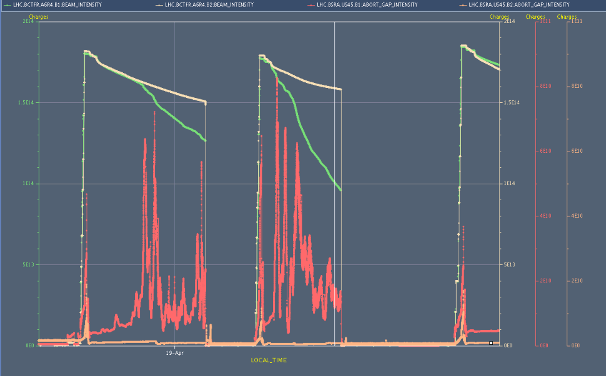
... resulting difference after fixing RF
Beam currents
Abort gap population

Slide 4
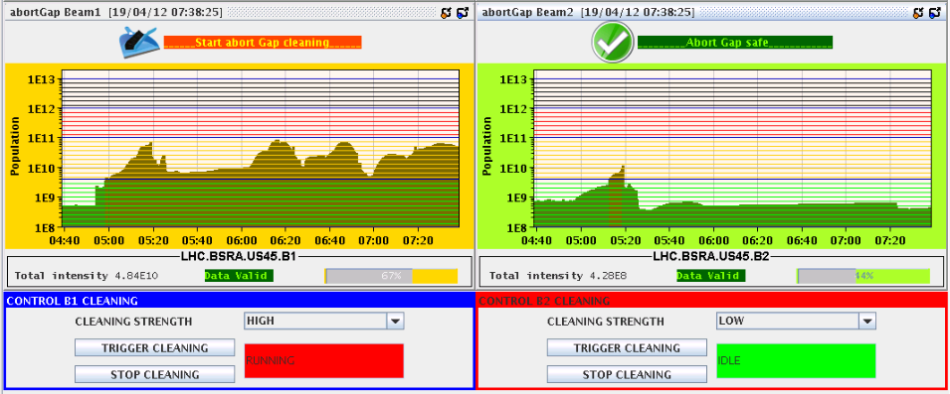
Abort Gap Cleaning
Allowed to keep the fill in during RF problems. Gained in efficiency!
Prevented from potentially dangerous situation of having to dump the beam with a “full” abort gap
With RF problem on B1
DUMP
Switched on cleaning for 1 min
No RF problem

Slide 5
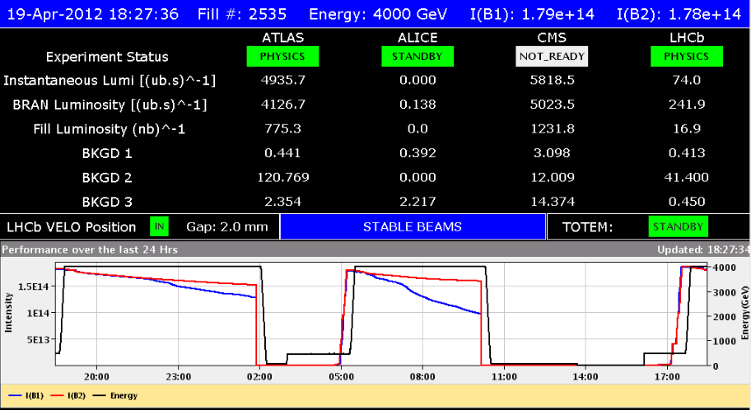
Fill #2535: Average init. Lumi of 5.4e33

Slide 6
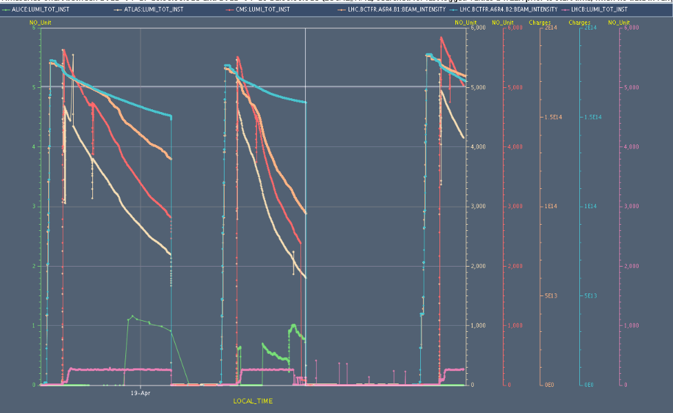
Fill #2535: Average init. Lumi of 5.4e33

Slide 7
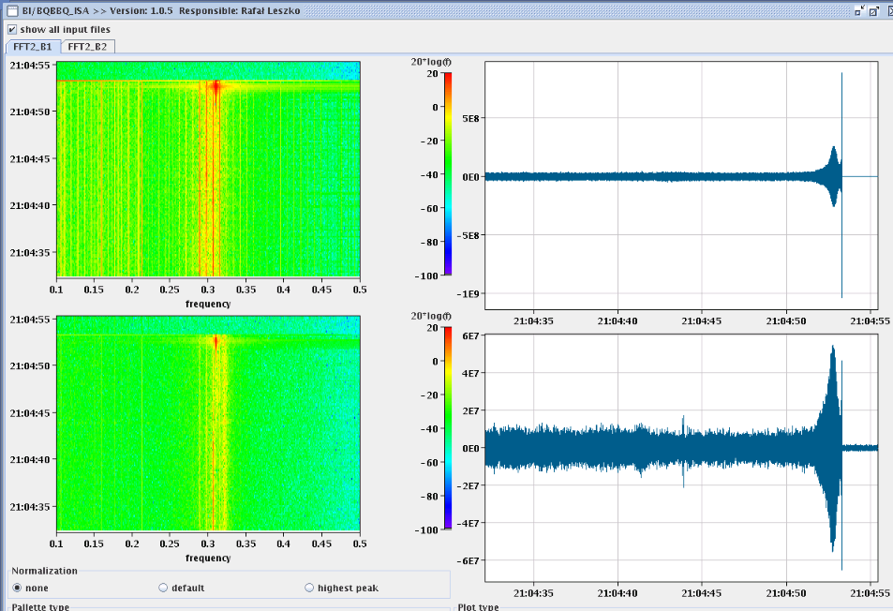
Start length scale calibration...
Apparent instability when separating the beams by 2.5sigma in Pt 1. This then caused a loss in RS_08 of BLM at the TCLA_D_L7B2. The instability was in both beams an both planes.

Slide 8
World FIP problem
21:34 Cryo FIP communication problem S34: mask during injection.
Pierre Charrue:
We are aware of the WFip repeater in RE38 problem and we are ready to exchange it if ever this decision is taken by Cryo this morning.
I will be in the CCC to organize this with the Cryo people if this will take place.
For the record, please note that this is the 6th repeater breaking since the last 3 years.

Slide 9
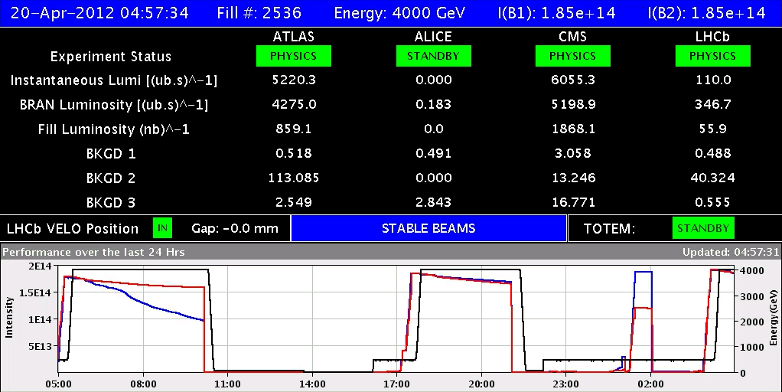
Present fill #2536
Average lumi 5.6e33 cm-2s-1

Slide 10
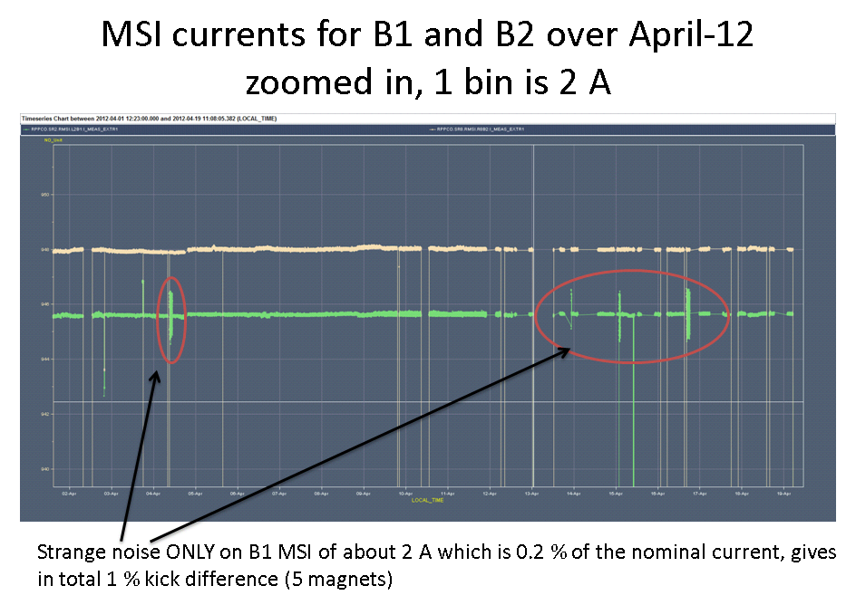
Injection steering problem B1 (W.Bartmann)
= what is needed to steer the line at the MSI
PC to be checked

Slide 11
The Plan
Fri Physics with 1380b
Length scale calibration will be after the Technical Stop during intensity ramp up
Sat 06:00 Start of LHC MD #1 (cut short by 1 day)
Mon 06:00 Start of LHC technical stop (new software for orbit feedback)

Slide 12
Updated of shortened MD Schedule
Sat
06:00 – 07:00 end of fill study (tune scan, …)
09:00 – 13:00 450 GeV: Longitudinal impedance
13:00 – 17:00 450 GeV → 4 TeV: ADT (no fast blow up)
19:00 – 00:00 450 GeV → 4 TeV: Collimation
Sun
02:00 – 07:00 450 GeV → 4 TeV: Aperture
09:00 – 17:00 450 GeV: RF batch by batch blow-up
17:00 – 23:00 450 GeV → 4 TeV: BI (emittance cross calibration with ADT blowup)
01:00 – 06:00 450 GeV → 4 TeV: ADT (tune compatibility)

