Slide 1
Friday morning
Dump fill due to the trip of the RQF.A78
intervention had been just planned for the morning on the circuit
Access, interventions:
RQF.A56/78, replacement of the faulty sub-modules;
TCDQ.B1, tightening of the clutch screw already done in the last days;
Investigation on ROF.A81B2 (QPS+ElQA+EPC), a power converter module was changed, but no clear evidence of the fault of the last days;
BE-BI accessing at point 4 to fix the LDM, the FBCT system C, the Schottky;
EN/EL to fix a problem on an open switch;
CO accessing to repair a broken Wiener alimentation on cfi-ua63-mkdpm2;
EPC depositing spare modules in UJ14 and UA63.

Slide 2
Friday afternoon
During the accesses, the thresholds of the warm magnets at point 7 were increased by a factor 2→
End of the access, started precycling…
14:00 Ready for beam but…
RF fault: klystron filament current incorrect
Access to fix the problem
Cleaning of Klystron filament contacts.

Slide 3
Threshold changes
All 48 monitors in family THRI_MQW (BLMs protecting warm quadrupoles) have their thresholds increase by a factor 2 in RS8-RS12 (integration windows from 0.8s and until 83s).
The monitor factor is reduced from 1.0 to 0.5 and the Master threshold is properly scaled to keep the applied thresholds at the same level as before the change.
Note that the applied thresholds are reduced from 23.17Gy/s to 11.58 in the integration windows of 2.5 ms and below due to the limit of the electronics.
Two TCLA monitors in IP7 (BLMEI.06R7.B1E10_TCLA.C6R7.B1 and BLMEI.06R7.B1E10_TCLA.D6R7.B1) have their monitor factor increased by a factor 2 (from 0.1 to 0.2).
Eduardo Nebot Del Busto

Slide 4
Friday afternoon
16:10 Beam in following access for RF
17:05 1092 bunches – very smooth injection
17:50 Stable beams Fill 2511
Initial luminosity in Atlas 3.78x10³³ cm⁻²s⁻¹
1.29e11 ppb
19:00 Internal fault of ROD.A12B1 converter. For coupling also ROF.A12B1 and RSF/D.A12B1 tripped.
Access required, RP piquet a wee way away, biometry didn’t work…
Precycle etc.
23:40 Injecting probes

Slide 5
Saturday morning
LINAC2 quadrupole problem
01:30 re-injecting
02:45 Squeeze
Hitting ~30% dump threshold on two BLM *TCLA*.L7.B2 between 2.5 and 2.0 m. Probably orbit.
03:08 Colliding
Hitting ~45% dump threshold on two BLM *MQWA*.L7
03:10 Stable beams - fill 2513
1.26e11 ppb
3.37 x 10³³ cm⁻²s⁻¹
(~2.6 micron from luminosity)

Slide 6
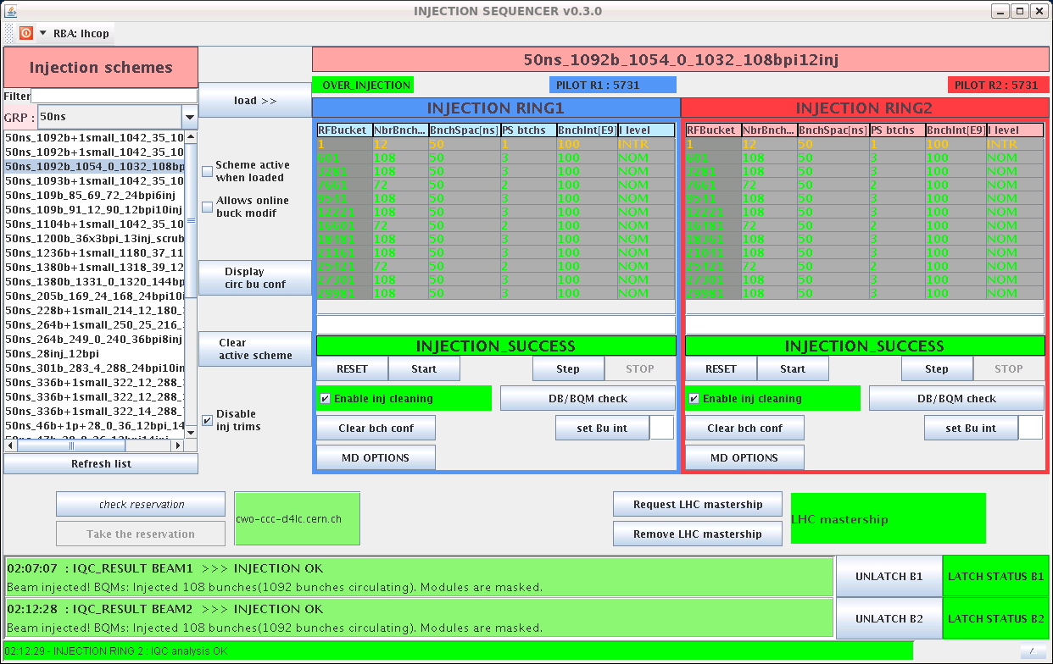
Injection

Slide 7
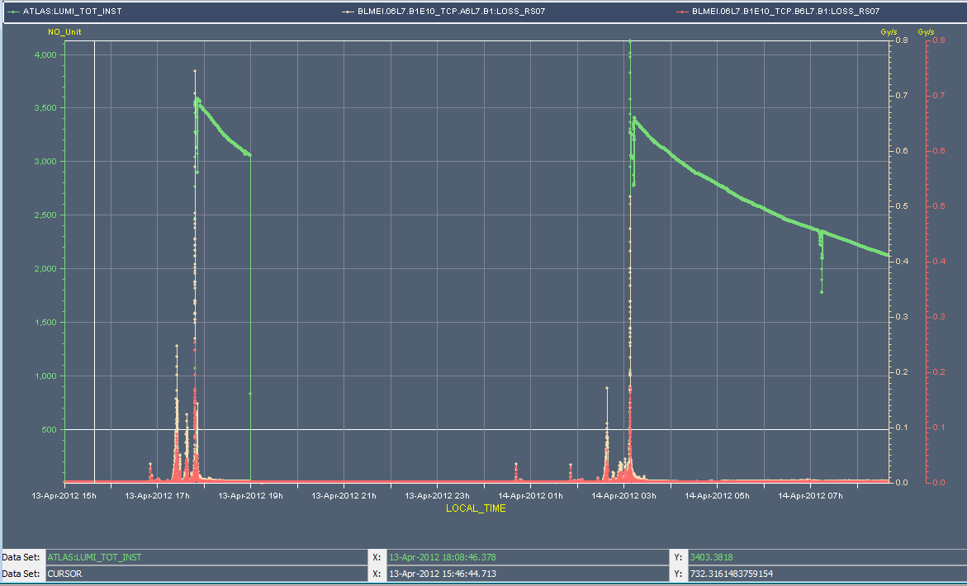
Beam loss spikes

Slide 8
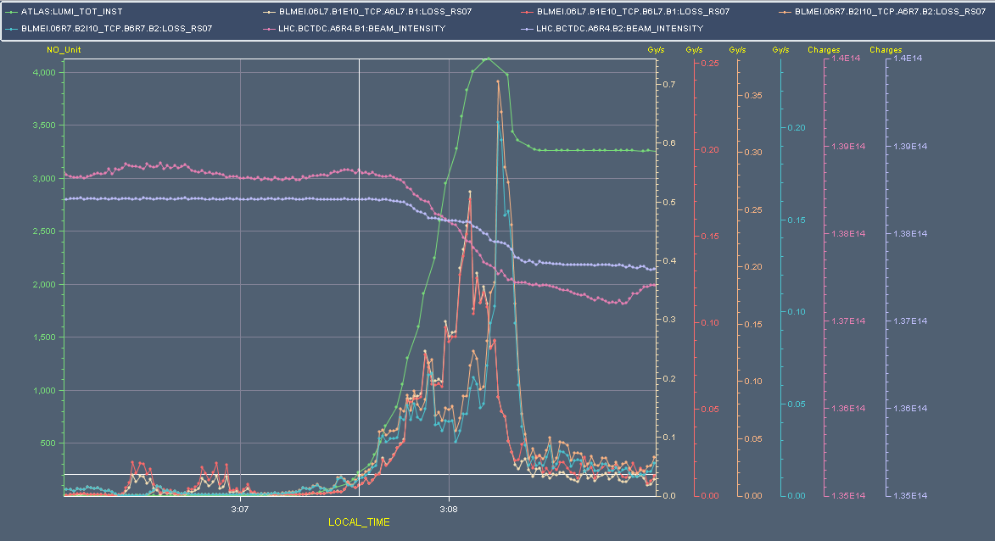
Collisions

Slide 9
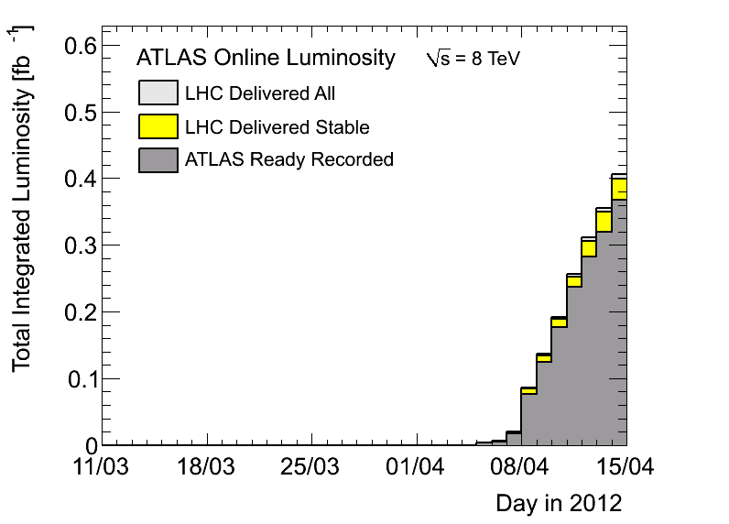
Performance

Slide 10
LBDS issue
We have had this morning (7h52) a partial “trip” of the UPS in point 6 (UA63) used in LBDS general purpose racks (lost of electrical power simultaneously in 8 racks).
The result of this UPS trip is that we have lost all our LBDS FECS (BETS, TSU, IPOC), the triggering system (Trigger fan-out) and re-triggering systems… EN/EL has had to intervene on the UPS to restart it.
Failure happened when there was no beam in the machine… and when some tests were done in the CCC on an electrical circuit in sector 56.
During the recovery phase, we have found a WIENER power supply broken (short-circuit on the mains input) in one of the two IPOC FECs. We have also found the rack UPS circuit breaker tripped.
Etienne Carlier

Slide 11
LBDS issue
Not clear for me if the WIENER power supply failure is the consequence of the UPS trip or if it is the failure of the power supply that has tripped the UPS. My feeling is that the second option is the most probable.
Such a failure with beam in the machine will result in an “asynchronous dump”. As it is the second time that we have this type of failure within the LBDS this year, I think it is worth to see how we can improve the protection of the electrical distribution system against WIENER power supply failure.
As it seems that there is no internal protection within the WIENER power supply (still to be confirmed by BE/CO) and that the selectivity of the different EN/EL protection (circuit breakers) to avoid a propagation of the short-circuit current up to the output protection of the UPS is not correct, I start to be worried to continue to operate the LBDS under such conditions and I don’t see “easy to implement” additional protections within our system

