Slide 1
Thursday 12th April - morning
One week since first stable beams in 2012
Machine in access for a problem on the injection kickers…
MKI2 problem – fuse - PFNs were properly charged but pulses were inhibited by the BETS system due to bad reading of PFN voltages. BEAM1 was not injected in the machine. (Etienne Carlier)
Alice dipole and solenoid back on
SPS kicker problem
Injection set-up with 108 bunches
Chiara Bracco & Wolfgang Bartmann
12:30 Filling for 840 bunches
Very good injections after the set-up, minimal losses.

Slide 2
Thursday 12th April - afternoon
13:35 Beams lost at end of squeeze
Vacuum interlock on tank 1 of the dump kicker (MKBH A and B magnets).
Glitch of the interlock that lasted only 8 seconds.
Start of a ion pump in the B1 kicker tank 1…
15:12 Ramp started
16:00 Stable beams – fill 2508
Initial luminosity 2.83e33 cm⁻²s⁻¹ in Atlas
1.29e11 ppb, Nc =807
(2.5 microns at 60 cm gives ~2.8e33 cm⁻²s⁻¹)
22:13 Beams dumped
FMCMs 3 & 7
La perturbation est liée à un déclenchement monophasé sur la ligne 400kV numéro 2 Charpenay - Echallas. L'origine du déclenchement est pour le moment inconnue.

Slide 3
Thursday night – Friday morning
01:20 Stable beams Fill 2509
Separated CMS by 46 um to reach 615 hz/ub
07:05 Beams dumped
problem on the power converter of RQF.A78.
Preparing for access (~3 hours)

Slide 4
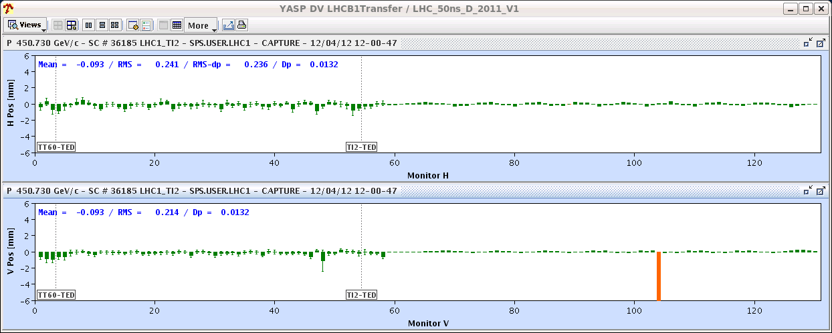
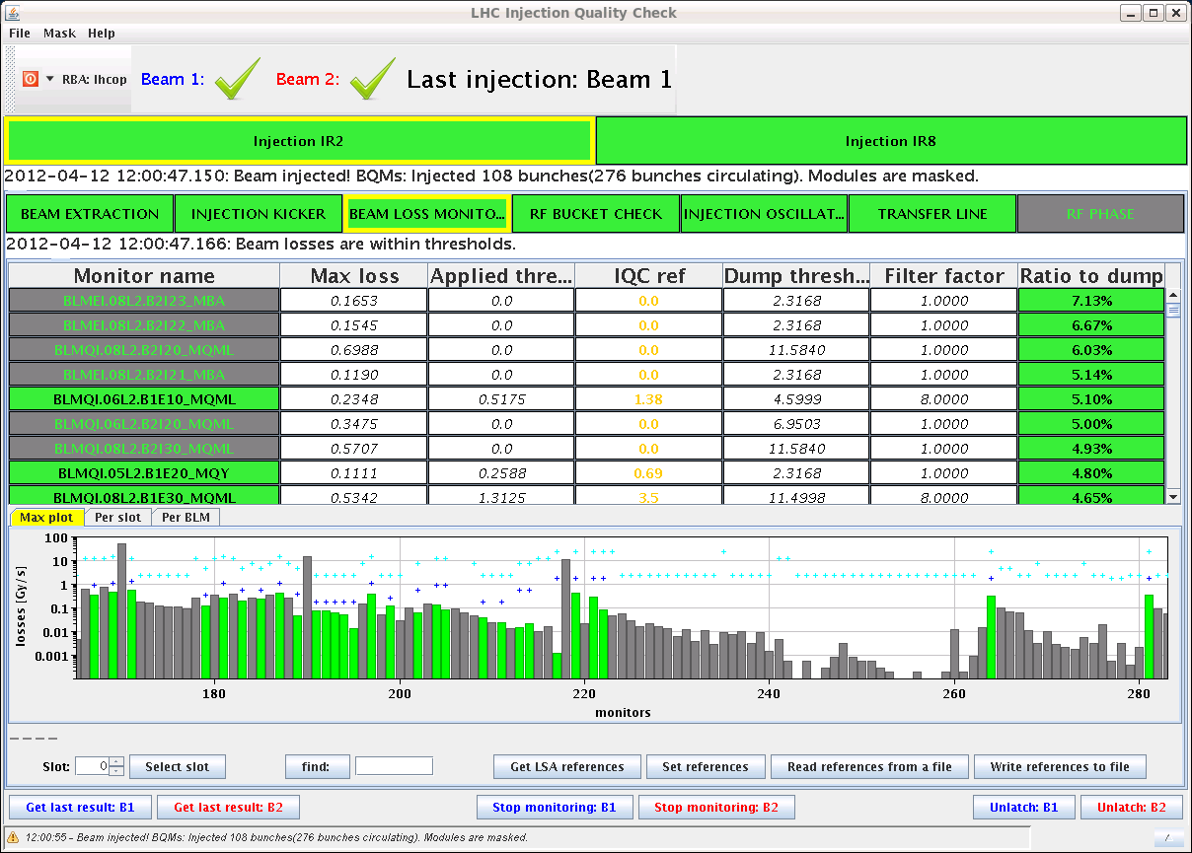
TL/injection steering

Slide 5
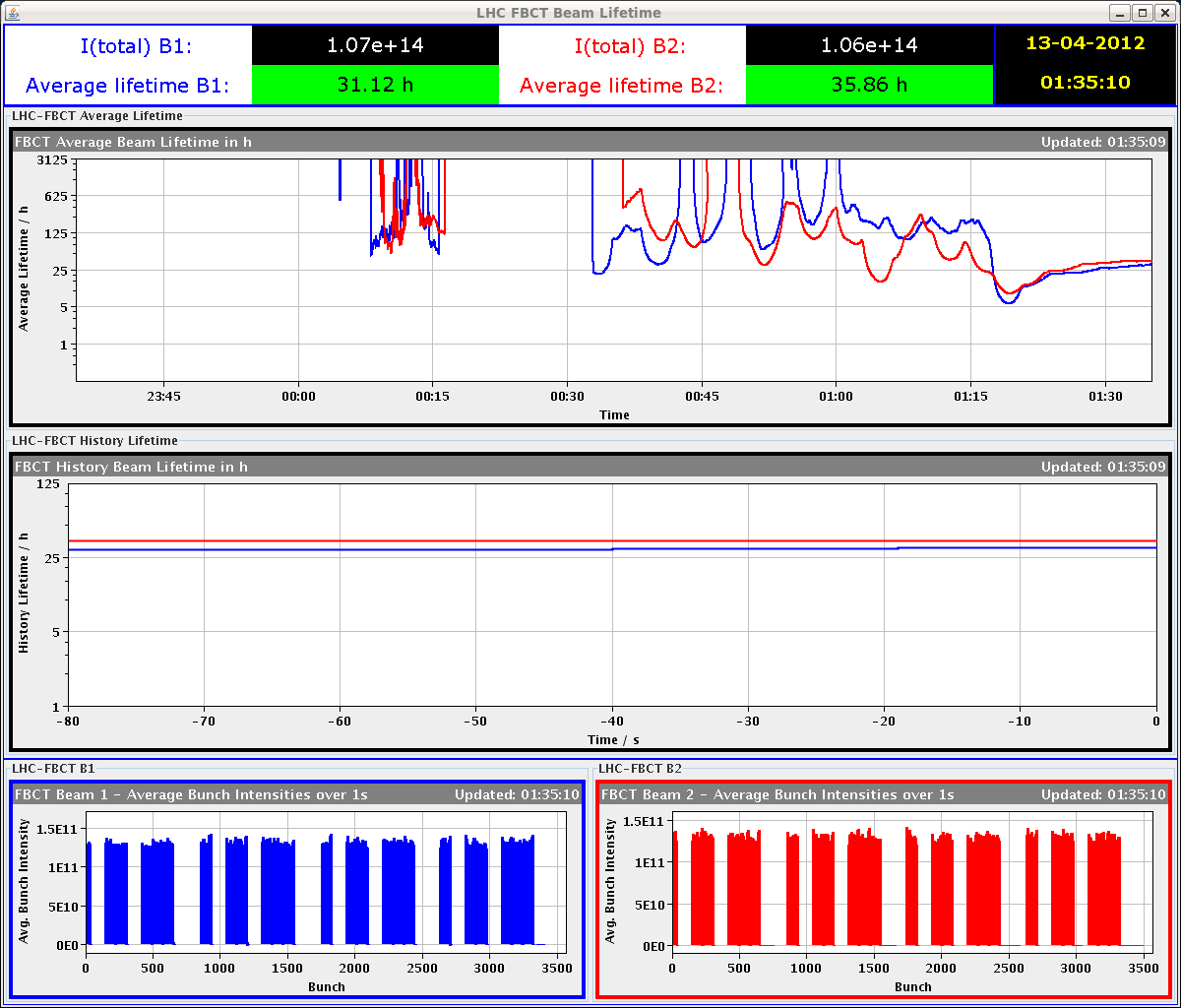
Lifetime in ramp & squeeze

Slide 6
SMOG
The LHCb SMOG test performed by Gerhard and Didier has been successful,
We started at 14h50 and ended at 15h50.
The VELO pressures before (1e-9 mbar) during (4.5e-8 mbar) and after (2e-9 mbar) the gas injection were as expected.
The LHC started the beam injection during our procedure and we stopped the gas injection when the beam reached 4 TeV, this was fully transparent for the LHC.

Slide 7
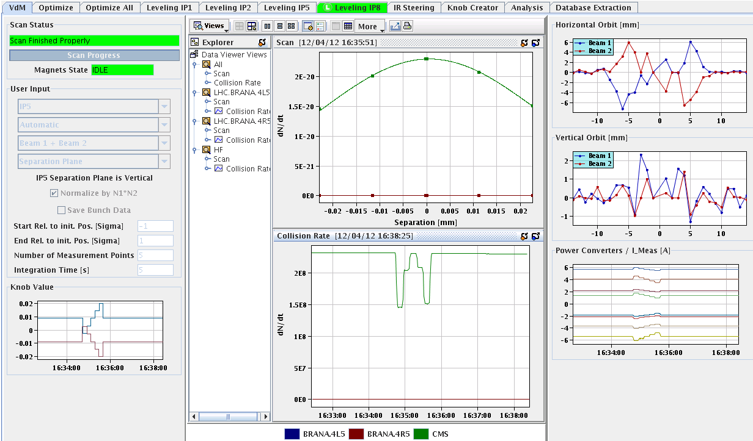
Mini VdMs
 | Scan sigma – Gaussian fit [e-2 mm]
5H Crossing | 3.14 (Bran R) 3.18 (HF)
5V | 2.40 (Bran R) 2.43 (HF)
1H | 2.47 (Bran L) 2.49 (Bran R) 2.52 (BCMand)
1V Crossing | 3.20 (Bran L) 3.22 (Bran R) 3.23 (BCMand)
2.5 mm.mrad→ sigma 19 micron
~13 micron lumi region width
~ 26 micron scan width

Slide 8
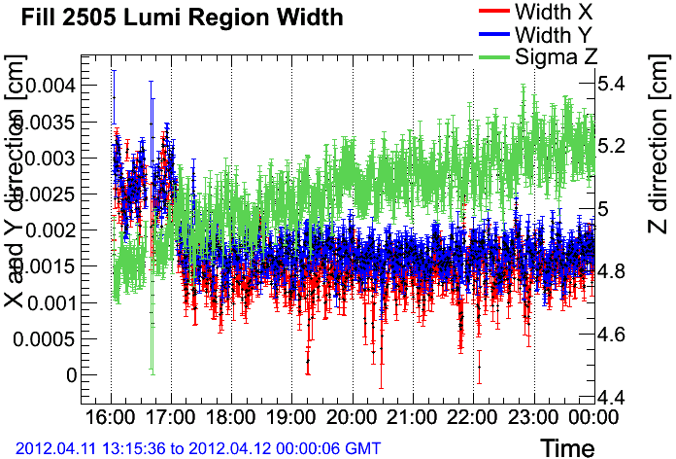
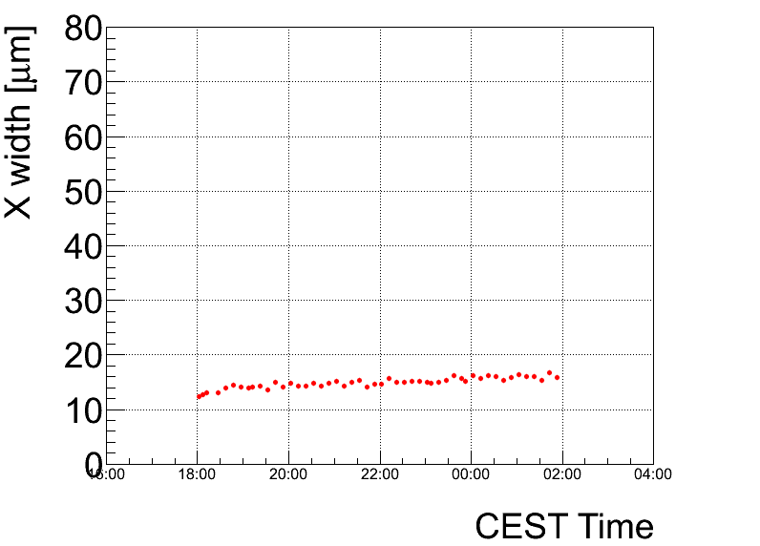
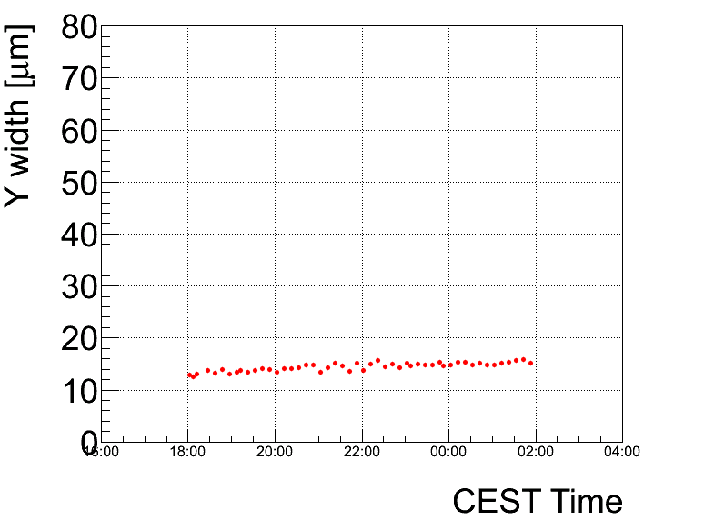

Slide 9
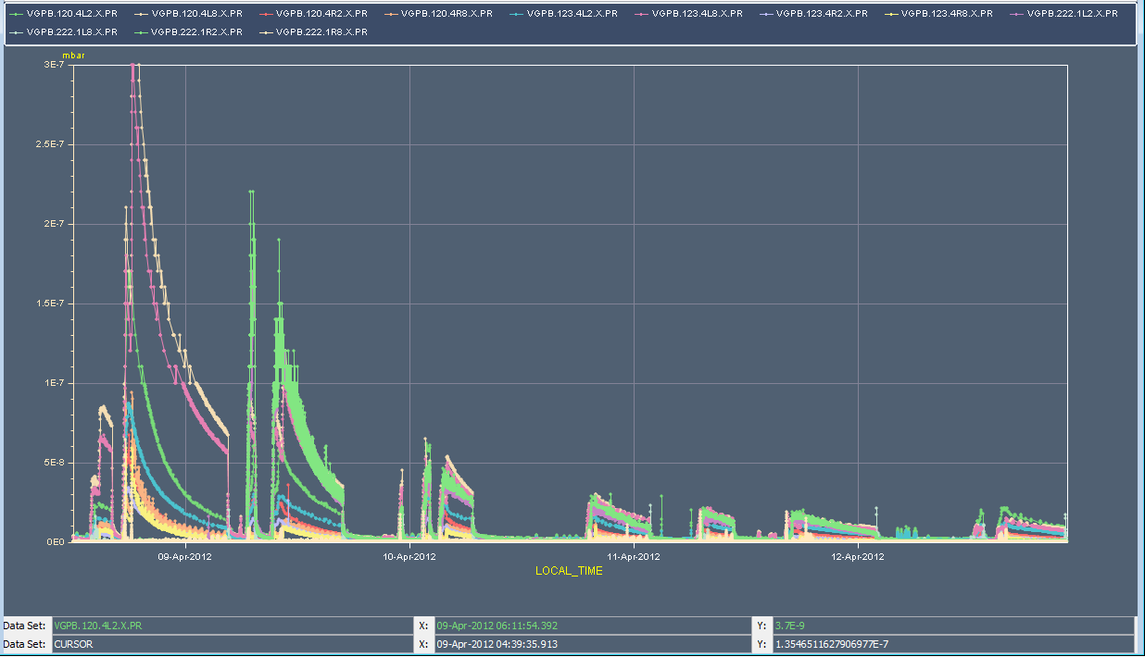
Vacuum last fills

Slide 10
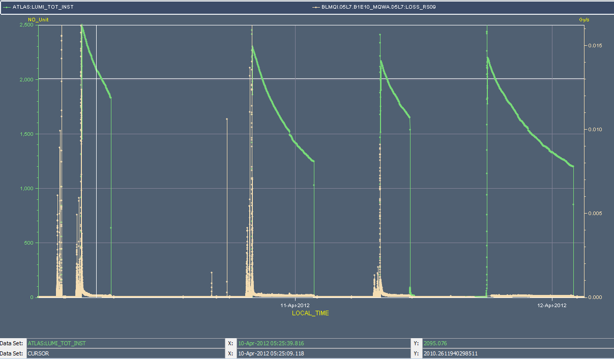

Slide 11
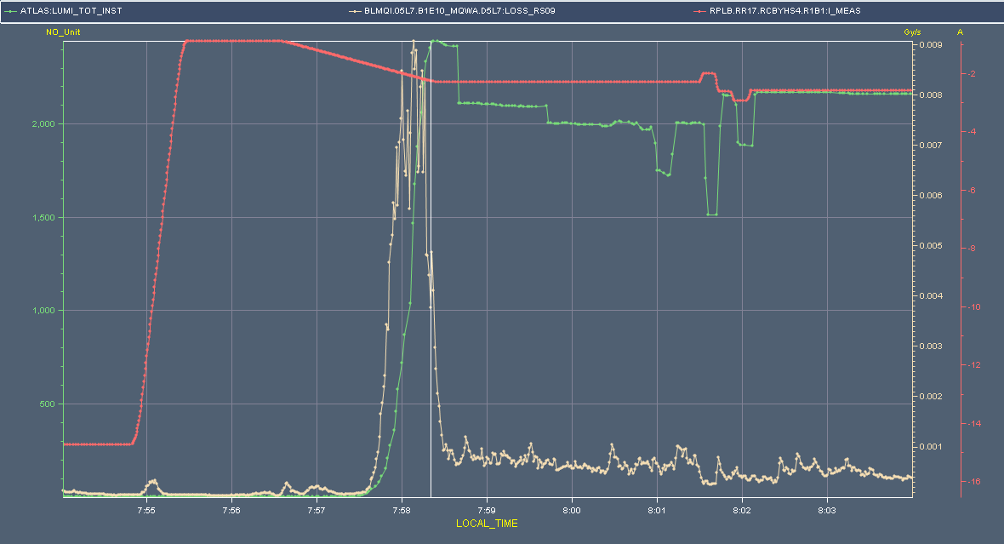
Collisions – point 1

Slide 12
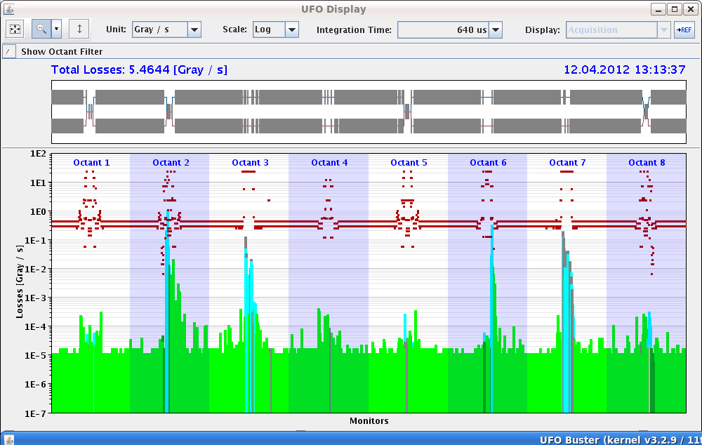
UFOs
MKI > 20% of dump threshold

Slide 13
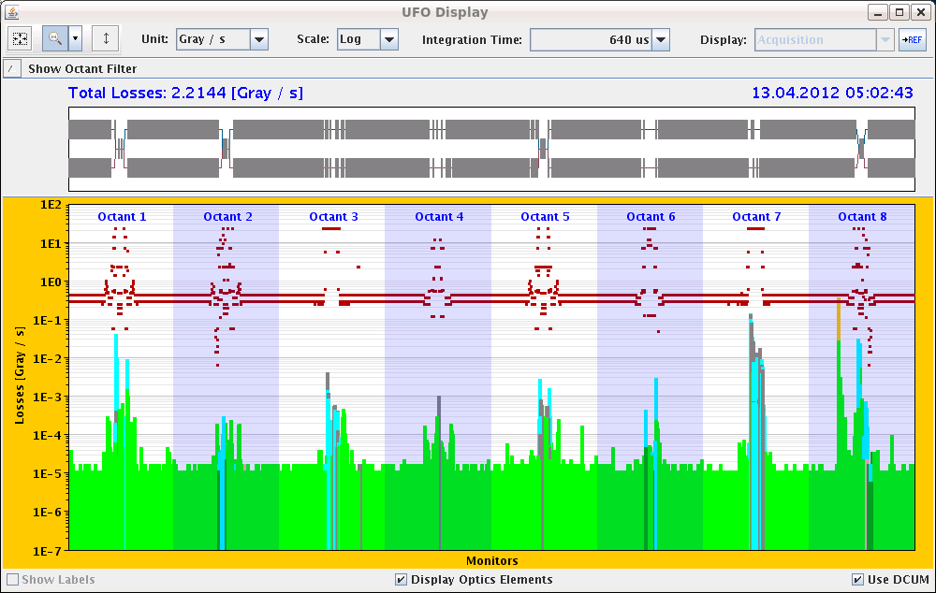
UFO – 92% dump threshold – this morning

Slide 14
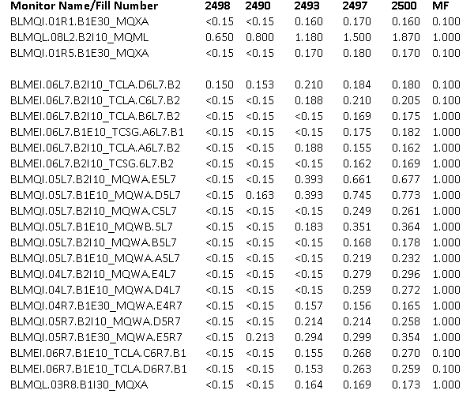
Today
Access this morning
Looking for approval for 1092 bunches (Rudiger)
BLM thresholds MQWA/TCLA point 7 to be raised (MZ, ENdB)
Steady running…

Slide 15
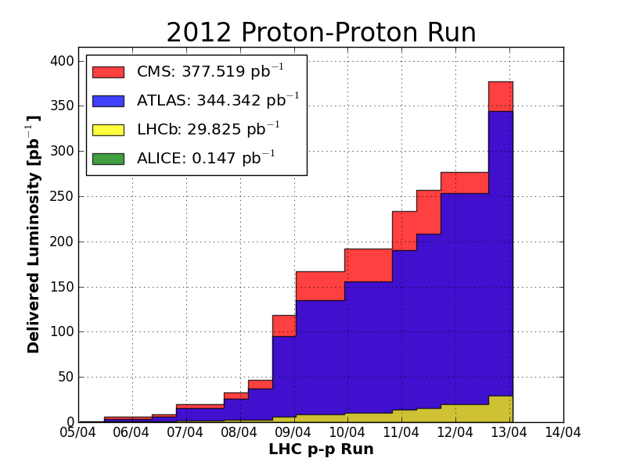

Slide 16
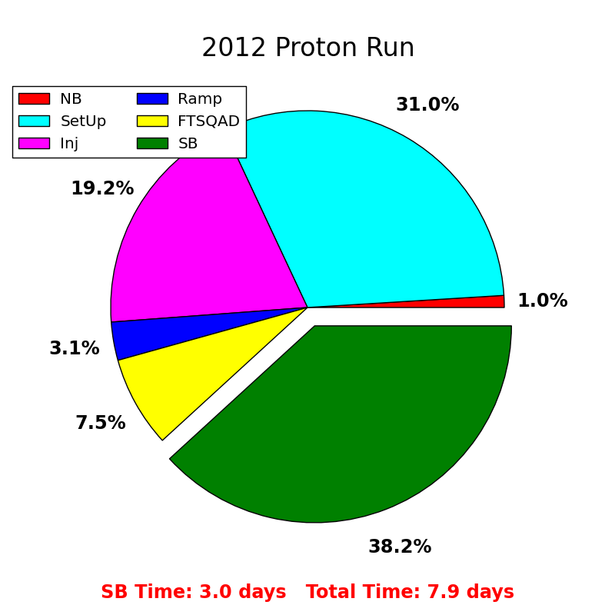

Slide 17
