Slide 1
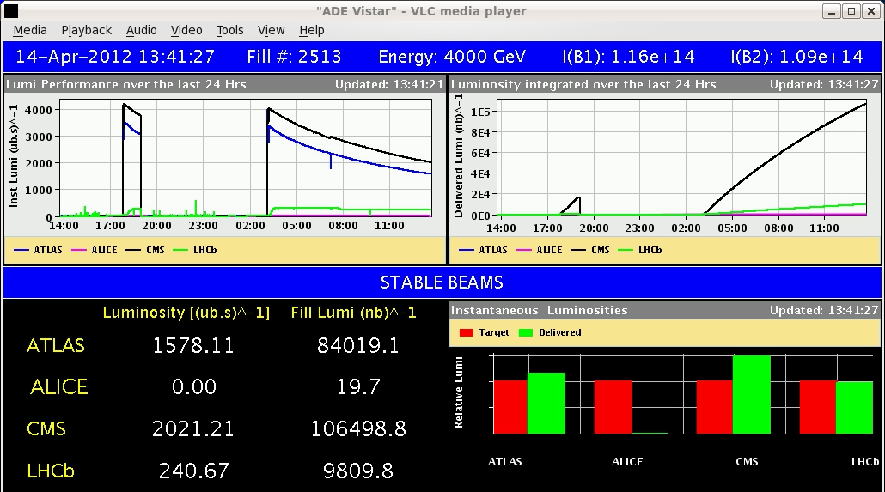
LHC Status Sun Morning 15-April
Bernhard Holzer, Mike Lamont
Saturday Morning:
08:00h Stable beams
13:40h Scheduled Dump at
50% init. Luminosity
15:00h new injection for physics
Np = 1.3*10¹¹
Ramp done without chirp,
β*=2m in IP1/5 passed without BLM warnings!!
very smooth procedures !!

Slide 2
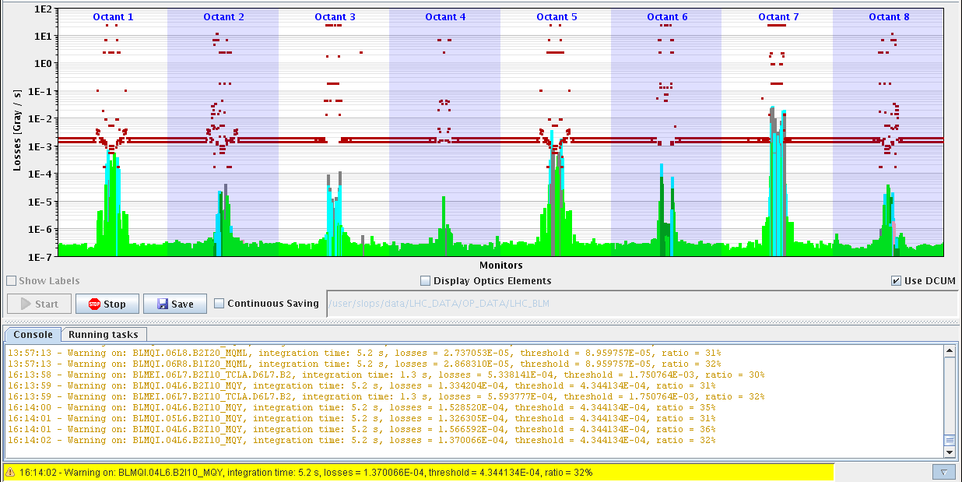
Sat Late
16:14h Luminosity
again: smooth, no problem
Losses during collisions beam process up to 36% max and for very short time!
36%

Slide 3
Sat Late
16:17 Lumi Optimisation
lifetime ... during squeeze / ... during adjust
some issues:
RQS.L7B2 lost the QPS OK (board to be changed).
RB.56 lost the QPS OK

Slide 4
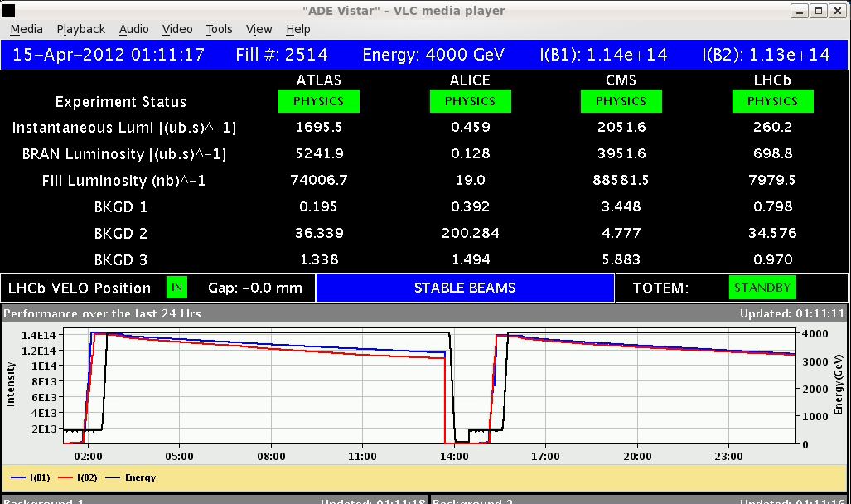
Sat Night
01:15h stable beams & scheduled dump

Slide 5
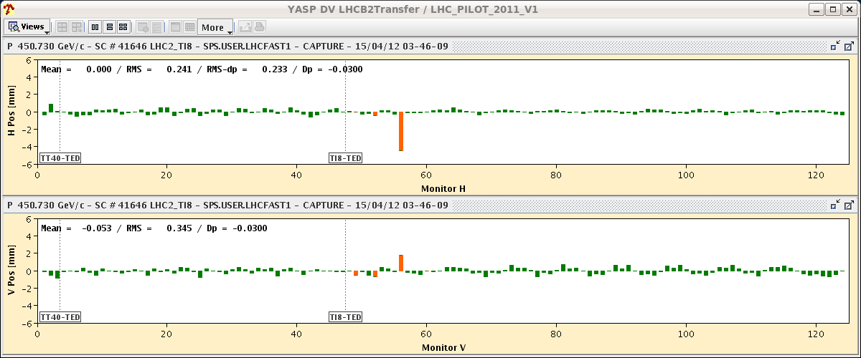
Sat Night
some issues: TDI.B2 didn't move to PARKING
ROF.A81B2 tripped (EE switch)
03:46h injection
... lovely ... in the beginning
BUT:
04:47h beam dump during injection

Slide 6
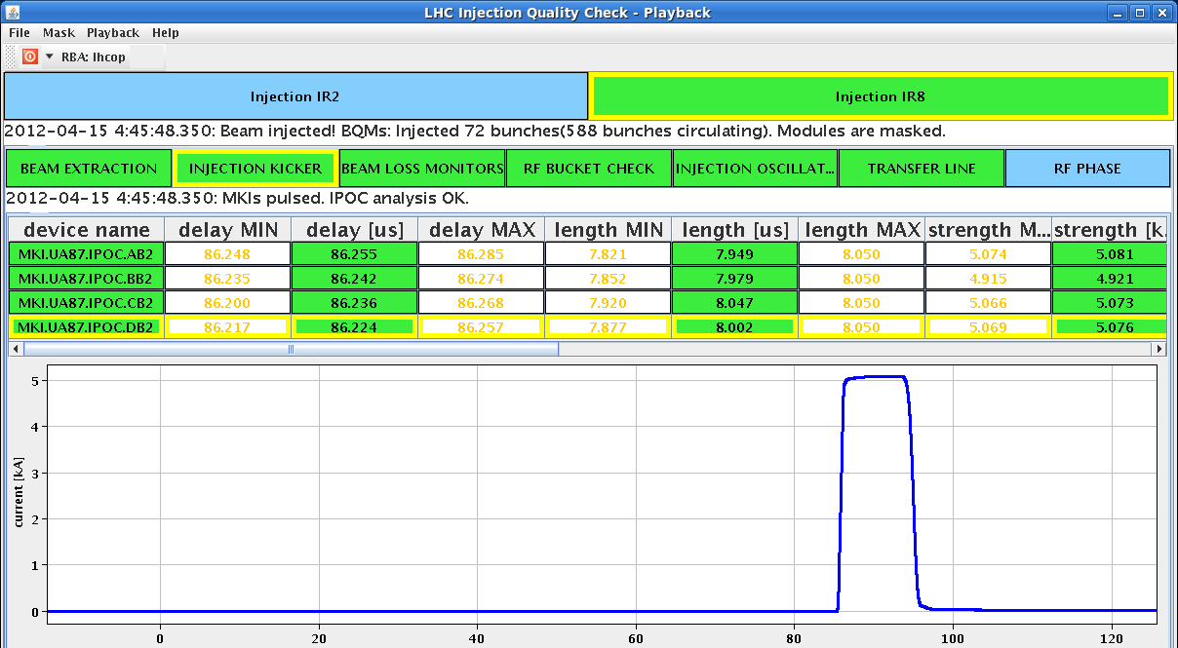
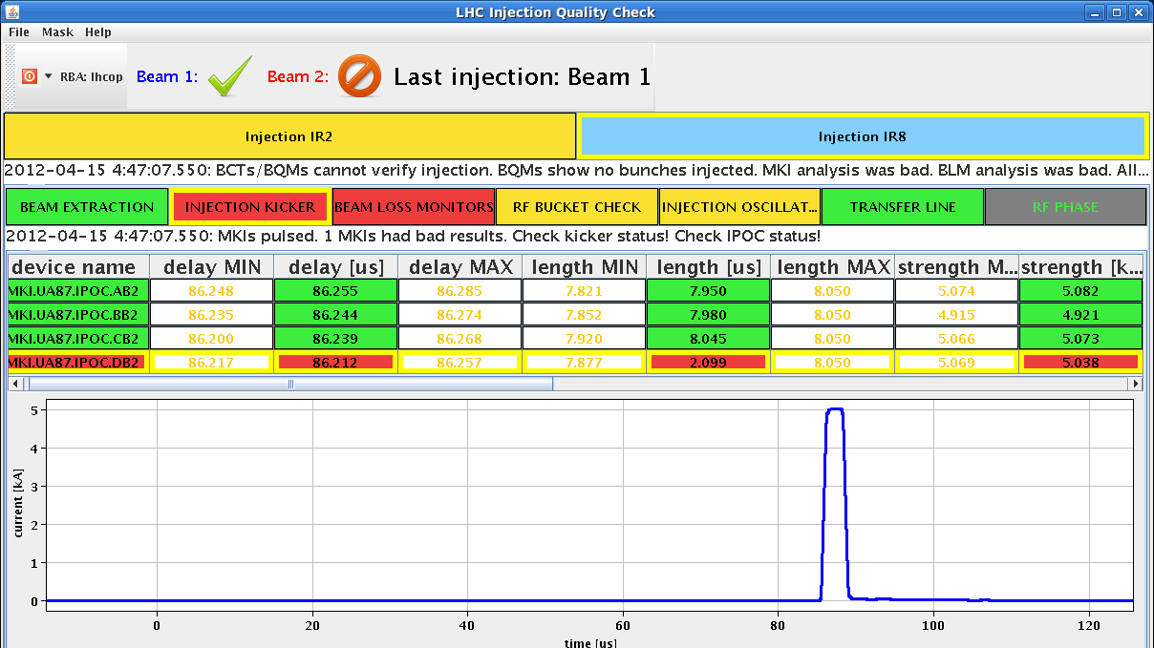
Sat Night
04:47h Pulse length of Injection Kicker MKID2 Beam2 is too short
Laurent Ducimetiere / Mike Barne break down of kicker field
last event, same kicker: 6 days ago (Easter Monday)
extended soft start performed,
experts checked situation (Kicker, Vacuum, Cryo, Magnets)

Slide 7
Sat Night
losses during injection
dump threshold

Slide 8
Sun Morning
The vacuum piquet:
During the failed injection a pressure rise triggered the valve closures.
present status: all valves and pumps which had tripped are back on and the
pressures are recovering.
Cryo: S78 and IT XR8 tripped, several quenches
lost cryo condition for arc in S81 ... which recovered meanwhile
Magnets: checked by Arjan, ok
Kickers: checked by Laurent Ducimetiere/ Mike Barnes
ok for restart

Slide 9
Sun Morning
still ...
Plan of the day: stable beams with 1092 bunches

