Slide 1
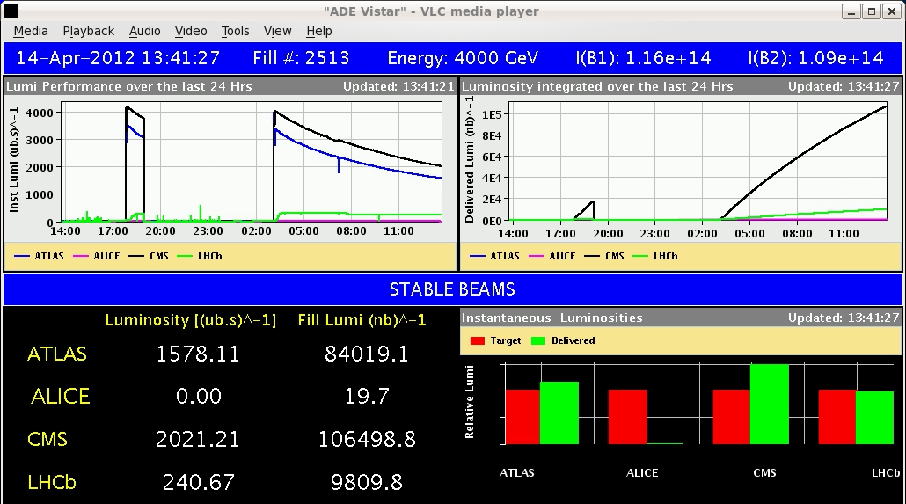
LHC Status Mon Morning 16-April
Bernhard Holzer, Mike Lamont
Saturday Morning:
08:00h Stable beams
13:40h Scheduled Dump at
50% init. Luminosity
15:00h new injection for physics
Np = 1.3*10¹¹
Ramp done without chirp,
β*=2m in IP1/5 passed without BLM warnings!!
very smooth procedures !!

Slide 2
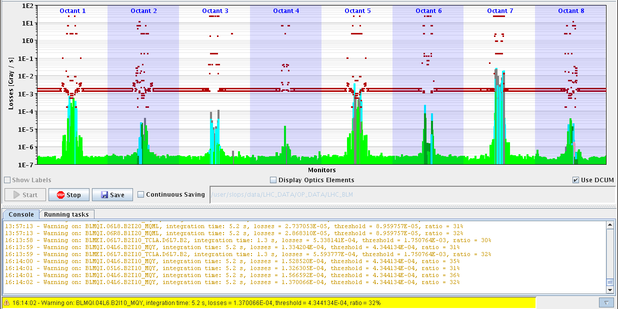
Sat Late
16:14h Luminosity
again: smooth, no problem
Losses during collisions beam process up to 36% max and for very short time!
36%

Slide 3
Sat Late
16:17 Lumi Optimisation
lifetime ... during squeeze / ... during adjust
some issues:
RQS.L7B2 lost the QPS OK (board to be changed).
RB.56 lost the QPS OK

Slide 4
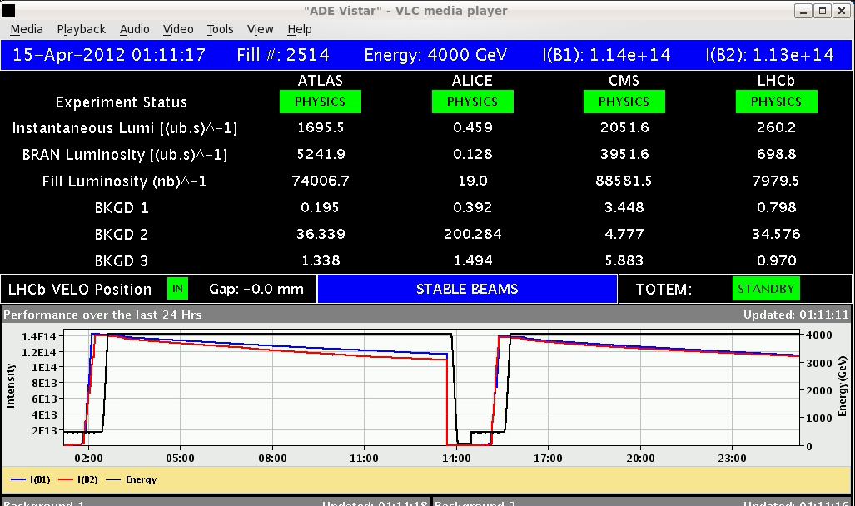
Sat Night
01:15h stable beams & scheduled dump

Slide 5
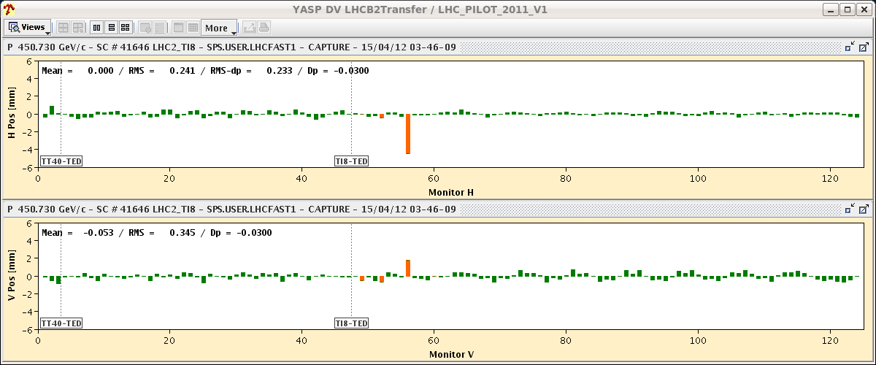
Sat Night
some issues: TDI.B2 didn't move to PARKING
ROF.A81B2 tripped (EE switch)
03:46h injection
... lovely ... in the beginning
BUT:
04:47h beam dump during injection

Slide 6
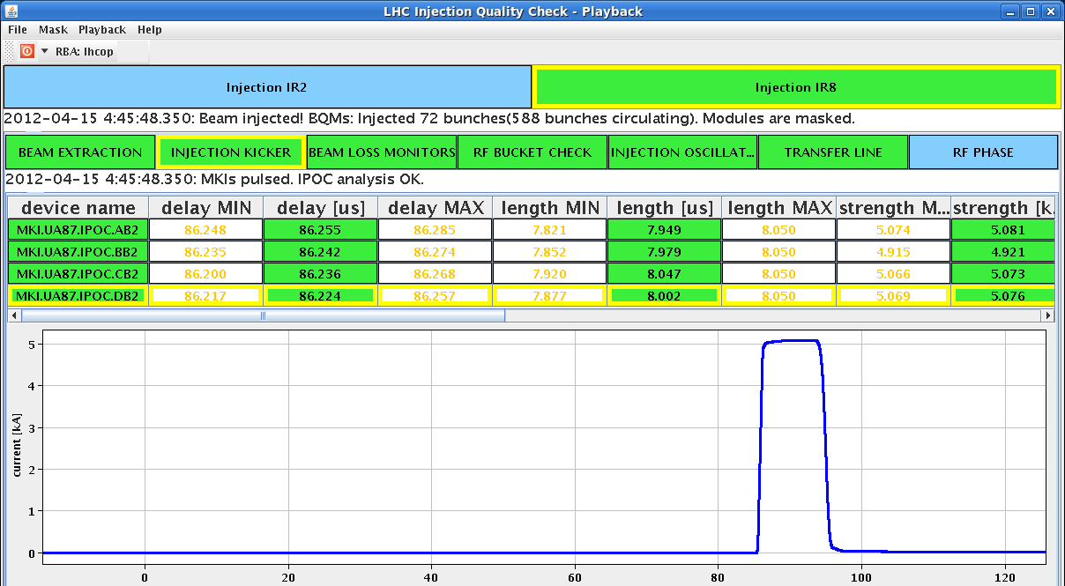
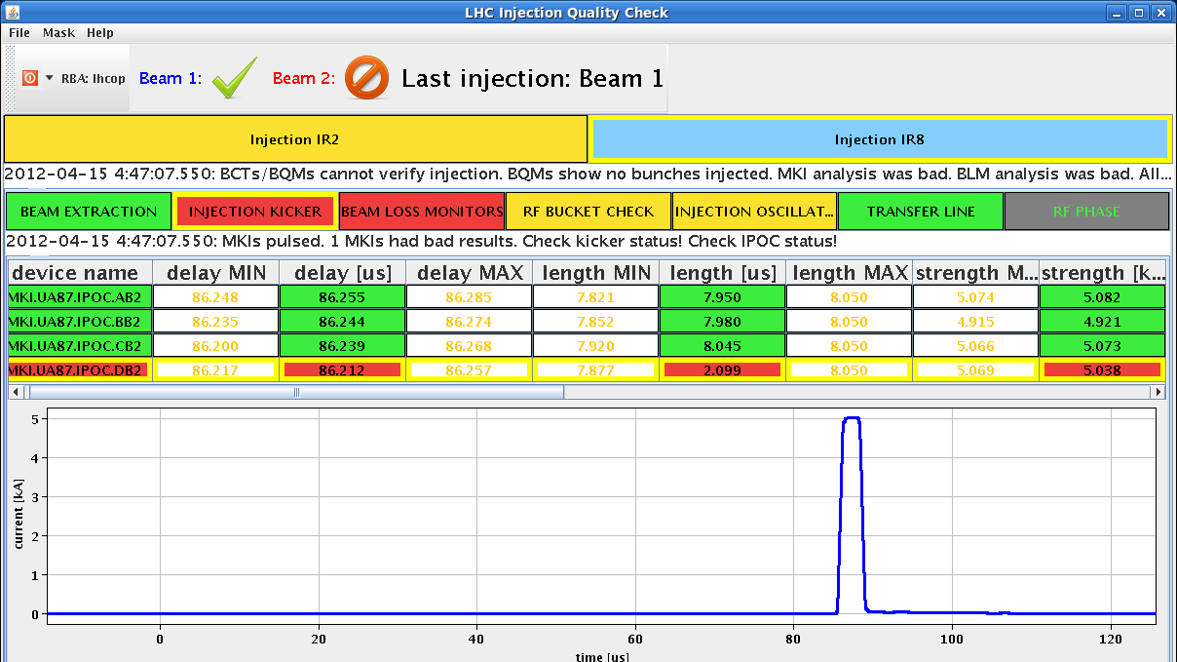
Sat Night
04:47h Pulse length of Injection Kicker MKID Beam2 is too short
Laurent Ducimetiere / Mike Barne break down of kicker field
last event, same kicker: 6 days ago (Easter Monday)
extended soft start performed,
experts checked situation (Kicker, Vacuum, Cryo, Magnets)

Slide 7
Sat Night
losses during injection
dump threshold

Slide 8
Sun Morning
The vacuum piquet:
During the failed injection a pressure rise triggered the valve closures.
present status: all valves and pumps which had tripped are back on and the
pressures are recovering.
Cryo: S78 and IT XR8 tripped, several quenches
lost cryo condition for arc in S81 ... which recovered meanwhile
Magnets: checked by Arjan, ok
Kickers: checked by Laurent Ducimetiere/ Mike Barnes
ok for restart

Slide 9
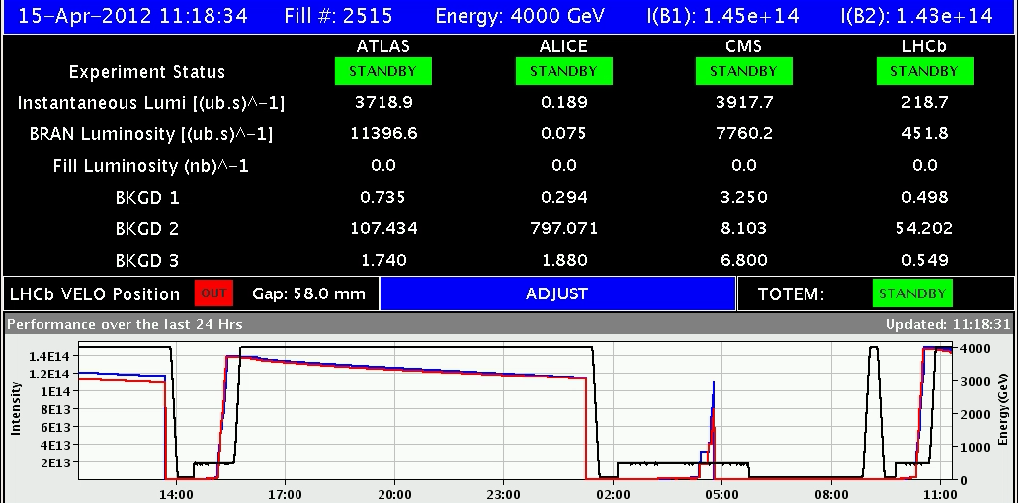
Sun Morning/Late
08:30h restart, precycle
10:00h injection
13:15h stable beams
23:00h scheduled dump
(minor) problems during pre-cycle:
“TDI.4R8 has interlocks ... that disappear after some reset (?)
Intervention on ROF.A81B2 (Access): MPE-piquet exchanged the switch on the EE system.
05:30h restart, precycle

Slide 10
Mon Morning
07:00h prepare machine with special filling scheme (Benedetto)
* VdM scans
* Abort Gap Cleaning test
* ? flip LHCb Polarity ?
Restart -> 1380

Slide 11
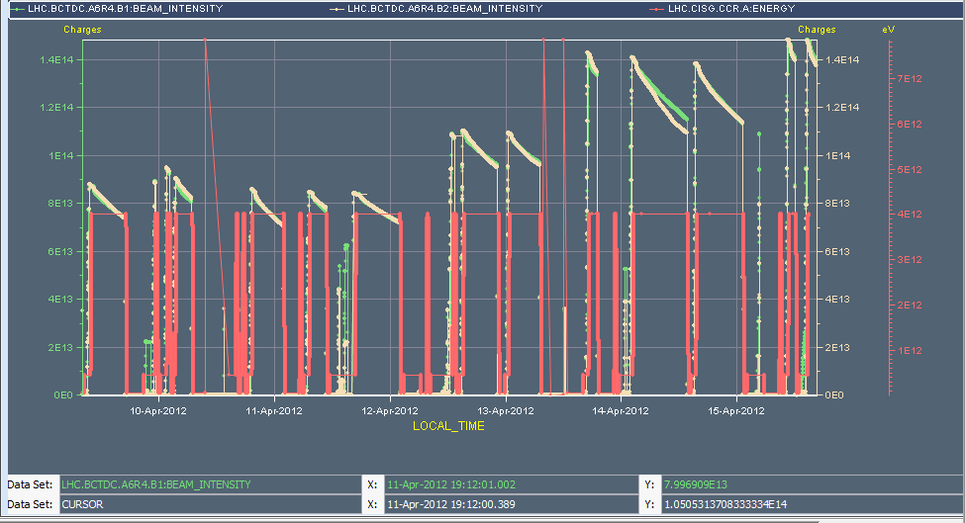
Week 15
1092
840
624

Slide 12
Week 15
Summary:
keep single bunch intensity on a level of N_{p} = 1.3*10 ¹¹ bunch number increased in steps
2-3 fills and 4-6 hours with 48b, 84b, 264b and 624b (cycle validation)
3 fills and 20 hours with 840b, 1092b, 1380b
Bunches | Max number of bunches injected | Alice
3 | 1 | Main-main
48 | 12 | Main-satellite
84 | 36 | Main-satellite
264 | 36 | Main-satellite
624 ✔ | 72 | Main-satellite
840 ✔ | 108 | Main-satellite
1092 ✔ | 108 | Main-satellite
1380 | 144 | Main-satellite

Slide 13
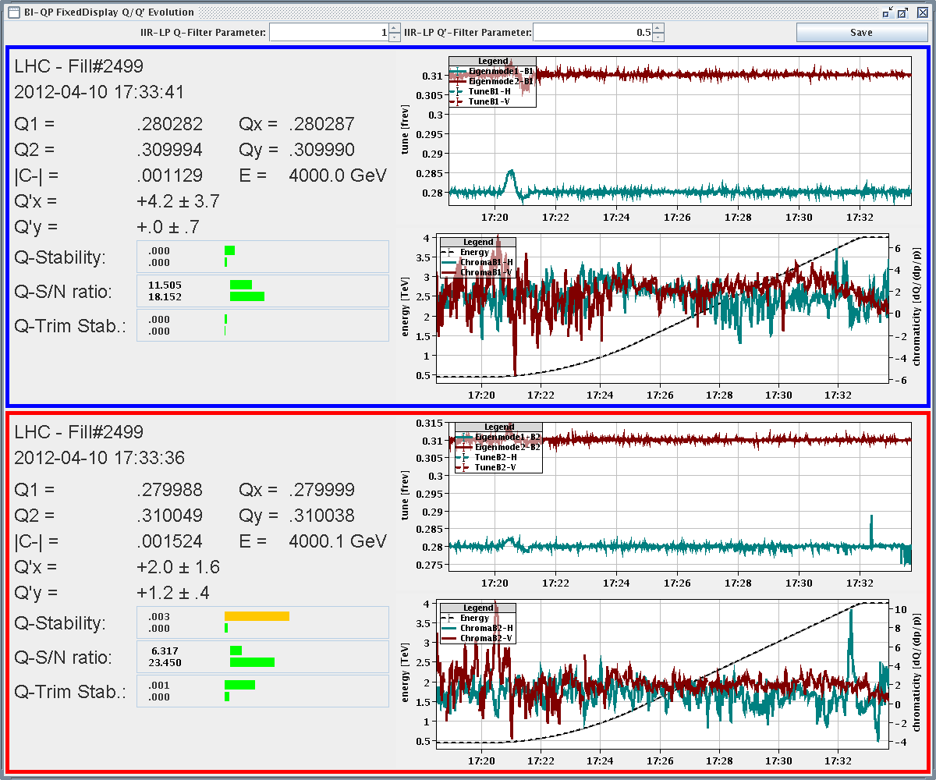
Week 15
Q & Q’ on ramp

Slide 14
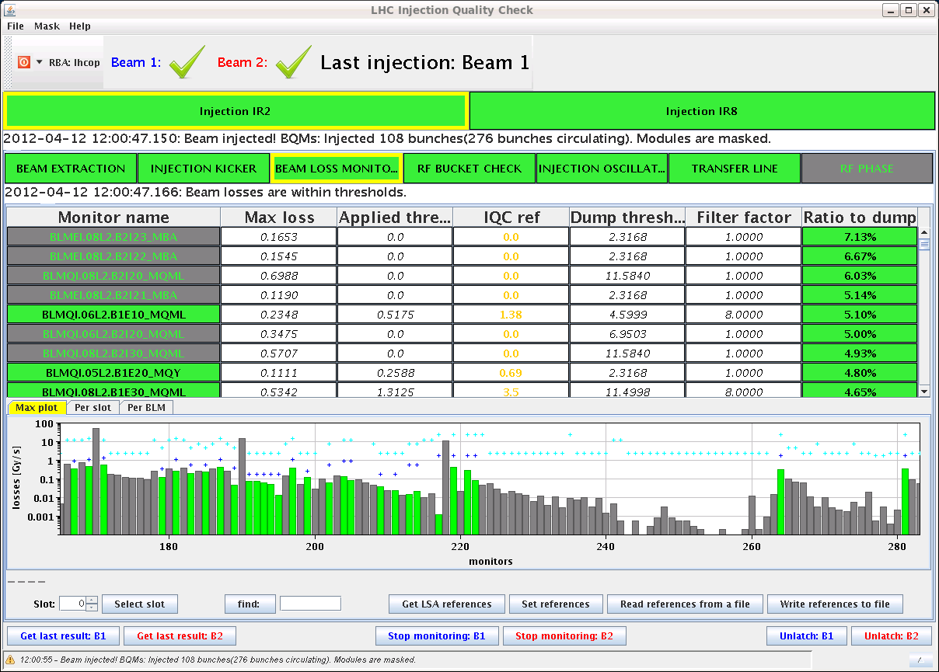
Week 15
Transfer Line Steering:
Injection set-up with 108 bunches
Chiara Bracco & Wolfgang Bartmann

Slide 15
Week 15
Main Hick-ups
TCSG.5L3.B1 (Tue morning) mechanical problem with a roller screw
blocked at inj. position, loss maps to validate: ✔
Up to 77 % of dump threshold during collisions BP
in general: lifetime “dips” during squeeze & adjust
Lift horizontal tunes to nominal before collisions – losses down to 42% of dump threshold going into collisions
Raise thresholds of long RSs of MQWA BLMs

Slide 16
Threshold changes
All 48 monitors in family THRI_MQW (BLMs protecting warm quadrupoles) have their thresholds increase by a factor 2 in RS8-RS12 (integration windows from 0.8s and until 83s).
The monitor factor is reduced from 1.0 to 0.5 and the Master threshold is properly scaled to keep the applied thresholds at the same level as before the change.
Note that the applied thresholds are reduced from 23.17Gy/s to 11.58 in the integration windows of 2.5 ms and below due to the limit of the electronics.
Two TCLA monitors in IP7 (BLMEI.06R7.B1E10_TCLA.C6R7.B1 and BLMEI.06R7.B1E10_TCLA.D6R7.B1) have their monitor factor increased by a factor 2 (from 0.1 to 0.2).
Eduardo Nebot Del Busto

Slide 17
Week 15
Main Worries:
MKID Beam2 HV break down, only 25% pulse length
UPS in point 6 (UA63) used in LBDS general racks
→ asynchr. dump
OFSU: problem of “zero references”
Check Orbit references before squeeze
UFOS

Slide 18
Remark OFSU:
Check Orbit references before squeeze
Wed Night
a new SIS interlock has been deployed which is checking that the reference orbit is not zero during the beam mode RAMP and SQUEEZE, andnot in SAFE BEAM.
two tasks have been added in the nominal sequence just after the loading of the reference orbits before the ramp and before the squeeze.
One task (CHECK ref orbit for ramp/squeeze) is reading back from OFSU the list of loaded reference and compare with the contents of the optics table.
it is followed by a pop-up window which ask the operator to perform the same check in the YASP reference orbit panel. In addition, you can check more FESA fields, as explained at the end of the email and in the logbook of Wednesday 11/04/2012 night.In case the check task failed, showing that one reference was not loaded correctly, just repeat the previous task till the check is OK

Slide 19
Remark OFSU: Check Orbit references before squeeze
3. The new SIS interlock is also dumping the beam during RAMP and SQUEEZE mode in case of crash of the OFSU (in this case, the OFSU iscoming back with the actual reference, but losing the next one to beplayed, cannot be recovered so we have to dump).
4. to avoid the crash of the OFSU (probably due to memory leak), it is now advice to restart the host OFSULHC_M on cs-ccr-ofsu during thepreparation for beam (can be done via DIAMON and a sequencer task will come soon)

Slide 20
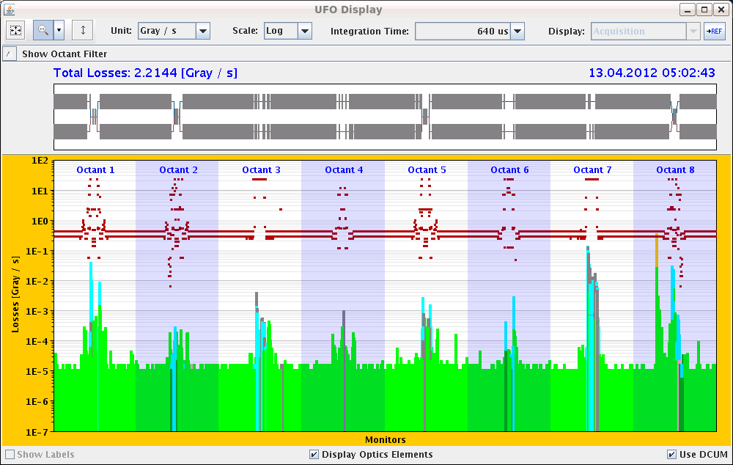
UFO – 92% dump threshold (Fri morning)

Slide 21
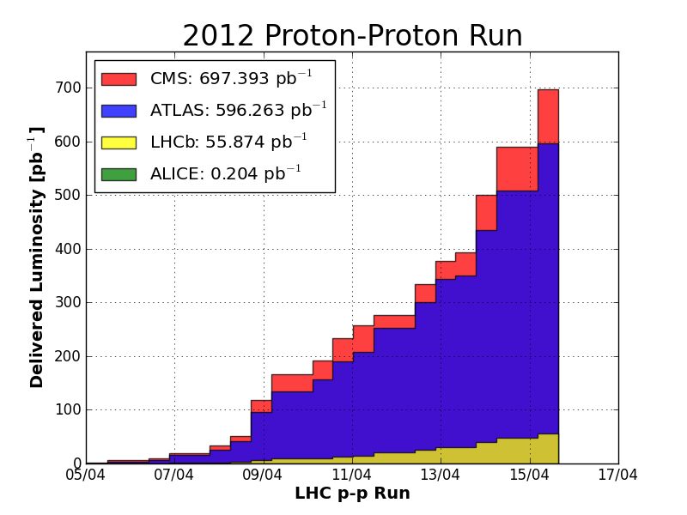
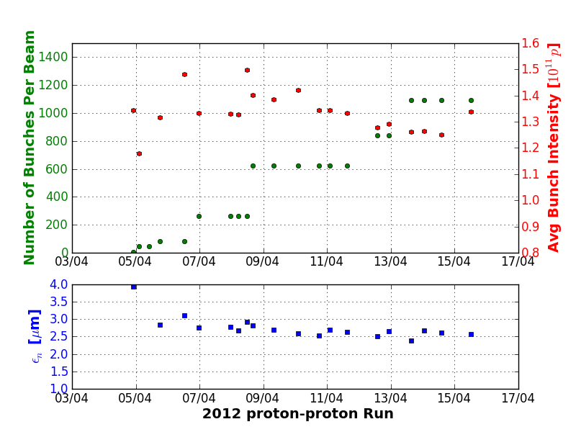
Week 15
Statistics (Alick):

Slide 22
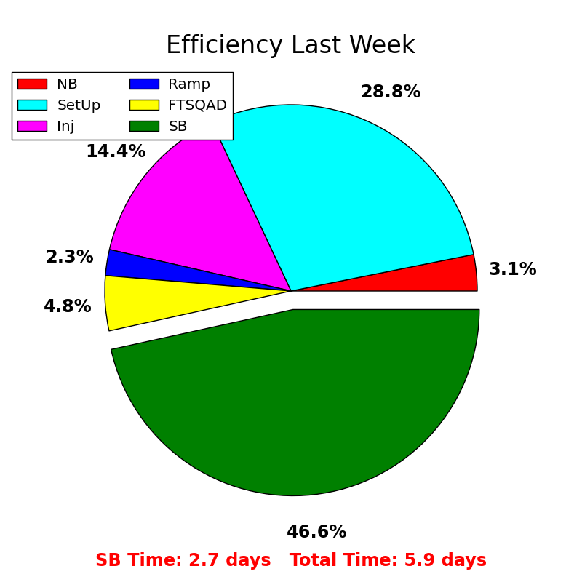
Week 15
Statistics (Alick):
machine performance:

