Slide 1
Mon 2/4
08:00-13:00: Access for:
Experiments
Power converters
BBQ
Cryo point 2 (insulation vacuum pump)
BLMs point 2 and 8
During pre-cycle trip of RQTL10.R3B2 twice. OK after QPS reset by MPE piquet.

Slide 2
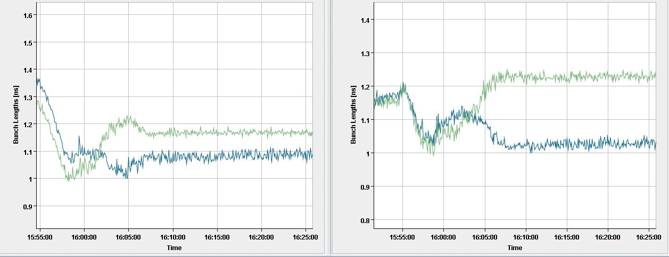
RF blow-up status (Philippe et al.)
We injected 2 equispaced bunches per ring 1.1-1.2E11 p.
We had extended the lower frequency of the excitation spectrum on B2: For B1 we excite from 0.85 fs0 to 1.1 fs0, for B2 from 0.75 fs0 to 1.1 fs0. (to test the hypothesis that the synchrotron tune shift brings the excitation outside the bunch tune spectrum).
Concerning the beam we observed similar behaviour on both rings: no instability, still significant dispersion in final bunch length (attached). 100 ps in B1, 200 ps in B2

Slide 3
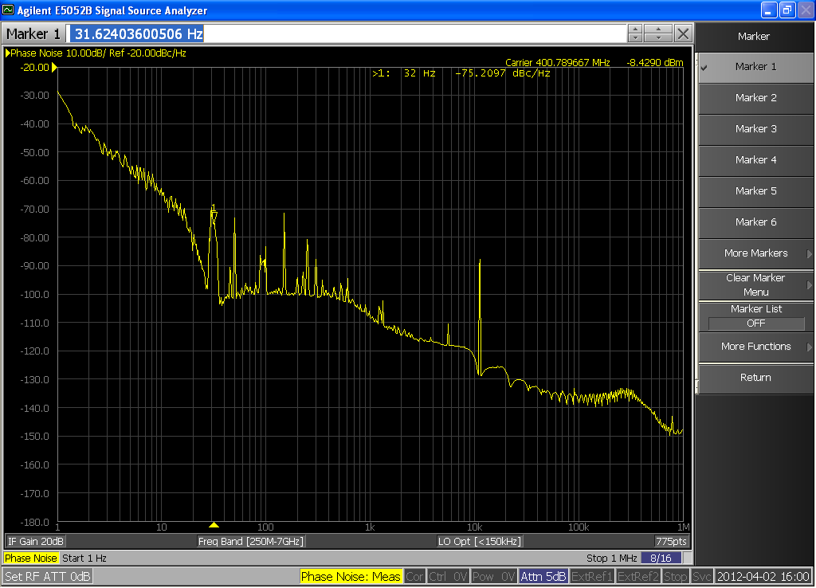
RF blow-up status (Philippe et al.)
We observed the phase noise spectrum during the ramp in cav1B1 and the Cavity Sum phase noise spectrum. These were as expected. We also observed the phase noise in time domain and saw no visible modulation at frev (that could explain different bunch lengthening).
We have reverted Controls and Functions to the Old Blow-up (acting via the main phase loop) for the next ramp.

Slide 4
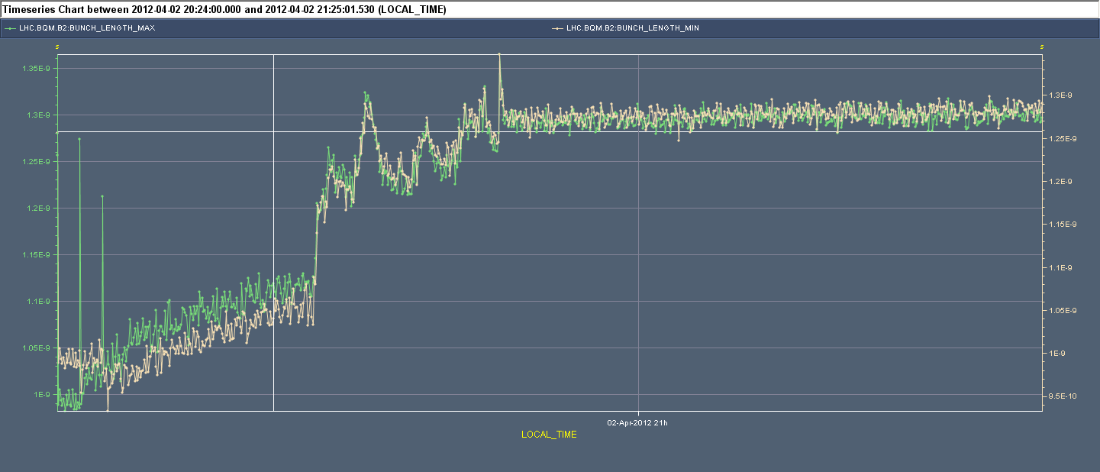
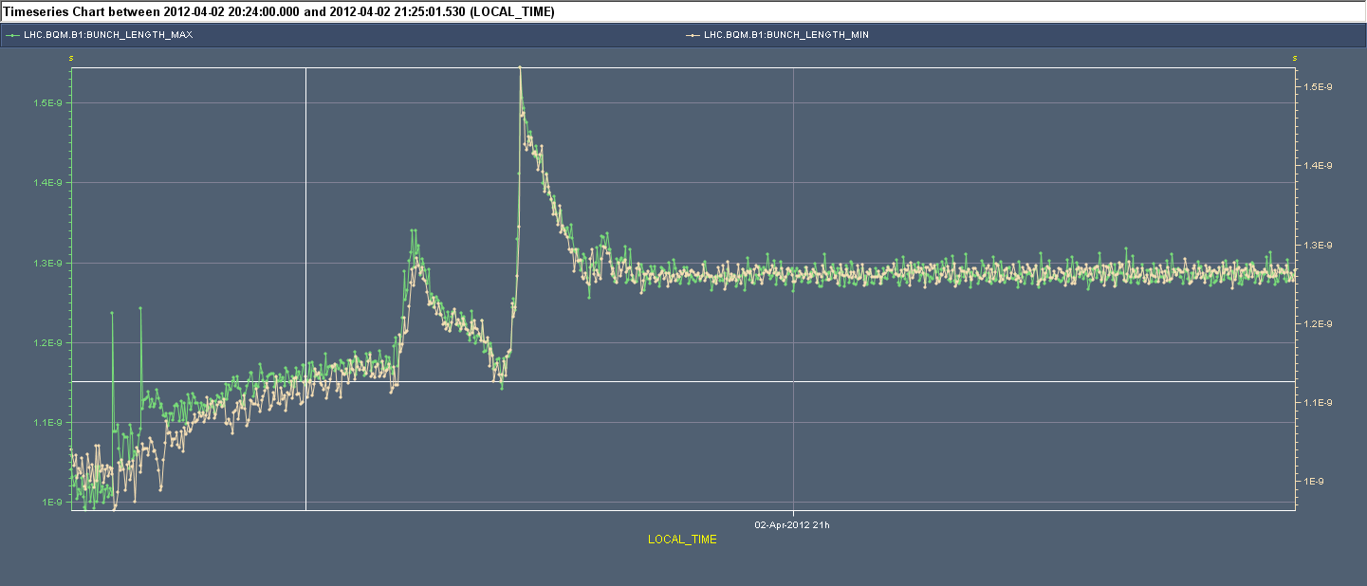
RF blow-up status (Philippe et al.)
"2011-style" longitudinal blow-up: We observed nice convergence of bunch lenghts (the plus)... but big jumps (probably changes in bunch profile, quite violent on B2) on the way (the minus)... See attached figures. The target was 1.3 ns and we got very closed. I have reduced it to 1.25 ns for later ramps.
We have a problem when launching the blow-up from the sequencer. This needs CO expert intervention to-morrow. Andy will follow it up with CO."

Slide 5
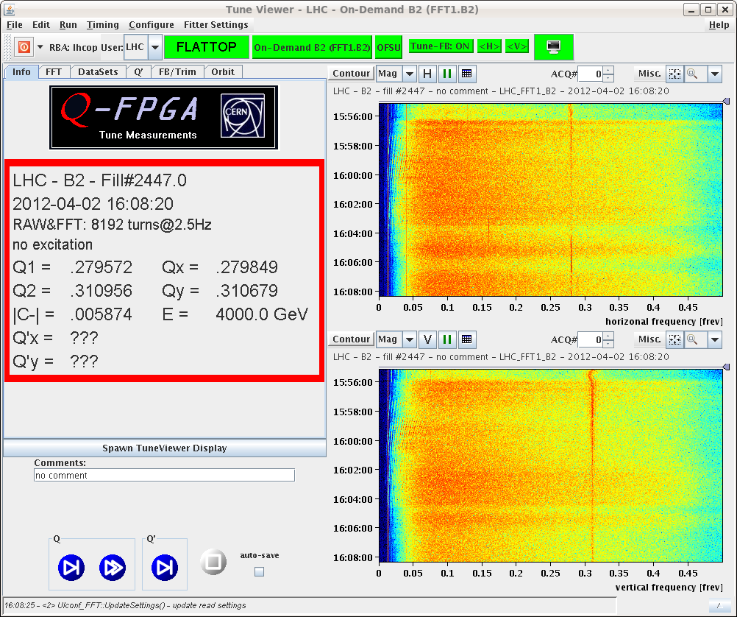
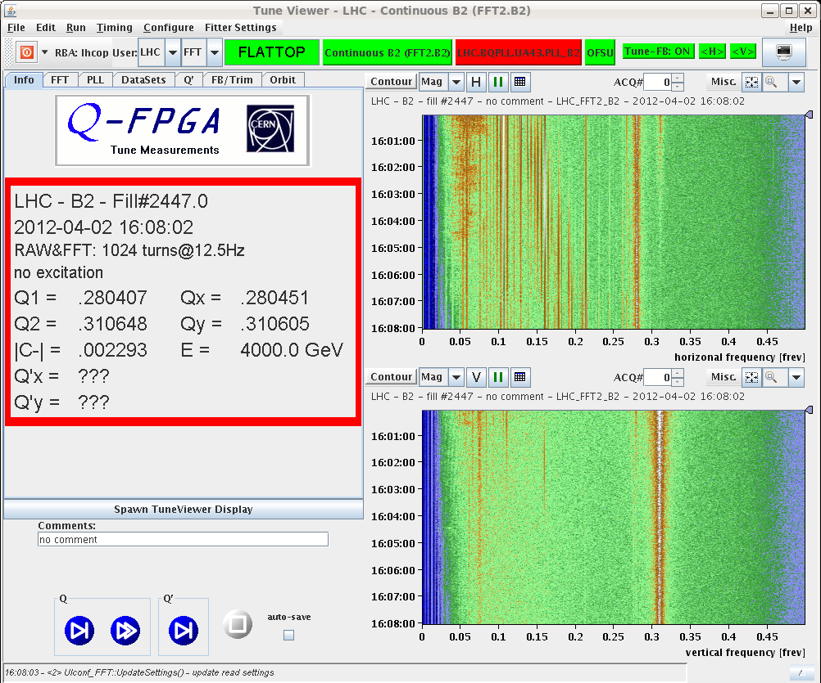
BBQ
Detectors for continuous and on-demand tune measurement exchanged (low pass filter at 450 MHz now in continuous BBQ to reduce the noise level in particular during long blow-up)

Slide 6
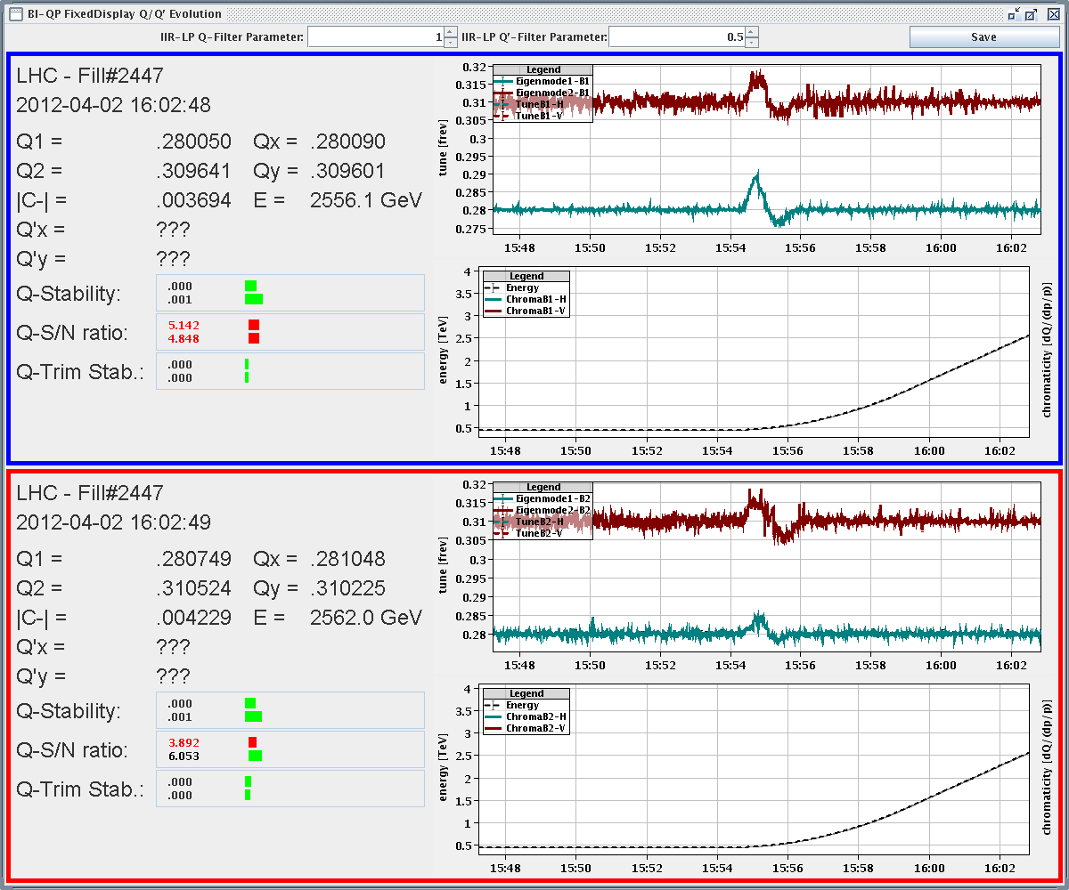
Ramp
Fidel correction (tune and chromaticity still to be improved. Fidel team working on that.

Slide 7
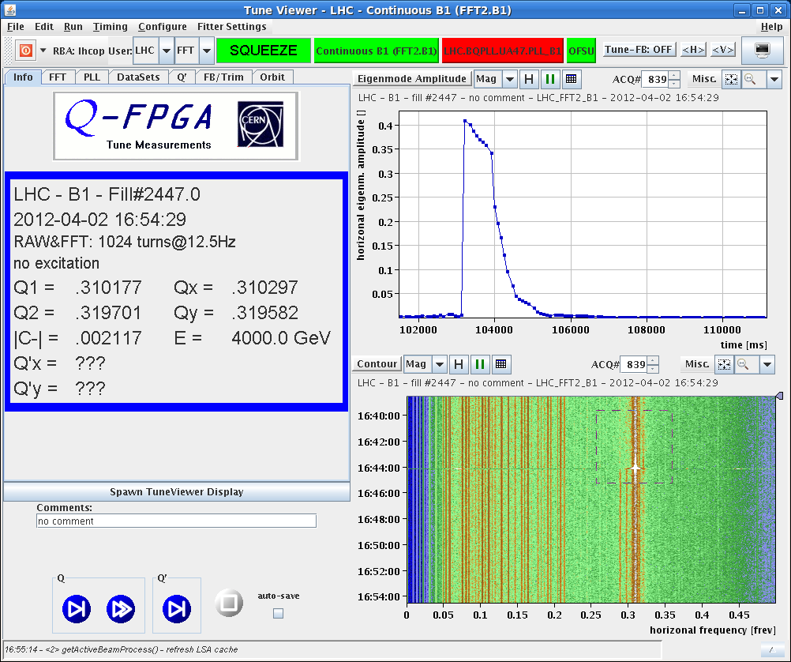
Squeeze
Instability developing (B1/B2 H) when ADT OFF for loss maps at the end of the squeeze: Q’ B1 -1/+4 Q’ B2, -3/+8. Correction to 3-4 units.
Need to revisit flat-top and squeeze ➔ this morning

Slide 8
b3 knob and loss maps
Test of b3 knob for correction of chromaticity decay at flat-top (Mike)
To be implemented this morning
Then loss maps (Betatronic) and asynch dump test at the end of squeeze and separated.

Slide 9
MPS tests
To be analyzed by Collimation team and confirmed OK by rMPP
Injection loss maps (B1-H and asynch dump to be repeated after readjustement of TCSG in point 6 for B1 yesterday
 | Injection | Flat-top | Squeezed | Collision
Betatronic-H | To be repeated B1 | Done | Done | Done
Betatronic-V | Done | Done | Done | Done
Off-mom +500 Hz | Done | Done |  | Done
Off-mom -500 Hz | Done | Done |  | Done
Asynch dump | To be repeated B1 | Done | Done | Done

Slide 10
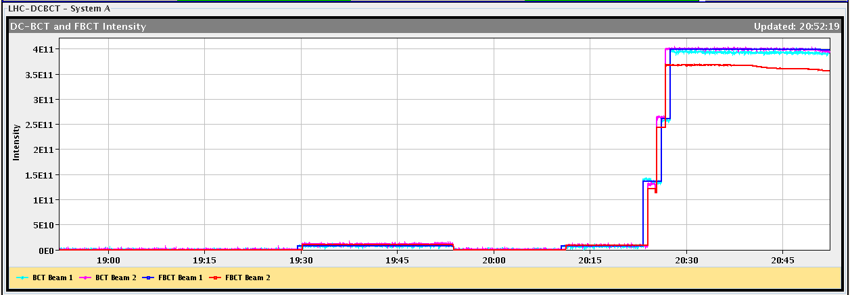
Issues
FBCT is giving lower intensity as compared to DCBCT for beam 2
BBQ: When switching on the chirp during the squeeze, the tune fitter window jumps to injection settings.
The Post-mortem cannot be launched from the CCM

Slide 11
Plan
Loss map at injection ongoing
Date | Day | Shift | Time (h) | Activity | System/topic | Beam
2 | MON | M | 2 | Loss map at injection betatronic B1H + asynch dump | Collimation | Nominal
3 | TUE | M | 6 | Chromaticity correction with MCS at flat-top + chromaticity correction through the squeeze | OP | Probe
3 | TUE | A | 8 | Injection setting-up with 50 ns beams (injection, damper) | ABT/RF | 50 ns
3 | TUE | N | 5 | BI shift with 50 ns | BI | 50 ns
3 | TUE | N | 5 | Loss maps | Collimation | Nominal
4 | WED | M | 6 | STABLE beams with 3 on 3 bunches
4 | WED | A | 8 | STABLE beams with 48 bunches and low-pile-up for ATLAS
4 | WED | N | 8 | STABLE beams with 48 bunches and low-pile-up for ATLAS
5 | THU | M | 8 | STABLE beams with 84 bunches

