Slide 1
Thursday morning
→15:00 Collimator setup at 4 TeV (unsqueezed).
Still bunch length issues in the ramp. Instability in beam1 calming down around 8:40…
The blow-up did work, with bunch lengths of 1-1.2 ns on FT.
A quadrupolar oscillation of the bunches developed in the last part of the ramp, at length where there was never a problem in 2011.
Suspicion is that the phase loop has influence on the stability (now off in the ramp).

Slide 2
Thursday morning
→15:00 Collimator setup at 4 TeV (unsqueezed).
Despite those ‘conditions’, collimator setup was completed in 7h45 hours and a single fill (first time).
First a coarse setup was performed, using the automatic setup algorithm, in parallel for all collimators per plane in B1 and B2. Then the semi-automatic algorithm was used to fine-tune the parllel alignment and drive in the collimators again towards the beam. Once all collimators were close to the beam, they were aligned sequentially, first with the 12Hz data and then cross-checked with 1Hz data.
During the alignment B2 was scraped down to levels where the orbit readings disappear and the position interlocks trigger (at ~3E10 p/bunch, but they were masked).
Betatron loss maps look very good (done with ADT).
Off-momentum loss map (+500 Hz, ‘natural’ failure direction) done.

Slide 3
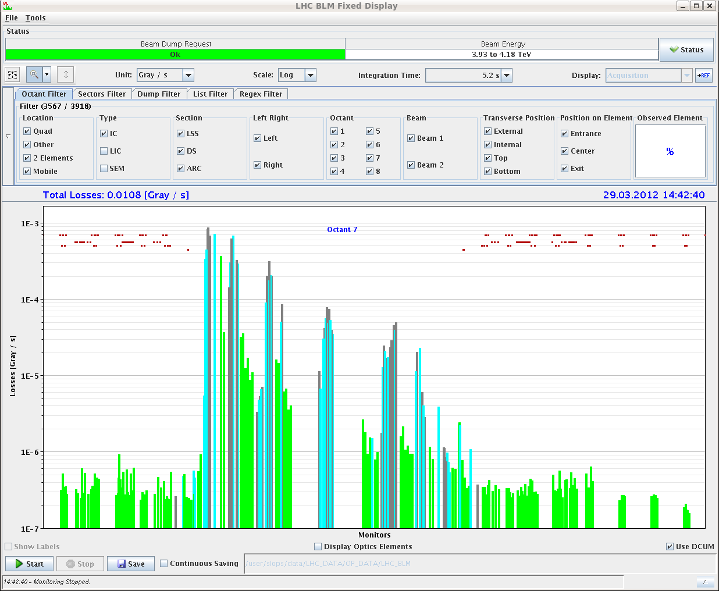
B1H loss map

Slide 4
Thursday afternoon
17:10 Electrical perturbation while preparing for special ramp for RF instability investigations.
CERN wide.
Trip of RD1.LR1, LHCb dipole + compensators and RB.A23.
18:00 Dry ramp of the collimators with the new functions based on the alignment at 4 TeV – ok.
19:00 Moving to injection and dump setup.
Abort gap protection checked: limit bunches 1-31181.
MKI failure simulation and beam grazing on TDI. Analysis to follow.
Settings defined for TCLI (6.8σ,8.3σ), TDI (6.8σ), TCDI (4.5σ).

Slide 5
Thursday night
MKD test 14/15 kicker simulation – OK.
No increase in losses for ‘-1’ kicker.
Dump with extreme bunches (1- 34291) OK.
03:00 Preparing for optics measurements squeezed.
04:00 Beam ready at 0.6 m.
Collapsing crossing angles.
Strong losses on TCTH.4R1 (parking) with AC-dipole.
Ramping down the octupoles improves things.

Slide 6
Today
Optics until ~10:00
From 10:00: special ramp(s) to understand longitudinal beam instability.
Following program depends heavily on outcome of the ramp(s).
If the beam is in good conditions at 4 TeV: carry on with squeeze and collisions, else prepare a fresh fill (assuming ramp with nominal works!).
Evening/night : loss maps.
We will review the program of the weekend today – expect changes.

