Slide 1
Friday 23rd March
08:00 Access
11:20 Machine closed, cycling the magnets
12:45 Probe injected, machine protection tests after modifications during access
14:00 Refill blown-up probes for aperture measurements
14:40 Ramp - squeeze - aperture measurements at 0.6 m
23:39 Dump after aperture studies
01:16 Ramp of 1 pilot with flattened functions for Q and Q’ corrections
MP tests and ramp with collimator functions
06:30 access interlock (from door between UJ83 and LHCb cavern US85)

Slide 2
Access
Cleared the long list of outstanding items
Fixed many things and hopefully did not introduce too many other problems

Slide 3
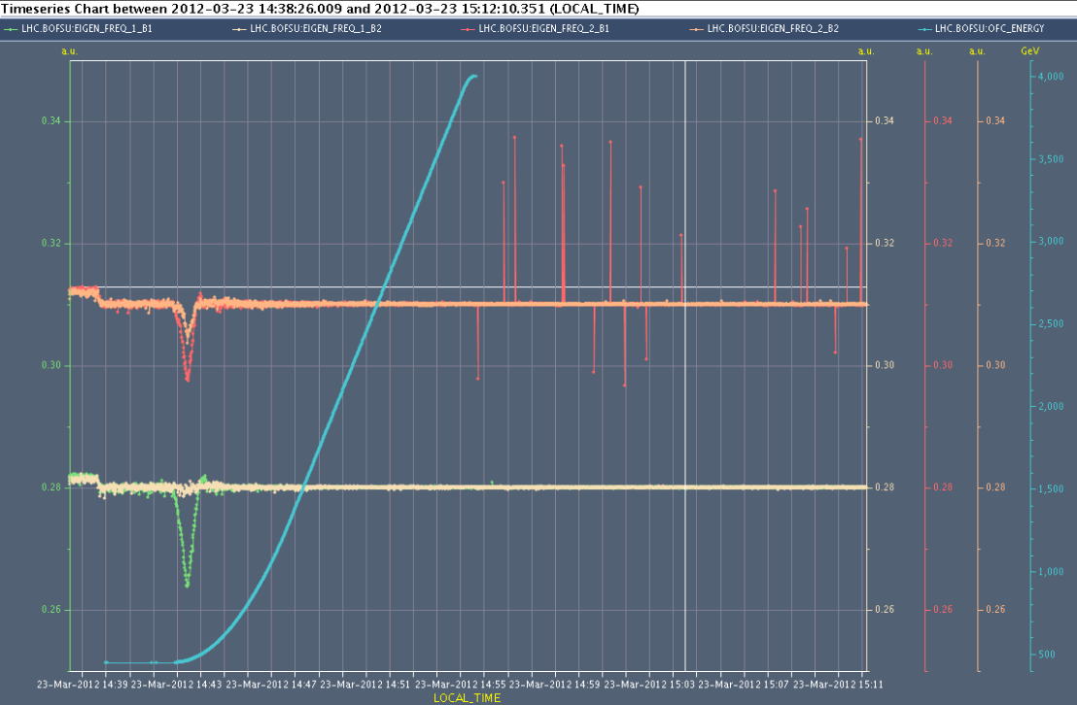
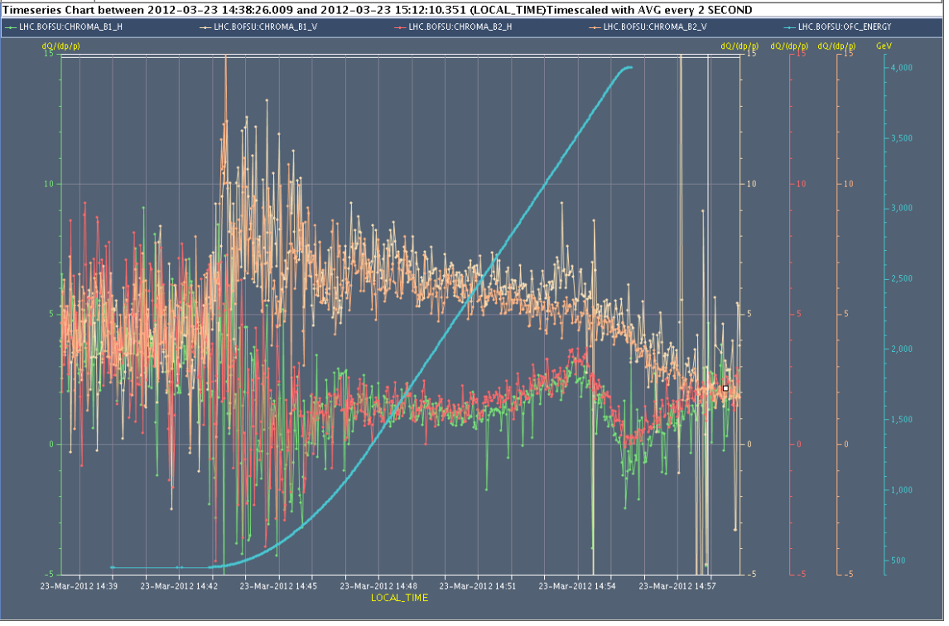
Ramp – Aperture checks at beta* = 0.6 m
Tunes and Chromaticities during the ramp

Slide 4
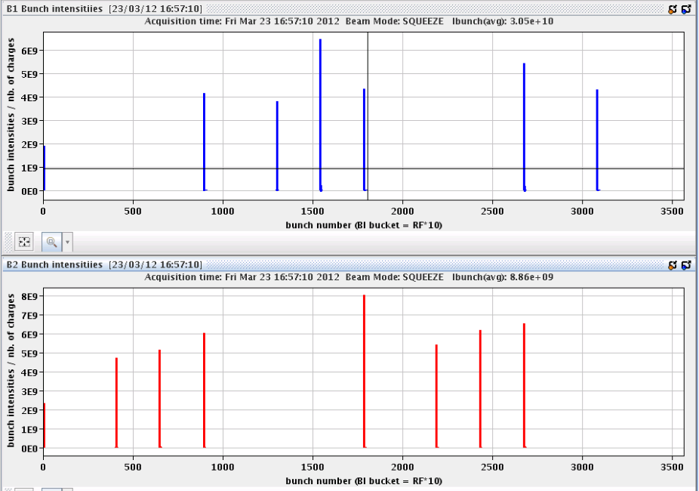
Aperture at 0.6 m
Use ADT to blow up the bunches
7 low intensity bunches B1, 8 B2
Method worked very well!

Slide 5
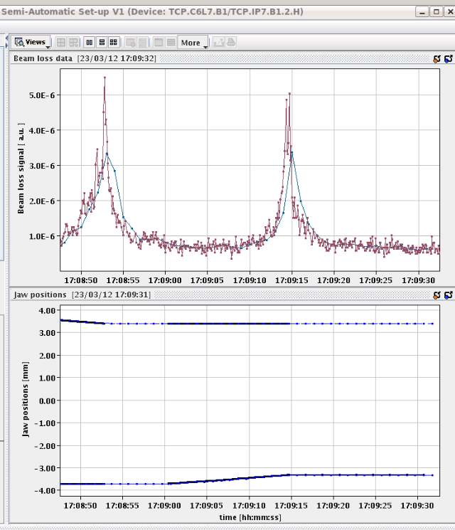
TCP.C6L7.B1 alignment with fast data
Test the new collimator alignment with 8Hz jaw movements and 12.5Hz after a bug was corrected with the BLM mapping.
It now worked reliably at high energy

Slide 6
Aperture conclusion
The bottlenecks are found in the triplet of IR1/5 as expected
B1-V: limit in IP1-left (crossing plane). Aperture 11-11.5 sigmas
B1-H: limit in IP5 left (crossing plane). Aperture 11.5-12 sigmas
B2-V: limit IP1 right (crossing plane). Aperture 11-11.5 sigmas
B2-H: limit in IP1 right (separation plane). Aperture 11.5-12 sigmas
The latter result is a bit puzzling as the limit should be in IP5 (crossing plane). This case was repeated several times, but the loss location was always confirmed.
Beta* of 0.6 m looks promising

Slide 7
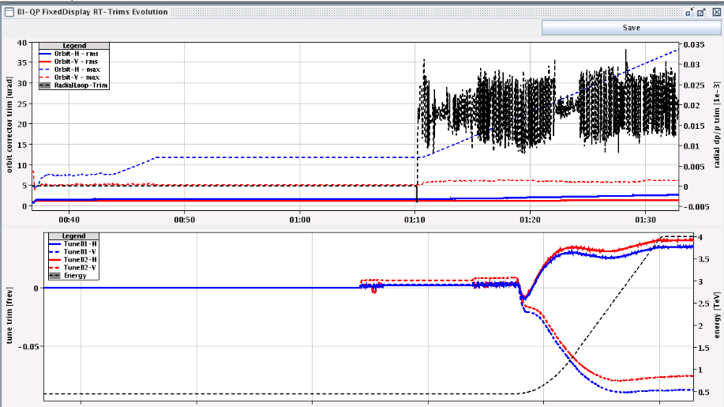
Ramp of pilot with flat functions
To be used for tune and chroma snapback modelling / FIDEL
(faster) tune and orbit feedback corrections during the ramp
Smooth corrections, except some h correctors (bump point 2)
Measured tune perfectly flat

Slide 8
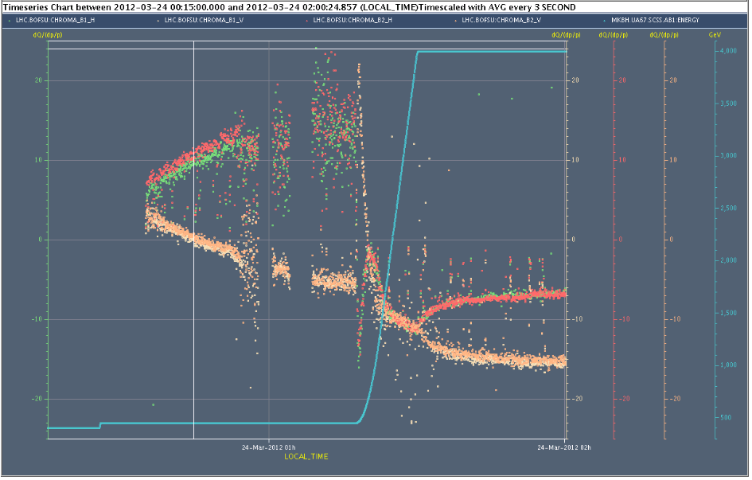
Chroma measuerments, no corrections
Snapback
20
-20

Slide 9
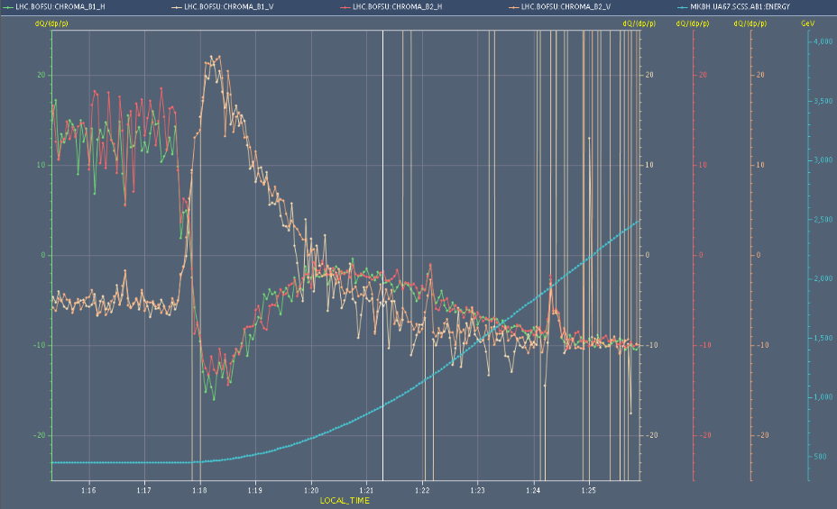
Snapback
Q' snapback of around +/-27 units in ~27 seconds well resolved - again to be fed forward into settings
Decay on flat-top also cleanly measured +/- 3 unit in H/V
Ralph, Mike, Ezio, Giulia, Guy

Slide 10
MP test & ramp with collimators
Scraped down single indiv to verify BPM interlock:
orbit BPMs lose the readings sooner than the interlock BPMS in pt 6. Reading correct (one bunch only in the machine)
Orbit BPMs loose readings around 4e10 p+
Interlocked BPMS in point 6 loose readings around 1.6e10 p+
Performed a ramp with collimator functions followed by a squeeze in one step (no TCT functions).
Observed lifetime dips towards the end of the ramp and during squeeze, losses in 7 and 8. Long. blowup was on, QFB often turned off during squeeze and had large RT trims (>25urad) in B1H orbit.
Dumped with a MP test: RD1.LR5 PC off (FMCM triggered).

Slide 11
Access / outstanding
FMCM on RD34 in 7 still not ok. Will prevent us from taking up more than 3 nominals to 4 TeV.
the BPMSW.1L5 is now OK in the V plane, but has the incorrect sign in the H plane
“un problème sur le circuit RCBV25.R4B1. Vous risquez de perdre rapidement ce circuit, (pb Alim Aux)”
TCDQ angular alignment to be revisited
BPMD giving bad reading
lost RCD/RCO.A34B1 twice, third time in 3 days, looks like a QPS problem
Lost fBCT fixed displays (and maybe more), for the experts to check;

Slide 12
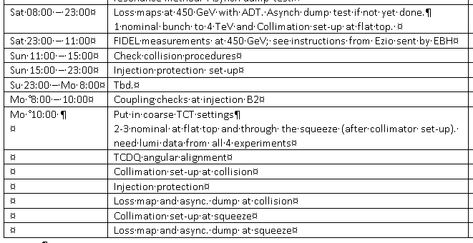
The Plan

