Slide 1
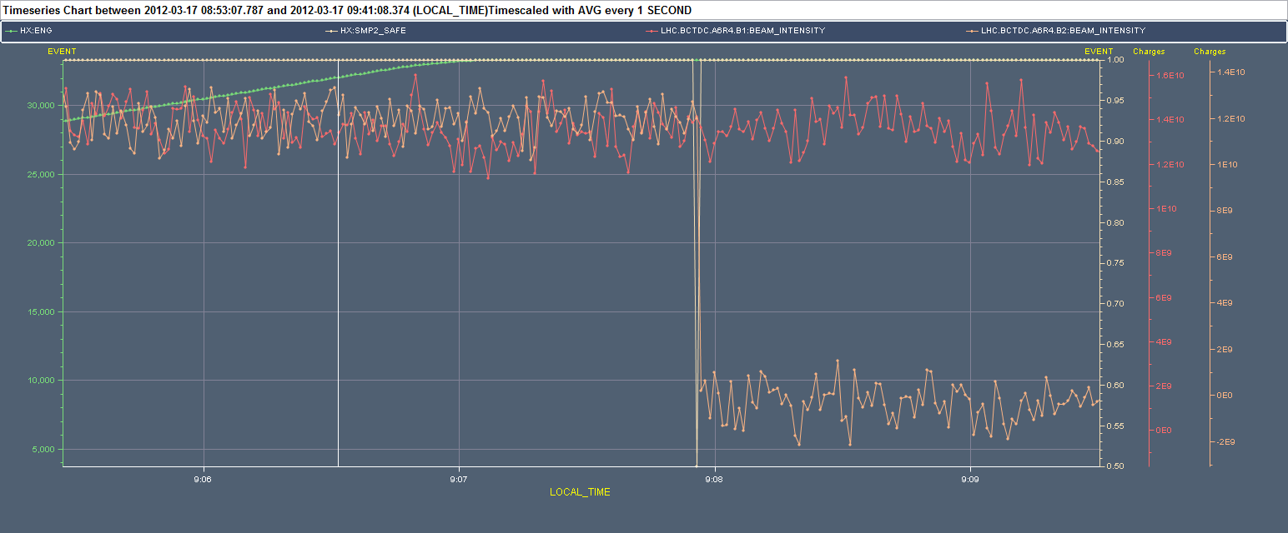
Sat 18/3 - Ramp to 4 TeV
Again glitch on the safe beam flag for beam 2. Cause identified: noise on BCT2B giving values above the safe beam limit (2.4×10¹⁰ p @ 4TeV). For the time being forced relaxed safe beam flag (~1.2 ×10¹¹ p @ 4TeV) and relaxed thresholds on noisy BPM: BMPSA.B4R6.B2 ➔ follow-up with BI for the BCT and BPMs problem

Slide 2
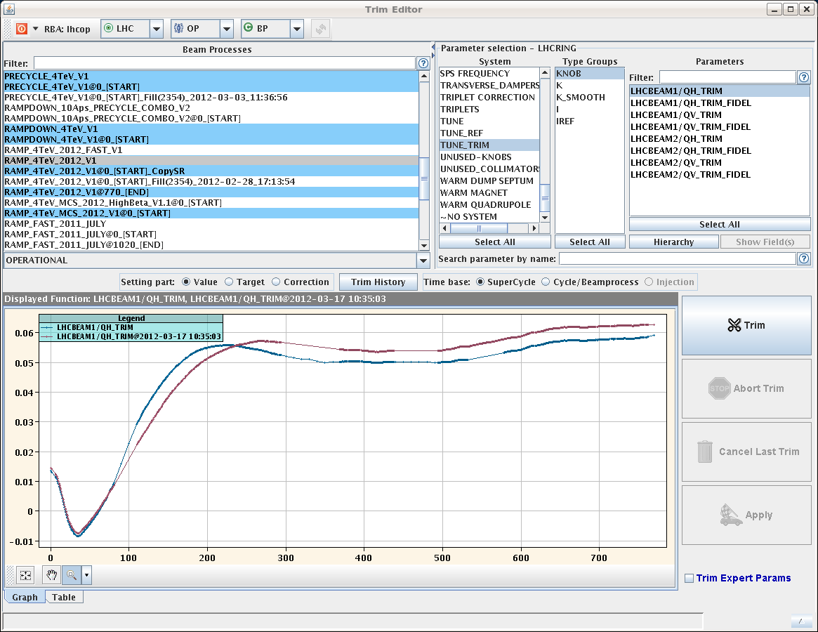
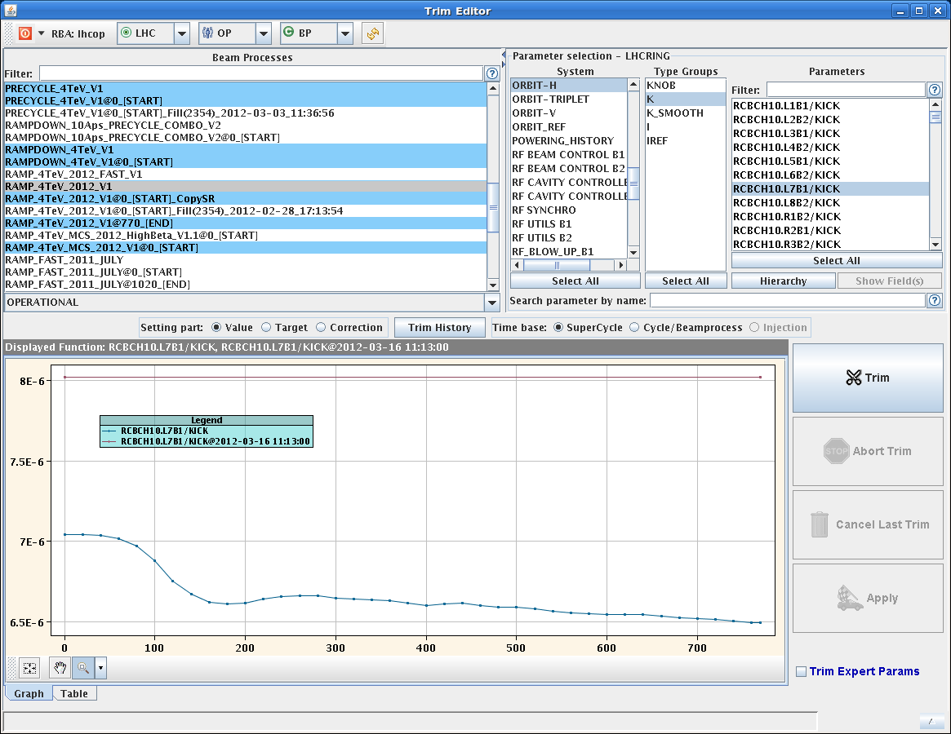
Saturday 18/3
Feed-forward on the orbit based on the previous ramp: - Applied 60% of the RT correction with an interval of 20 s. - Most changes occur around 1 TeV, as in previous years.\
Feed-forward on the tunes based on the previous ramp: - Applied 80% of the RT correction with an interval of 10 s. - FF takes out a tune bump between 100 and 200 s.

Slide 3
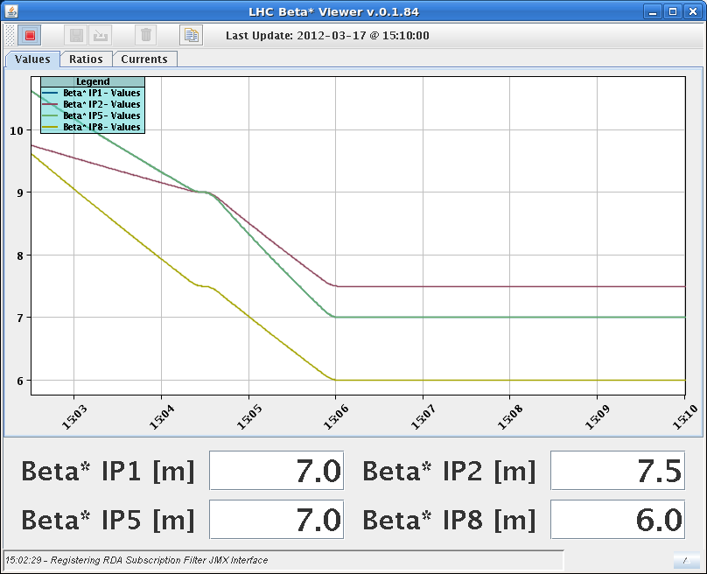
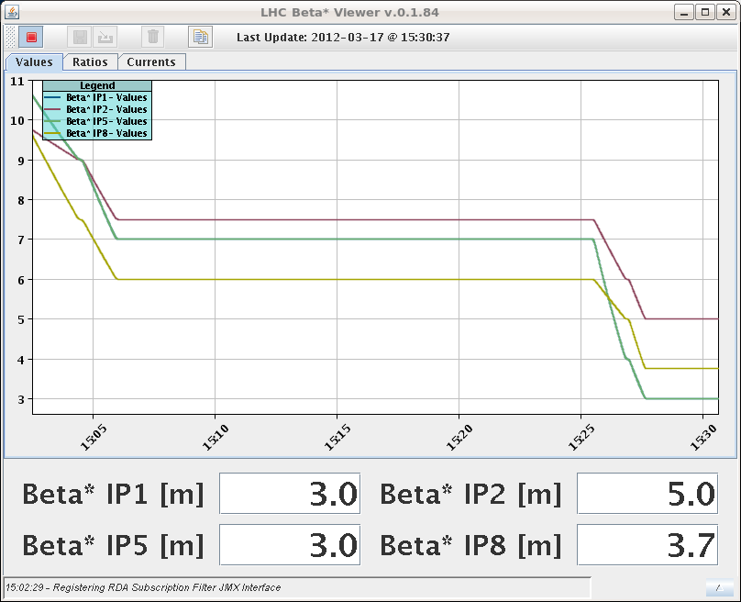
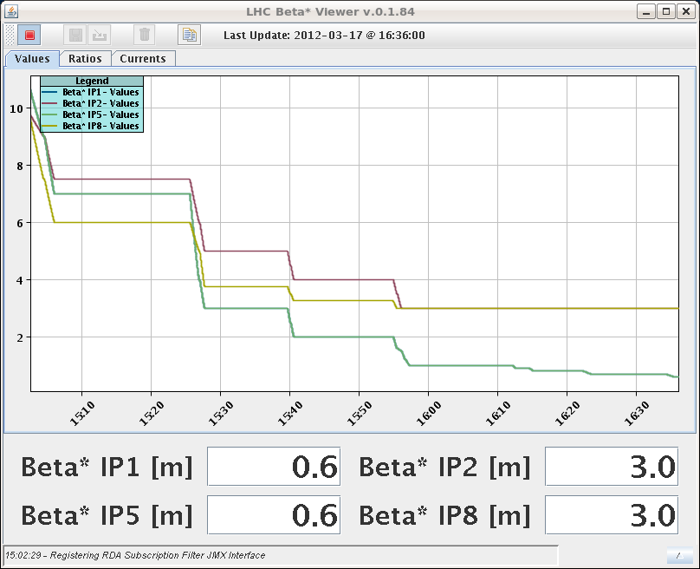
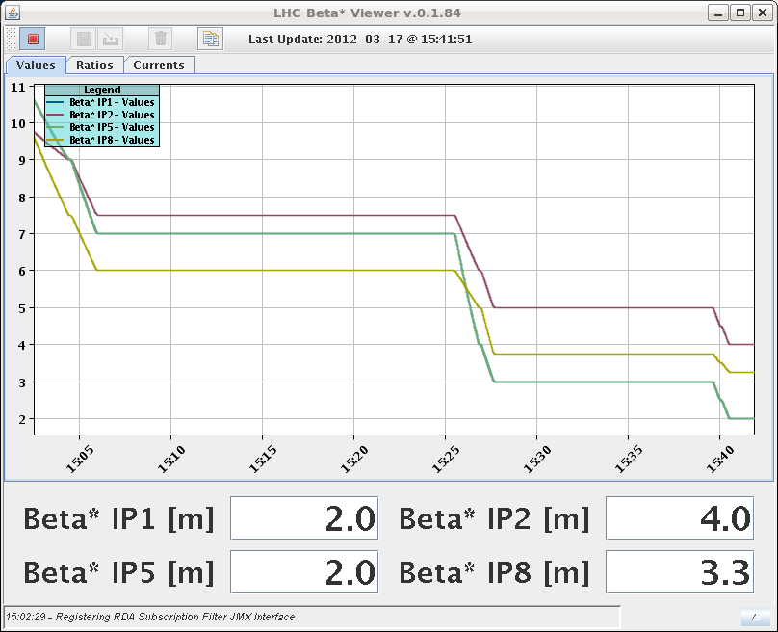
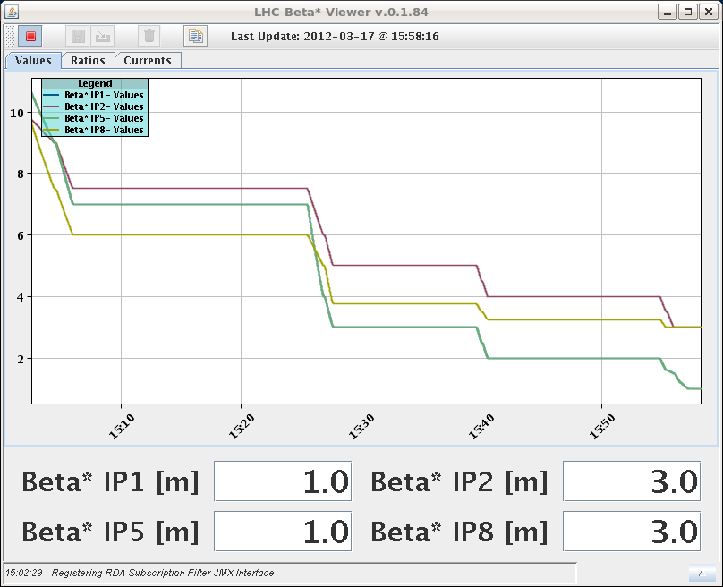
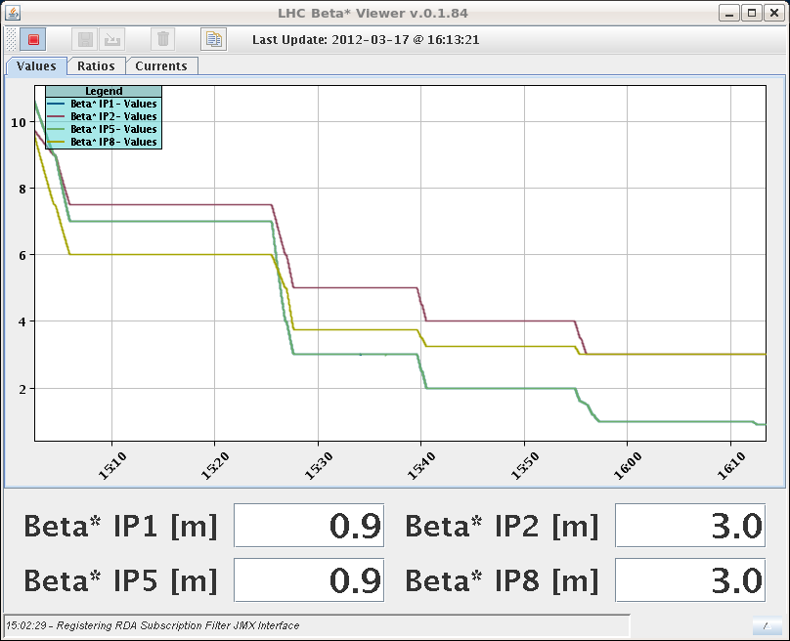
Saturday 18/3
No beam 2 from the SPS from 11:00 due to problem with extraction magnetic septum power converter
Decided to go through the squeeze with beam 1 only

Slide 4
Squeeze to 60 cm
Rather smooth. No lifetime dips. Rather gentle corrections required

Slide 5
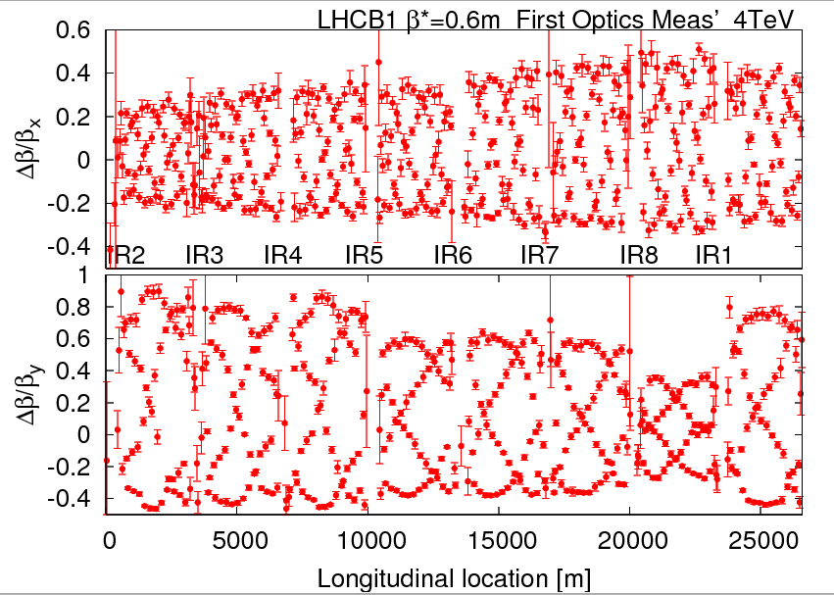
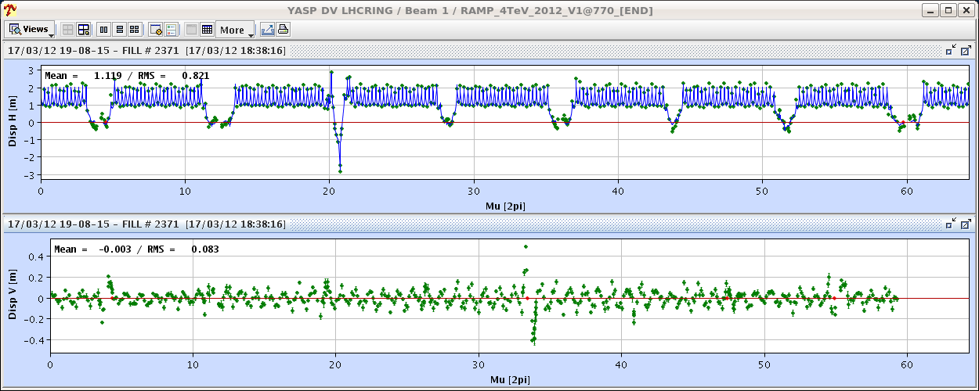
Optics
Optics measurements at 60 cm. Some work to do…

Slide 6
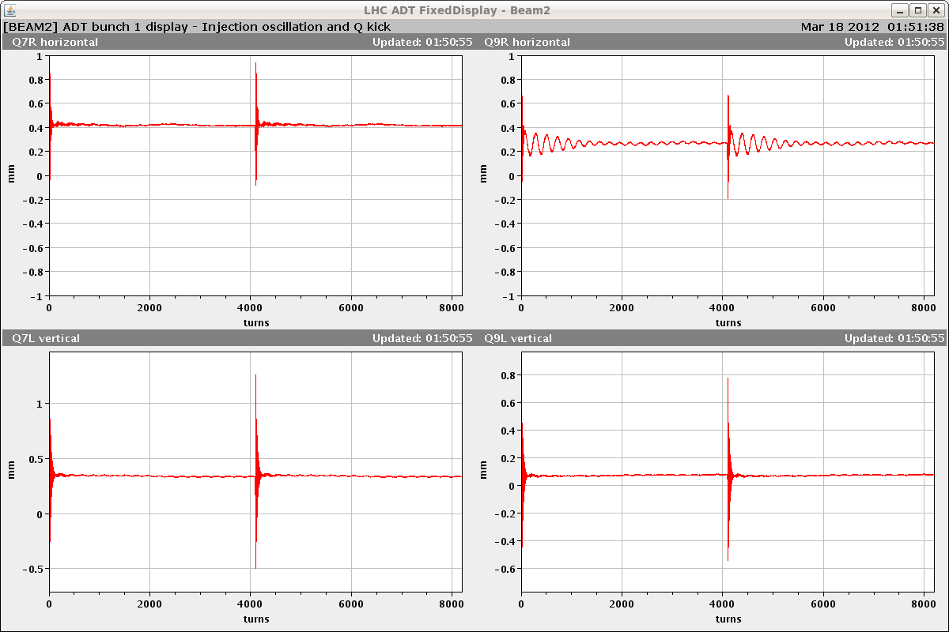
Damper setting-up
19:00: still no beam 2 from SPS ➔ dump and go for damper setting-up (thanks Daniel!!)
Summary of the ADT setting up:
the re-cabled system (Hor. B2) was set-up and it is operational
checked/adjusted loop parameters for all units
Injection gap and abort gap cleaning is preliminarly set up (there was major intervention on this system during the TS).
Transverse blow up available for both beams now (unfortunately there was not much time to test it tonight).
The ADT is left loaded with settings for nominal intensity and 50ns or greater bunch spacing.
The blow-up strength and mode is set to safe values (zero and OFF) so there is no accidental trigger before proper rbac roles are prepared.

Slide 7
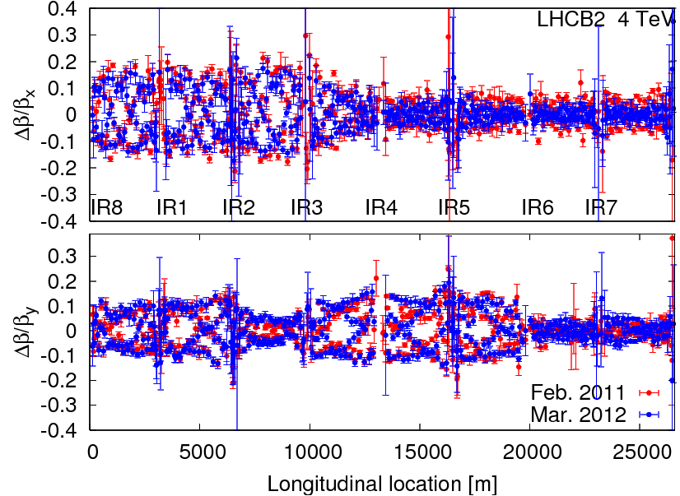
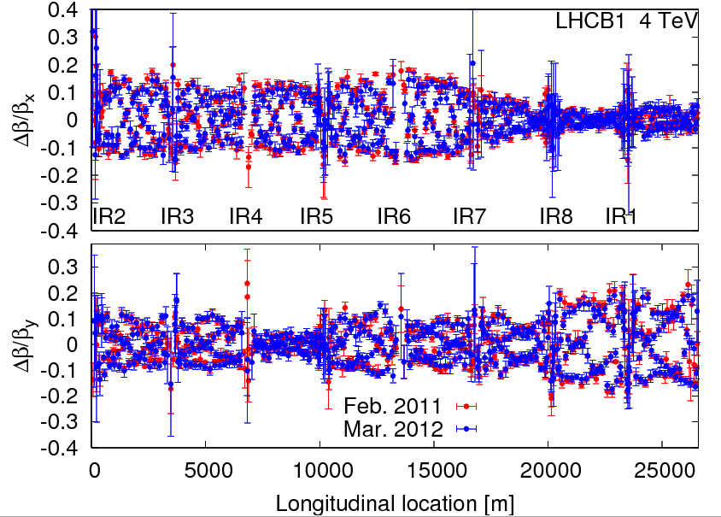
Ramp and squeeze
Beam 2 available in the evening
Ramp and squeeze after damper setting –up (completed by 2 AM)
Machine at 4 TeV very similar to 3.5 TeV
04:11 Spurious dump from unmaskable BLM channel in point 1

Slide 8
Status and (this was the…) Plan
Optics measurements ongoing
There will be a stop of the injector complex on Monday 19 March at 09:00 for about 2h for an intervention of EN/EL on the SPS cables. In the shadow of this a number of interventions are scheduled in the other machines (Linac2 RF tube change, TT2 for nTOF DSO tests, EN/CV intervention in the PS).
Day | Shift | Time (h) | Activity | Breakpoint | System/topic | Beam
SUN | M | 8 | Optics measurements during the squeeze to 0.6 m | First squeeze with B2 | Optics | Probe
SUN | A | 4 | Orbit at injection with nominal bunch and bumps |  | OP | Nominal
SUN | A | 4 | Experimental magnets ON |  | OP | Nominal
SUN | N | 4 | Orbit feedback with dynamic reference in the ramp |  | Feedback | Nominal
SUN | N | 4 | Pre-cycle or ramp (no beam) - decay measurement at 450 GeV |  | Magnets | Probe
MON | M | 6 | No beam from the injectors from 9 to 11. Test ramp and squeeze |  | OP | Probe

Slide 9
Latest news
Smoke form SPS RF transmitter
Possibilities of having pilot – single nominal bunch during the day being investigated
Try to plan accordingly

Slide 10
Pending issues
BPMSA.B4R6.B2 + BCT Noisy and giving spurious interlocks
Vacuum gauge outgassing between Q6 and Q5.L5. V. Baglin investigating: likely vacuum gauge outgassing when switching ON
Still some issues with chromaticity measurement and feedback displays ➔ Ralph
Suspected electrical problem on a fire detection unit in UX85. Access required at the next occasion.

