Slide 1
Thursday morning – optics correction
11:00 Beta-beat , dispersion and coupling measurements and corrections finished.
Beta-beating down to 5-10% from 20-40%.
Dispersion beat in horizontal reduced.
Local coupling corrections applied – significant reduction of the global coupling correction.
In parallel setup of the tune measurement (filters).
During the tests of the tune FB, a bug was found in the FCG software that ignored the real-time correction.
EPC localized the problem in the afternoon – fix will be applied this morning : all the LHC must be switched OFF and then pre-cycled.

Slide 2
Beam 1 beta-beating

Slide 3
Beam 1 dispersion error

Slide 4
Injection
The transfer line steering was checked in view of injection of the nominal bunch.
A vertical bump is now present at the bottom of both lines – required to injection onto the LHC closed orbit.
Could be due to a problem with the bunch placement on the MKI waveform.
A kicker delay scan was tried, but had to be stopped because of abort gap keeper. To be done later.
Some new LIC BLMs seem to have wrong thresholds in IQC.
Injected nominal bunch without problems.
TCDI collimators at +/- 5mm
but TCDIV.29509 + TCDIV.88123 (@ +/- 10 mm, 1sigma = 1.3 mm).
TDI to +/-6 mm (10 sigma) .

Slide 5
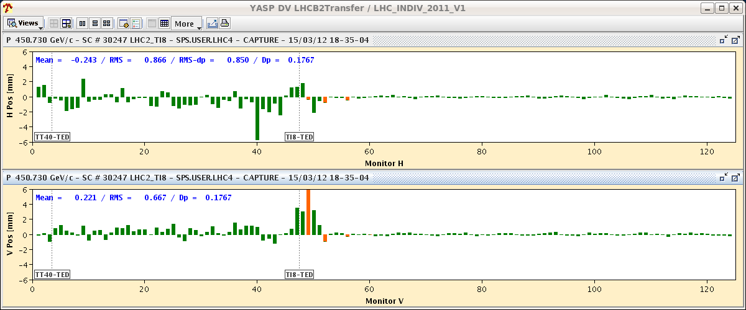
Injections
LHC
TI2
LHC
TI8

Slide 6
Injection - LICs

Slide 7
Orbit with nominal
Orbit was re-corrected, first against 2011 reference, then some absolute corrections were applied.
RMS a little better than 2011, but orbit very similar to 2011 reference (0.2-0.3 mm rms difference).
The structures (mostly in the IRs) are ~ identical to last year.
CMS similar or better (fewer outliers) than last year.
BPM quality was measured with new tool based on kicks from 2 correctors at (almost) 90 deg phase advance.
Fast (< 1 minute / beam /plane) check of the BPM response.
Some scale issue possible (~ 20%) for IR BPMs.
Short orbit response measurement.
Very good BPM quality, very few issues.
SIS orbit and COD interlocks tested with beam – OK.

Slide 8
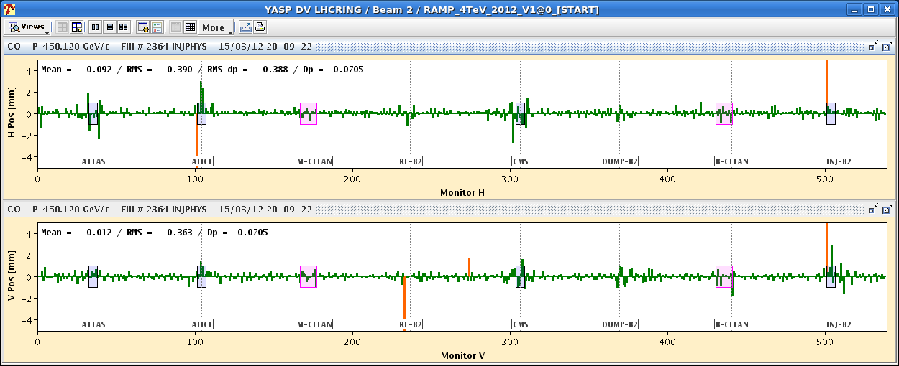
Reference – flat machine
0.47 mm
0.33 mm
0.39 mm
0.36 mm

Slide 9
BPM quality
BPM scale factor (should be 1) along the ring for B1.
Oscillations reflect beta-beat and imperfect phase advance (not exactly 90 deg between 2 correctors).

Slide 10
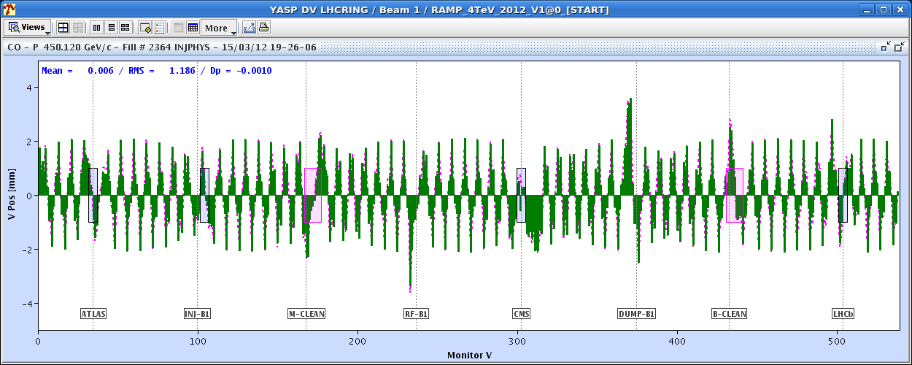
BPM quality
Response to corrector kick. Data (histogram) and model (points/line).

Slide 11
BPM issue
One of the interlock BPMs of system ‘B’, BPMSA.B4R6.B2’ frequently triggers spurious interlocks – sees 2 bunches when there is only in the ring…
Will be a killer with unsafe beam.

Slide 12
Collimator tests
As orbit setup was faster than foreseen, used slot to test new collimator setup SW and new 12.5 Hz BLM acquisition.
The setup sequence aligned the primary collimators, followed by moving all other collimators in parallel (for a given collimator group), followed by a sequential fine alignment – OK.
The fast BLM data was acquired, however the signal was not seen to rise with the 1 Hz signal as the jaw of a collimator was aligned to the beam. To be checked.

Slide 13
No signal on fast BLM data

Slide 14
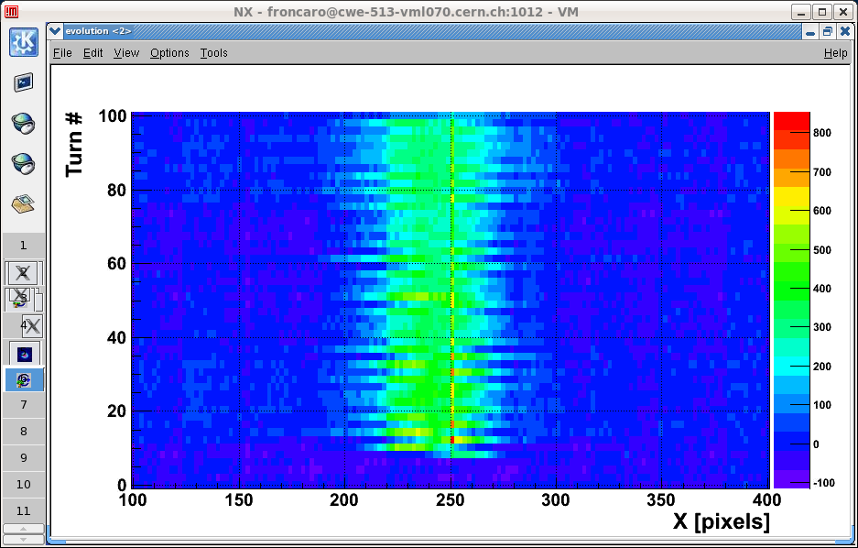
BI night
Matching monitor gave first real images and profiles.

Slide 15
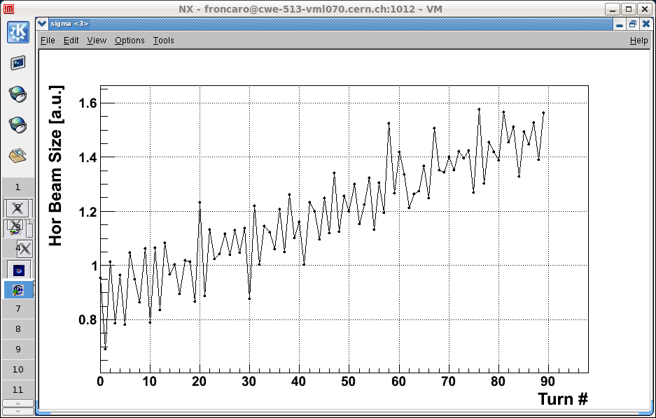
Matching monitor

Slide 16
BI night
BPM response versus intensity.
Beam1 - at intensity 3.3e10, first dump interlock BPMs drop out: BPMSA.4R6.B1 & BPMSB.A4R6.B1
Beam2 interlock BPMs have a lower threshold than all other BPMs, at around 2.1e10.
Beam Presence Flag:
B1 & B2 flags both disappear at around 2.1e9.
FBCT clocks aligned and systems were calibrated.
Both A and B system crates died during the exercice.
Bump scan at emittance monitors for calibration.
Corrector RCBYV4.L1B2 tripped and must be replaced this morning.

Slide 17
Synchroton light on the extraction mirror
1 pilot + 4 nominals

Slide 18
Today
08:30 – 10:30: FCG update, all PCs off (not CMS), precycle.
BLM card exchange in Pt7 in the shadow.
In parallel:
access for QPS to Pt1 for dump resistor inspection of S81 – high voltage (close to 1.4 kV) on resistor during 6.8 kA discharge.
Apparently already present (after check) in 2011.
access to repair RCBYV4.L1B2.
From ~10:30 : ADT and RF setup.
FB setup in the shadow when possible.
~17:00-18:00: FB tests, then first ramp attempt.
Night: aperture at injection.
Saturday devoted to squeeze.

