Slide 1
Saturday morning
RF de-bunching problem
The Beam Phase module measures the phase of each individual bunch and makes an average that is passed to the Low Level for updating the VCXO frequency. The module must discriminate between buckets with a bunch present (whose phase must be included in the average) and buckets with no bunch (whose "phase" must not be included). The beam signal comes from a PU and the RF mismatch at the module input will create a small reflection trailing the passage of the strong 1E10 bunch. To reject the reflection from being included we have a "threshold" that must be high enough so that the 1E10 fat pilot is rigthly considered as a bunch and low enough so that the reflection from a nominal is not considered as a bunch. That threshold was manipulated last week and NOT returned to the correct value (~ 3 times too low). That is the cause of last night’s miseries...

Slide 2
With pilot + indiv the LLRF was first seing 3 bunches (pilot + indiv + reflection). As the phase of the reflection is way different, that created a large Synchro Loop injection transient, correctly observed by Reyes last night. With time and loss, the indiv intensity decreased slowly and so did the reflection, finally reaching the threshold level. Situation then became chaotic as the phase average would jitter between two bunches and 3 bunches...with large noise. That caused the strong debunching. It did not last for long: As soon as loss had reduced the reflection intensity below threshold we reached a stable "two bunches" situation with good lifetime.

Slide 3
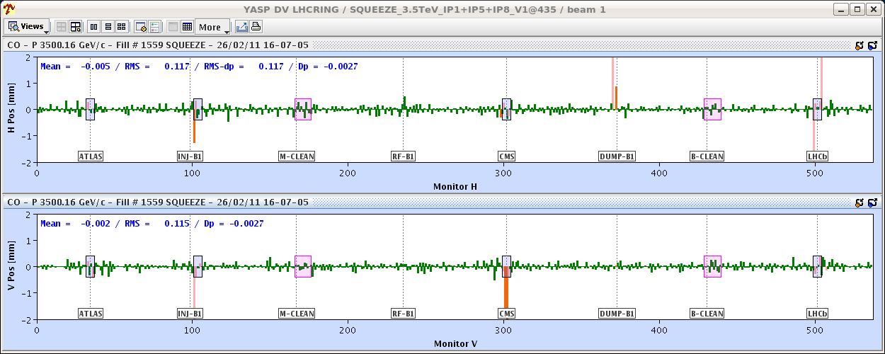
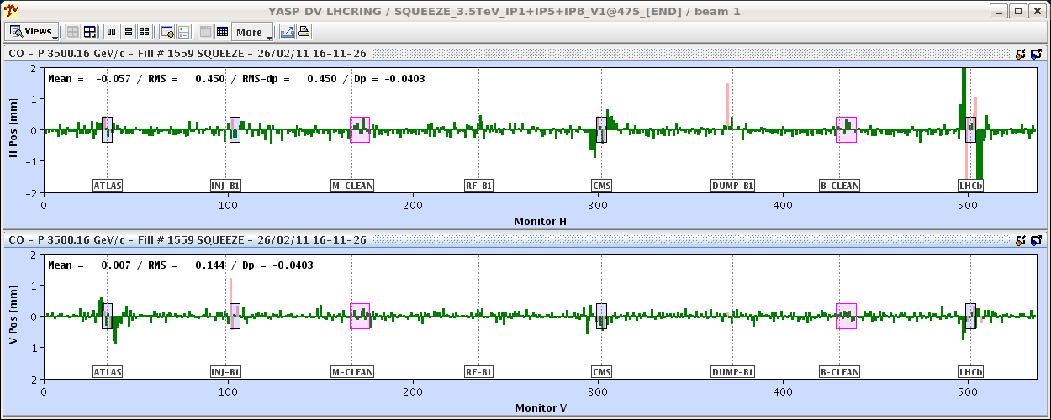
Saturday afternoon
Up ramp into squeeze
Step through looking closely at the orbit (Jorg & Kajetan)
At 1.5 m with correct 1.5 m bump reference.
The same real orbit as in the previous entry, but this time compared to the 10/11 m reference.

Slide 4
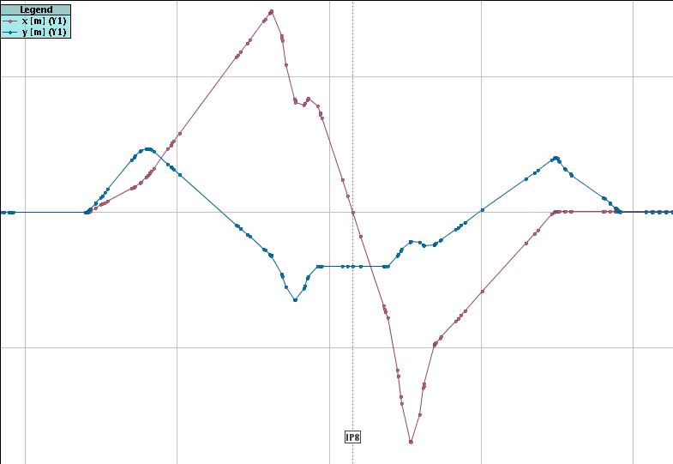
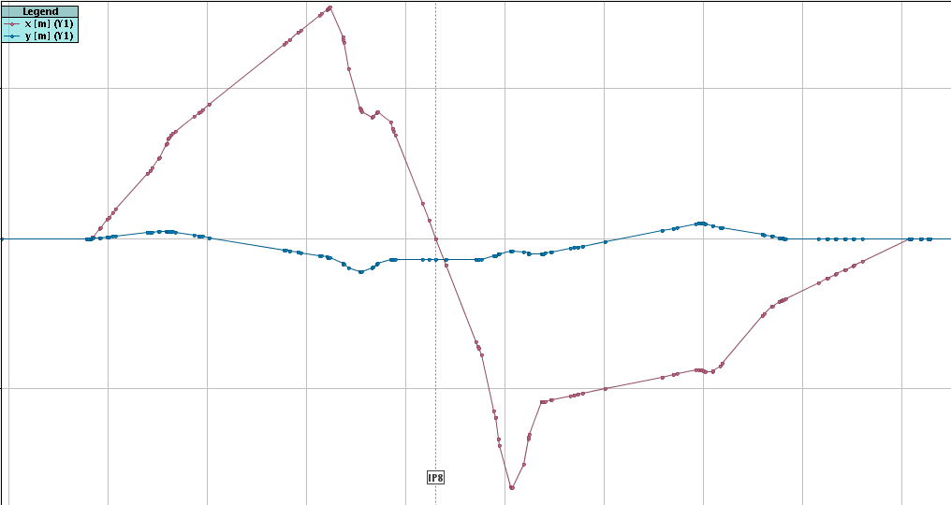
Crossing angle bump shape change
Kajetan

Slide 5
Orbit in squeeze
The orbit issue that we had in IR8 (IR1/5 to a reduced extend) is understood to be a large change in the shape of the Xing angle bump in IR8 (>> than in IR1/5) that we had unfortunately not checked. The difference in BPM readings reaches ~5 mm (!!!) around Q4/5, and the change is most pronounced between 10 and 6 m.
The present reference strategy of the OFB was to give a constant reference in the squeeze, which clearly does not work.

Slide 6
Orbit in squeeze
Possible ways out:
- Try to rematch a different Xing angle bump that minimizes the shape change. That would make life easiest from the control point of view.
- Run the OFB with all BPMs in the crossing angle region disabled - not sure that this works too well - see last years experience ! But this would be a short term solution for the few next squeezes.
- Implement a more sophisticated reference orbit system where we can change the bump shape in the squeeze as a function of b*.
- Prepare a set of reference orbits for different b* values and then send the new references on the fly along the squeeze (Argh !),

Slide 7
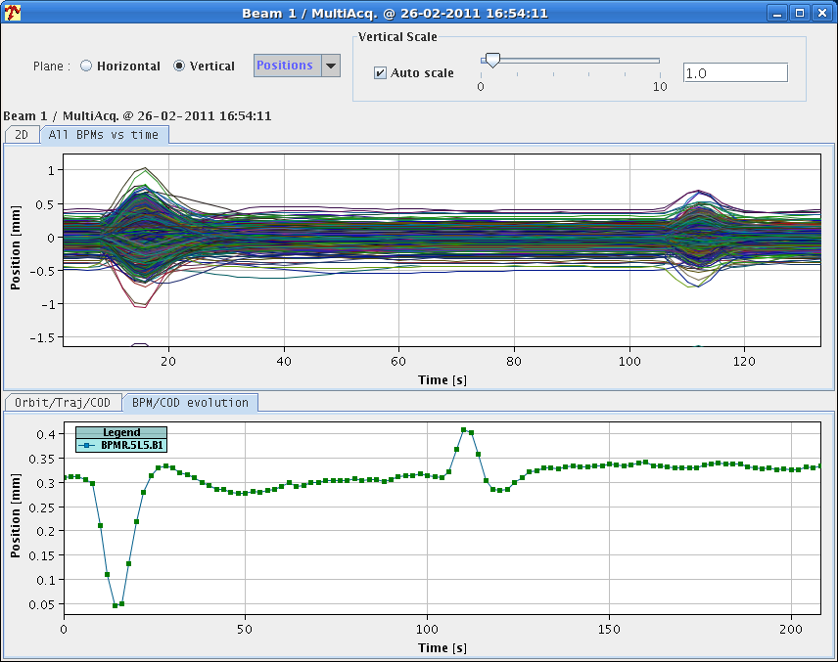
OFB stability
Tested the stability of the OFB by sending kicks of 10 microrad and checking the convergence. OK in all tested cases, when the CODs are near Q4 where the b changed most, the convergence is a bit slower. Note the overshoot on the BPM plot, corresponding to an IR BPM where the optics mismatch FB-machine is 'large'. In fact one can notice on the plot with all BPMs a groupd of monitors that 'bounce' once.
Jorg

Slide 8
18:00 start collimator set-up
01:00 Collimator alignment finished.
Collimator setup - intermediate summary
We started at around 7pm and stopped at 0:30am.
Done within 5h30mins: Beam 1: 17 Collimators (~19min per collimator) Beam 2: 22 Collimators (~15min per collimator)
As already foreseen, we had to repeat all collimators setup yesterday for B1 and all besides 3 collimators in B2. I.e. B1: 17 collimators setup B2: 25 collimators setup (all horizontal and 3 skew collimators)
Ring collimators were put back to the injection settings of last year and the operation should continue with those settings until the new ones are established fully and validation.
Partial settings imported in the collimator beam process "CollimatorBP-450GeV_V1@1".

Slide 9
Overnight – aperture measurements
Performed local scans at the triplets of IP2 and IP8 for both beams, in the crossing planes. Preliminarily, we found the following aperture values (gain with respect to bottleneck in brackets):
IP2 - B1 - V : 14.5 sigmas (+1.5 sigmas)
IP2 - B2 - V : 15.0 sigmas (+2.0 sigmas)
IP8 - B1 - H : 16.0 sigmas (+4.0 sigmas)
IP8 - B2 - H : 16.0 sigmas (+3.4 sigmas)
For the first three cases, the IR bottleneck is found as predicted at the Q2 of either IP sides. For the case IP8-B2-H, the bottleneck is instead found at the TCTVB.4R8 (collimator in the other plane). This indicates a potential problem to be followed up.
Also note that the additional aperture margins are calculated by considering orbit offsets and beam sizes at the BPMS of the Q2 magnets. The proper calculation for the interpolated orbit at the Q2 (peak of the bump) requires an offline analysis.
Stefano Redaelli & Roderick Bruce

Slide 10
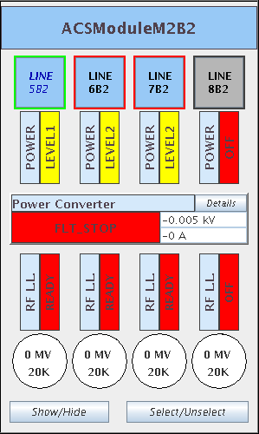
M2B2 is down…

Slide 11
Incoming

