Slide 1
Saturday 3rd December
08:10 Beams dumped
Problem with nQPS controller DQAMGS.RQF12.B10L2.
Restart/reset needed after programmed dump beams.
09:40 QPS problem solved. Starting pre cycle
Injector chain optimization (Django et al)
recovered about 10% in intensity
11:40 Probes in
12:00 Filling
14:05 Stable beams #2339
initial Atlas 4.9e26 cm⁻²s⁻¹
14:35 to 16:40 ATLAS length scale calibration
20:00 Beams dumped - OP request

Slide 2
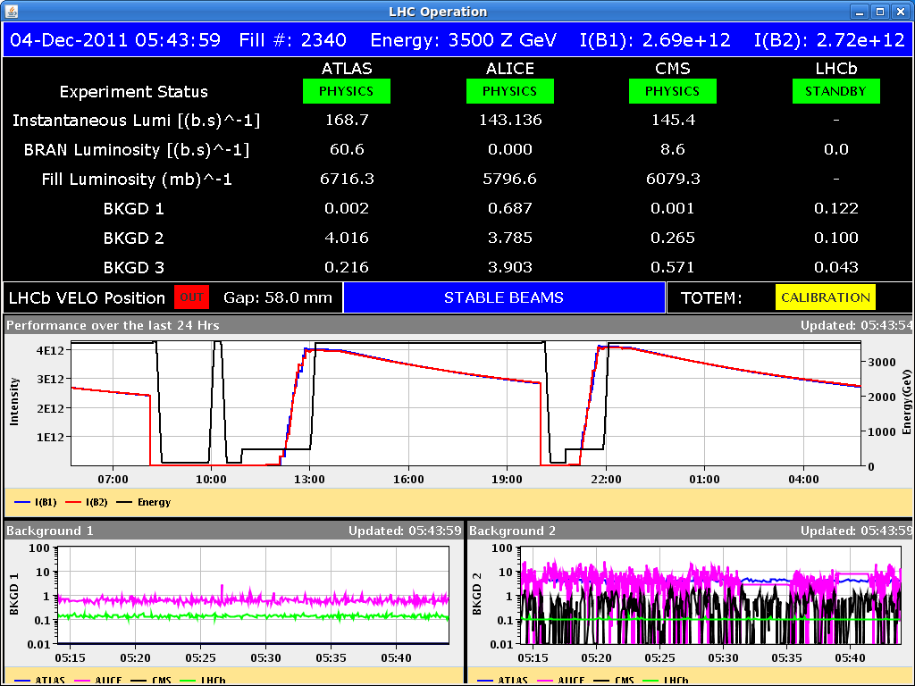
Saturday 3rd December
20:50 Probes
22:55 Stable beams #2340
Initial lumi: ~4.7e26 in Atlas
Itot: 3.99e12
05:50 Beams dumped – OP request

Slide 3
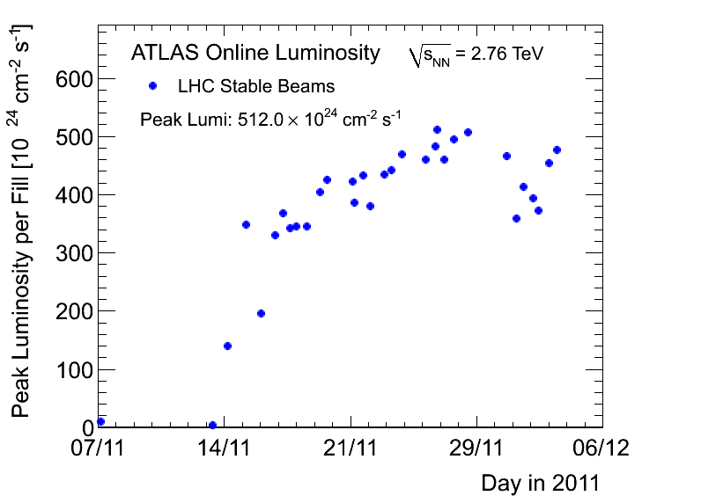
Atlas peak

Slide 4
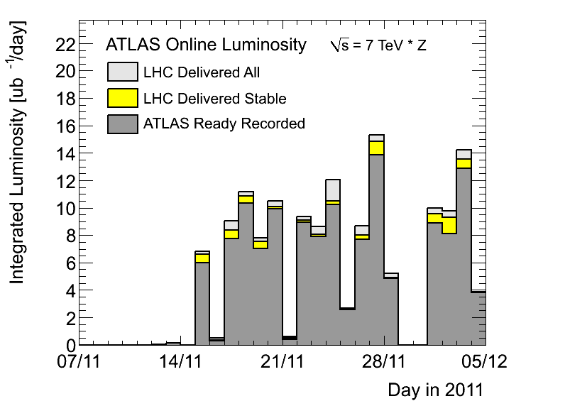
Atlas per day

Slide 5
Sunday 4th
05:50 Beams dumped
Just prior to injecting, L1B1 of the RF gave an interlock that blocked the arming of the BIC, and could not be reset.
Access for Luca Arnaudon
Plus some curious timing problems LHC/SPS/PS…

Slide 6
Incoming
ADT: physics fill with gated damping (24 bunches not damped) to assess possible coexistence damper/BBQ measurement
Use bunch mask to inhibit damping for a normal Physics fill. Do not change any other parameters. The only risk here is that the first bunch train with no damping will suffer more blow-up
Ion Quench test MD (> 8 hours). Proposed for Mon 5/12
Alternative blow-up method
Monday? Test with beam at injection energy. 30 min should be enough. That will provide a rough scaling of the new method vs. the old one (in term of bunch lengthening vs. rms phase noise)
Monday, Tuesday or Wednesday. Test in the ramp with a least 2 batches evenly spaced around the ring. We could also go for a full physics filling.
100 ns checks in SPS

Slide 7
Recent fills
 |  | CMS e24 | SB [hr] | CMS [fb-1]
28.11 | 2332 | 460 | 1:12 | 1.7
1.12 | 2334 | 426 | 5:45 | 5.1
1.12 | 2335 | 334 | 5:46 | 4.2
2.12 | 2336 | 375 | 6:14 | 4.8
2.12 | 2337 | 371 | 4:15 | 3.2
3.12 | 2338 | 345 | 7:39 | 5.3
3.12 | 2339 | 417 | 5:55 | 5.1
3.12 | 2340 | 442 | 7:01 | 6.2

