Slide 1
Cryo problem – point 4
At 20:26 water level sensor of the cooling tower SF4 at pt 4 had a short-circuit, which resulted in an electrical shutdown of the tower (24V). This cut the water to the cryo and at 20:29 the cryo installation at pt 4 switched off.
Deterioration of insulation vacuum on DSLC

Slide 2
DSLC Pressure Rise 29 Nov 2011
permanent
turbo
pump
permanent
turbo
pump
vac
gauges
vac
gauges
DSLC 500 meters
DFBLC
Arc 3-4
Q7R Q11R
annex volume
current lead?
heater?
Sector 3-4
UJ33
Simplified insulation vacuum layout

Slide 3
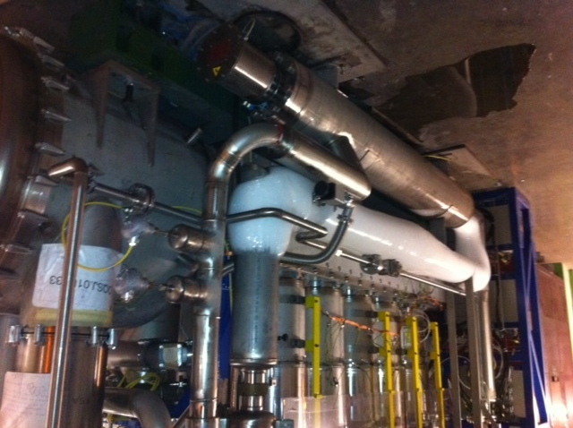
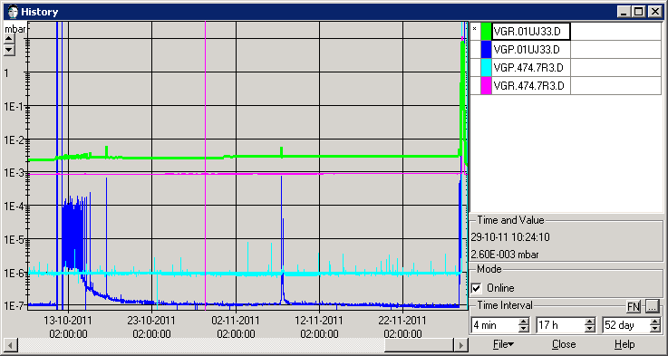
Icing of annex volume Oct 2011,
Pressure perturbation seen on DSLC
when put into communication with annex
Self recovery of pressure indicates air leak

Slide 4
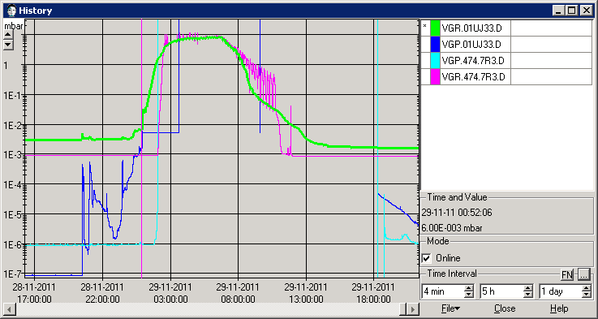
DSLC Pressure Rise 29 Nov 2011
UJ33
Sector 3-4
permanent
turbo
pump
permanent
turbo
pump
vac
gauges
vac
gauges
DSLC 500 meters
DFBLC
Arc 3-4
Q7R Q11R
annex volume
- current lead, heater?
Summary of events:
Ice observed on DFBLC annex volume Oct 2011
Annex volume connected to DFBLC volume 11/10/11
Cryo stop P4 28/11/2011 pm
Pressure in DSLC rises to 10 mbar in few hours
VSC piquet intervention to install mobile pump
Nominal vacuum conditions re-established
Annex volume still in communication!!
Cause of leak ??
Consolidation to do??

Slide 5
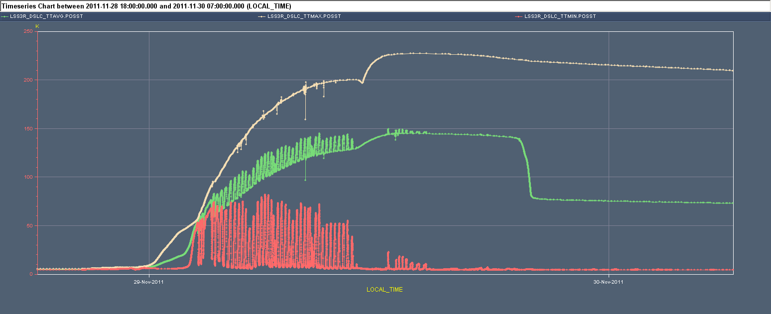
Max. Temperature on DSLC reaching 250 K at 14:00 and in a short period ➔ need ELQA before powering (A. Siemko)

Slide 6
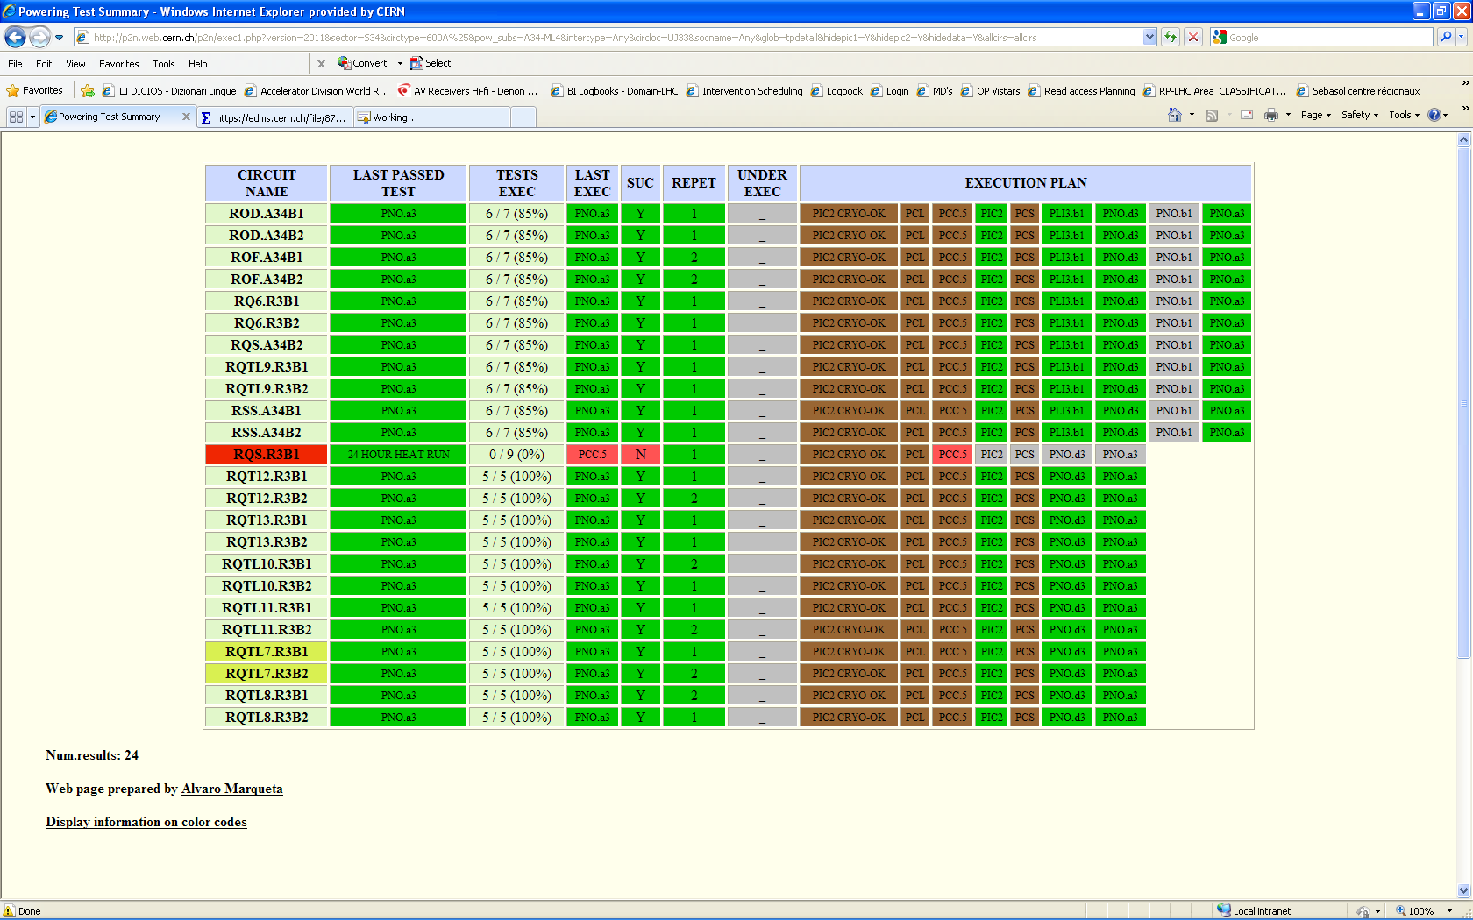
600 A on Sector 34 (M. Pojer)
Not powered from DSLC
Not used

Slide 7
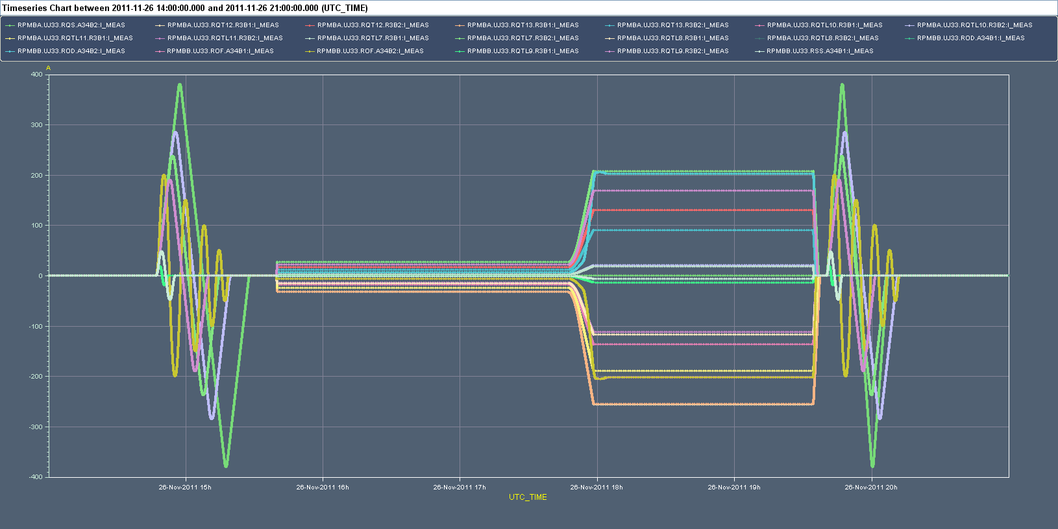
Currents on the circuits powered via DSLC

Slide 8
Plan
09:00 Access for blocking out power converters (EPC) + patrol for verifying the DSL (ice or condensation) – VSC+CRG
10:00 Access for disconnecting cables
12:00 at the earliest cryo conditions for ELQA
ELQA (~2 hours)
Re-connection (~2 hours)
Unblocking power converters
HW commissioning tests over (part of) night ➔ need MP3 and QPS support. Possible list (M. Pojer, A. Siemko)
PIC2_CIRCUIT QUENCH VIA QPS
PCS (to check the splices)
PNO.a3 (cycle to full current)

Slide 9
In the best case fill in the early morning
Van der Meer scan starting in the late morning/afternoon.

