Slide 1
Overview LHC Operation Week 47
Coordination:
Joerg Wenninger, Barbara Holzer,
John Jowett for the ions

Slide 2
Sunday 27.11.
3 long fills ended by operators; stable beams:
0:03 – 6:11 Fill 2328
Afterwards: access for QPS reset MB cell 11 L1
12:29 – 18:47 Fill 2329
22:03 – Mon 5:12 Fill 2330
After last fill reset of new QPS cards
DC BCT problem under investigation by Patrick Odier
6:16 pre-cycle
Now: switching ALICE polarity
Afterwards: fill with reduced number of bunches

Slide 3
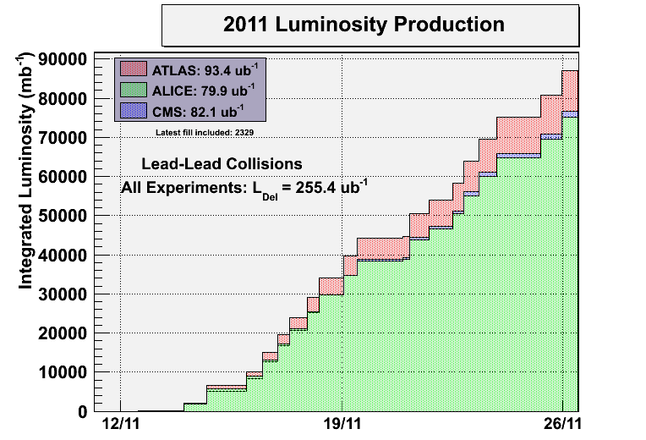
Atlas luminosity measured ~15% higher than CMS – this discrepancy is expected to be sorted out this week with the VdM scans.

Slide 4
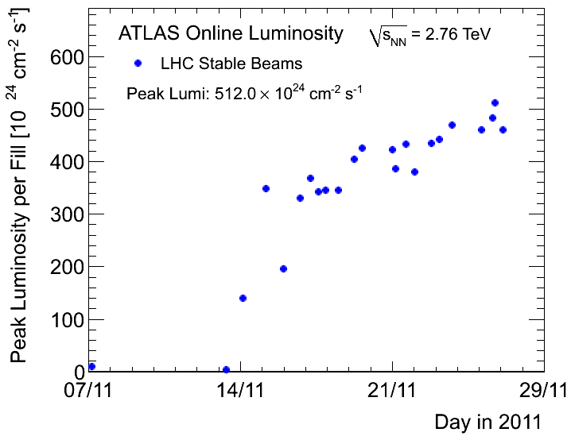
Peak luminosity slowly increasing

Slide 5
Fills with Stable Beams
Fill # | Start Stable beams | Duration [h] | Initial lumi (Atlas) | Int. lumi (Atlas) | Reason Dump
 |  | [hh:mm] | [10²⁶ cm-2s-1] | [ub-1]
2314 | Mon 23:30 | 0:23 | 4.5 | 0.5 | QPS (RB.23)
2315 | Tue 4:33 | 7:21 | 4.2 | 5.8 | Programmed dump
2316 | Tue 19:35 | 2:50 | 4.7 | 3.3 | RF trip (quench)
2317 | Wed 13:15 | 4:57 | 4.1 | 4.5 | Programmed dump
2318 | Wed 21:53 | 5:36 | 4.6 | 5.5 | Programmed dump
2319 | Thu 9:04 | 9:02 | 4.7 | 5.7 | Programmed dump
2320 | Thu 22:45 | 5:23 | 5.0 | 5.7 | Programmed dump
2325 | Sat 8:04 | 5:43 | 4.8 | 5.6 | QPS, trip of RQF/RQD.A45
2327 | Sat 19:58 | 0:34 | 5.2 | 0.9 | LBDS Self-trigger
2328 | Sun 0:03 | 6:08 | 5.3 | 6.4 | Programmed dump
2329 | Sun12:29 | 6:18 | 4.9 | 6.2 | Programmed dump
2330 | Sun 22:03 | 7:09 | 5.2 | 6.9 | Programmed dump

Slide 6
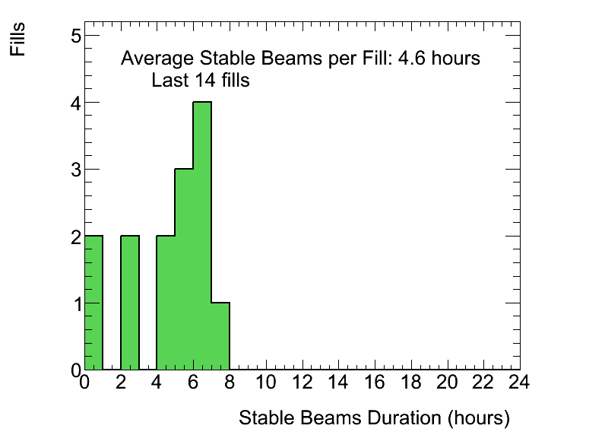
Operator dump after ~6 hours in stable beams

Slide 7
Beam Current and Luminosity Plot
source refill +
LINAC3 + POPS + RF
Cryo
POPS
POPS
Q FB B1 H triggering QPS RQTF

Slide 8
Monday: Orbit FB test using a fill for a test dump
Orbit transients at the ‘matched points’ (where we pass a matched optics) – issue for tight collimators.
Transients are due to mis-match of the Xing and separation bumps due to optics interpolation between matched points.
LHCb Xing bump of 250 urad is driving source !
Simplest cure: faster orbit FB for better damping…
Beam 1
Squeeze to 1.5 m

Slide 9
OFB gain – response to a kick – 3.5 TeV
Default
Gain x 5
Gain x 10
IR 1+5 at 1 m, with
Injection optics

Slide 10
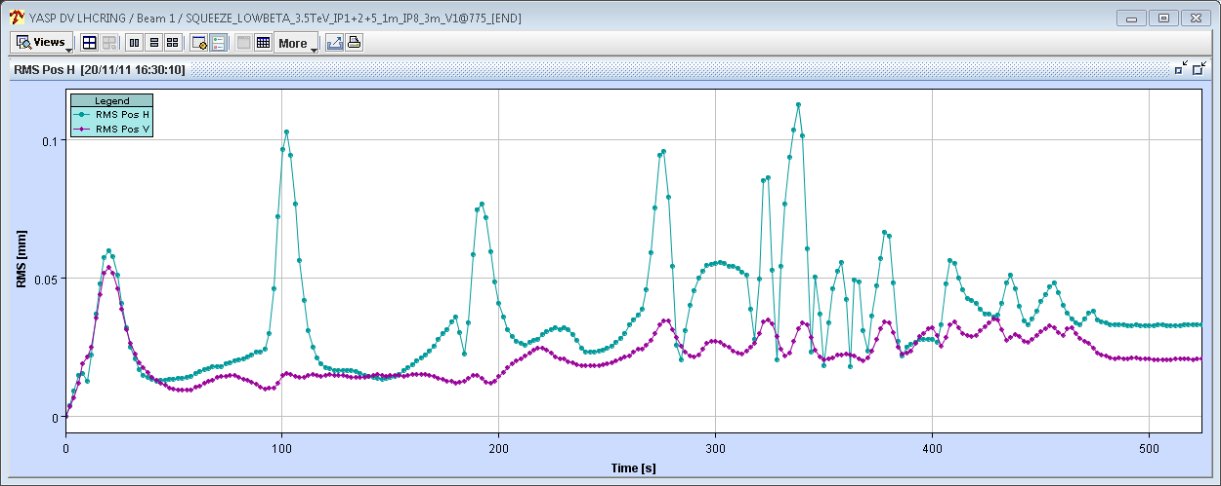
The good… IR1+5 to 1 m
40 um
Gain x 10
40 um

Slide 11
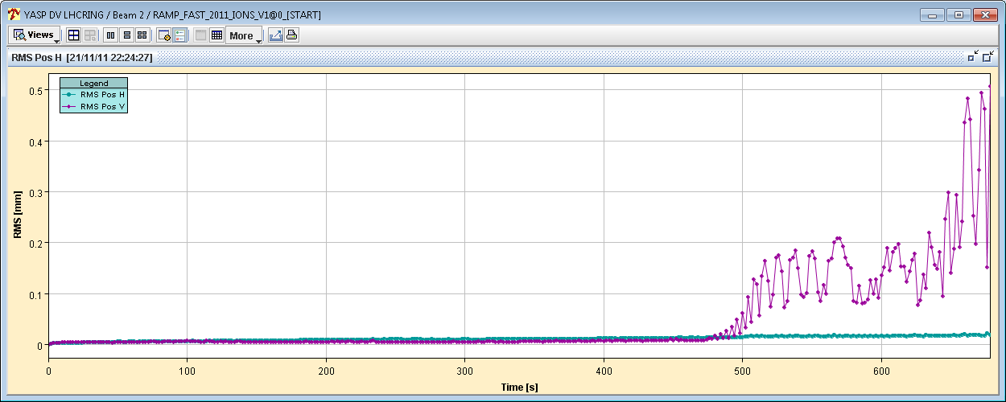
The bad… RT trim oscillations IR2 to 1 m
In the end the gain was not increased, as it did not work during the IP2 squeeze (large oscillations lead to a dump with factor 10 increase)
Beam2
400 um

Slide 12
Wednesday test of TETRA
TETRA: new radio communication network
Aurelie Pascal:
23.11. from 16h to 17h30, during stable beams
We first switched ON our TETRA repeater for a first record of measurements and then switched it OFF to check the impact on the beam.
Finally we let it ON for a period of 1h from 16h30 to 17h30 for a further analysis.
Influence on beam (hump?): Nothing evident. Off-line analysis required.

Slide 13
Thursday - SUMMARY OF END-OF-FILL STUDIES
REVERSAL OF ALICE EXTERNAL CROSSING ANGLE
15:01 – 16:00 Test to validate the proposal of a shortened setup after the ALICE polarity reversal.
Beams separated by 0.7 mm horizontal at IP2 (~60% of their initial intensities)
Crossing angle changed from -80 urad to +80 urad in steps of 10 urad
This exposed the beam to parasitic encounters in the triplet and D1 magnets with less than 1 sigma separation.
Test very successful: Bunch intensity losses, beam emittances (BSRT), longitudinal beam size not affected by the flip of the crossing angle!

Slide 14
Thursday SUMMARY OF END-OF-FILL STUDIES
John Jowett:
BFPP ALLEVIATION STUDY
We tried to apply the procedure to the highest BFPP loss peak from Beam 1 right of CMS.
A 3 magnet bump of the horizontal orbit was set up and used to displace the closed orbit inwards at the Q11 in order to reduce the flux and the angle of incidence of the secondary Pb81+ beam from the IP on the chamber. We observed a reduction of the highest BLM peak at the MB cell 11 by a factor approaching 5. Signals in nearby BLMs (Q11) increased somewhat, consistent with the spreading of the loss spot due to the larger angle of incidence. The amplitude of the bump was limited to -2.6 mm for machine protection reasons. This was insufficient to create a second loss spot at the Q13.

Slide 15
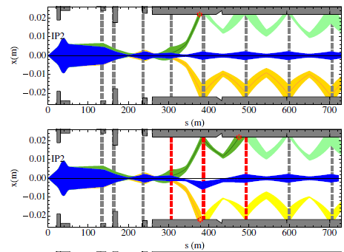
BFPP ALLEVIATION STUDY - Slide from John Jowett
Bump strategy studied a few years ago
–R. Bruce et al, Phys. Rev. ST Accel. Beams 12, 071002 (2009)
–Local bumps in DS, few mm amplitude
–Aperture still OK at 3.5 Z TeV
–Losses can be spread out or distributed over two loss points
–Should be able to see changes of loss peaks in BLMs
6 sigma envelopes at 7 Z TeV

Slide 16
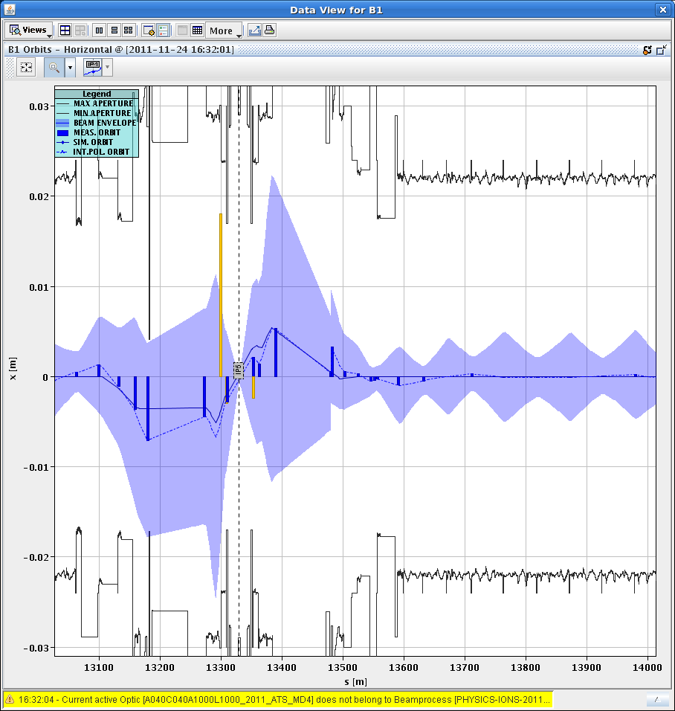
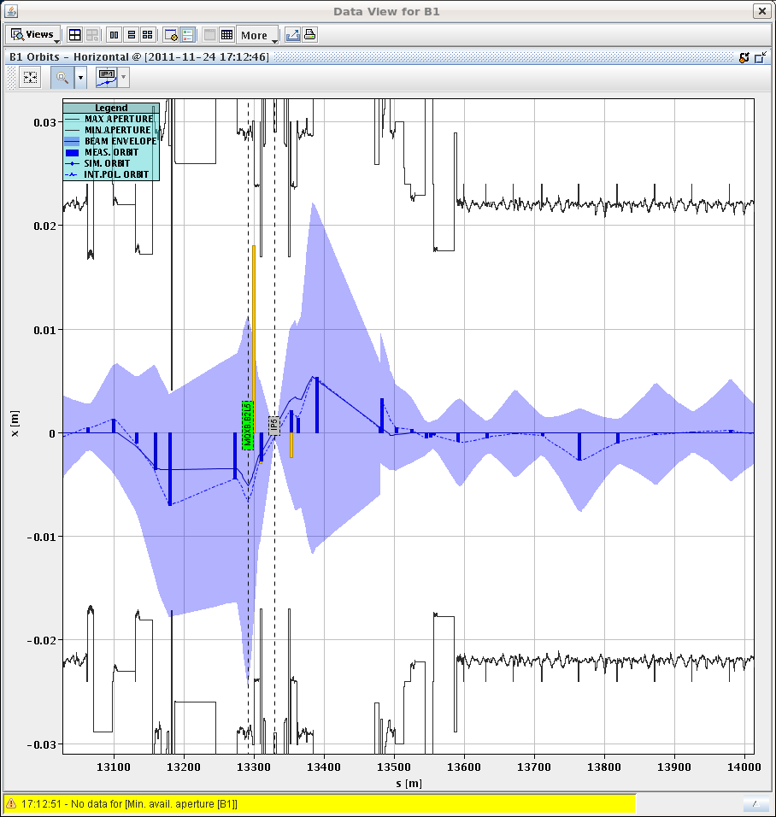
Orbit bump -2.6 mm HOR at Q11.R5.B1 (steps of 0.2mm)
12 sigma envelopes
without bump with bump

Slide 17
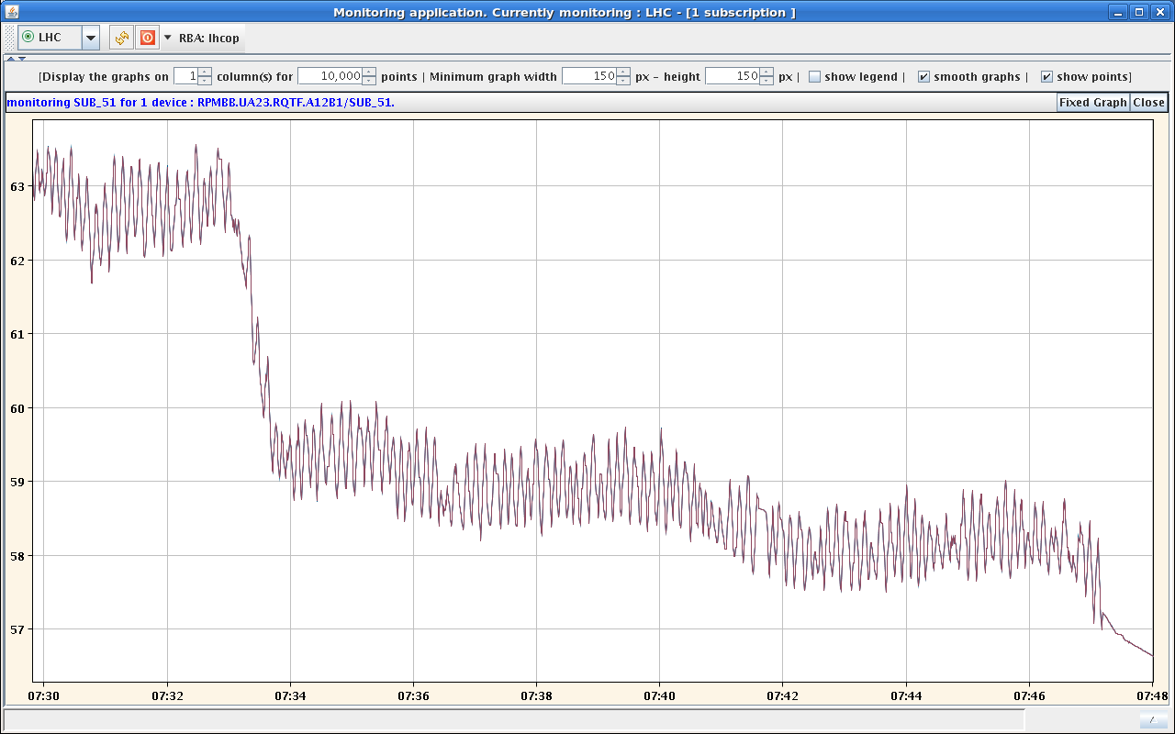
Friday: Tune feedback and RQTF QPS
Friday 6:39 dump of fill #2321 during squeeze: RQTF.A12B1 tripped
Friday 9:58 Fill 2322, 3 RQTF circuits tripped: RQTF.A12B1, RQTF.A23B1, RQTF.A67.B1
again due to tune FB on B1 H plane triggering the RQTF QPS
→ following fills horizontal tune feed-back off during ALICE squeeze (either B1 alone or both beams)
RQTF current in the squeeze

Slide 18
Saturday Fill 2325
13:11 dip in lifetime (beam intensity, luminosity) and bunch length; abort gap intensity going up to 5E9

Slide 19
Saturday RF checked by Andy Butterworth
No obvious noise on cavity fields, except that 4B1 is noisier than the rest during this fill (maybe due to increased voltage?). B1 cavities were running at 1.9 MV in this fill as we were down to 6 cavities. Perturbation seen on beam control loops, both beams.
This looks similar to the event we had a couple of weeks ago for which we thought we had found the cause (a wrong delay calibration after a firmware reload), but maybe this was not it.
This needs more investigation by the experts.

Slide 20
Others
Cryo Pt8: Conditions have stabilized for the filter of cryo Pt8. We can carry on without stop of the cryo. Will hopefully be fine till end of run.
RF voltage at 3.5TeV: now at 12 MV both beams
Mobile BLMs installed in IP2 (TDI.4L2.B1, TCTVB.4L2, MBXA):
Readout of these monitors is not compatible with current DB and software settings → solutions under investigation
PM machine protection SIS interlock after the beam dump without clear reason, reset by PM expert but to be looked at Monday.
Today 00:50: The fire brigade just came to announce that during a routine visual inspection around point 2 they saw lots of water coming though from TZ32. (They checked with RP: the water is not radioactive).
Coordinators this week: Mike Lamont and Gianluigi Arduini

Slide 21
Outlook
ALICE polarity change probably Monday
VdM scan probably Tuesday
ADT tuning and verification tests:
Loss maps at injection using ADT (MD preparation); possibly Tuesday (max 1 h)
~1 hour end-of-fill study to measure damping time at top energy
Beams separated
Kick beam with Qkicker (a small amplitude <0.5 is sufficient)
Try to improve tune measurement by “gating off” the ADT for the first batch injected (Tuesday after)
Wire scan measurements at injection. If OK: ramp & squeeze; if problem: switch on damper for all bunches on the fly
Look at specific luminosity to see what lumi cost
Quench MD (approx. 8 hours, at the latest on Monday 5.12.): induce losses (using ADT or resonance crossing) at IP7 collimation and possible magnet quench in DS (cell 11 left of IP7)

