Slide 1
Thursday 24 November 2011

Slide 2
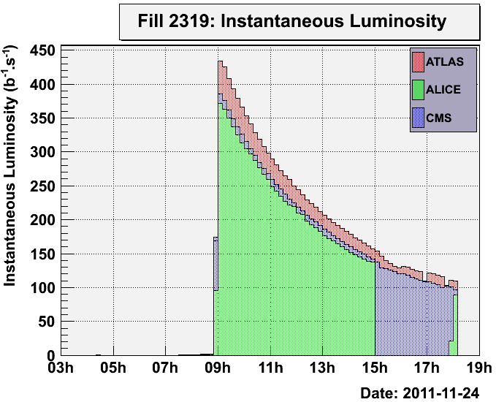
9:04 – 15:01 and 18:06 Stable beams Fill 2319
15:01 – 16:00 end-of-fill study for ALICE polarity change next week:
Beams separated by 0.7 mm horizontal at IP2
Crossing angle changed from -80 urad to +80 urad in steps of 10 urad
Test very successful: Bunch intensity losses, beam emittances (BSRT), longitudinal beam size not affected by the flip of the crossing angle!
16:00 Beam separation set back to 0 in HOR plane. Colliding again in IP2. Losses increase and beam lifetime decreases again for B1.
16:00 RF problems in the SPS: Since it is not possible to re-inject, proceeded to BFPP alleviation study
17:42 – 18:06 back to stable beams
18:06 programmed dump. Integrated Luminosities: ATLAS: 5.7 ub-1, ALICE: 4.8 ub-1, CMS: 5.2 ub-1

Slide 3
SUMMARY OF END-OF-FILL STUDIES (John Jowett)
REVERSAL OF ALICE EXTERNAL CROSSING ANGLE
This was a test to validate the proposal of a shortened setup after the ALICE polarity reversal.
We re-separated beams at ALICE with about 60% of their initial intensities and then changed the external crossing angle from -80 to +80 micro rad in steps of 10 micro rad.
This exposed the beam to parasitic encounters in the triplet and D1 magnets with less than 1 sigma separation.
There were no significant losses or increase of emittance during the procedure.

Slide 4
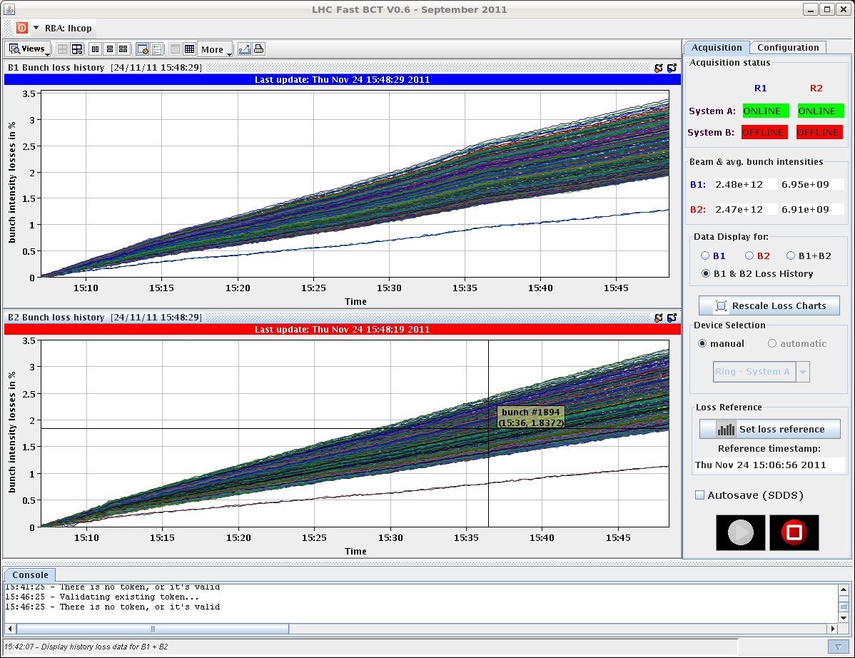
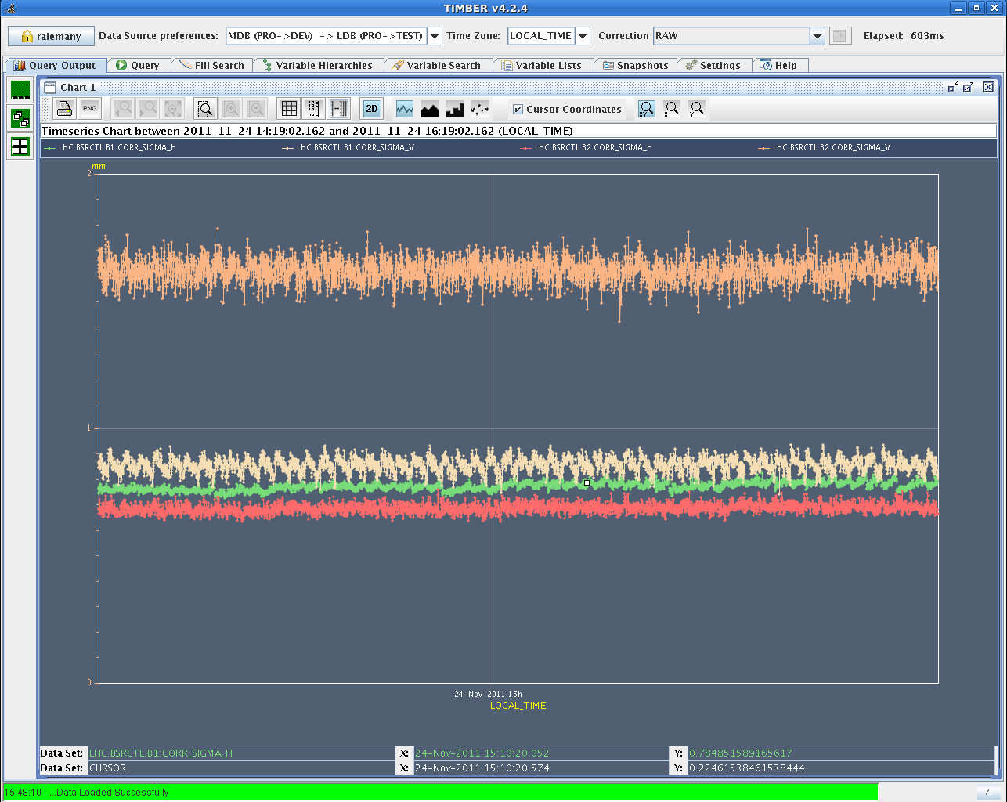

Slide 5
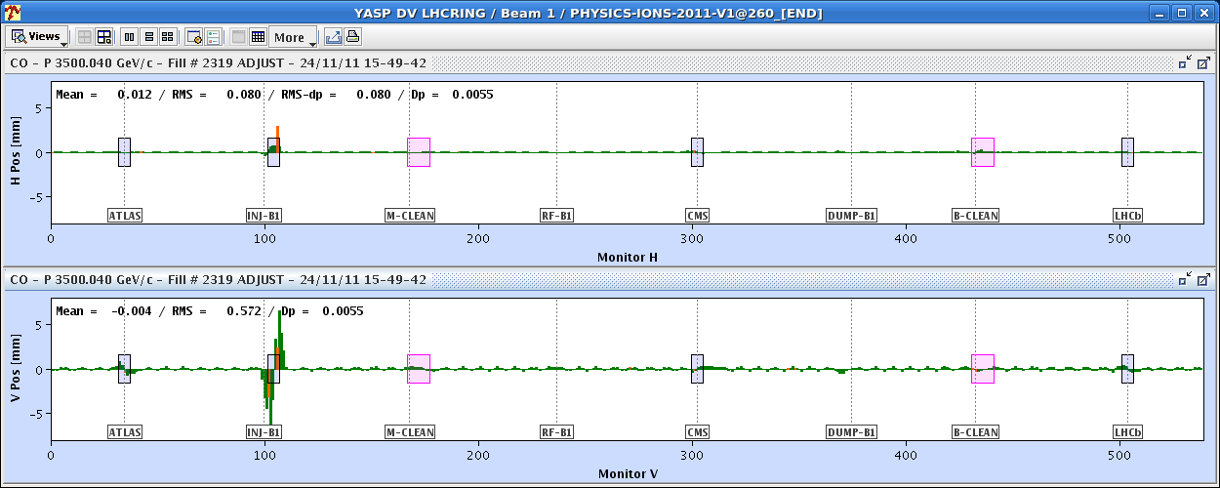
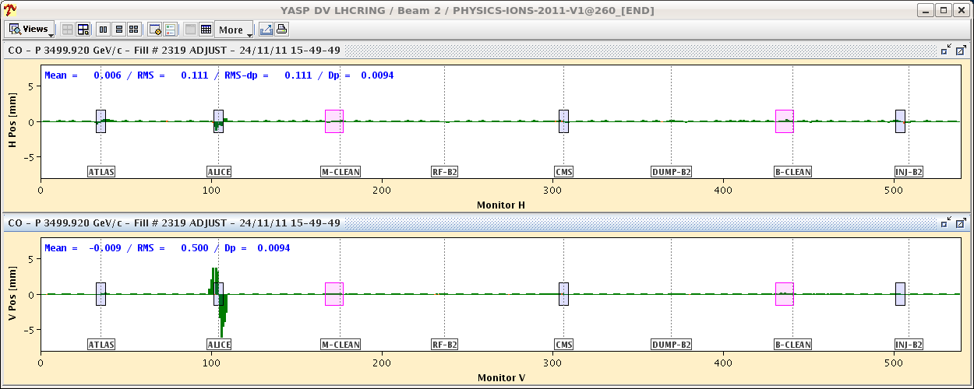

Slide 6
SUMMARY OF END-OF-FILL STUDIES (John Jowett)
BFPP ALLEVIATION STUDY
As this unexpected opportunity arose before rMPP approval had been given, we cleared it by phone and email.
We tried to apply the procedure described in Section IX of Physical Review Special Topics - Accelerators and Beams 12, 071002 (2009) to the highest BFPP loss peak from Beam 1 right of CMS.
A 3 magnet bump of the horizontal orbit was set up and used to displace the closed orbit inwards at the Q11 in order to reduce the flux and the angle of incidence of the secondary Pb81+ beam from the IP on the chamber. We observed a reduction of the highest BLM peak at the Q11 by a factor approaching 5. Signals in nearby BLMs increased somewhat, consistent with the spreading of the loss spot due to the larger angle of incidence. The amplitude of the bump was limited to -2.6 mm for machine protection reasons. This was insufficient to create a second loss spot at the Q13. Putting the bump back to zero did slightly increase the loss there but further analysis is necessary for a detailed interpretation.

Slide 7
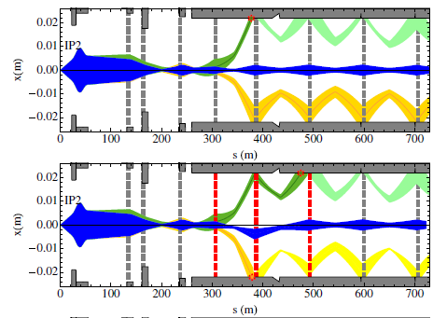
BFPP ALLEVIATION STUDY - Slide from John Jowett
Bump strategy studied a few years ago
–R. Bruce et al, Phys. Rev. ST Accel. Beams 12, 071002 (2009)
–Local bumps in DS, few mm amplitude
–Aperture still OK at 3.5 Z TeV
–Losses can be spread out or distributed over two loss points
–Should be able to see changes of loss peaks in BLMs
6 sigma envelopes at 7 Z TeV

Slide 8
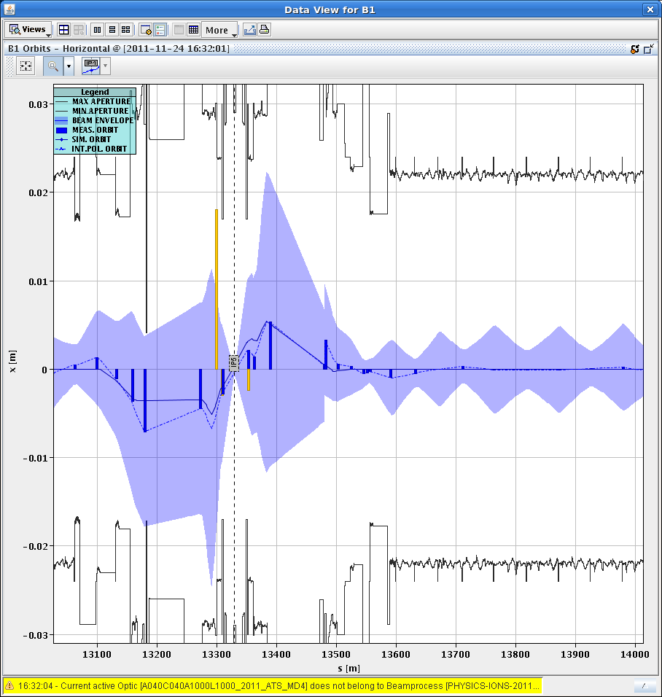
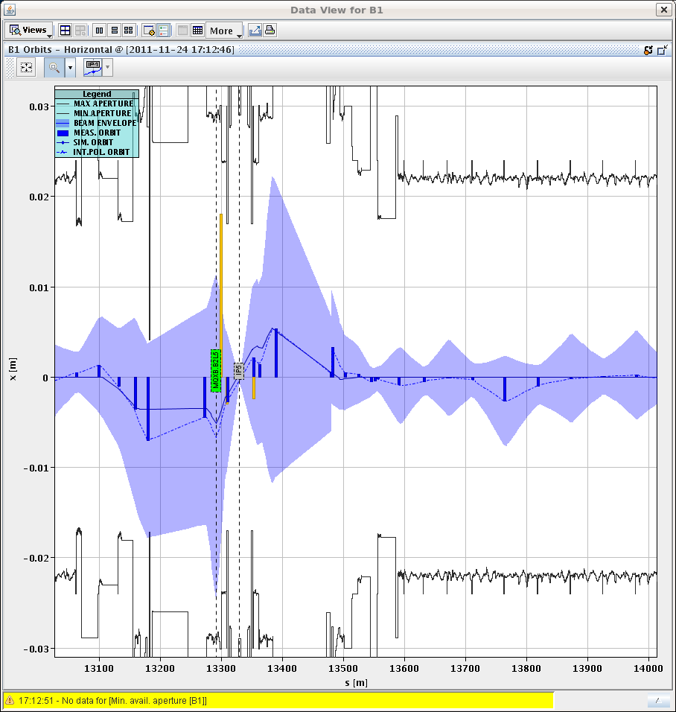
Orbit bump -2.6 mm HOR at Q11.R5.B1 (steps of 0.2mm)
without bump with bump

Slide 9
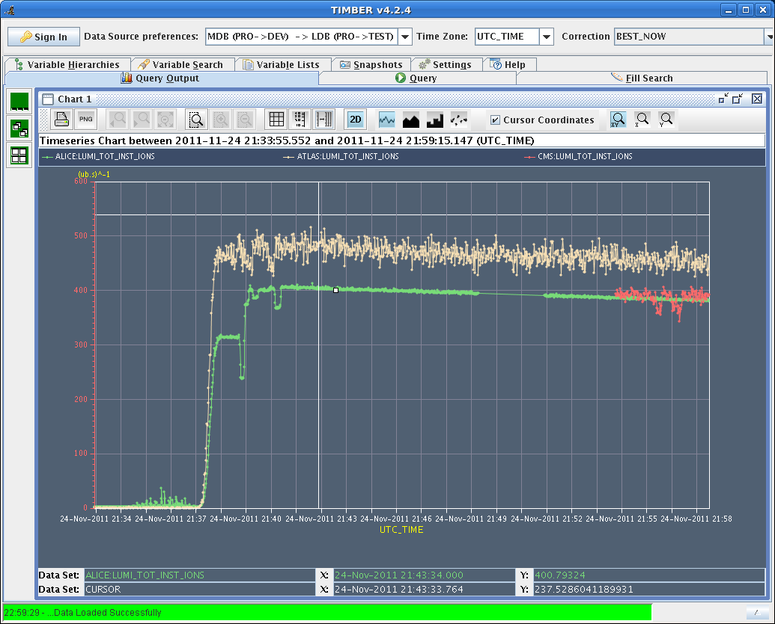
18:50 – 20:00 Lost the cryo in S23 due to a false temperature sensor reading
20:16 injection probe beams
22:45 stable beams fill # 2320
ATLAS ~500 (ub s)-1 (CMS had data acquisition problems at the beginning of the STABLE BEAMS)
4:08 Programmed dump Integrated Luminosities: ATLAS: 5.7 ub-1, ALICE: 4.9 ub-1, CMS: 4.8 ub-1
6:39 dump of fill #2321 during squeeze: RQTF.A12B1 tripped (problem of tune feed back versus QPS?)

Slide 10
Others
Joerg (11:02): New version of YASP released.
The OFB masks and mask comments are now trimmed via LSA settings (non-multiplexed BP) and not send directly to FESA.
This opens the possibility to drive/reload the masks with the sequencer (+ we get the trim history).
12:03 – 14:10 news on POPS
PS trying to switch back to POPS - POPS still not working - Switch back to MPS.
18:21 New version of LHC SIS deployed, server restarted. Fixes for actions triggered by sequencer (like unlatch, unmask).
BLM Signals at beam dump slightly above XPOC thresholds on TCDSA and TCDQA B1
Cryo in IP8
1 out of 4 subconverters of RQ10.R5 broken

Slide 11
Outlook
Fill now
Start source refill as soon as LHC is filled
SPS: work on RF problem
After this fill (probably in the afternoon): access for ALICE (~6 hours)
Physics for the rest of the week (VdM scan beginning of next week)
Today: Source refill (between 6 and 30 hours)
ALICE polarity change probably Monday
VdM scan probably Tuesday

