Slide 1
Friday
~09:20 Source change starting.
10:00 Beam dumped (again) due to tune FB on B1 H plane triggering the RQTF QPS.
Very tricky to anticipate as Q stability not so bad…
Going to access.
cryo in point 8
EPC in PM56 for intervention on RQ10.R5
CMS
LHCb
BLM installation in UJ23
GS/ASE different PM
BI in UX451

Slide 2
Friday
In the afternoon discovered that the addition of more BLMs for Pt2 is not possible due to protections in DB and controls.
HW in place… but not usable.
SPS RF ok again.
Problem on LINAC3 RF delays ion restart.
~21:30 Ion beam back in LEIR.
… but POPS down in PS !
23:00 Ready to fill.
RF trips and dumps from line 6B1.
02:30 Line 6B1 disabled. Intervention needed (faulty PLC).

Slide 3
Night
03:40 Beam lost due to wrong RF configuration when starting the ramp.
Mistake in ramp settings between cavity 6 and 7.
RF settings reconfigured with help of RF low level expert.
11.5 MV at 3.5 TeV.
06:30 filling for physics.
During squeeze of IR2, QFB in H switched off to prevent trips of RQTs.
08:00 Stable beam fill 2325.

Slide 4
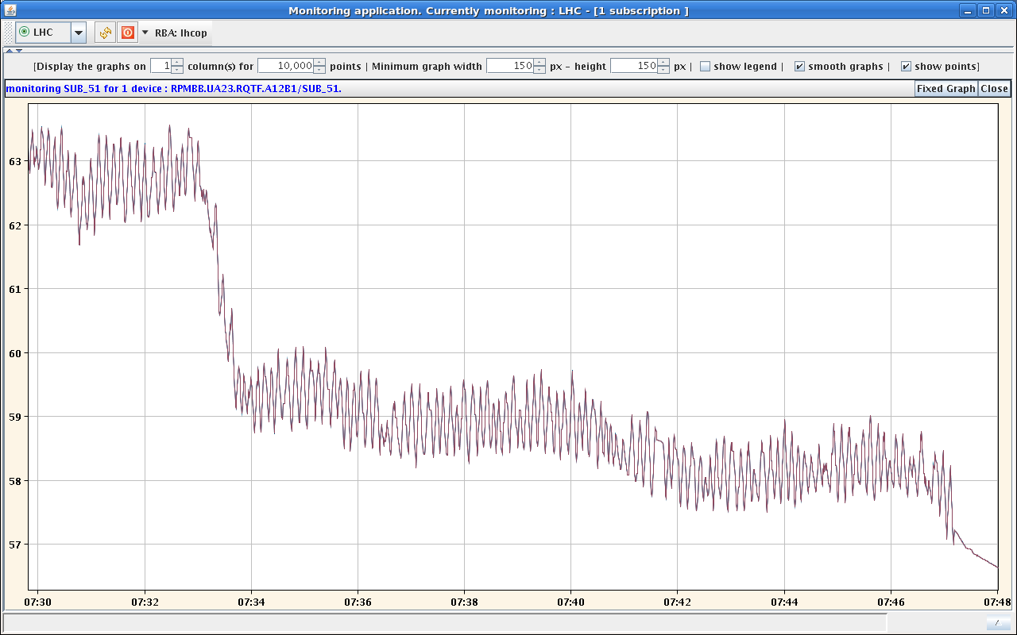
Fill 2325 – RQT in the squeeze…
QPS does not like this…
It can’t be good for the beam either !

