Slide 1
First SMOG gas injection test with beams, 15 Nov 2011
many thanks to
Gerhard Schneider (TE-VSC)
Colin Barschel (PH-LBD)
and many others...

Slide 2
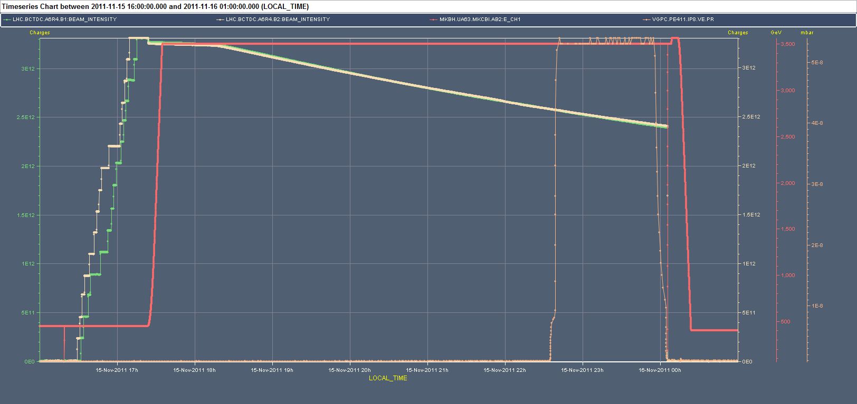
Overview, fill 2297
VELO/beam vacuum

Slide 3
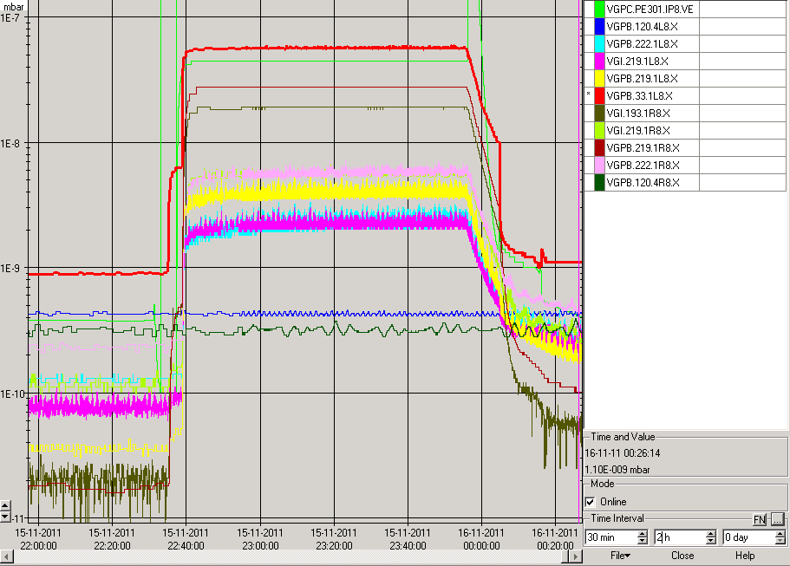
IR8 PRESSURES
velo TP301 pump

Slide 4
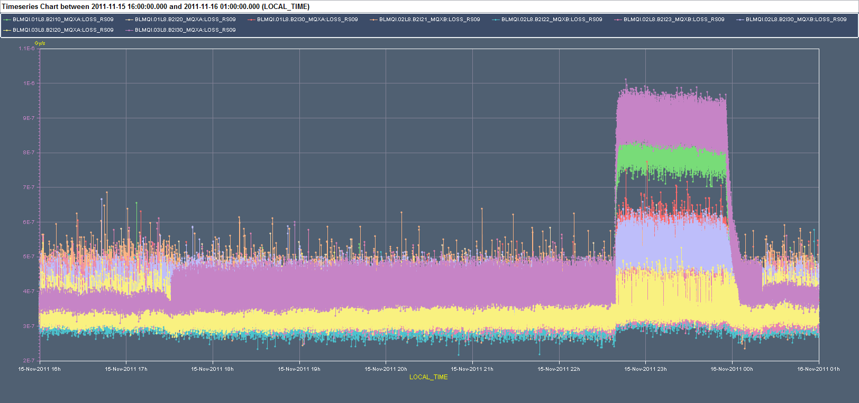
IR8 BLMs, here MQX...B2

