Slide 1
Monday 14th November
∼10:00 PS vacuum recovered after replacing leaky wire scanner by vacuum pipe, start taking ions again.
10:30 XPOC release and checks
11:20 FMCM for RD34.LR7 gives intermittent interlock, ok afterwards (Markus keeping an eye on it)
11:30 Injecting probes
Adjust RF delays for pre-pulse so injection kickers kicking at the same moment, relative to beam, as for protons (this time from calculation instead from ‘scope’)
Still, IQC threshold for MKI need to be updated
Most of the afternoon, waiting for trains of 24 bunches from the SPS
Some problems setting up 24 bunches in SPS
PS 80 MHz cavity
Timing problem SPS / SPS Dump
Bumper in PS

Slide 2
Again... Injection 24 bunches not very smooth
Problem with filling pattern and over-injection of pilot
Change BQM sensitivity to allow over injection
About half the injections are successful: the BQMSPS blocks the other half
Problems copying steering setting of the transfer lines on the SPS side from LHCIONS2 to LHCIONS1
Twice a spurious dump due to excursion at point 6
00:20 Start Ramp
1:30 Stable Beams:
losses at 11R5 reached 38% dump threshold at the start of collisions;

Slide 3
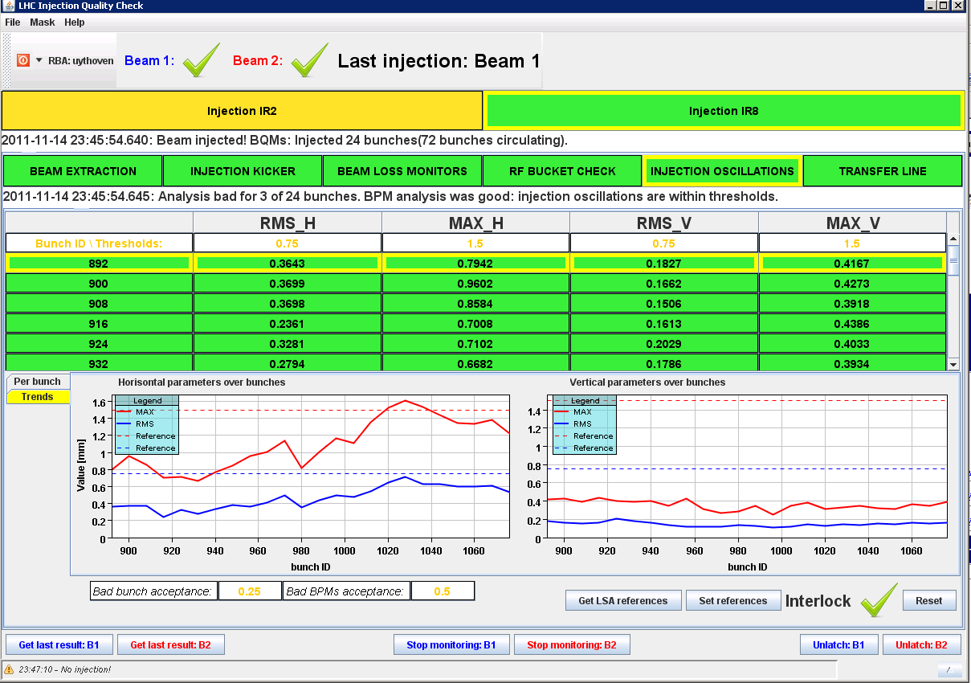
No b2 vertical injection oscillations!
MKE - SPS
MKI - LHC

Slide 4
....and finally made it: 170 x 170 ion bunches

Slide 5
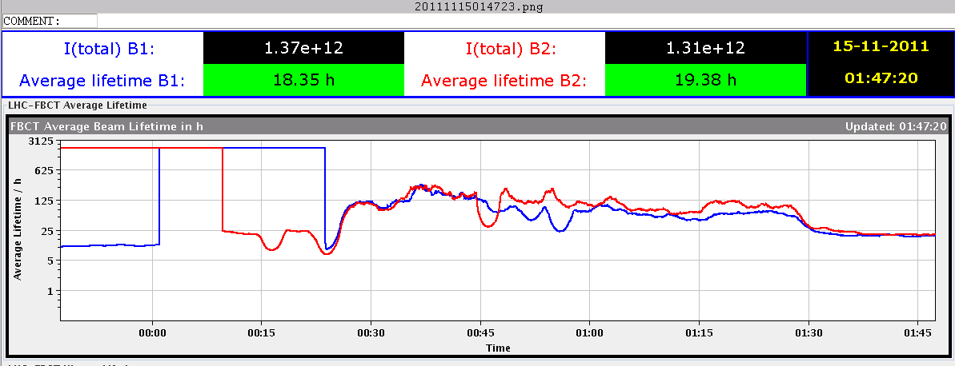
Physics
Optimised lumi’s
ALICE having 144 instead of 168 collisions
19 hours beam life time, very flat
At about 1/3 of initial peak after 2 hours of stable beams,
Half peak lumi after 4.5 hours

Slide 6
8:25 Dump – Abort gap is full
Dumped because of RF interlock: vacuum pump on RF system tripped

Slide 7
Plan
Pb – Pb physics
200ns_170b_168_168_0_24bpi9inj_IONS
200ns_358b_356_336_0_24bpi15inj_IONS
p⁺ - Pb MD and physics (see next slide)
LHCb gas injection (like BGI), half an hour this fill
Some Transverse Damper work
See the wish list from Wolfgang
Access
Installation of four BLMs for IP2 Aperture checks (4hours)
Ready from Wednesday onwards
LDM repair in tunnel, about 1 hour
Beam dump – check of 1 MKD switch B1, about 1 hour
CMS – tunnel for 1 hour
For the moment cryo point 6 is looking better
Leak rate has gone down
144

Slide 8
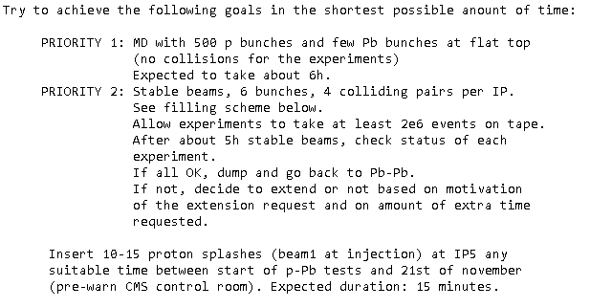
LPC on p⁺ Pb
Normally foreseen for this Wednesday

Slide 9
Wolfgang’s wish list
On the todo list with not so high priority:
end of fill study with separated beams kicking with Q kicker and damper ON, to determine calibration of gain at 3.5 TeV
agree if abort gap cleaning and injection cleaning is to be used or not and possibly check some settings for this
First need BSRA working again
Wednesday: If Pb-p test we need to do some checks and possibly load other settings, to be discussed with Daniel
loss maps with blow-up, do you want to test this, Ralph ?
a mechanism for the fixed display "injection oscillation" is needed to update its calibration (this is slightly different for ions than for protons)
Wolfgang Hoefle

