Slide 1
LHC Status Mon Morning 14 Nov 2011
Bernhard Holzer, Mike Lamont
Weekly Summary: Fri - Sun

Slide 2
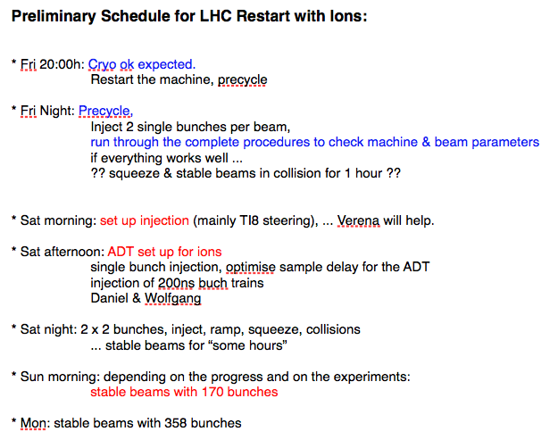
LHC Status Sat Morning 12 Nov 2011
Bernhard Holzer, Mike Lamont
Plan:
Restart for Pb

Slide 3
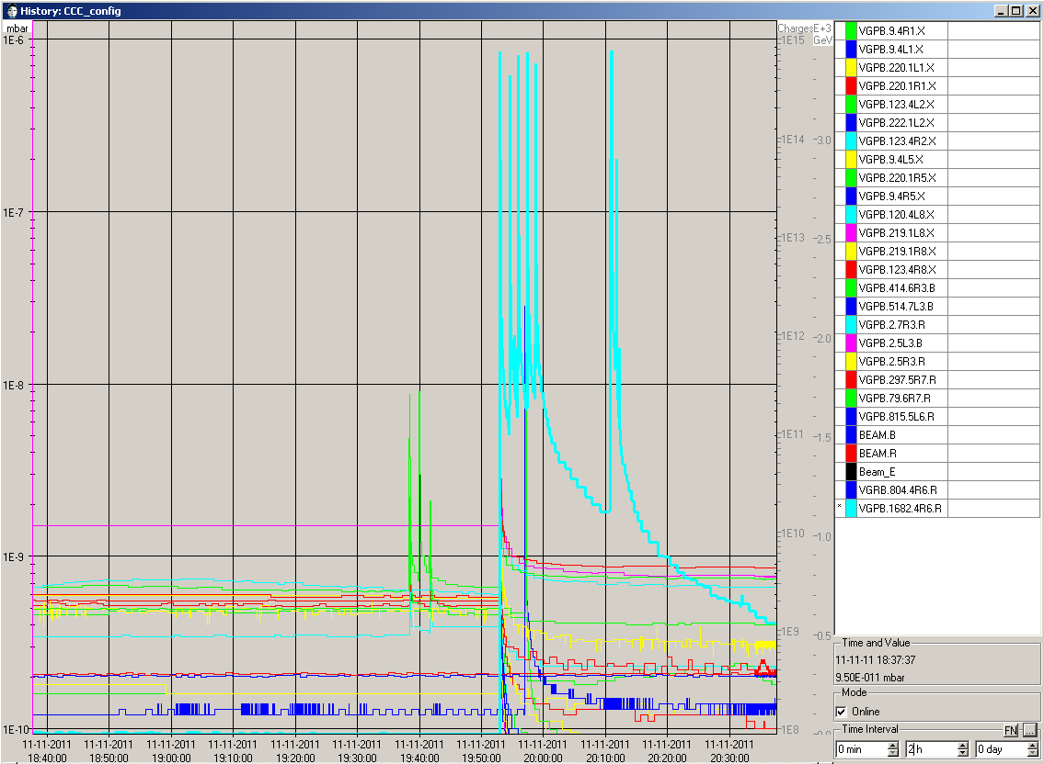
LHC Status Sat Morning 12 Nov 2011
18:40h Sectors 23 45 78 81 prepared for powering
“In 67 only one error left:RCBV26.R6B2
-> FGC_STATE,
Sent an additional off and it cleared out.
20:00h a little bit of vacuum ...
Opening all vacuum valves... sent sequence twice,
not enough. Had to open "Alice" and "CMS" by hand.
Some valves in UP63 stay closed...
Calling up the vacuum piquet.
Outgassing and still rather
high pressure in Q4.R6
10⁻⁶

Slide 4
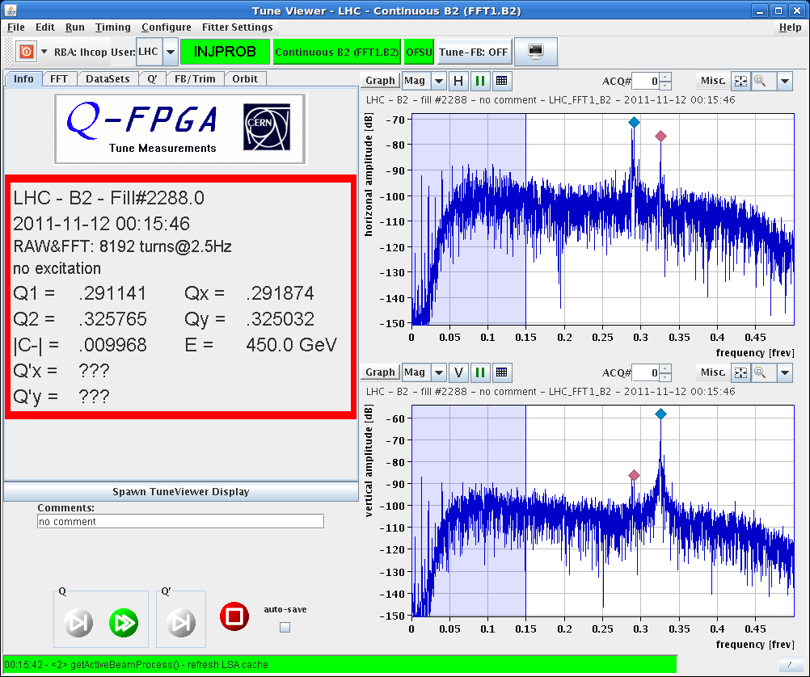
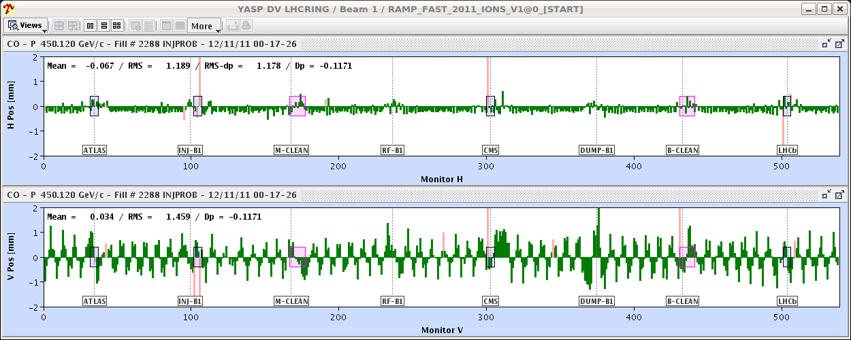
LHC Status Sat Morning 12 Nov 2011
22:02h precycle started
00:00h BEAM MODE > INJECTION PROBE BEAM
orbit correction b1 v ... needs tlc
(BPM.6L7.B1)

Slide 5
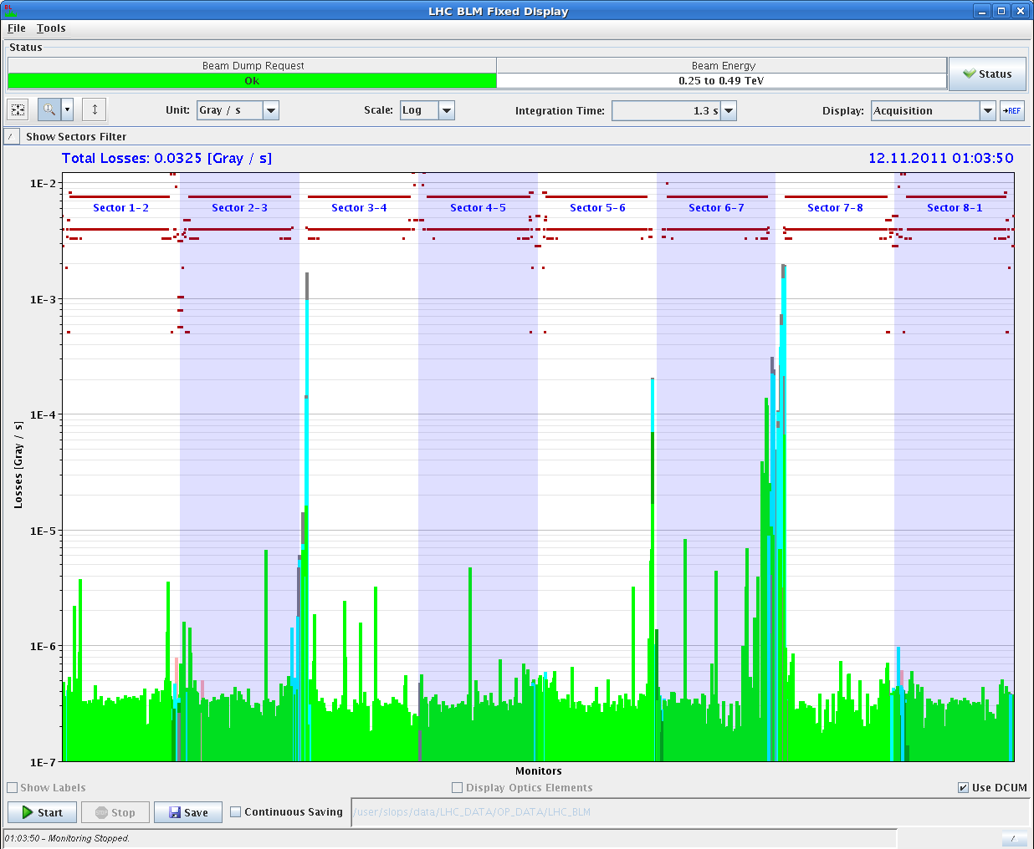
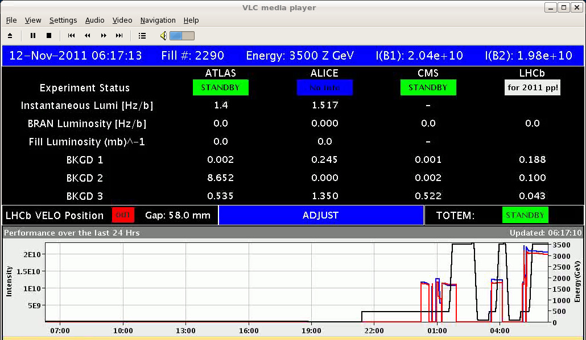
LHC Status Sat Morning 12 Nov 2011
00:48h Asynch beam dump
01:00h Loss Maps: Injection Pb
03:35h Injection, Ramp, Flat Top
05:03h Injection, Ramp & Squeeze ... for physics

Slide 6
Async dumps
12/11/11 at 00:48 at injection:
B1: TCT/TCDQ ratio not measurable. TCDQA.B measures 12.9 Gray/s. 5e-4 times this loss is 6e-3, which is well above the noise level of the TCT BLMs, so loss ratio is below limit.
B1: TCT/TCDQ ratio again not measurable. TCDQA.B measures 11.7 Gray/s, which would again have been enough to measure the TCT losses if unacceptable.
No losses on triplet measured.
Asynch dump ok.
12/11/11 04:08 at flat top:
B1: TCT/TCDQ ratio again not measurable because of too small losses on TCTs. TCDQA.B measures 471 Gray/s, which would have been largely sufficient to measure any losses above threshold.
B2: TCT/TCDQ loss ratio is 1.1e-6, very low for ions.
Triplets are clean.
Asynch dumps all fine – ok for stable beams with multiple bunches.
Jan Utyhoven

Slide 7
LHC Sat Late ADT setting up summary
setting up of the front end started parasitically already with the stable beams in the morning
dedicated setting up continued at ~15hr, the front ends saturate at intensity ~1.6-1.8e11 and 2mm
setting up was interrupted by the CMS access, in the mean time we have updated the LSA functions (phase advance) and pre-calculated settings for the 200ns beam
whole system was verified by measuring the beam transfer function in SR4
intervention finished two hours ahead the expected schedule, now we are waiting 4 hours for beam :-))
Daniel Valuch, Wolfgang Hofle

Slide 8
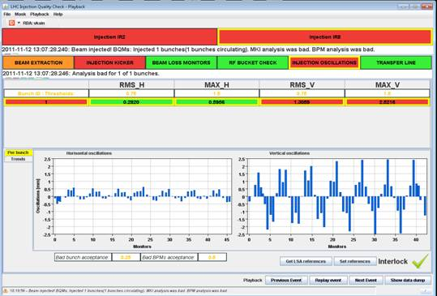
Injection a lengthy story
It looks like the first bunch was on the rising edge of the injection kicker beam 2. The OASIS picture is misleading, the delay through cable length is not included.
*) We completely flattened the trajectory in TI 8 V at the end of the line before starting.
Resulting injection oscillations: 2.5 mm in V
Verena Kain

Slide 9
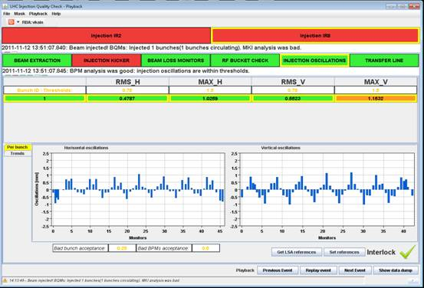
Injection midday
Then adjusted the BT injection pulse delay for ring 2 by 25 ns (removed 25 ns)
Resulting injection oscillations (no other changes): ~ 1 mm in V
Summary: The change of the injection pulse delay improved the oscillations by 1.5 mm. The injection oscillations are now within tolerance, but can now also be even further reduced without increasing the offset within the TCDIs beyond tolerance.
Verena Kain

Slide 10
Saturday evening
19:30 24 bunch set-up in SPS – adjustments required
Fun filling
injecting beam 2, 24 bunches – dump after ~30 turns – BPMs point 6
Adjusted trajectory on first bunch (pilot) but following 23 have large injection oscillations
Transverse damper does its job but interlocked BPMs in IR8 say no (bunch*turn > limit)
Adjusted pre-pulse delay to get all bunches on more-or-less same trajectory and then corrected.
re-synch is required after each trim of the synchro crates

Slide 11
Injection B2
kicker delay moved another -150 ns
kicker pulse
beam inj
After looking in Timber, I think that the MKI8 kick for bunch 1 is now too close to the end of the AGK. The 10ns jitter on AGK window rising edge can now generate missing kick while trying to inject in bucket 1. This has happened already once today during morning shift. So I think that it is worth to add a positive delay of +15ns to the prepulse w.r.t. the 150ns removed yesterday by Stefano. (Etienne Carlier)

Slide 12
Sunday morning
00:30
PC trip in S56: RQT12.R5B2 VS :OUTPUT STAGE POWER SUPPLY :FAULT :UT:LT
Access required
04:20 Access required for Atlas – circuit breaker of water pump
PS announced us a vacuum problem at the location of the wirescanner.
They said the vacuum is degrading rather quickly and an intervention to perform a leak detection would have to be done soon.
the decision was taken to start the vacuum intervention in the PS and let ATLAS repair their detector cooling problem which is still not solved.

Slide 13
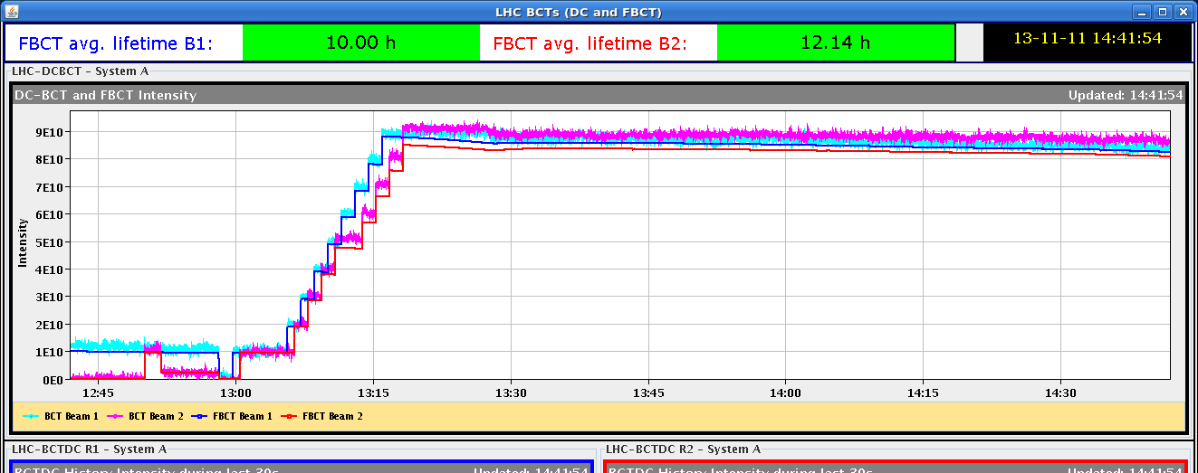
Sun Morning14
11:00h ATLAS access finished, restart
13:04h Injection for physics, ramp, squeeze
14:40h stable beams
9 x 9 bunches
lifetime = 20 h
intensity Np = 10¹⁰

Slide 14
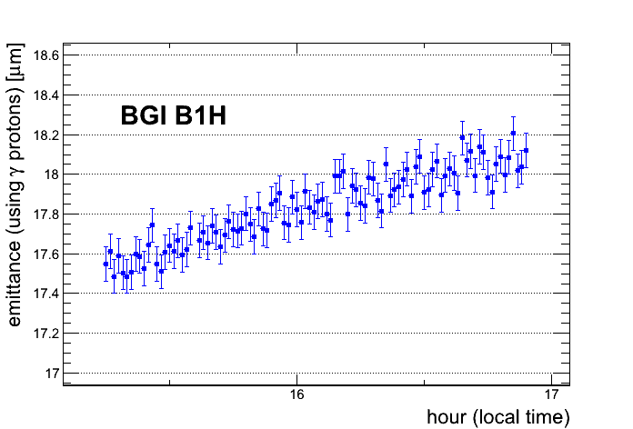
Sun Morning / Late
emittances ... ? B2V 2.45
B2H 5.6
B1H 5.2
B1V 1.74
bunch lengthening
1.6ns
1.0ns
13:30h
21:30h

Slide 15
Sun Late
21:30h Dump
Alice has a problem with the pixel cooling -> dump
PS vacuum is now around 3e-7,
at 1e-8 they will open the vacuum valves,
tomorrow morning at 7:00 it is foreseen to carry out the
sublimation.
present status:

Slide 16
Plan & Info for Ralph & Jan
PS recovery
Checks of B2 injection
170 b physics
Off momentum loss maps at injection
IP3 showing up in betatron loss maps – safe but irregular (Ralph Assmann) – should understand situtation

Slide 17
On the list
Additional BLMs L2 (Bernd Dehning)
I propose to prepare the installation beginning of next week, with 4 new monitors monitors. We will pull an new optical fibre cable and install new electronics in this area.
We need for the installation 4 hours, hoping that could be scheduled during some downtime of the LHC.

Slide 18
P6 compressor station
info for Jan & Ralph: water leak

Slide 19
Pt 6 compressor station - action plan

