Slide 1
BI cont.
*** Summary Matching Monitor test *** We only had ~15minutes of inject and dump, but managed to see a profile with ~9e9 p (!)

Slide 2
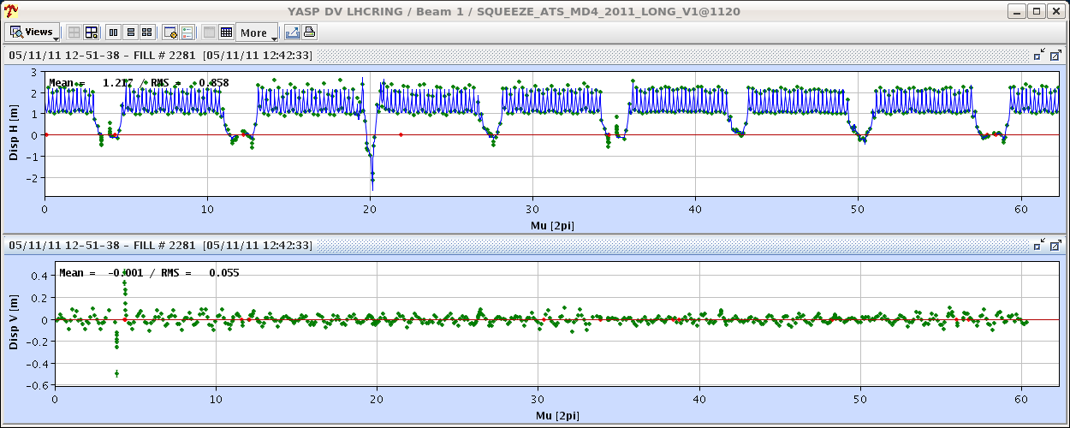
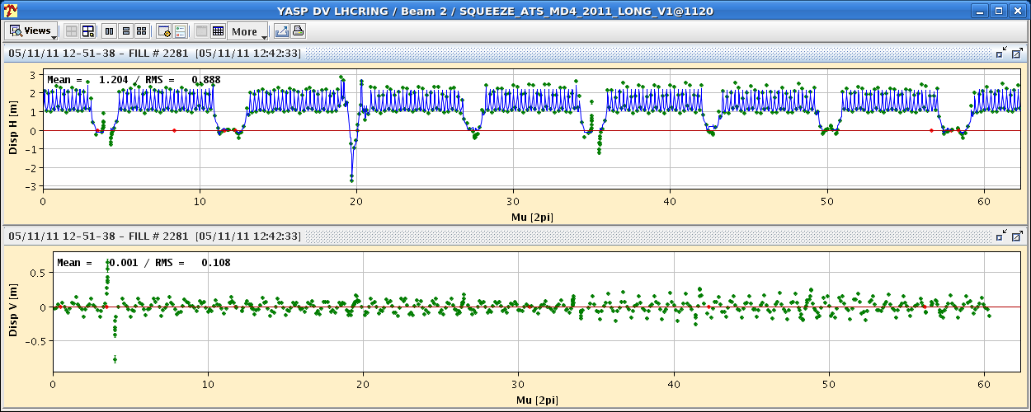
ATS optics
Squeezed down to 40 cm

Slide 3
ATS optics
Measurements were conducted at β* 1m and 40cm. The beta-beat is increasing from 30% to 50% for beam 1 horizontal and from 20% to 40% for beam 2 vertical. A correction was calculated and implemented for beam 1 at 40cm, this reduced the peak beta-beat from 50% to 20%. For beam 2 a correction will need to be calculated off-line, it is expected that because of the missing BPMs global correction could not calculate and effective correction. For the correction only ~20 correctors around IP1 and IP5 were used.

Slide 4
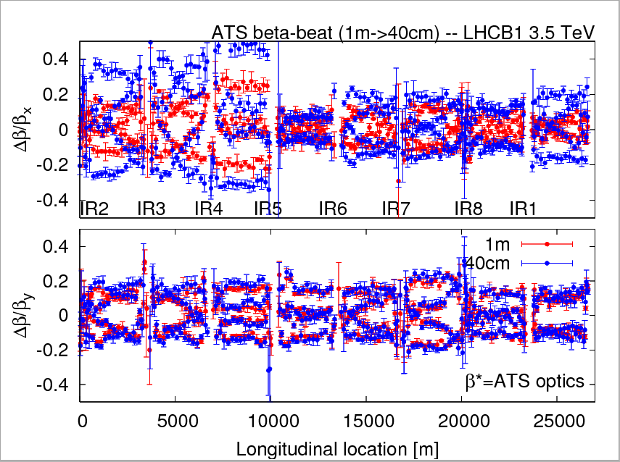
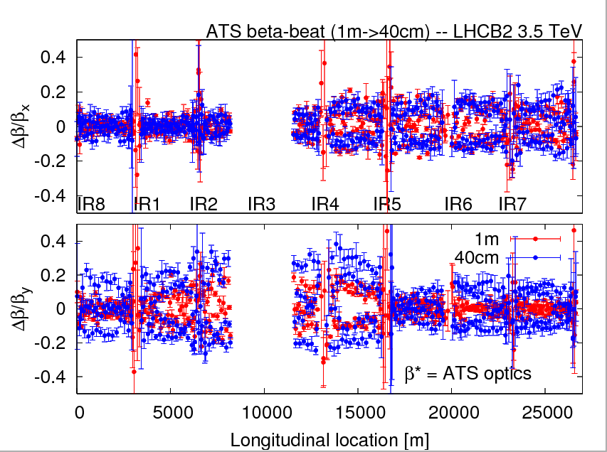
ATS optics
R. Tomas et al.

Slide 5
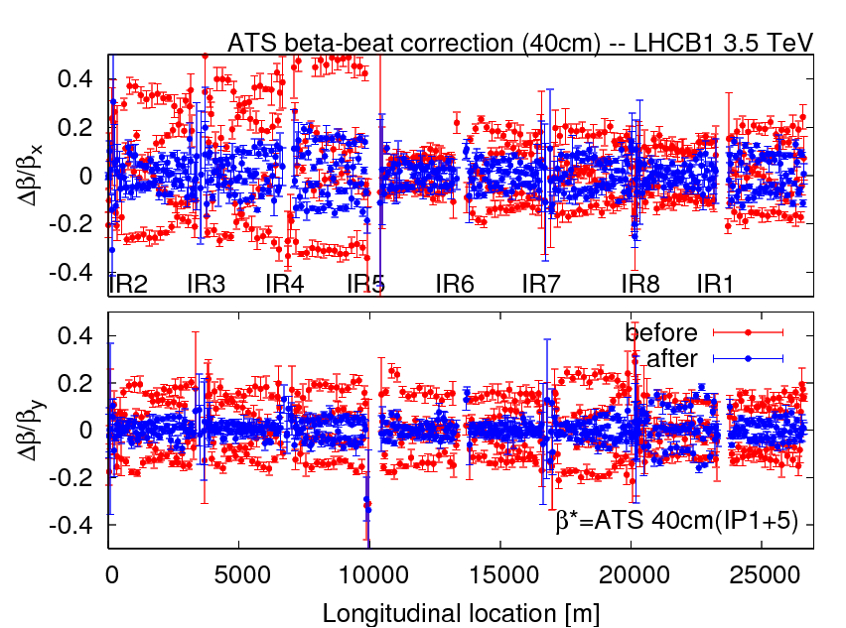
ATS optics
R. Tomas et al.
Premature end of the ATS MD due to trip of trim quadrupoles when re-distributing the strength among sectors before telescopic squeezing

Slide 6
Ion commissoning
17:30 Beams to last TEDs to adjust kicker timing
Problem with the SPS Rephasing for Pb:
The rephasing would often not work. We notice a systematic 3 Hz error between the LHC/2 frequency and the one sent to the SPS through the FESA class AllPhaseSynchroSPS. We trim the FESA class manually. In the meantime best not to trim the injection frequency ➔ To be followed-up with experts
21:30 ➔ both beams circulating
23:40 ➔ Flat-top
01:30 ➔ Collision in ALICE
02:00 ➔ Collisions in ATLAS and CMS (large trims required)
Quiet beams until 03:00

Slide 7
Ion commissoning
Still some problems with re-synchronization (not catched by BQM)
QPS problems for RCD-RCS in Sector 12
05:30 – 06:30 Loss maps at injection
Preparing for injection and ramp to 3.5 TeV ➔ Lost communication with TCTs in point 1

Slide 8
Issues:
Run configuration still set to protons ➔ CO
Wire scanner signal quite noisy for B1
SPS-LHC synchronization
BQM not stopping injections in case of bad synchronization

Slide 9
Plan
Access ongoing
Afternoon - evening:
Setting-up of collimators (TCTs in point 2)
Loss maps + Asynch dumps (verifications of tune and orbit feedback during the cycle)
ALFA: if loss maps at 7 mm is required people from ALFA should be around
Definition of the functions for the TCTs during ALICE squeeze
Night: chance to go for stable beams if all conditions (machine protection) are met and OK from rMPP.
Monday 6 AM beam dump

