Slide 1
Draft MD Planning Thu (3.11.)
Day | Time | MD | MP
Thu | 05:00 | Ramp down, cycle
 | 07:00 | 450 GeV: Injection stability and losses – check steering constraints, define limits for correctors, operational procedure for more stable injection line steering | B
 | 14:00 | 450 GeV: Quench margin at injection – BLM thresholds required at injection, room for optimization | C
 | 18:00 | 450 GeV → 3.5 TeV: Quench margin at 3.5 TeV – apply transverse damper method, confirm May result, longer sustained losses, identify other possible limitations (know already about BLM power supplies); If any beam left Wire Scanner Quench Test | C
 | 20:00 | 450 GeV → 3.5 TeV: ATS – Simultaneous squeeze to 0.4 m then to 0.1m in IR1 and IR5 with pilot beam, test of possible future upgrade optics for LHC | A
Fri | 06:00 | Ramp down, cycle.
SPS Beam dump
kicker problem

Slide 2
Thu 3/11
Accesses:
BGI
Standalone magnet splice measurement (D3) ➔ campaign completed
Investigations on aperture issue in point 2 (RP, Survey)
16:30 start pre-cycle hoping to have beam at ~20:00
…but we have not yet beam

Slide 3
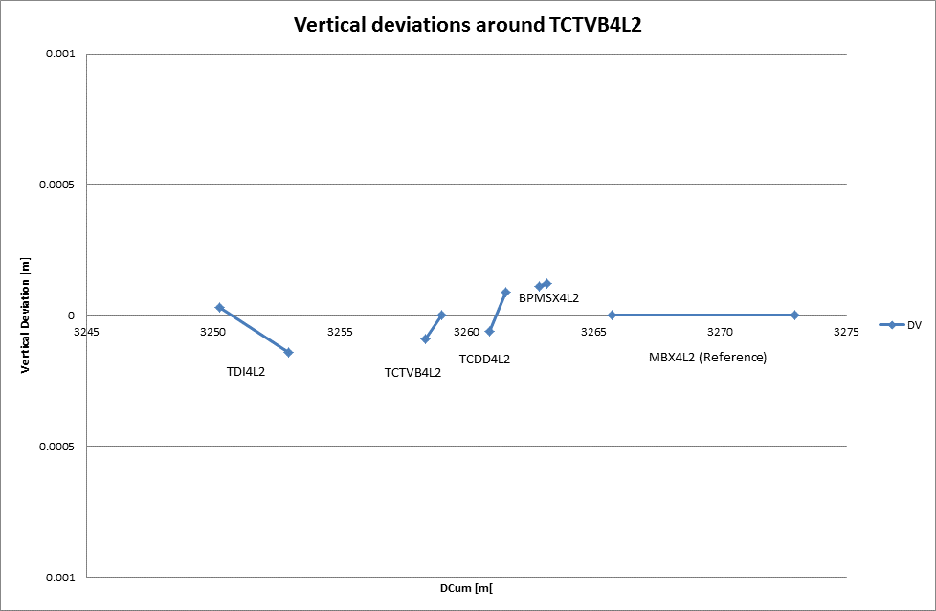
Alignment checks
P. Bestmann

Slide 4
RP survey (L2)
K. Weiss

Slide 5
RP survey (R2)
K. Weiss

Slide 6
Aperture IR2 (M. Giovannozzi)
this afternoon I had a discussion with Vincent Baglin to check the drawings of the elements in between the D2 and the TCTV on the left side of IR2. Nothing special was found. He also showed me the results of X-rays on the bellows installed in the same region and the RF-fingers seem in good shape (apart one case that was considered not-conform, but still the probability of having fingers falling inside the aperture is considered negligible).
Tomorrow I will have another check of the shape of the bump used in the scan (indeed it is the superposition of three bumps) using the detailed aperture model with the vacuum elements. Although such a model has some limitations and some information is not fully certified, still I would like to be absolutely sure that what we observe is not due to an obvious problem with the bump and the complex layout of the injection region (this could also explain why the right side of the insertion did not show any problem).

Slide 7
Fri 4/11
MKD Conditioning still ongoing ➔ it will not be completed before beginning of the afternoon
Connection of the TETRA radio signal (410-430 MHz signal – will be used in the future for communication in the tunnel) in SD8 and will be propagated through this cable up to RE82 and RE88 alcoves for test. Tests performed last year did not show any effect on beam ➔ 09:30 (does not require access).
If no issues: leave it ON until tech stop. Additional tests will be required later for RF compatibility
Need to start with low intensity beam

Slide 8
Draft MD Planning Fri (4.11.)
Day | Time | MD | MP
Fri | 06:00 | Ramp down, cycle.
 | 08:00 | 450 GeV → 3.5 TeV: Beam instrumentation – check various beam instrumentation, calibrate emittance measurement, … | B
 | 15:00 | Ramp down, cycle.
 | 13:00 | 450 GeV: Beam shape and TCLIB (scraping and BLM calibration for FLUKA simulations on injection quench margin) | B
 | 15:00 | 450 GeV → 3.5 TeV: Longitudinal beam stability – Explore single and multi-bunch stability in longitudinal phase space, instability thresholds, optimal and required RF parameters | B
 | 20:00 | Ramp down, cycle.
 | 22:00 | 450 GeV → 3.5 TeV: Quench margin at 3.5 TeV – apply transverse damper method, confirm May result, longer sustained losses, identify other possible limitations (know already about BLM power supplies); If any beam left Wire Scanner Quench Test | C

Slide 9
Draft MD Planning Sat (5.11.)
Day | Time | MD | MP
Sat | 06:00 | Ramp down, cycle.
 | 08:00 | 450 GeV → 3.5 TeV: Tight collimation | B
 | 12:00 | Combined ramp & squeeze (if time left after tight collimation) | A
 | 14:00 | End of MD#4. Ramp down, cycle.
 | 16:00 | Start of ion commissioning.

