Slide 1
LHC week 42 summary
Coordinators: Mike Lamont & Bernhard Holzer
Invited speakers: Massi Ferro-Luzzi, Elias Metral, Karsten Eggert

Slide 2
W42 – Totem sandwich
Physics until 2:10 Tuesday morning
Fill number | Total I | ppb | Initial luminosity | Int
2220 | 1.95e14 | 1.41 | 3.59x10³³ cm⁻² s⁻¹ | 13.0
2221 | 2.03e14 | 1.45 | - | -
2222 | 1.93e14 | 1.41 | 3.47x10³³ cm⁻² s⁻¹ | 41.8

Slide 3
W42 – brief recap
Tuesday
Loss maps at 450 GeV – normal injection optics
First attempt 90 m data taking – high background, 90 m loss maps at end of fill
Optics measurements overnight Tues - Weds
Wednesday
TOTEM, ALFA data taking attempt lost to self trigger of beam dump
Next attempt - beams lost just at start of data taking - power converter L4, access required.
Unsuccessful Van der Meer scans overnight lost to software interlock on orbit corrector strength in squeeze
Thursday
TOTEM/ALFA successful data taking.

Slide 4
W42 – brief recap
Friday
Lost VdM attempt to QPS trigger in S45, tune trim quads
Next attempt successful, Van der Meer scan until…
End MD Friday 14:30
trip of RQX.L2
Electrical glitch (see below)
17:40
Recovery by 222

Slide 5
Friday evening/early Saturday morning
22:00 Injecting for loss maps (nominal at 3.5 TeV)
Loss maps
betatron
+500 Hz off momentum
02:30 Injection, dump, refill
Many BQM latches - latches on "stability”
Injection phase off by -70 degrees
06:45 Stable beams 3e33 cm-2s-1
low bunch intensity (1.23e11) for first run after MD

Slide 6
Saturday to Sunday
07:45 Saturday Beams dumped
LHCb triggered, glitch of the beta* flag
The glitch of the stable beam flag Saturday at 07:45 is due to a glitch of the beta* computation (which is part of the flag condition). In the 2 minutes before the glitch the SIS error log is full with huge lists of data errors from PCs As a consequence SIS could not compute beta* from the currents in which case it sends out '0'. (Jorg)
11:14 Saturday Stable beams Fill 2240
initial luminosity 3.26e33, 1.37e11 ppb
Dump 01:45 Sunday - failure of rcbx.v2.r1 – after110 pb⁻¹
Refill 2241 Sunday morning
some issues at injection again
3.48e33
26 pb⁻¹ dumped by QPS trip on Q9.R1, possibly SEU event

Slide 7
Sunday morning – wrestling match
Could not manage to reset the Q9 - access was needed;
Alice accessed in the shadow also.
For both accesses, we had an eye scanner problem (PX24 and UJ16, possibly SEU also):
while Alice could bypass it, we needed Serge and Jean-Francois to go and reboot the access crate.
Additionally gave an access for TI in pt 8 for an oxygen deficiency alarm which would have soon gone to level 3.
Following this access one ventilation door in TI8 was left open. We need to do a short access again to close it.

Slide 8
Sunday evening/Monday morning
18:00 Start ramp 2242
I total = 2.01/2.0 e14 (FBCT)
Crashed FBCT – check if I > 2e14 – fixed by Lars Jensen
1.45e11 ppb
Initial luminosity: 3.54x10³³ cm⁻² s⁻¹
emittance from lumi ~2.45 microns
Dumped RCBX.V2.R1 after 96 pb⁻¹
Ramp down and prepared for 25 ns
110
26
96

Slide 9
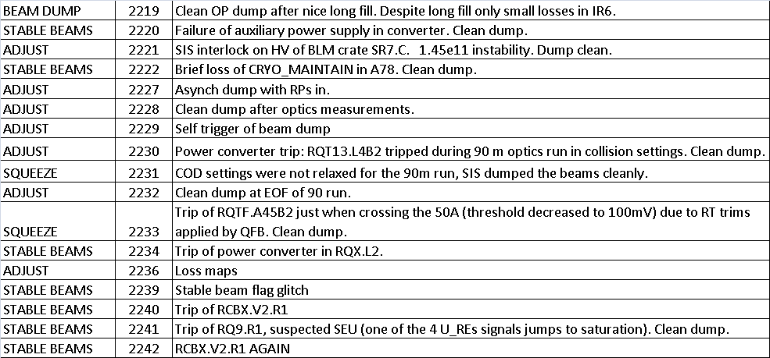
W42: dumps

Slide 10
Special running

Slide 11
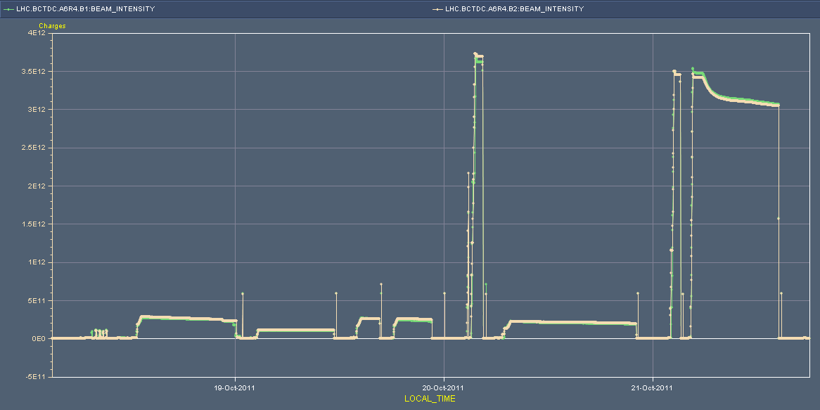
Week 42: special running
RQTF.A45B2 in squeeze
RQT13.L4B2 tripped
SIS COD settings
RQX.L2
Beam dump self trigger
Loss maps
“High background”
Data taking!
Optics
VdM
Tuesday
Wednesday
Thursday
Friday

Slide 12
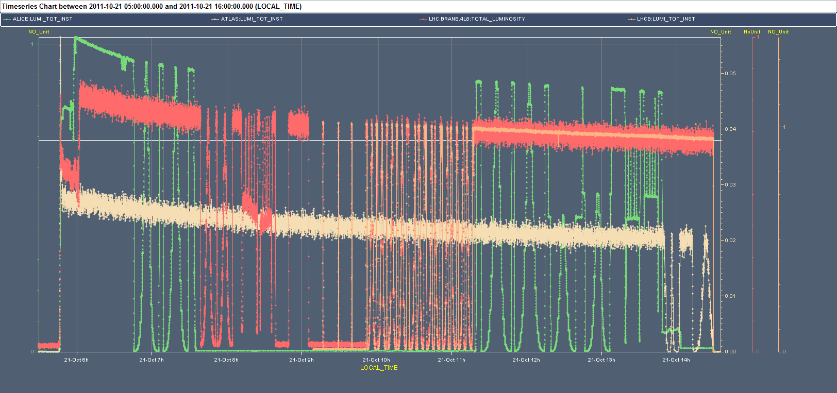
Luminosity scans etc
See Massi Ferro-Luzzi

Slide 13
Loss maps and asynchronous dump
OK for stable beams with intensities of up to 1e13. This intensity would give comparable absolute losses into the LHC cold magnets as during standard physics (compared to IR7 DS magnets)
Check of asynch dump at 00:37 on 19/10 with RPs in...
Losses on XP/TCT/triplets at or below 1e-5 level for B1 and 5e-5 for B2
Losses at triplets and XP are slightly higher than the losses seen on the TCTH elements (factor ~1.5)
BLM data in XPOC seems to be incorrect for B2 - do not see the losses at the dump elements - experts to check
Can conclude that dump protection elements are protecting triplets, XPs and TCTs, and that TCTs are not protecting XPs/triplets at these settings
Collimation team
Brennan

Slide 14
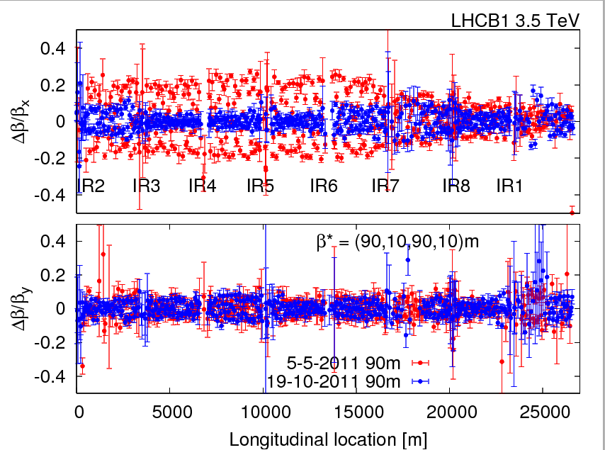
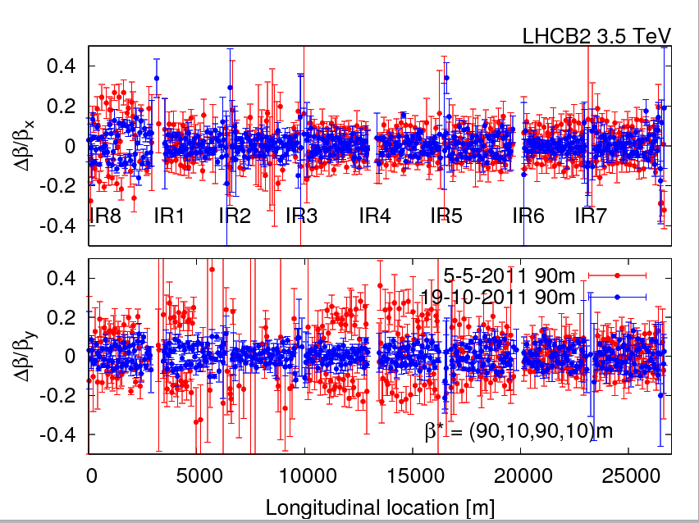
Summary of the beta-beat measurements:
Measurements were conducted with corrections implemented during the previous 90m MD (5th of May 2011).
The beta-beat in both beams before corrections was ~30%, after the corrections this was reduced to 10% level.
Rogelio, Glenn et al

Slide 15
Observations
Complex set-up
2 different bunch intensities, low bunch number in a machine tuned for 2e14: instrumentation, feedbacks
Modified interlock settings
Non-standard collimator set-up
Non-standard sequence – clear instructions for shift crews
Long set-up times
Alignment, scraping
Long runs
Exposure to the normal (non high intensity fault space of the LHC)
Set-up and beam conditions should be fully thought through…

Slide 16
Main TImeout

Slide 17
17:36 Electrical glitch - Description
Friday evening
16h50 TI averti le de la manipulation sur le réseau
17h30 SIG et EDF previennent TI de la manipulation
17h40 Nombreux UPS LHC sur batterie + filtres ME9, SE2, SE4, SE6, SE8 déclenchés.
Alarme sur les aimants ATLAS, ALICE, LHC

Slide 18
Glitch - Action
le LHC ramp down le solenoide de ALICE; en attendant les piquets vont enclencher le point 4
19:40 Filtre SEF4 ré-enclenché
19:45 Filtre SEF6 ré-enclenché
19:49 Filtre SEF2 ré-enclenché
20:19 Filtre SEF8 ré-enclenché
20:35 EN-EL baisse les gradins de l'EHT102/1E
20:40 Filtre ME9 ré-enclenché
21:40 ATLAS Torroid on standby. V.Montabonnet clearing warnings, so the long ramp up can begin.

Slide 19
ISSUEs, OBSERVATIONs & TESTS

Slide 20
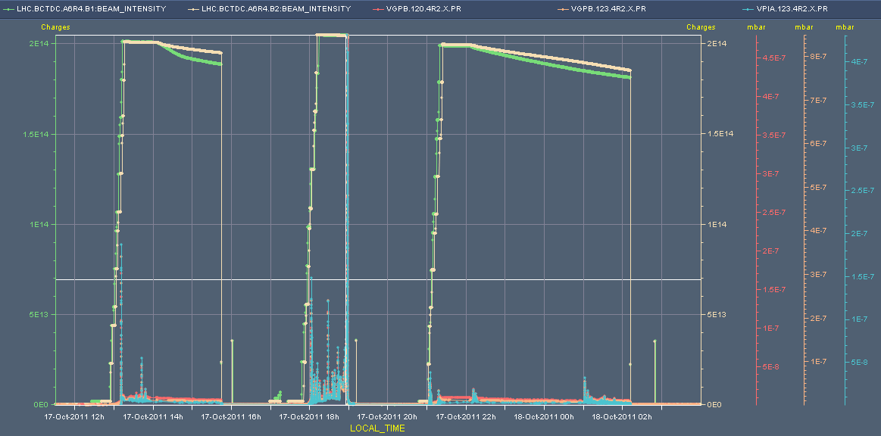
Vacuum R2: Monday/Tuesday
2e14

Slide 21
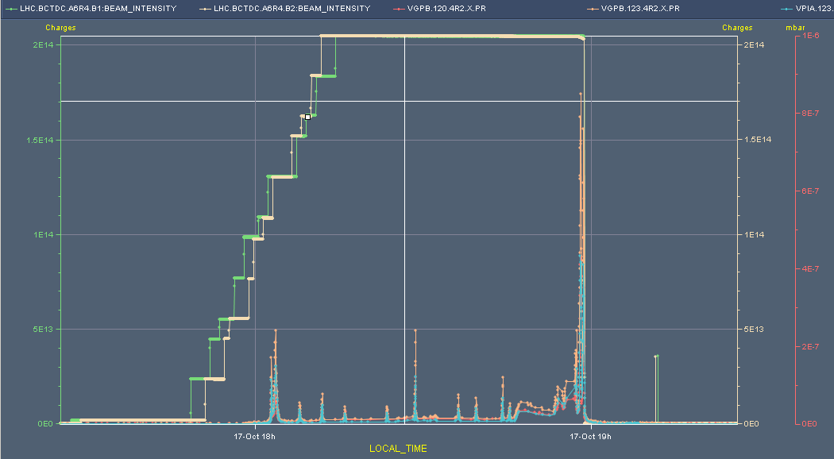
Vacuum R2: Monday/Tuesday
Kicks off during injection: bunch intensity?

Slide 22
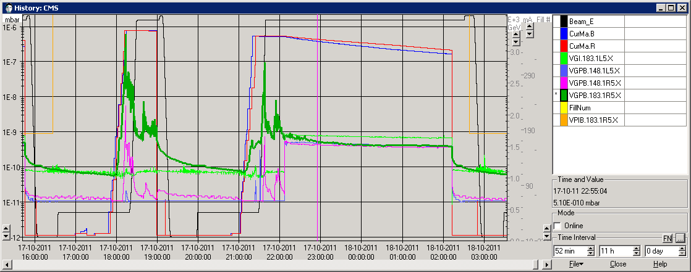
During fill 2221 and 2222, VPIB.183.1R5.X was off (orange curve)
Still pressure spikes are observable in CMS at 18 m, right (dark green curve)
Conclusion : VPIB.183.1R5.X is not the origin of the spikes. It must stay ON for future fills

Slide 23
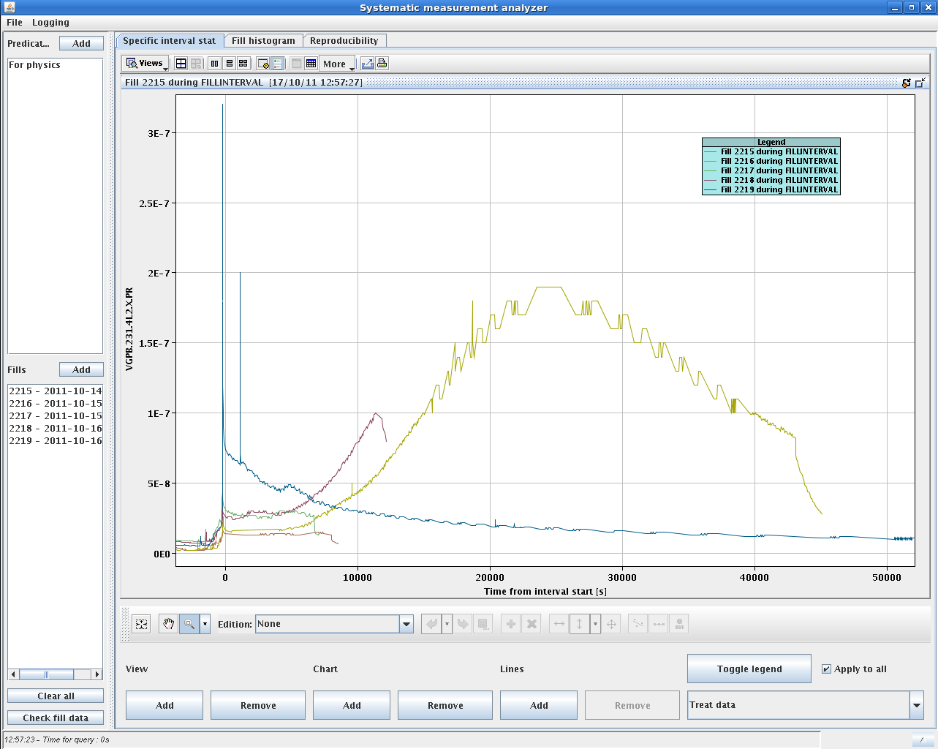
TDI parking positions
Stefano
Check of vacuum in IP2 and IP8 with the increased TDI gaps: +/-55mm in fill 2219 compared to +/-20mm in the fills before. Time zero in the x axes correspond to the time of the ramp start. The vacuum behaved clearly better with larger gaps.

Slide 24
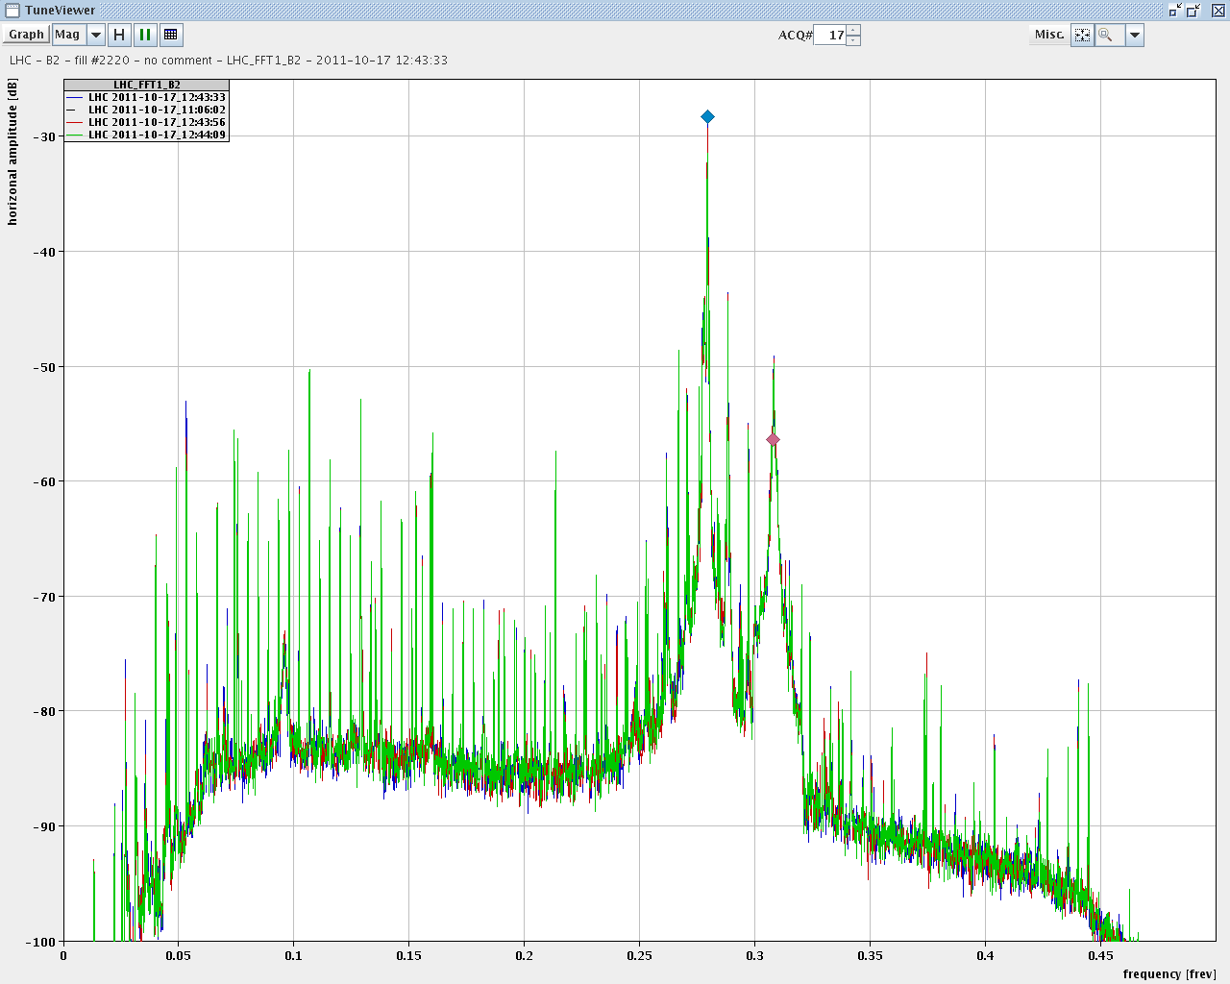
RB active filters
Hughes, Valerie, Ralph
RB active filters OFF and then back ON. blue: before red: active filter 'off' green: active filter 'on' Differences only on the 3 dB level for most lines but nothing major visible.

Slide 25
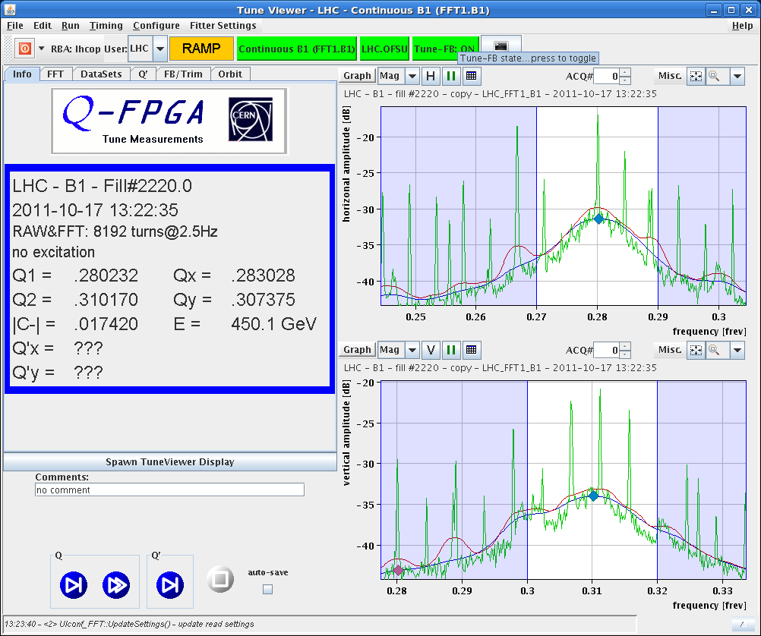
Tune feedback optimization
Comparison of tune spectra as seen by the feedback - raw spectrum (green), old settings (red), new settings (blue)
Ralph Steinhagen

Slide 26
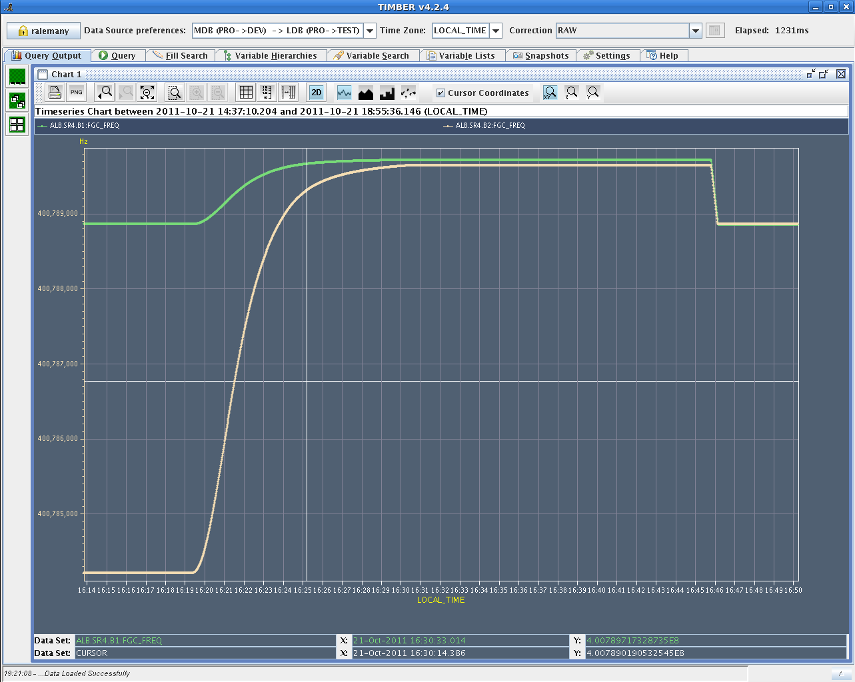
Proton Lead frequencies in ramp
Test of RF ramp with hypercycle p-Pb with unlocked frequencies. Some issues revealed.

Slide 27
CMS vacuum: 183.R5
The ion pump located at 18 m right of CMS was switched OFF for fills 2221 and 2222 (orange curve in attached plot).
During these fills, the ion gauge (VGPB.183.1R5.X, dark green curve) located at 18 m right of CMS saw several spikes, some above 1e-7 mbar.
Conclusions:
The origin of these spikes cannot be attributed to the ion pump located in the vicinity of the ion gauge.
This ion pump must stay ON for the operation of the machine.
Vincent Baglin

Slide 28
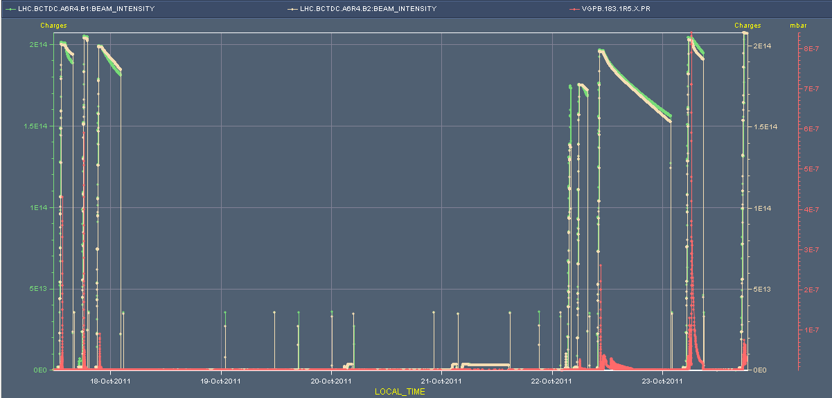
183.R5

Slide 29
Note
Landau octupoles trimmed up to 200 A at end of ramp, and through squeeze – looks good for 1.45e11
ZS sparking in SPS during filling
Injection phase is moving
LHCb – too high luminosity – orbit optimization
Wire scanner loses limits – unable to scan 144b
Injection kickers needed 4 hours of cooling after sustained high luminosity operation

Slide 30
Incoming
24 hours of 25 ns
High pile-up revisited
End of proton running for 2011

