Slide 1
Monday morning
07:00 Dump fil #2219, 123 pb⁻¹ delivered.
Trim TDI parking position to +/- 55 mm in the collimator BP
trimmed the temperature kicker limit to 62 degrees for beam 2
Access required for QPS reset RQD.26L8
SPS has prepared bunch intensities of 1.45e+11
Test RB without active filter for tune signal
Putting the RQTDs of B1 in open loop.
QPS trigger during test of RQTD B1 in open loop while FiDel trimming - oops

Slide 2
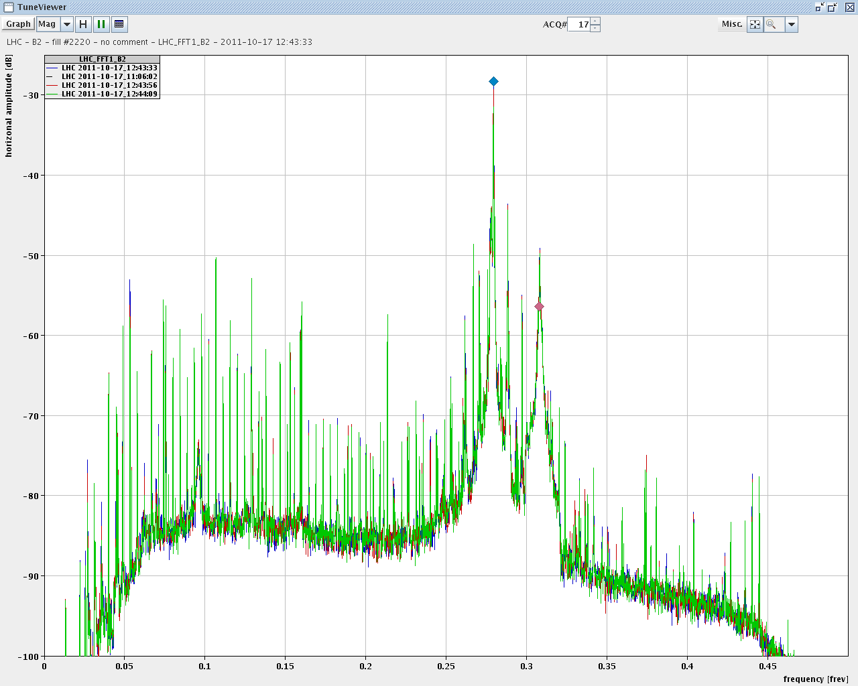
RB active filters
RB active filters OFF and then back ON. blue: before red: active filter 'off' green: active filter 'on' Differences only on the 3 dB level for most lines but nothing major visible.

Slide 3
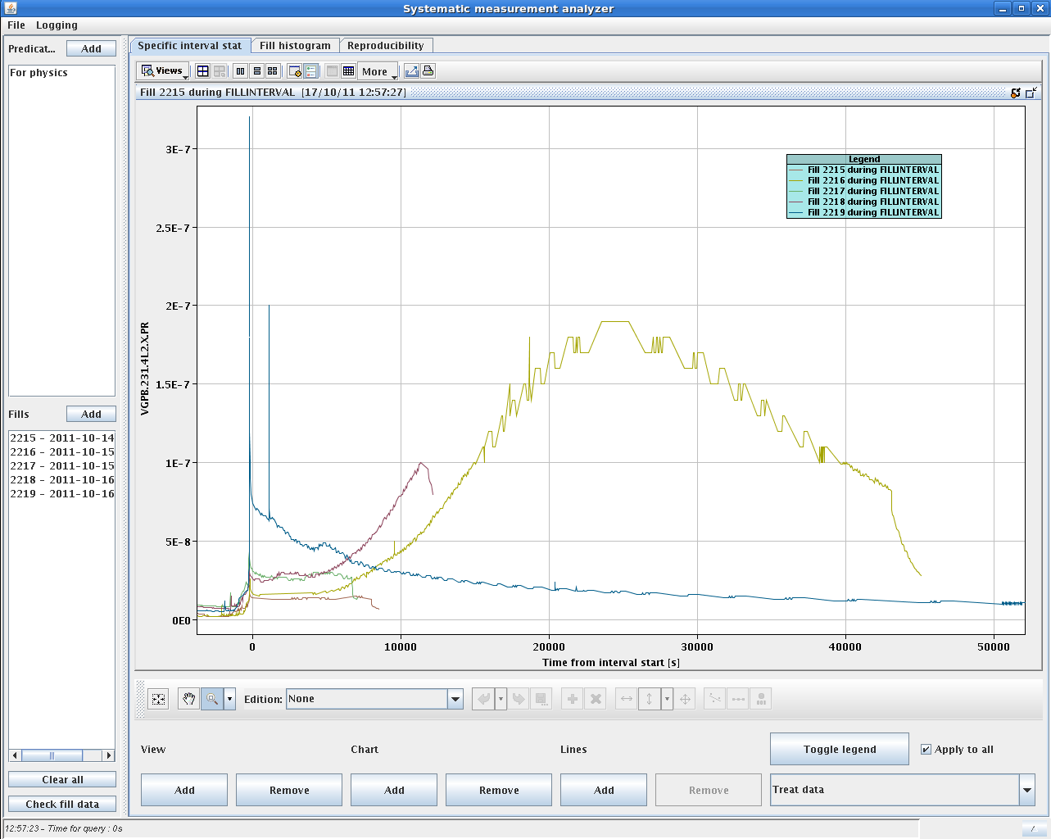
TDI parking positions
Stefano
Check of vacuum in IP2 and IP8 with the increased TDI gaps: +/-55mm in fill 2219 compared to +/-20mm in the fills before. Time zero in the x axes correspond to the time of the ramp start. The vacuum behaved clearly better with larger gaps.

Slide 4
Tune feedback optimization
Changed BBQ Tune-Fitter Settings: Increased the rejection threshold for the spurious lines: - median filter 5 -> 12 - average filter 5 -> 10 This should further suppress locking on weaker spurious lines such as Qs-sidebands sitting on one of the 50Hz harmonics.
Ralph Steinhagen

Slide 5
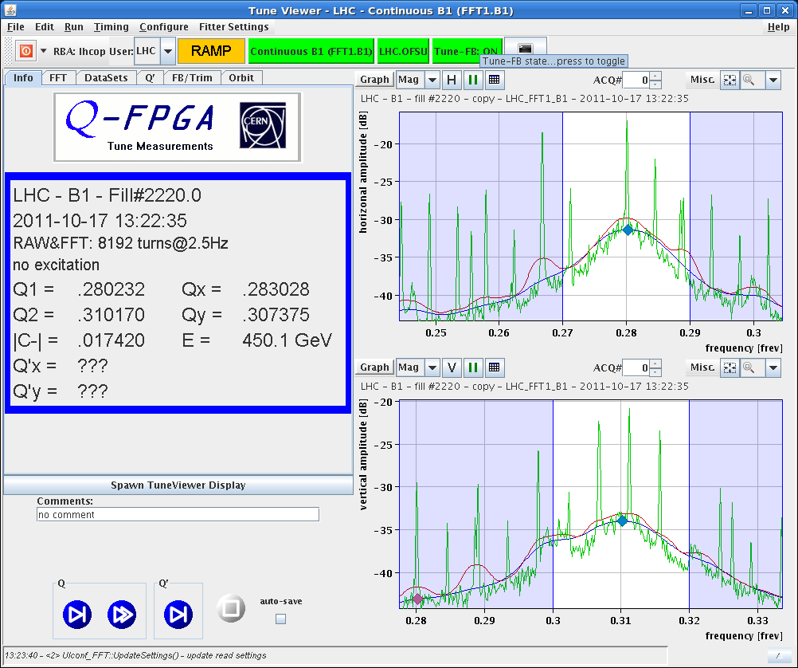
Tune feedback optimization
Comparison of tune spectra as seen by the feedback - raw spectrum (green), old settings (red), new settings (blue)

Slide 6
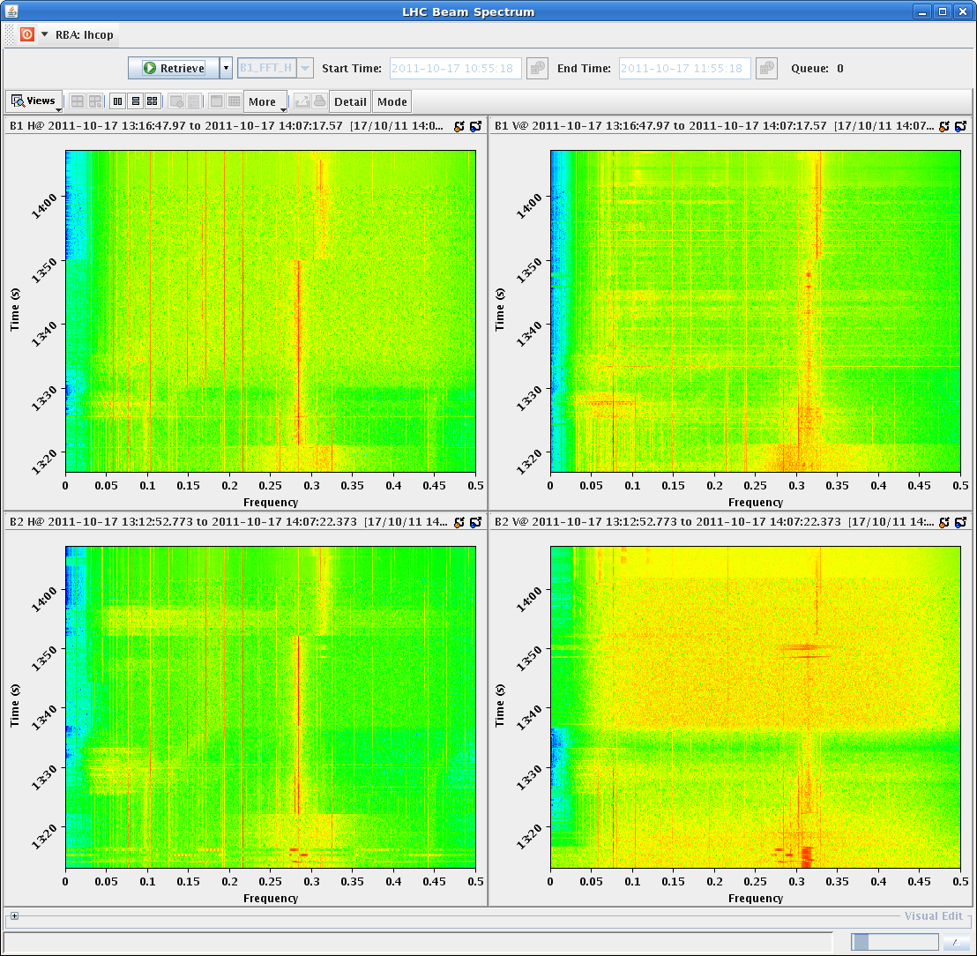
Next ramp
Tune signals and trims during the yesterday's and today's ramp (bottom) Lost significant S/N ratio for B2V during the last ramp (see spectra). Chirping (at 1% level) helped to recover the signal. Will leave the new settings in place as the generally (for the periods with sufficient tune signal) reduced the spurious jumping between spectral lines.

Slide 7
2220
The SPS prepared bunch intensities of 1.45e+11. In the LHC we had average bunch intensities of 1.42e+11.
The injections were clean, vacuum OK. Had vacuum spike however at MKI8 during ramp.
14:11 Stable beams
3.6e33, 1.41e11 ppb
15:45 beam dump
Trip of power converter RQT13.R5B1
Converter error could be reset remotely.
Not the first time…

Slide 8
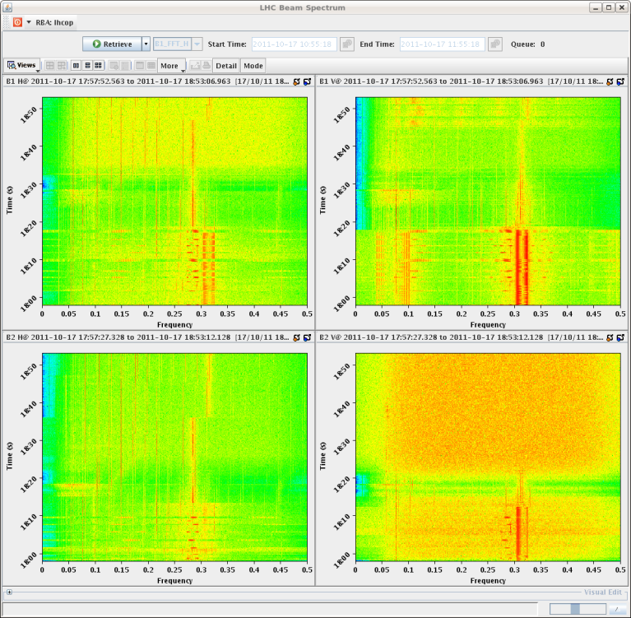
2221: probing the limits
17:15 Injection
transfer line steering required
18:20 start ramp
2 e14, 1.45e11, 110 MJ
Lost B2V tune signal early in the ramp
We are running the squeeze with both QFB off. Initially, only B2-V was off, but then we lost all the other planes.

Slide 9
2221: probing the limits
18:58 Beams lost in adjust
Instability beam2
Lost about 1.5e12p before the dump, over about 80 seconds. Peak loss was 2.3e11p in 5s.
Cleaning efficiency in the Q8-L7 = 4.6e-4. Nothing seen on the cryo - dumped on the BLM HV before getting close to quench limit.
Peak loss at the TCP location: 3e-1 Gy/s (1.3s running sum).

Slide 10
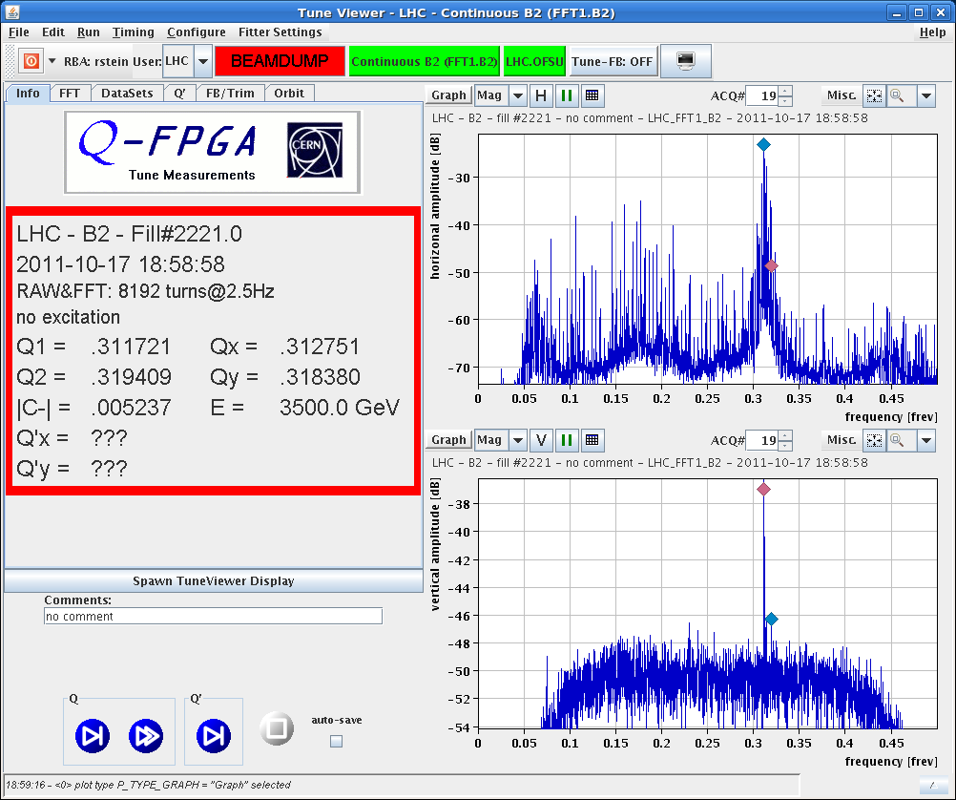
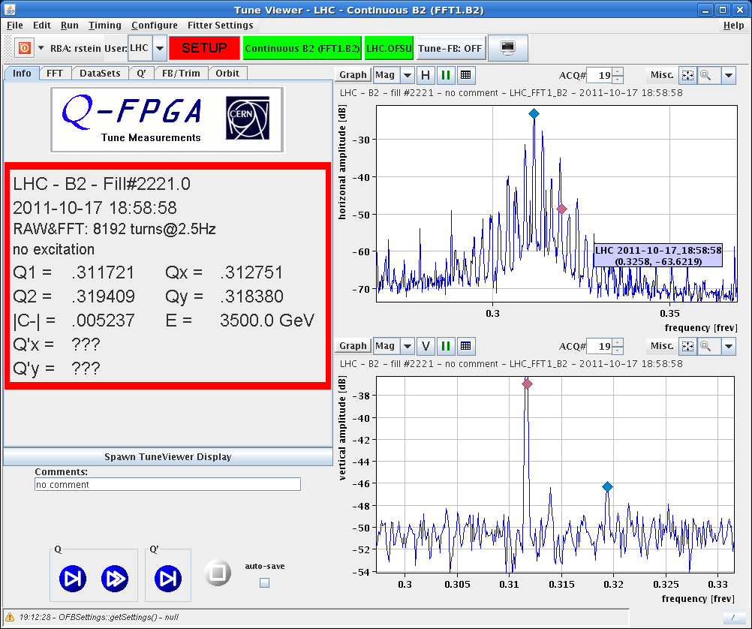
2221 - instability

Slide 11
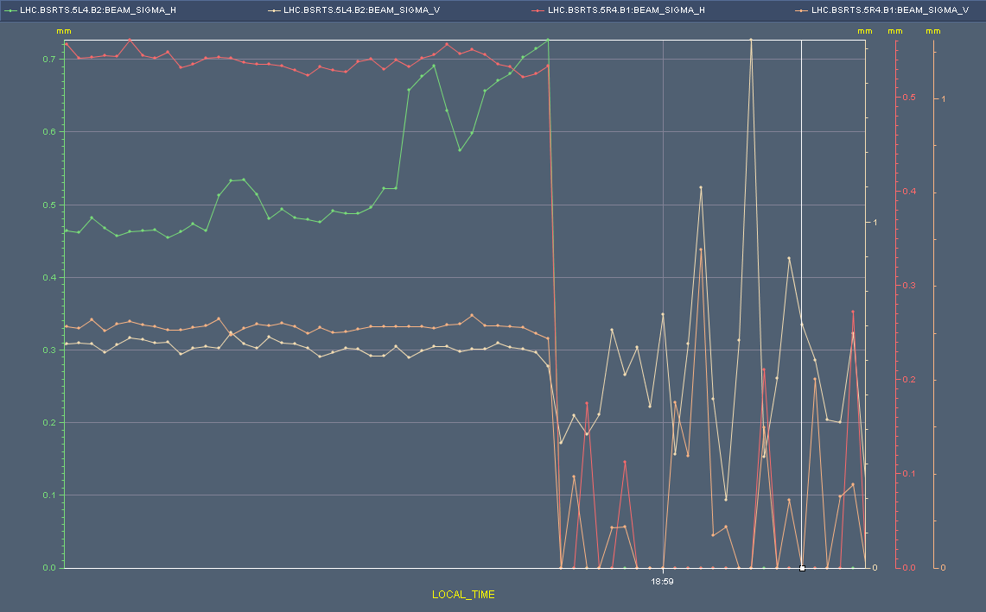
2221 - instability
27 s

Slide 12
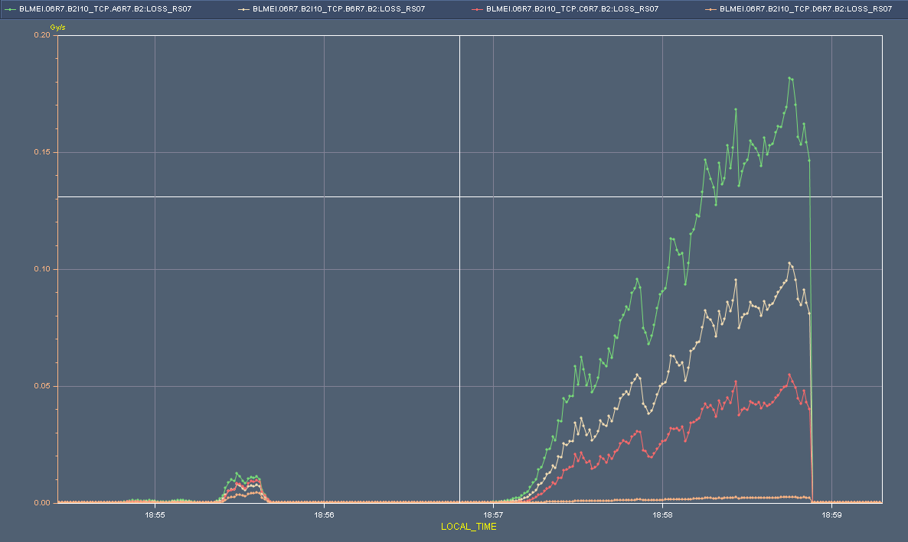
2221 - instability

Slide 13
2222 – late Monday evening – Tues morning
22:10 #2222 Back in stable beams with slightly reduced bunch currents - ~ 1.4e11
02:10 Fill lost to brief loss of cryo maintain due to a faulty temperature reading caused a slow power abort on the main circuits in S81 (-27K briefly)
Back down - with the circuits recovered and ready to inject, we were blocked by temperature interlocks on both the MKI8 and MKI2.
The interlock level for MKI8 is 62 deg and for MKI2 it is 41 deg. MKI2 took the longest time to recover, with the temperature dropping at ~0.1 degrees in 10 minutes and at the time of the dump the temperature was 43.8 de degrees => ~ 4hr wait. (note that after the beam dump, multiple soft starts had been done)

Slide 14
Tuesday morning
When finally able to inject, and after dumping the pilot, the B2 XPOC blocked due to a vacuum pressure in on the dump line (VGPB.623340.R) that was 2 orders of magnitude lower than usual. We recovered after several OFF/ONs of vacuum gauge.
Loss maps ongoing
Switch to 90 m at around 09:00

Slide 15
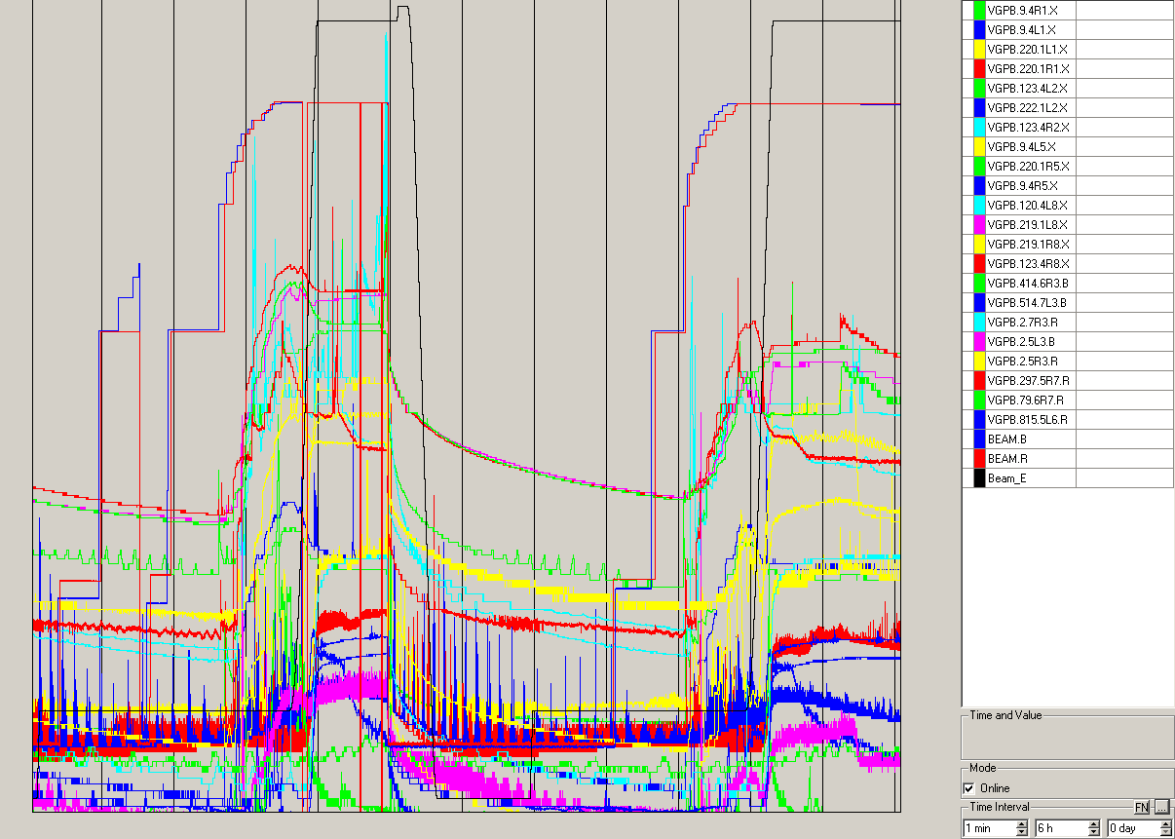
Vacuum 2221 & 2222

Slide 16
CMS vacuum
Subject: CMS ion pump VPIB.183.1R5.X OFF for fill 2221
As agreed this morning with CMS, I have switched off the VPIB.183.1R5.X for the fill 2221 to rule out its origin in the CMS pressure increase regularly observed at 18m right.
The pump was to be switched back on after the fill, but has not yet been done.
We checked with CMS and the see no sign of the pressure bump at 18m. For now we leave the pump off and switch it on at end of fill.
Vincent Baglin

Slide 17
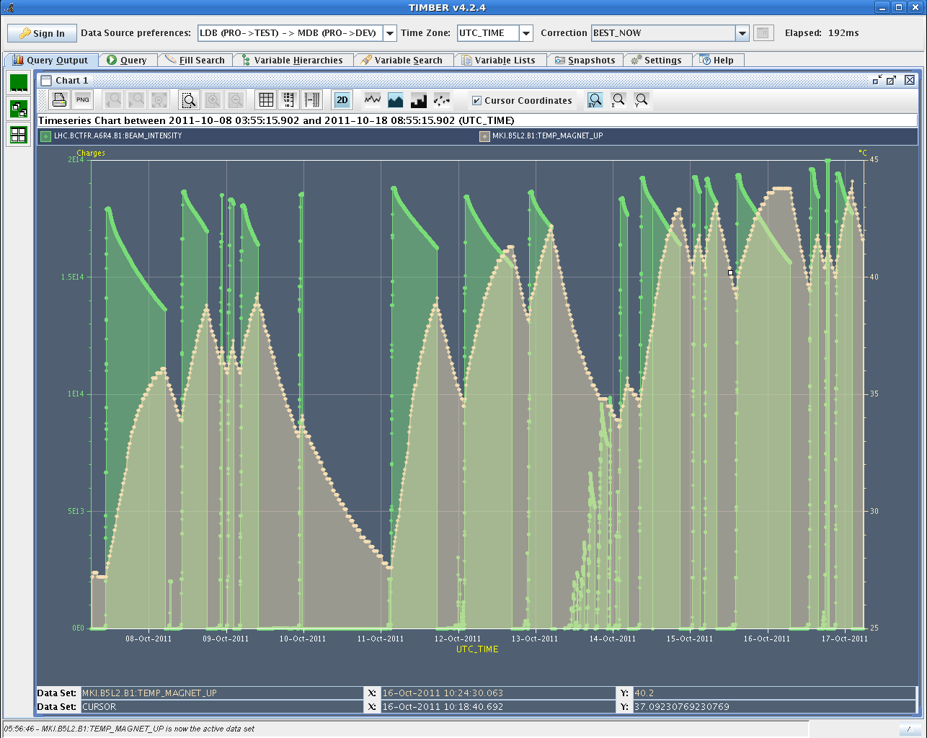
Kicker temperature

