Slide 1
LHC Status Wed Morning 19-Oct
Bernhard Holzer, Mike Lamont
Plan: 90 m Optics

Slide 2
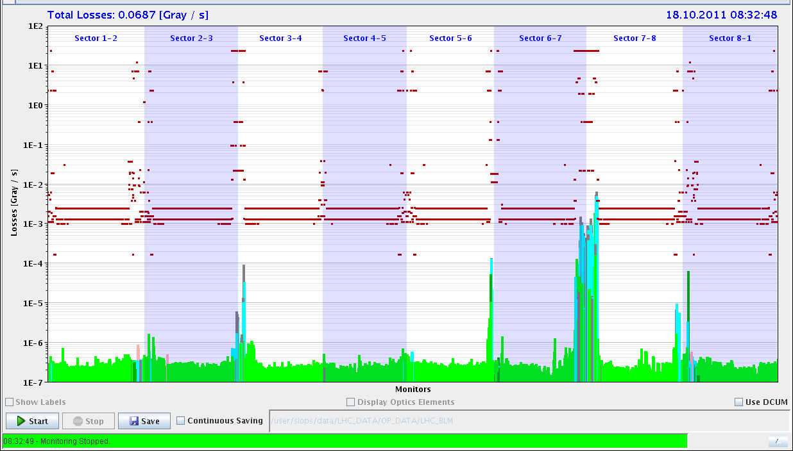
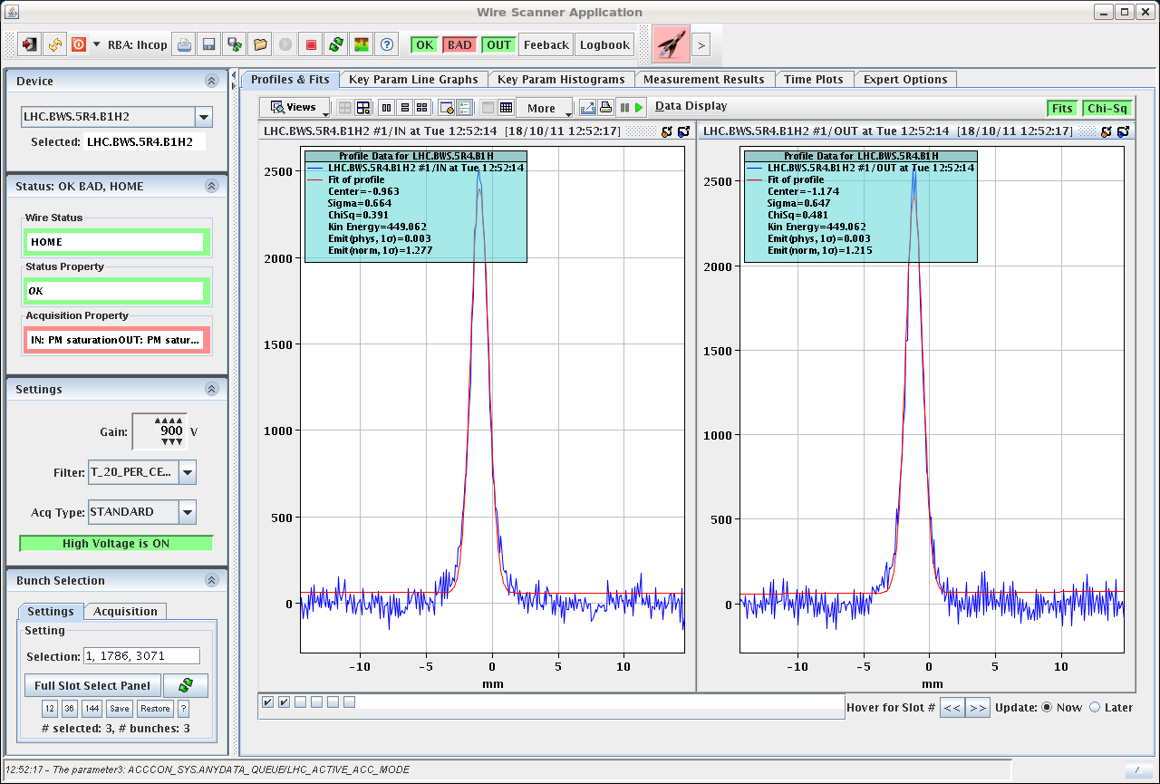
Tue Morning
07:09h loss maps at Injection (LHC Standard)
12:44h Injection for 90m tests
fill pattern: 2x7e10p + 13x1e10p per beam
Emittances B1H = 1.39
B1V = 1.11
B2H = 2.13
B2V = 2.01

Slide 3
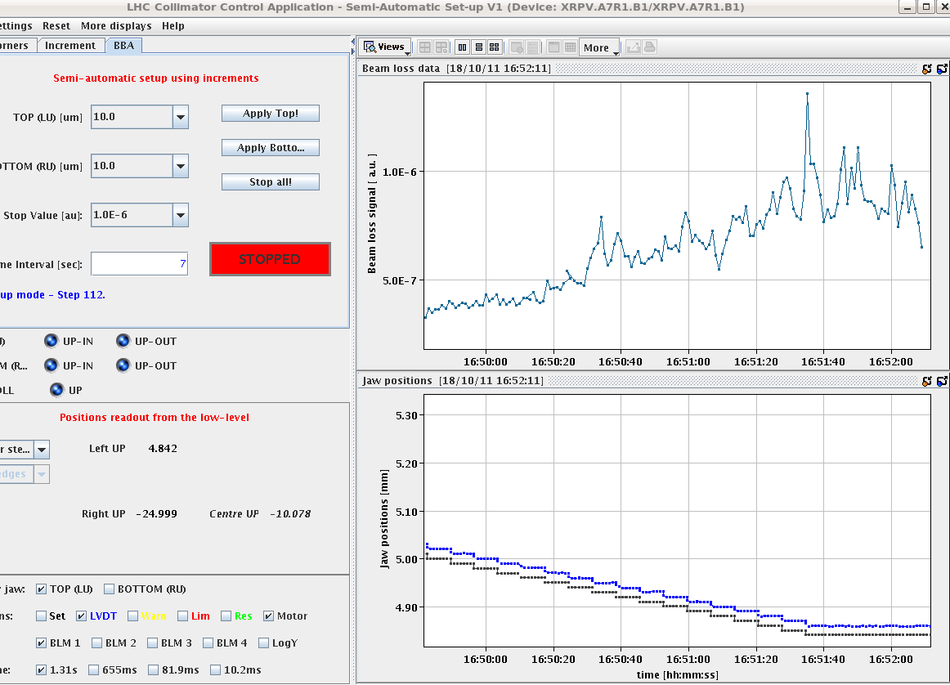
Tue Late
14:34h Ramp, Un- Squeeze into 90m
no problem ... “butter weich”
but ... after collisions
Emittances B1H = 2.3
B1V = 1.6
B2H = 2.9
B2V = 2.4
16:34h Start Pot-Alignment
Well: ... Reduced losses at the TCP when the
ALFA pot touched the beam.

Slide 4
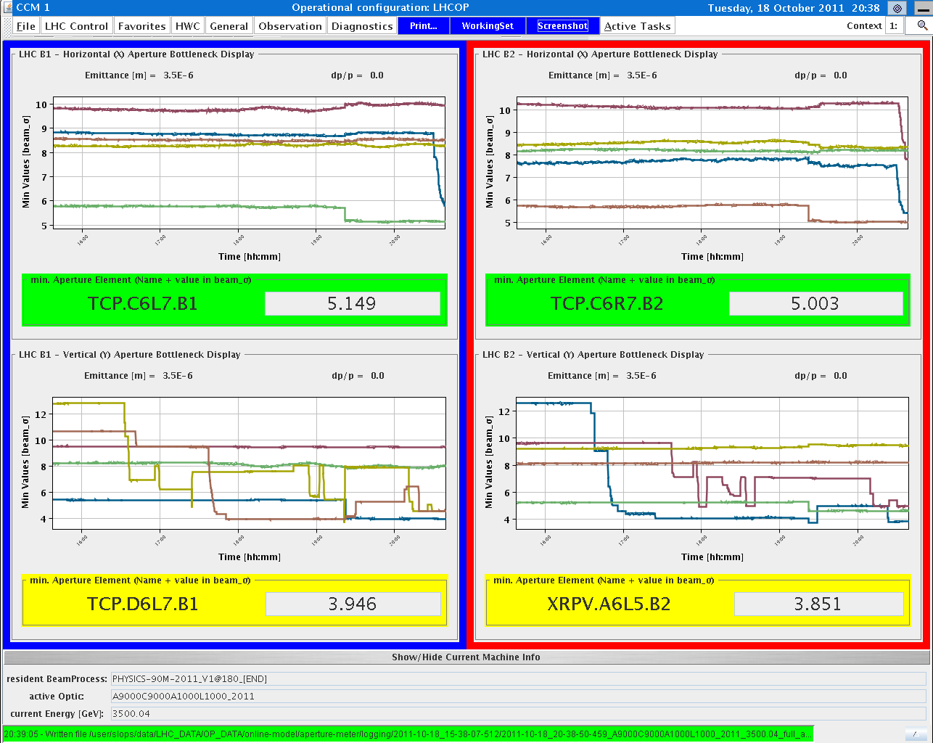
Tue Late
19:40h Re-centred TCP-V's and closed them to 4 sigmas
and the pot positions: Pots at 5.5 sigmas
B7L1 (4.518/-4.897)
A7L1 (4.713/-5.156)
A7R1 (5.511/-4.357)
B7R1 (5.195/-4.218)
Aperture-meter:
just a small remark from
an anxious person

Slide 5
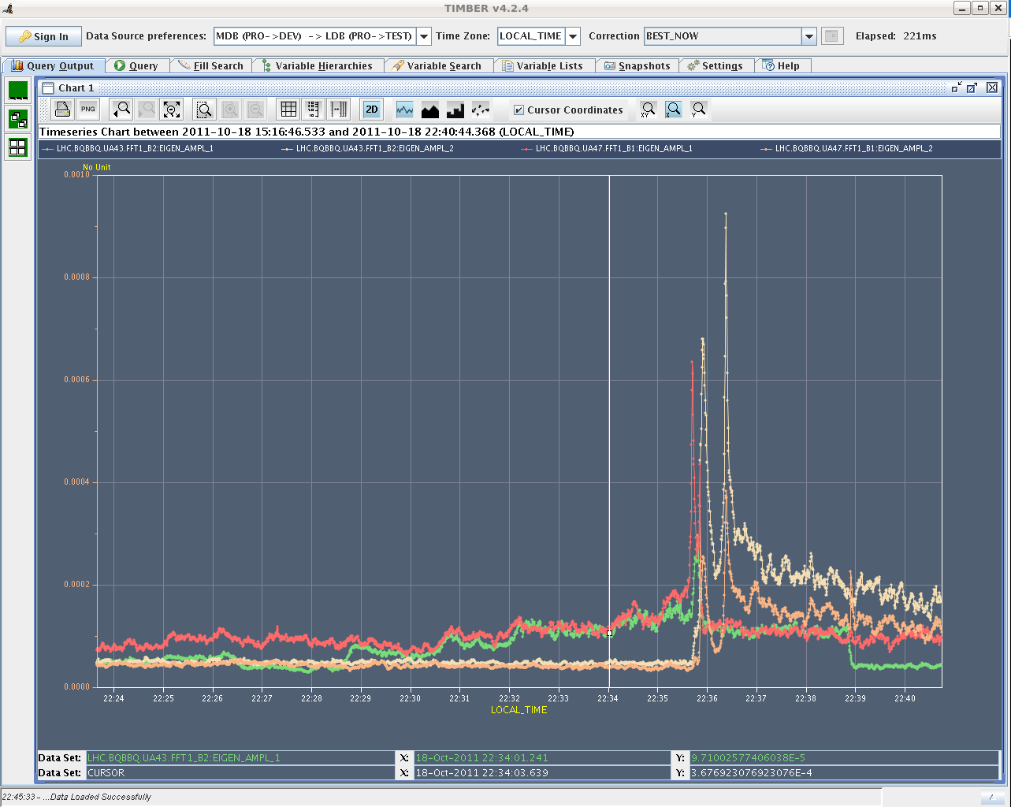
Tue late
22:34h All 4 TOTEM Horizontal Pots retracted to 12sigma
22:47h Sharp dip in lifetime - strong coherent BBQ signals ????
Decision: the beam quality is not good enough for data taking -> continue with loss maps for the pots.
Data taking postponed to Wed morning.

Slide 6
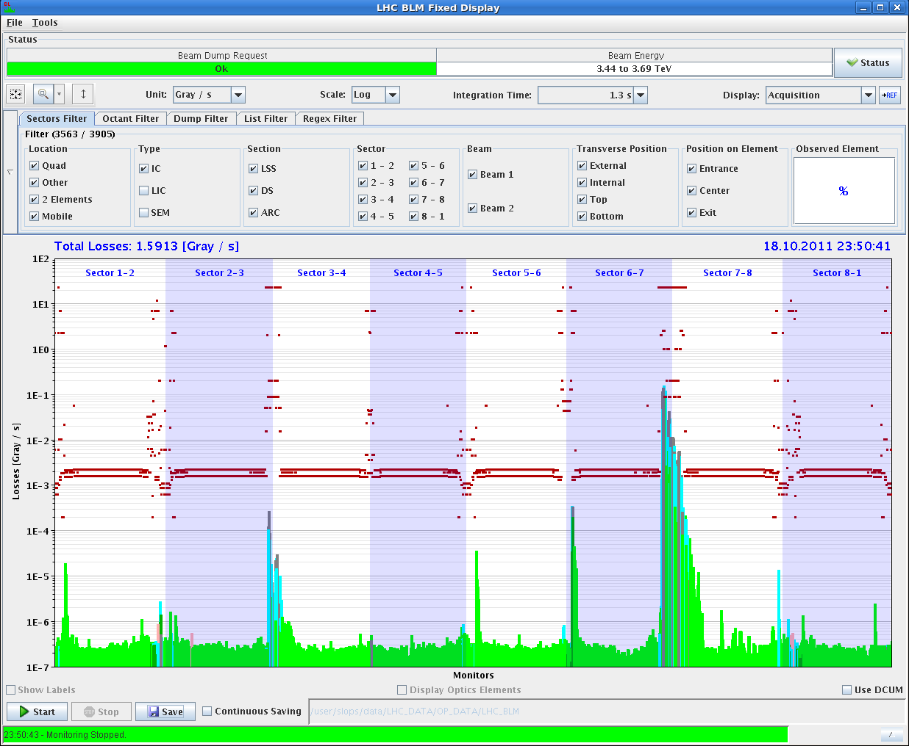
Tue Night
00:10h Loss maps for 90 m
pre-requisite for “90m vdm scans”
Roman pots set to V @ 10sigma, H @ 12sigma
Beam loss at ALFA during asynch dump:
to be checked by the experts,
but doesn’t look so bad.
02:10h new injection for optics check

Slide 7
Status at present:
✔
still to be done
✔
at the moment

Slide 8
technicalities
ADT
module 9 of the transverse damper has a broken amplifier
replaced by module 10
Wed 04:00h
Cannot start monitoring on LHC.BQBBQ.UA47.FFT2_B1
Caused by: cern.cmw.NoConnection: CMW::RDA BQBBQLHC.cfv-ua47-bq (CMW) is down

