Slide 1
LHC Status Fri Morning 21-Oct
Bernhard Holzer, Mike Lamont
✔
still to be done
✔
✔

Slide 2
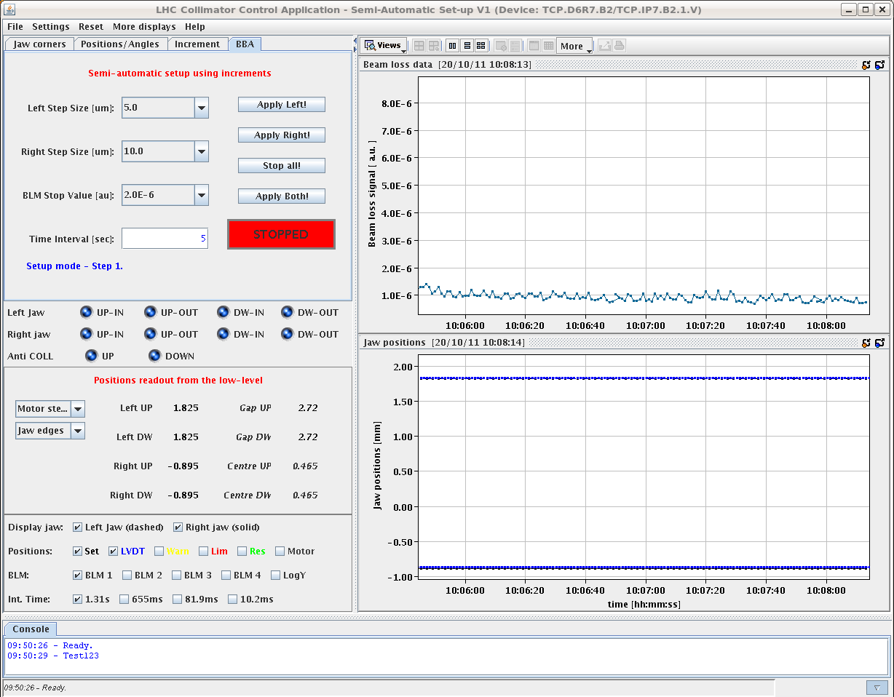
Thu Morning
Reminder:
04:30h Dump: SIS interlock on B2 COD settings.
07:00h new attempt: Injection for 90m tests
fill pattern: 2x7e10p + 13x1e10p per beam
ramp & un-squeeze
Profiles, all probes at 3.5 TeV
B1H 1.3
B1V 1.8
B2H 2.9
B2V 2.0
10:00h Collis to 5 sigma.
11:07h All vertical TOTEM pots now at 6.5 sigma.

Slide 3
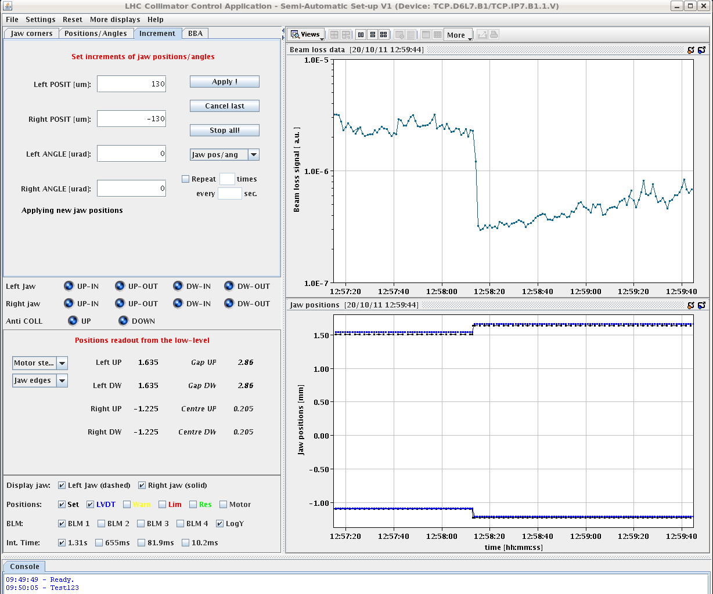
Thu Late
13:00h Closed TCP.D6L7.B1 to 4.86 sigma
... and fine tuning via loss rates:
TCP.D6L7.B1 retracted by 130 um
and the losses go down
500μm
until 18:00h All vertical TOTEM pots in B1&B2 at 5.5 sigma.
20:22h Start scraping with the TCPs to go for closer pot-settings
put the TCP.B1 & B2 from 5.3 sigma to 4.6 sigma.
20:22h all vertical TOTEM pots at 4.8 sigma.

Slide 4
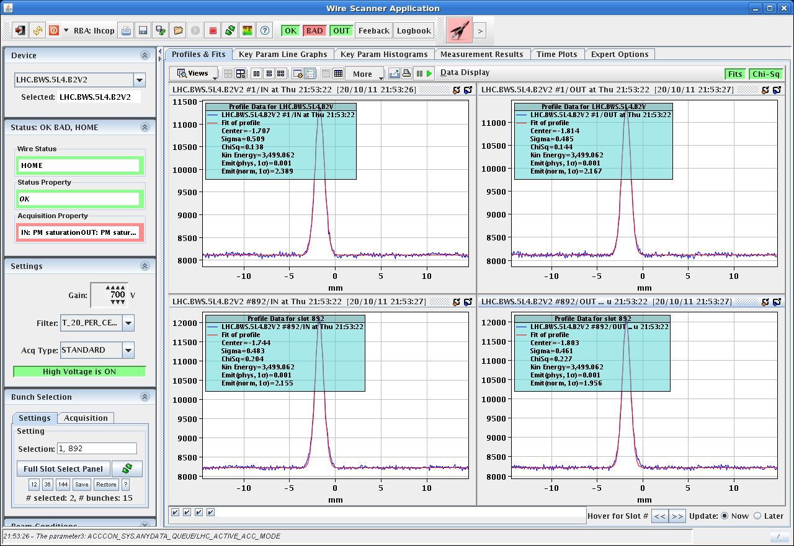
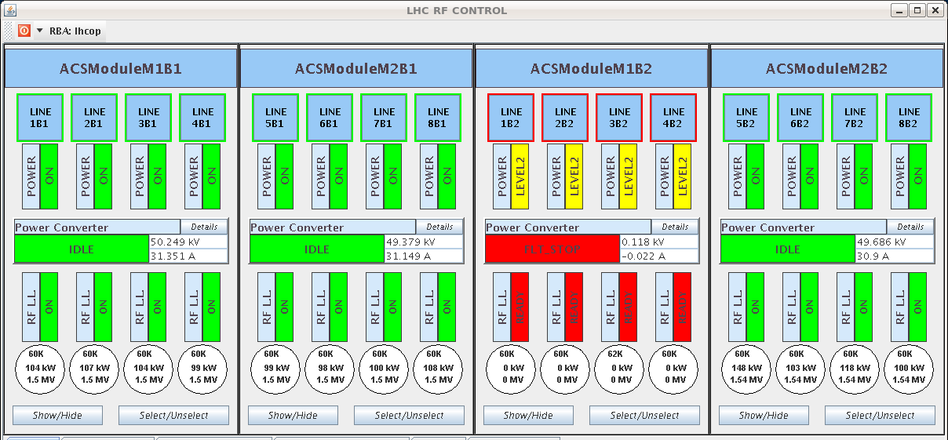
Thu Late
21:56h Emittance measurements at run-end:
intense bunches B1H = 3.05
B1V = 1.85
B2H = 3.99
B2V = 2.39
first pilot B1H = 2.9
B1V = 1.62
B2H = 6.46
B2V = 4.47
22:01h Pots move out
22:01h we call kicker piquet for the problem in point 8: MKI B2 is in fault
22:07h Cryo start signal lost in point 4

Slide 5
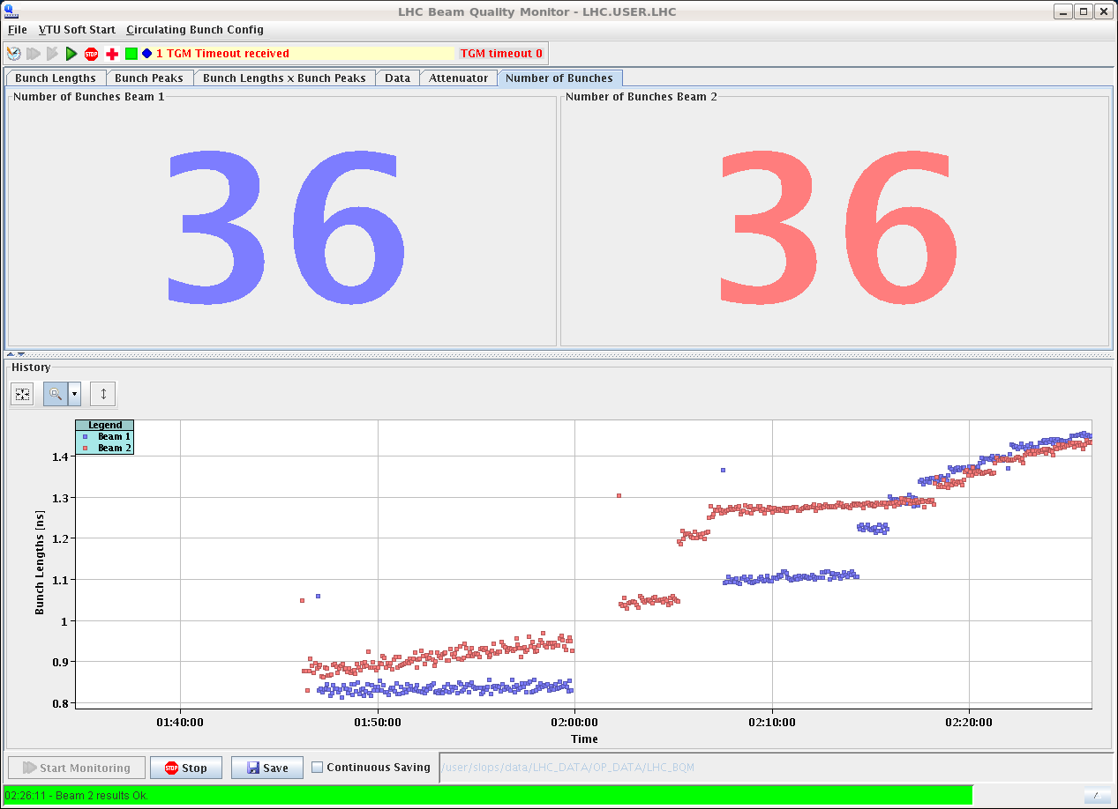
Thu late/night
22:22h Back to standard bunches, preparing for Vdm scans
Daniel set back the damper to only damp nominal bunches.
and back to routine problems:
Power converter tripped during ramp down:
RCBCH10.L2B2 “OVER VOLTAGE” ... reset by piquet
22:54: tripped again
23:31: tripped again, piquet needs access to replace the converter
01:39h Restart: Injection probe beam
02:26h Injection finished

Slide 6
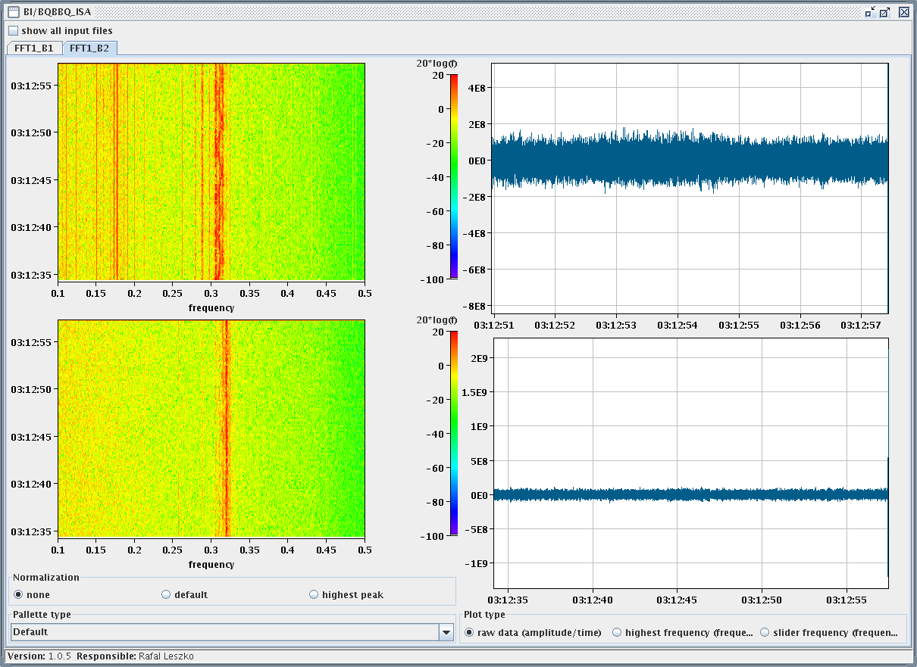
Thu Night
02:29h ramp, (un-)squeeze & dump
dumped at about β*= 54m
QPS trigger: Trip of a tune corrector circuit
in S45
difference to previous successfull runs ... ?
04:04h Restart: Injection probe beam
Emittances B1H = 4.31 B2H = 5.06
B1V = 3.13 B2V = 4.29
04:57h ramp & un-squeeze
05:38h β*= 90m, adjust & optimisation in all IP’s
lifetime:
06:42h start the VdM scan in H.

Slide 7
LHC Status Fri Morning 21-Oct
Bernhard Holzer, Mike Lamont
✔
✔
✔
✔
on going

