Slide 1
Abort gap cleaning tests (Daniel, Eliana, Jan)
The abort gap cleaning has been on during physics stable beams with two different lengths of the abort gap cleaning: Long cleaning: start of the gap to 2.5 us, Short cleaning: 375 ns after the start of the gap to 2.5 us. Whatever you do, when cleaning switched on with the configurations mentioned above there is a small effect on the luminosity lifetime. If you increase the kick duration or if you kick stronger, the effect on the lumi lifetime is more important. There does not seem to be much of a threshold effect. The cleaning of the abort gap is a lot more efficient with the nominal strength setting. After cleaning with the long pulse and the nominal power, the abort gap population did not significantly increase after reducing the length of the cleaning pulse. However, it is not clear that the reduced cleaning would be sufficient in case of sudden abort gap population (due to possible RF problems). If you want to protect against sudden abort gap population you will need to use the nominal cleaning pulse length (2.5 us) and nominal cleaning strength, at the price of a small reduction of luminosity lifetime.

Slide 2
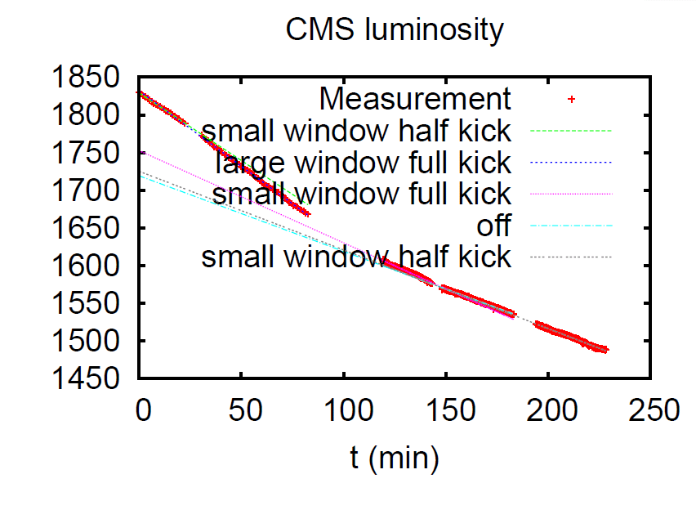
Abort gap cleaning tests
Proposed strategy: leave abort gap cleaning off and switch it on as soon as abort gap population reaches 1x10¹⁰ p and lower than 1x10¹⁰ p. Announcer giving a warning when 1x10¹⁰ p level in the abort gap is reached
E. Gianfelice, J. Uythoven, D. Valuch

Slide 3
Thu 13/10
13:00 TOTEM RPs moving into the beam.
16:15: ADJUST mode. Test of ADT gain reduced up to 30% - OK ➔ we will try to reduce gain of the ADT during the next fills to verify impact on lumi lifetime
16:30 Beam dump by OP. collected 102 pb⁻¹.
17:30-18:30 access for nQPS reset (MB.B8R1). Delay due to biometry (SEU) and key distributor problem n UJ16 (SEU)
20:30-21:30 Steering injection lines
Very reproducible beam intensiry from the injectors, rapid filling
22:53 STABLE BEAMS #2210: initial luminosity 3.48x10³³ cm⁻²s⁻¹ with 1.35x10¹¹ p/bunch

Slide 4
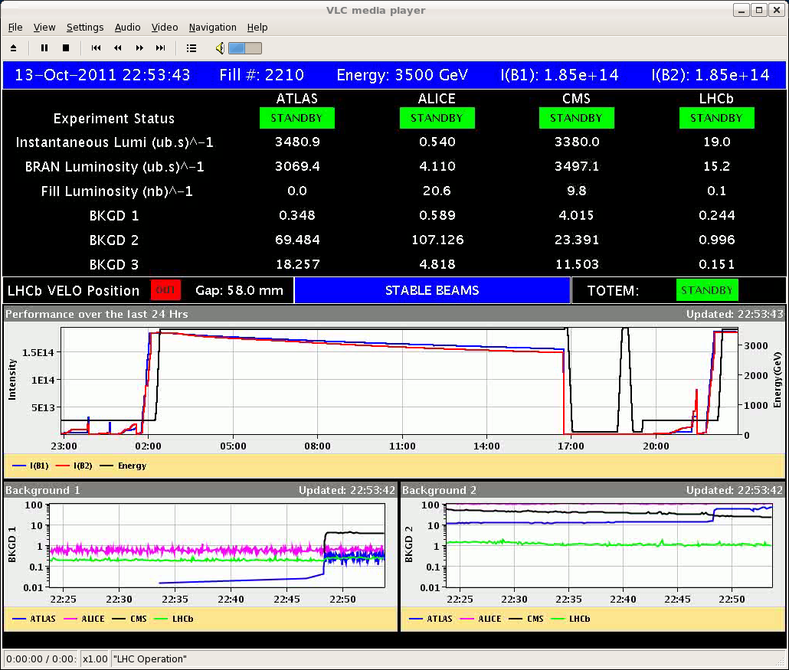
Thu 13/10

Slide 5
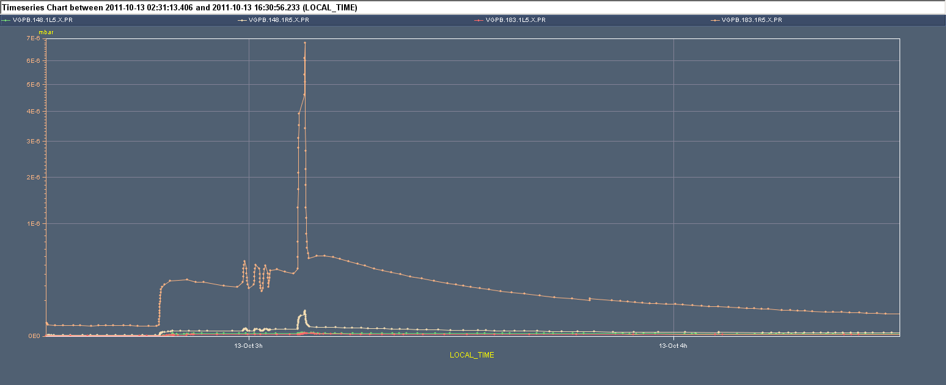
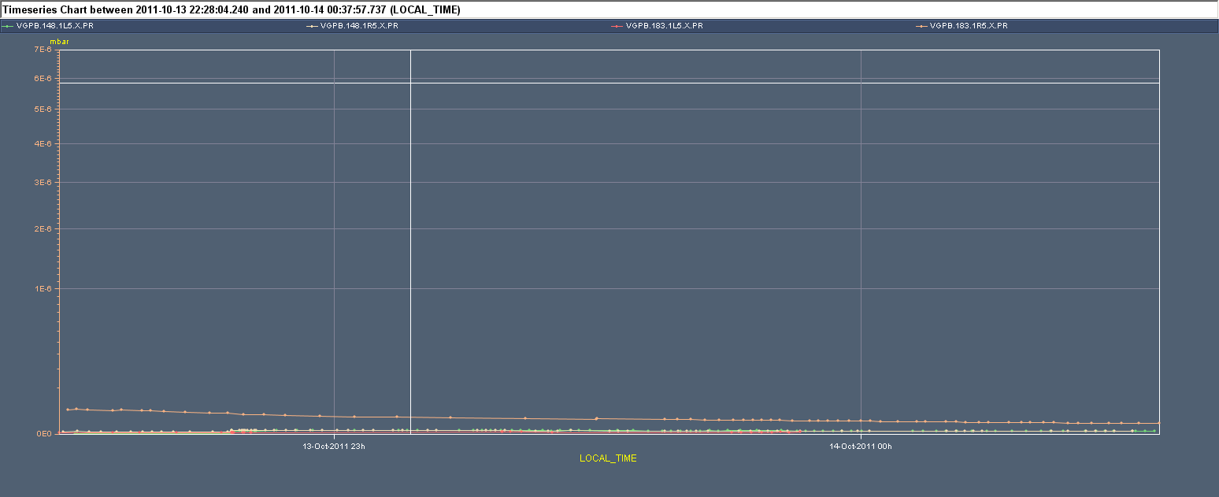
Vacuum IR5
2208
2210

Slide 6
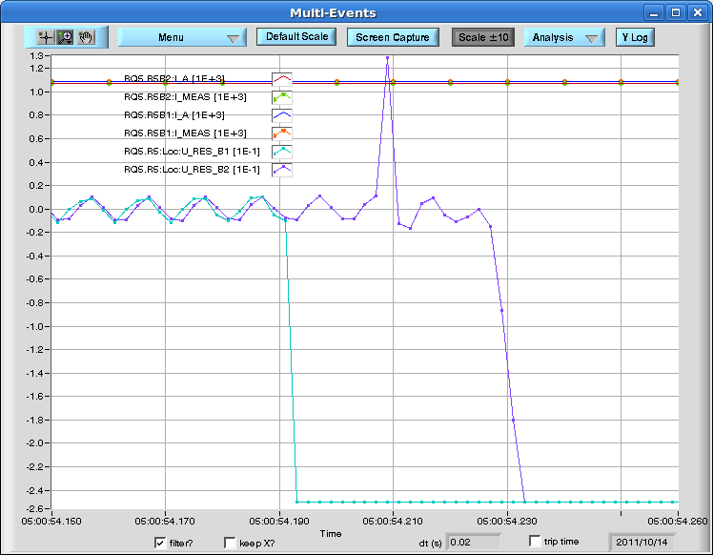
Thu 14/10
05:00 Beam dump due to trip of RQ5.R5 (likely SEU). ~50 pb⁻¹ in 6 hours
06:30-07:00 Access for QPS controller reset (MB.A9L5)

Slide 7
Plans
09:00 – 21:00: 25 ns MD at 450 GeV
Physics
Pending:
Loss maps at injection

