Slide 1
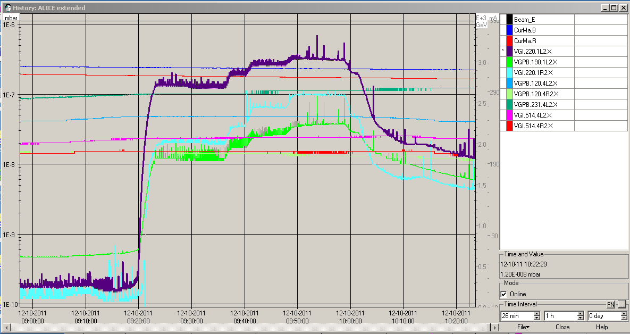
Wed 12/10
09:30 – 10:30 Ramp down of ALICE solenoid to 50% nominal field on request of ALICE. Increase of the vacuum (e-cloud in this area that has not profited of scrubbing during the physics run) ➔ too high background for ALICE ➔ go back to nominal field

Slide 2
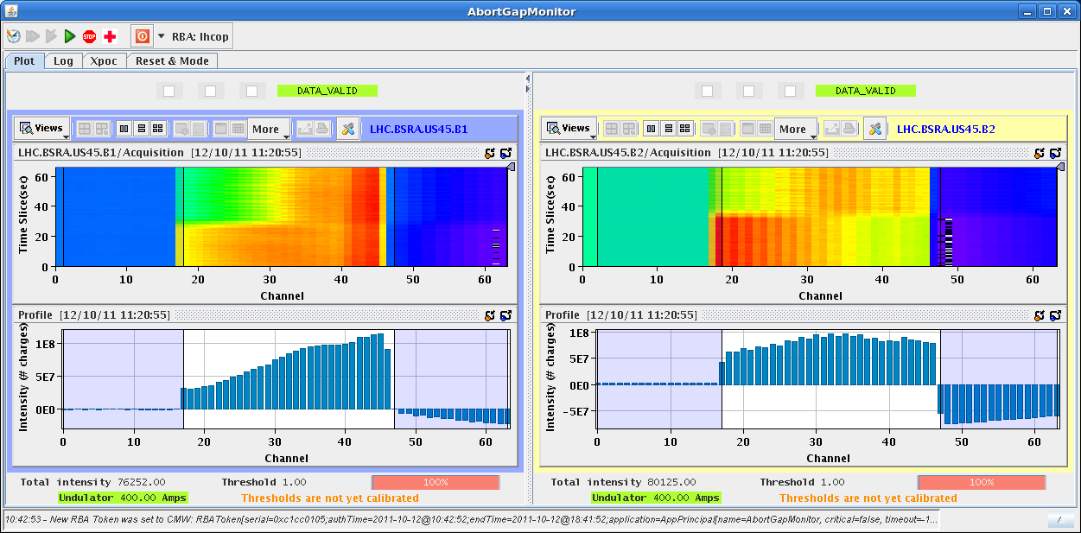
Abort gap cleaning in stable beams
This morning abort gap cleaning was switched on with stable beams (first switch on in ADJUST).
No problems. Losses (obviously) only in IR7.
Small effects on luminosity
Cleaning to ‘full’ power

Slide 3
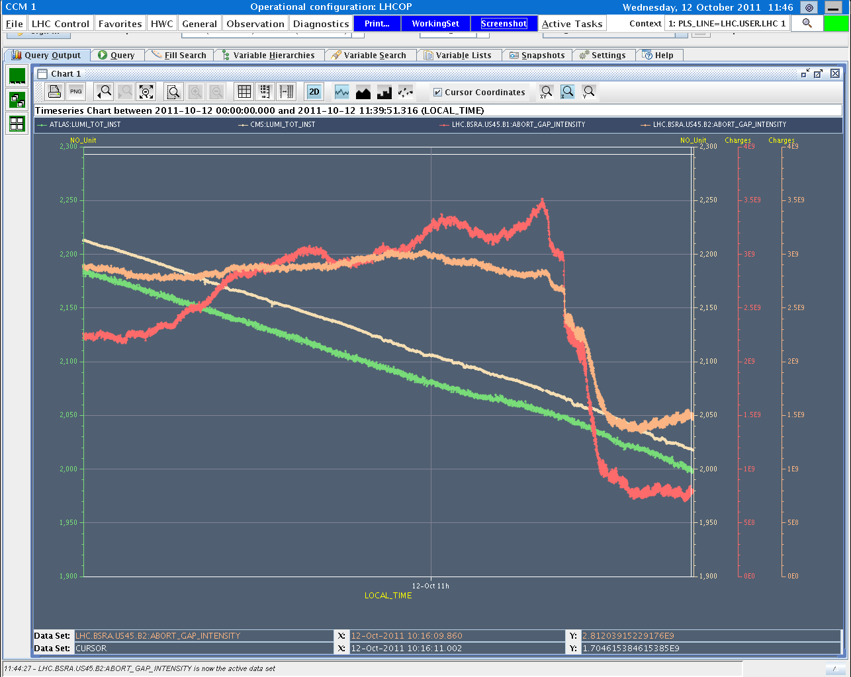
Cleaning effect on abort gap population
B1 AG pop
Lumi CMS
B2 AG pop
Lumi ATLAS
50%
100%

Slide 4
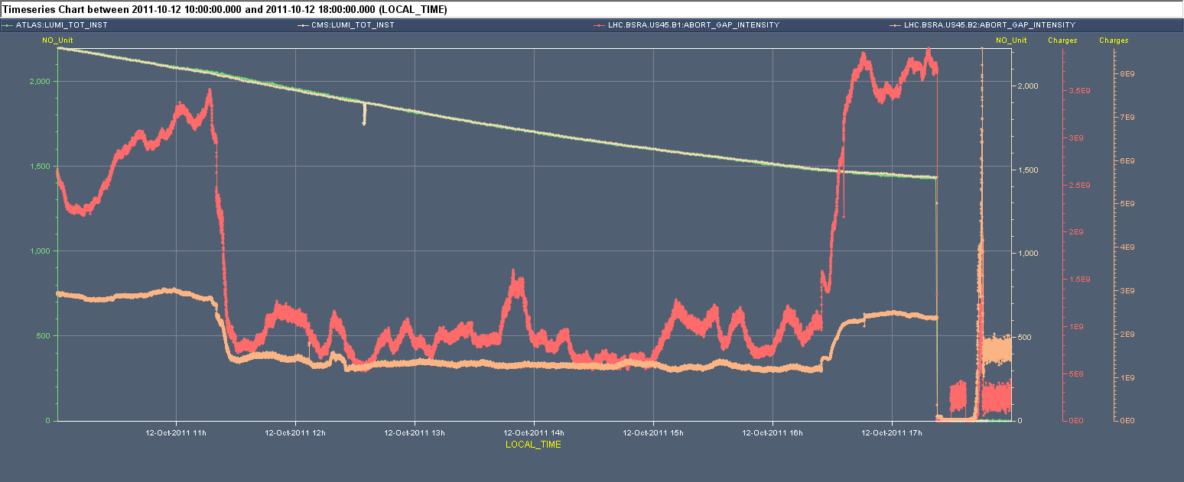
Abort gap cleaning
Still some effect visible on the luminosity
Abort Gap Cleaning ON
Abort Gap Cleaning OFF
Abort Gap Cleaning OFF

Slide 5
Next steps
Adjustment of the abort gap cleaning parameters?
Preparing tasks to switch on to 50% and 100% at end of squeeze / stable beams.
OP details to be finalized in the coming days.
Voice alarm in the CCC when population above 3E10 protons (per beam) since last week.
No action, but awareness.
No false alarms so far.

Slide 6
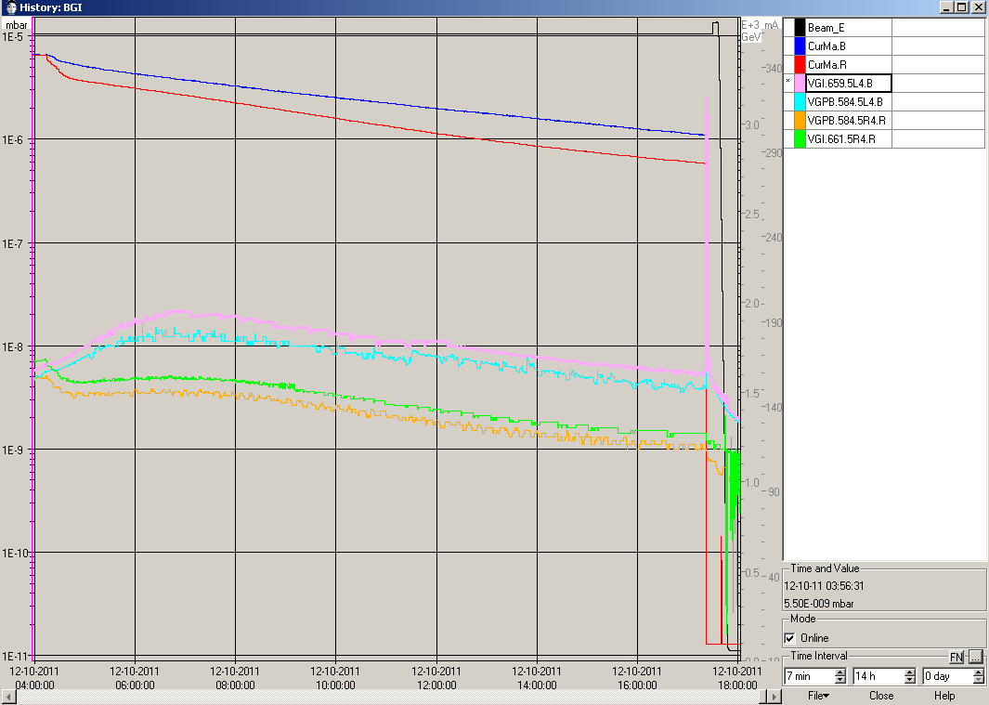
Wed 12/10
17:30 Beam dump, vacuum Pt4. Integrated luminosity 95 pb⁻¹.
BGI Tension regulation was started, supposed to be compatible with beam operation ➔ CCC was not informed.
18:30 Access for QPS controller reset in point 5: MB8.L5

Slide 7
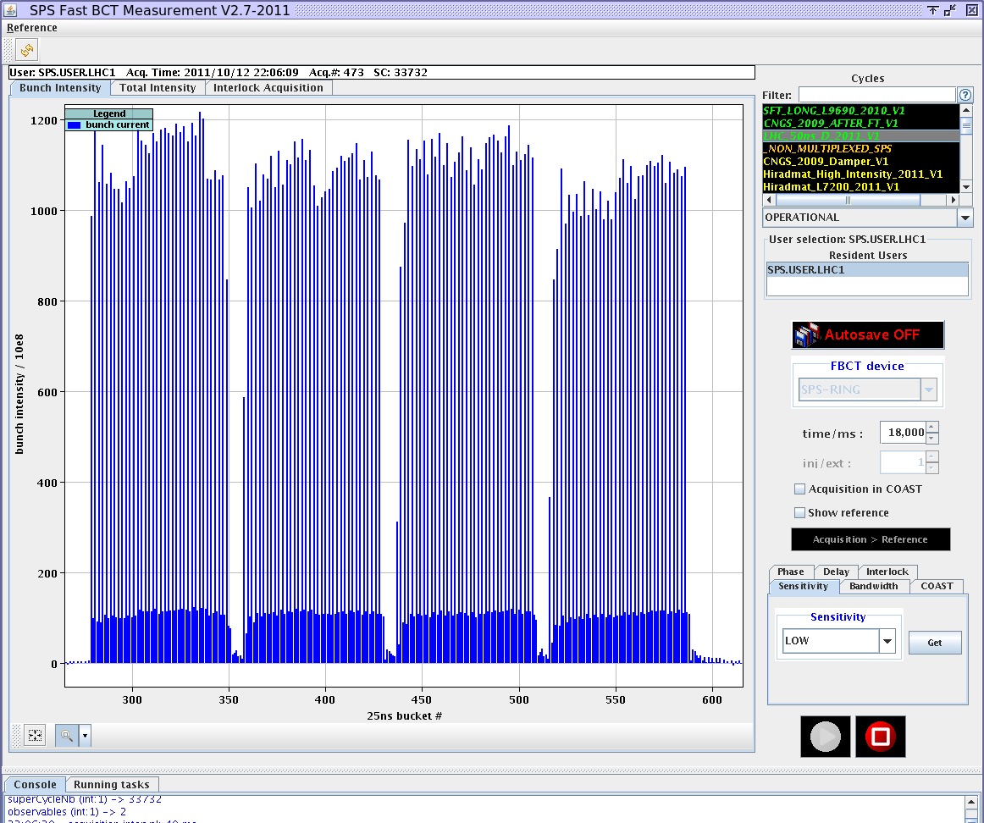
Wed 12/10
20:00 - 24:00 Bad beam quality from the injectors:
RF synchro problem PSB-PS (not really fixed ➔ to be followed-up today)
Loss of the SPS injection kicker fine delays after create reboot earlier during the day. Non uniform bunch population ➔ expert called in

Slide 8
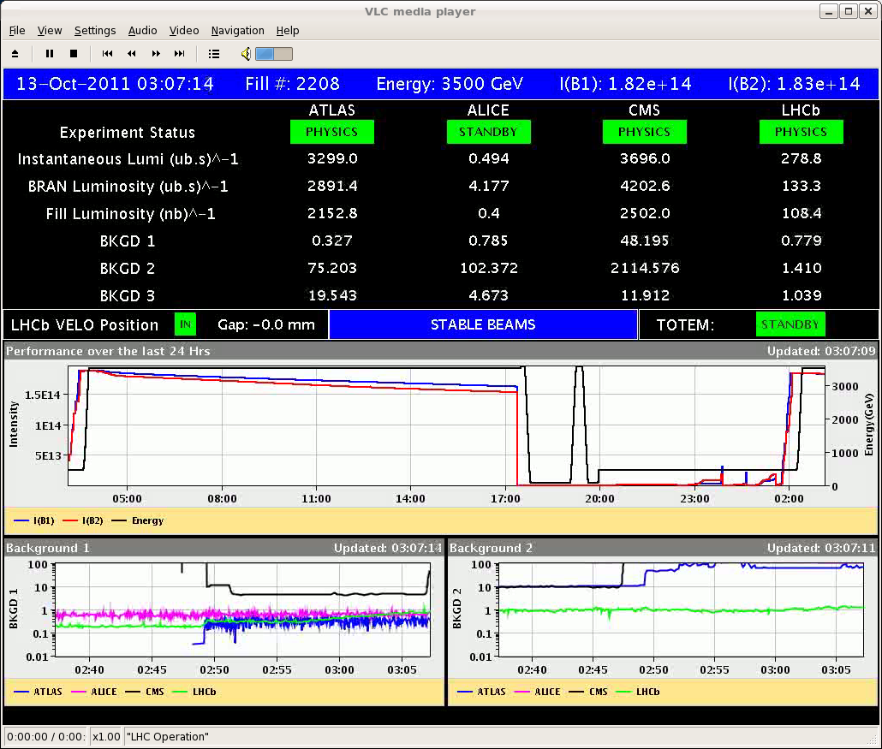
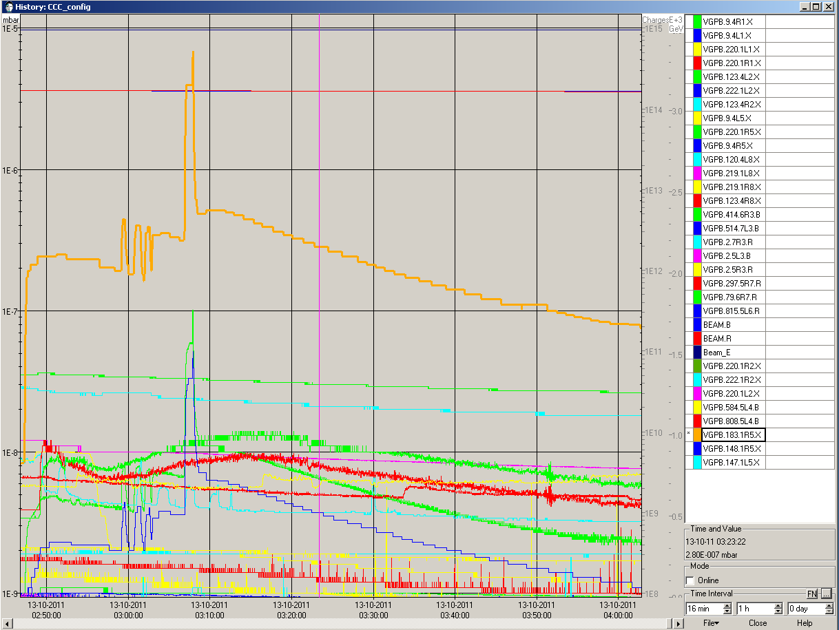
Thu 13/10
00:00-01:30 Injection corrections
03:00 STABLE BEAMS #2208 Initial luminosity 3.3x10³³ cm⁻²s⁻¹
Large vacuum spike R5 when going in collision

Slide 9
Plans
Physics
Dump at ~16:00
Might need an access for reset of QPS controller (Q8.R1)
Tomorrow 25 ns MD (12 h starting in the morning)

