Slide 1
Friday
25 ns MD – starting effectively around 10:30
First 3 hours dedicated to setting-up of the injection and preparation of the conditions for the MD (anti-ecloud solenoids, raising interlocks level on vacuum)
Part 1: reference measurements with trains of 72 bunches with different batch spacings.
Part 2: Filling with trains of 72 bunches.
Trains of 72 bunches spaced by 6.325 microseconds: accumulated 732(B1) +660 (B2) bunches.
Filling slowed down by the injection interlock on the vacuum pressure for MKI8 normally set to 2x10^-9 mbar. M. Barnes agreed to increase the threshold to 2.5x10^-9 mbar. In spite of that the injection for beam 2 was slow.

Slide 2
25 ns MD
Beam lifetimes of a few hours, systematically lower for Beam 1 as compared for beam 2.
Chromaticity set to ~ +15.
Loss pattern and emittance blow-up are consistent with electron cloud build-up and were affecting mostly the trailing bunches of each train.
Batch spacing was then reduced to 3.625 us: accumulated 1092 bunches in B1 and 1020 in B2.
In the last 30 minutes the spacing was reduced to 925 ns.
1020 bunches were accumulated for B1 in rapid sequence.
For B2 injection was limited to156 bunches because of the injection interlock from the MKI8 vacuum.

Slide 3
25 ns MD
Last beams had to be dumped to avoid loss of the cryo maintain as a result of the temperature drifts in the beam screen in 5 sectors (23,34,45,56,78).
The cryogenics operator did a real miracle in keeping he temperatures under control avoiding the loss of the cryo maintain.
Measurements of the RF stable phase are consistent with energy loss along the bunch train resulting from the electron multipacting along the bunch trains.

Slide 4
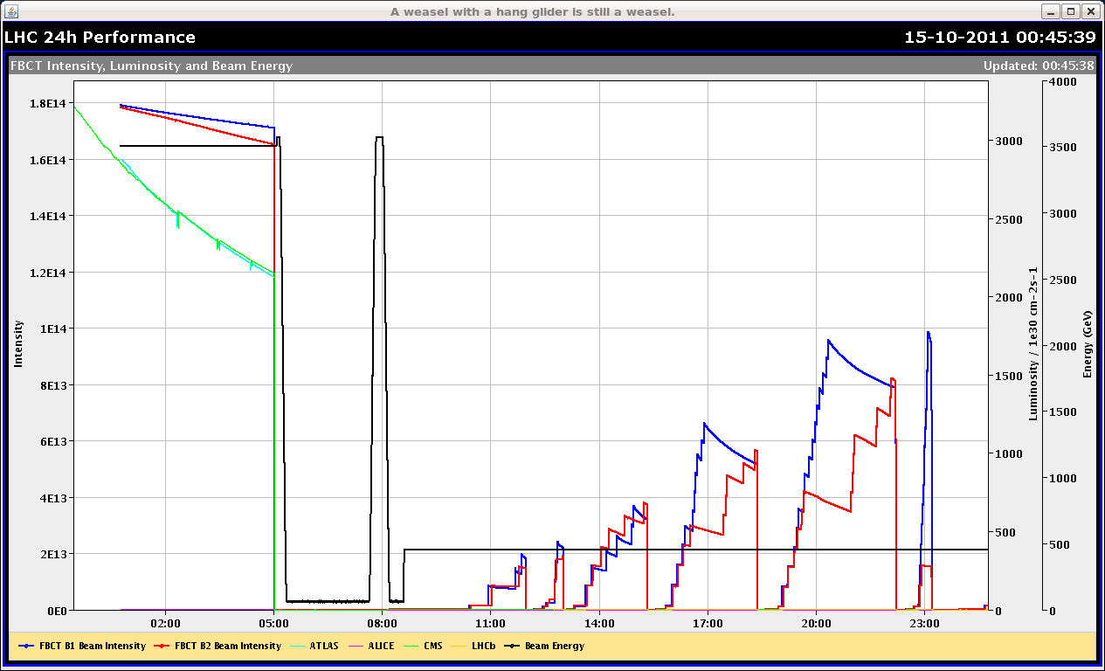
Intensity history

Slide 5
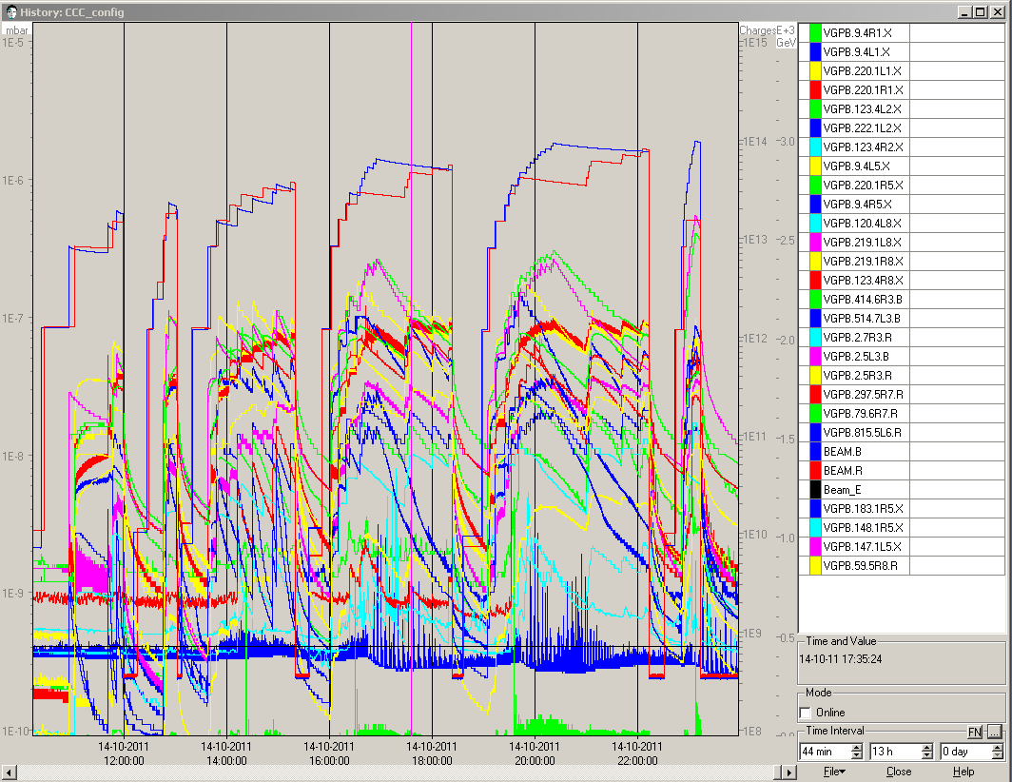
Vacuum during 25 ns MD
1E-6
1E-8

Slide 6
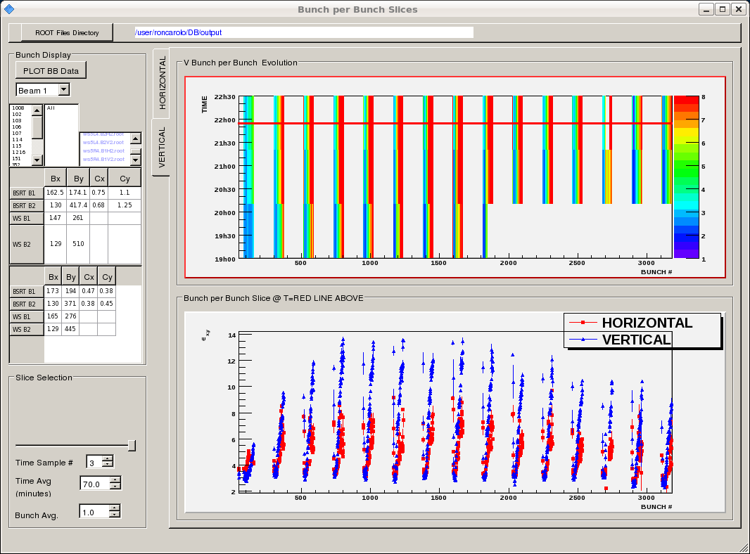
Emittances along trains

Slide 7
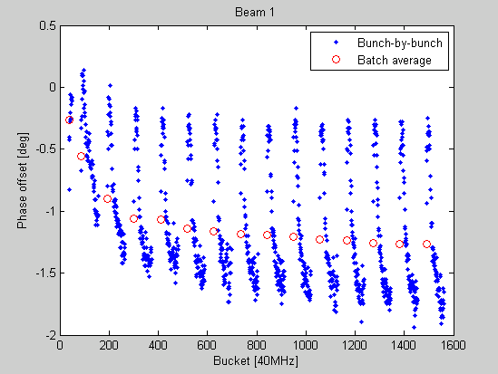
RF stable phase shift along batches

Slide 8
Night
00:00 Back to physics hypercycle.
Some trouble with the FIDEL correction mechanism (was not switched off for the change over).
01:00 Resteering TI8…
02:00 Ramp.
Large vacuum spike in 5.
03:00 Stable beams fill 2215, 3.2E33 cm-2s-1.
CMS background (too) high.
04:30 Dump, QPS trigger on RB 56 current lead, 15 pb-1.
07:00 Injecting.

Slide 9
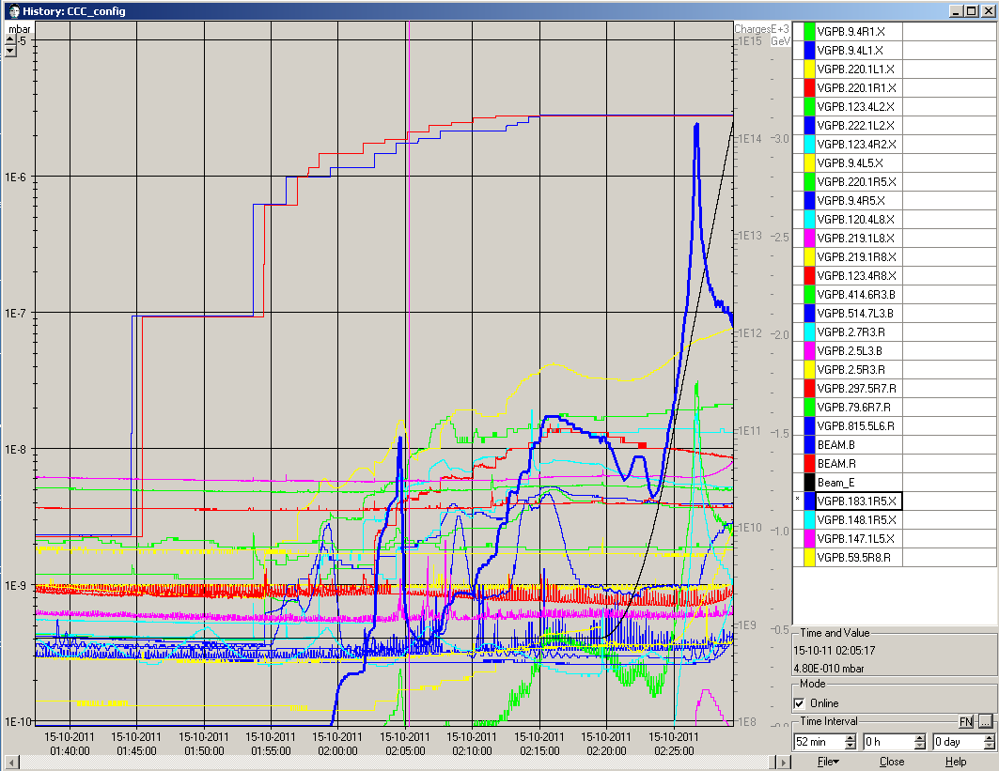
Vacuum spike R5

