Slide 1
Tuesday
Access….
QPS intervention at 09:00 in point 8 (quench heater exchange)
QPS installation oscillo for the ISRM measurement
EPC intervention in point 4 (60 A module in S34)
aperture Kicker intervention in point 4
MKI AGK delay in point 8
vacuum recabling in point 2
vacuum : BPM cabling in point 8
CNGS in point 8
BI in UA43 for dev BBQ
UX65 for RADMON installation
UW25 : inspection from CV

Slide 2
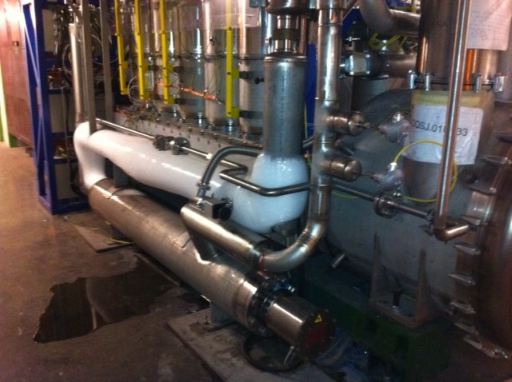
Frozen DFB in point 3
Insulation vacuum of DFBLC connection to the WRL was abnormally poor.
When the pump was restarted and the valve towards the insulation vacuum was opened, the pressure raised from 1e-8 to few e-5.
The ice was removed and the vacuum pumped back down to a good level.

Slide 3
Tuesday-Wed
Morning: ISRM tests on RQ4.L8 and RQ6.R8
00:00 Precycle.
Injection a bit rocky – 50 ns quality not at its best (int. spread) – lot’s of injections blocked by SPS BQM.
+ steering of TI8.
Lifetime dip when bringing into collisions – 4 hours – and losses in IR7 to 67% of threshold (on B1 monitor from B2 losses).
04:20 Stable beams fill 2204, 3.3E33 cm-2s-1.

Slide 4
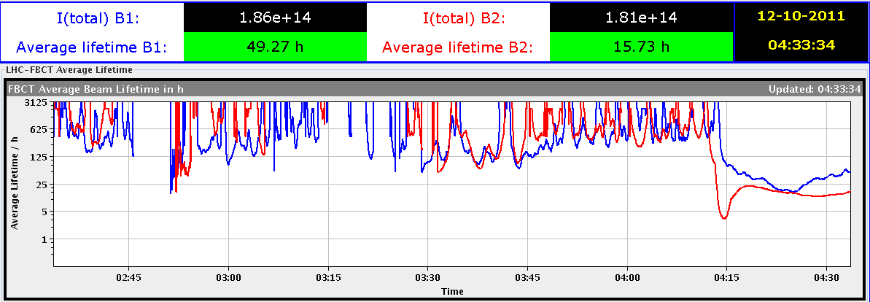
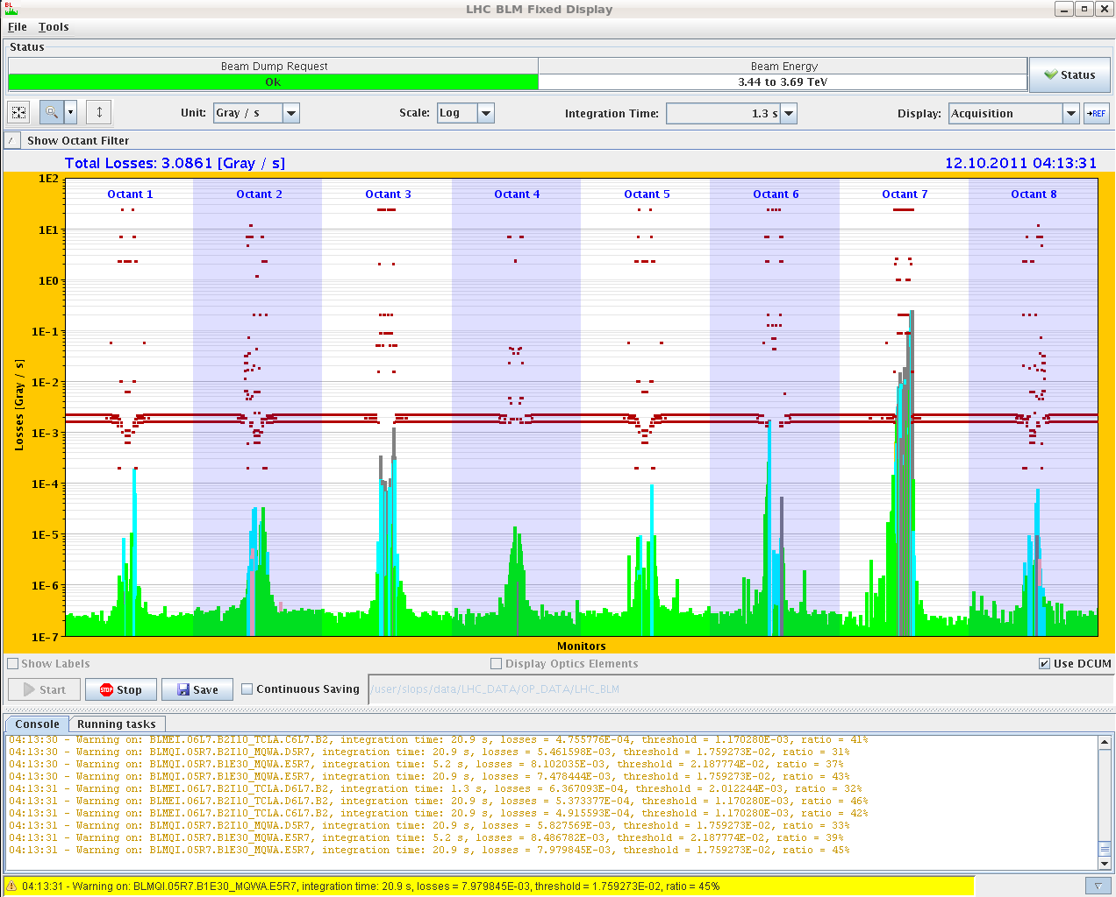
Lifetime & losses

Slide 5
Today
Stable beams.
ALICE reduced field test.
Abort gap at end of fill?

