Slide 1
Monday
09:50 Fill 2200 dumped on PC fault of IT L8, collected 44 pb-1.
After some attempts by EPC get to around a problem of a power module on one IT PCs, we finally gave access for a proper repair.
  CMS access in the shadow.
  S81 trip during access – problem with current reading triggered access interlock.
14:30 Injecting for ‘high pile-up MD’.

Slide 2
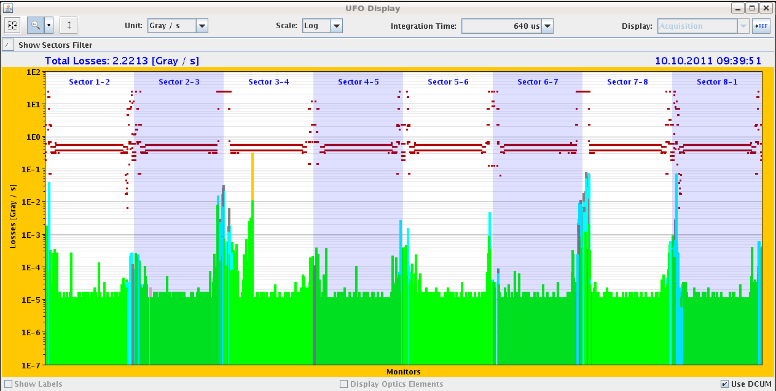
Just not to forget: a 63% threshold UFO in fill 2200

Slide 3
Monday
Filling 1 high intensity bunch per beam.
  At injection 2.4E11, 2 um.
Significant transverse blow-up while sitting at injection and in the ramp.
15:30 Stable beams fill #2201, 5E30 cm-2s-1.
  Average pile-up of ~ 32 events.
  Emittances ~2.8 to 3.6 um.
17:30 ALFA moving in to 7 mm.
19:20 Dump
  Emittances ~3.4 to 4.7 um towards end of fill.

Slide 4
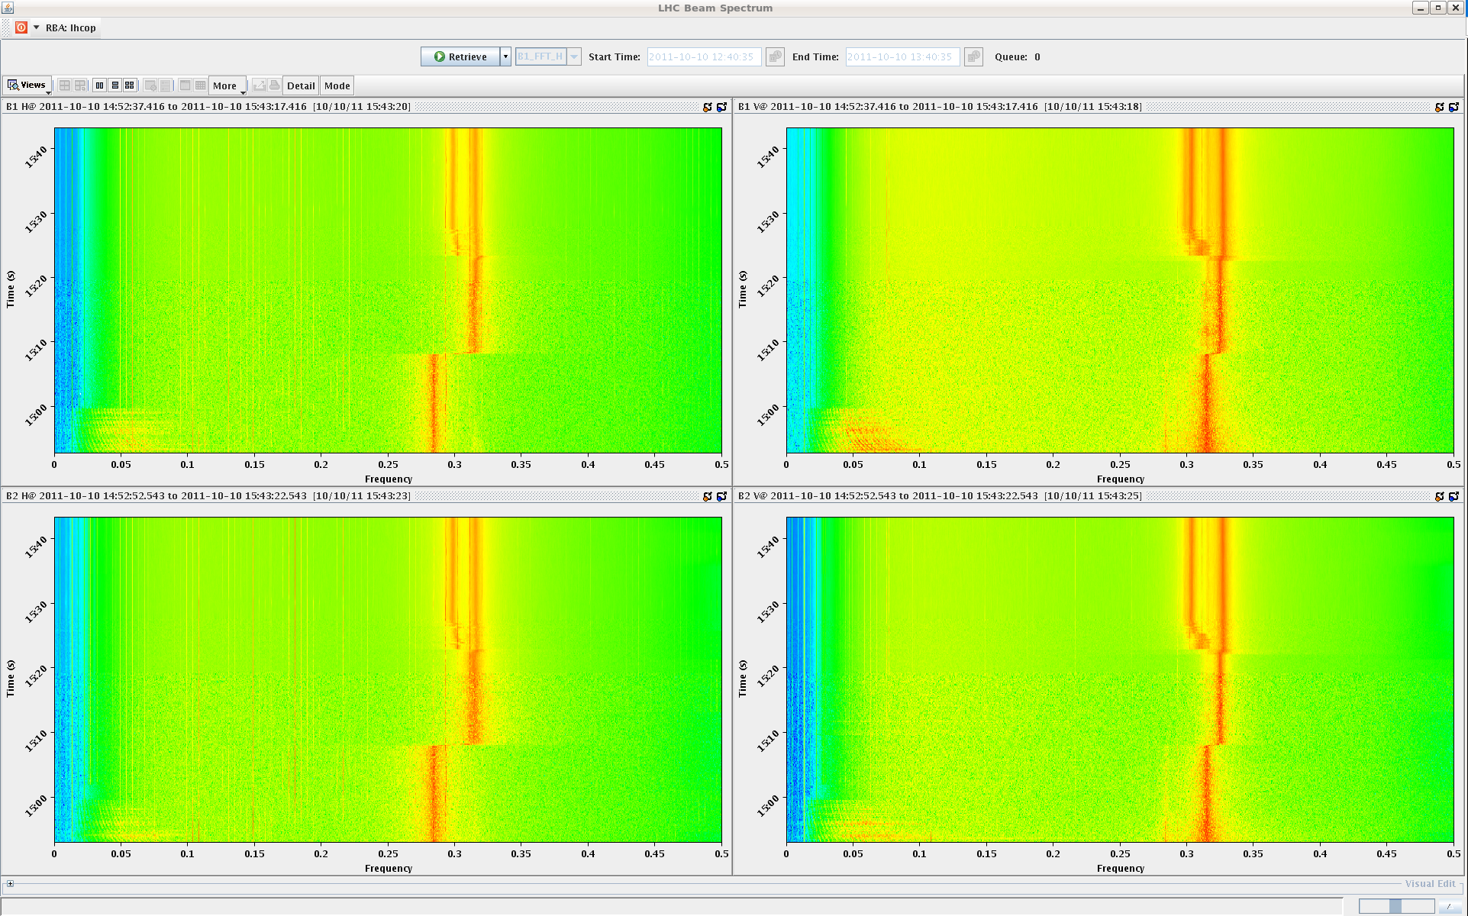
Beam-beam modes in collision
Collisions
Squeeze start

Slide 5
Monday -Tuesday
20:30-22:30 LINAC problem – no beam.
22:30 Filling again.
23:40 Beam dumped preventively. Cryo compressor stopped in Pt6. Lost communication with PLC.
03:30 Compressor restarted.
No beam before this evening.

