Slide 1
Wednesday 4 October 2011

Slide 2
Tuesday - Day
12:12 dumped Fill # 2181 after 12:15 hours in stable beams
Initial luminosity: 3.2e33 cm⁻² s⁻¹
Delivered luminosity: 92 pb⁻¹
Operator Dump procedure started – but in the end the beam was dumped by RF interlock because RF was switched off
When beam mode is changed to ‘beam dump’, the LHC page 1 displays the image of the last beam dump → need to check the time stamp
12:44 Remote reset of an error on the QPS crate in S45 (B8L5)
Plan was:
1 hour: RF test of new tuner firmware version for the 25ns MD
6 hours: abort gap cleaning commissioning (using the new RF firmware in order to test it at lower intensity beam)
Physics

Slide 3
Problem with the new RF firmware and problem rolling back to the old version
14:54 – 17:12: BLM power supply in IP7
Abort gap cleaning cancelled and moved to Friday 14:00 – 20:00
17:52 RF firmware rolled back – ready to inject for physics
20:36 Stable beams for Fill #2182
Bunch intensity: 1.3E11
Peak luminosity: ~3.2e33 cm-2 s-1
Total luminosity delivered: ~71 pb⁻¹
05:31 Dump: quench heaters discharged in MB10.L8
19:55 vertical OFB stopped at around 1.5TeV (BPM 31.L5 went bad) and was restarted after disabling this BPM
New RF firmware corrected, some tests done, but not tested with beam.

Slide 4
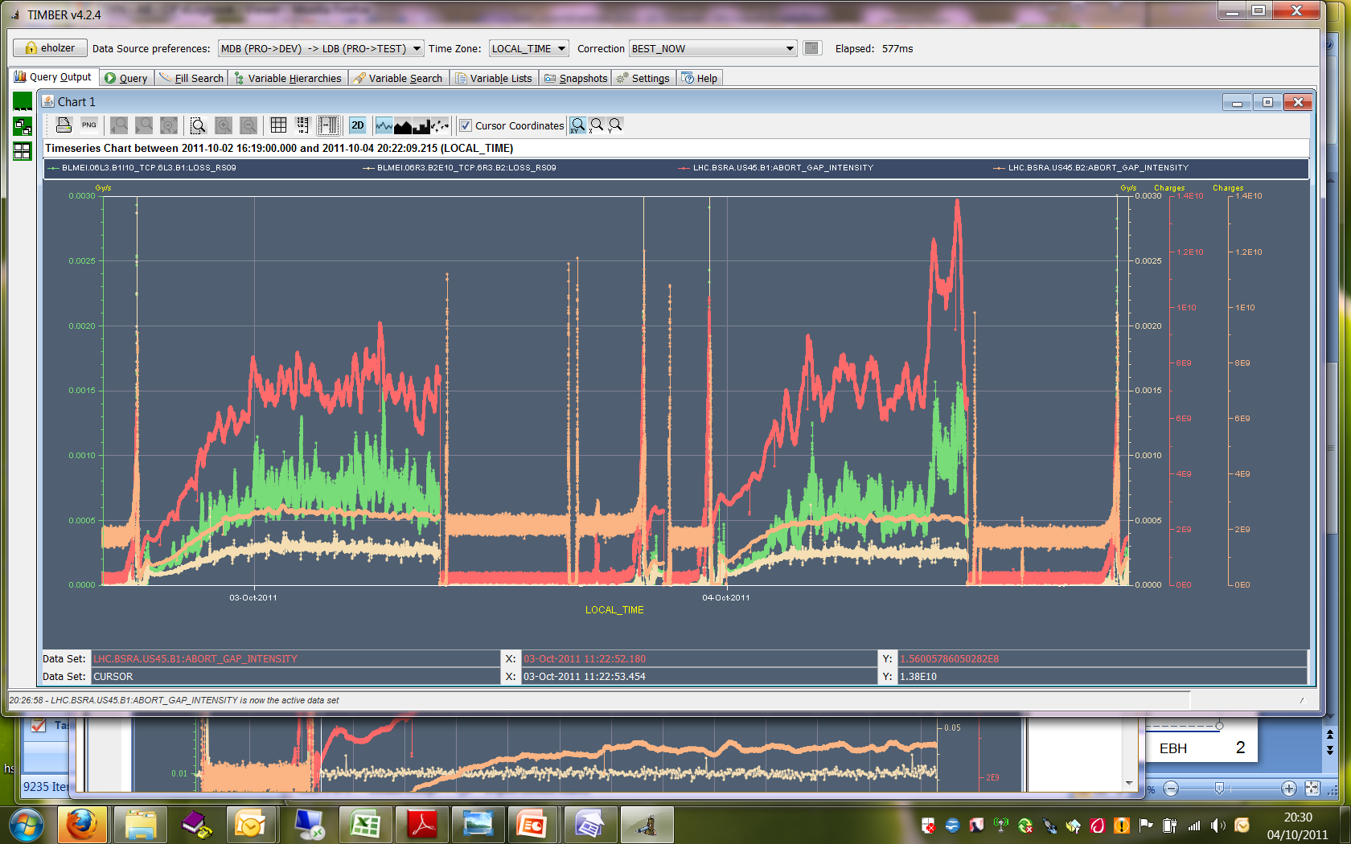
Fill #2180 and #2181
Abort Gap population up to 1.38E10 for B1 (red curve)
Correlated with losses in IP3 momentum cleaning B1 (green curve)

Slide 5
BLM Power Supply in IP7
TI operators need more information to find equipment owner quicker
CCC TI minor event report:
Piquet EL sur place, c'est un RACK qui fait déclencher se départ. Sur le rack le seul information écrit est: LHC TIMING
Demande au LHC qui nous dit de contacter des personnes pour le timing. Apres multiples coups de fils on trouve que ce rack est en effet un rack de Beam Instrumentation. La personne en charge se rend sur place et trouve une alimentation défectueuse. Apres échange de l'alimentation tout est de nouveau OK.
Suggestion:
Afin d'améliorer cette situation (et ne pas perdre plus de 2 heures a chercher qui appeler) il faudrait indiquer sur le RACK qui ou quel groupe en est responsable..

Slide 6
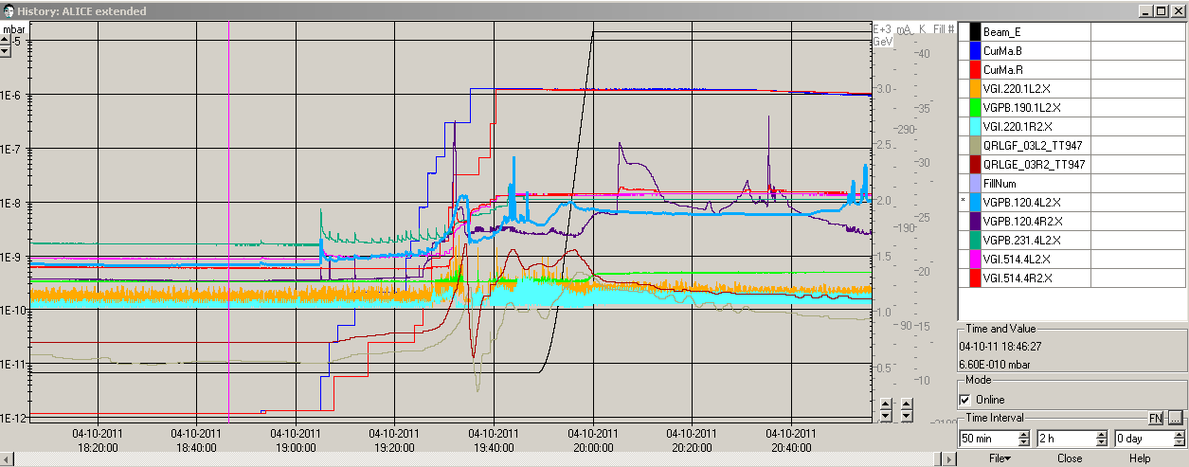
Fill #2182
Some vacuum spikes left and right if IP2 – calming down afterwards

Slide 7
Losses on B1 – lifetime down to 5 hours
“B1 lifetime dip started ~2min. before we optimised IP5, and at the time we started leveling ALICE to 0.7 (ub s)^-1.
Bunch length increased for B1.
CMS showed an increase of the difference between the arrival time of both beams at the IP of 0.15 ns which could be explained by the increase in bunch lenght of B1.
No emittance growth in the transverse plane.”
BLM TCT left of IP5 reached 60% of dump level

Slide 8
Philippe Baudrenghien:
" At the start of Fill 2182, Beam 1 experienced abrupt losses, with signs of debunching (abort gap population and bunch lengthening). It was traced to noise in Cav1B1. Attached a figure showing noise in 1B1, Fast BCT loss, abort gap population jumping to 6E10 and bunch lengthening. The klystron polar loop in 1B1 tried to compensate a ~ 6 dB loss in the RF chain and would saturate causing significant noise. We switched the loop off for the rest of the fill and configured it off for next fills. Obviously the open-loop gain has dropped (visible from the degraded control of cavity field). The open-loop phase has drifted also. We need to run our optimization tools without beam to localize and cure the problem.
N.B: The VME modulator card was replaced on Sept 19th on 1B1.”

Slide 9
Losses on the batch of 12 bunches after Qh trim of +0.002 → reducing by -0.001

Slide 10
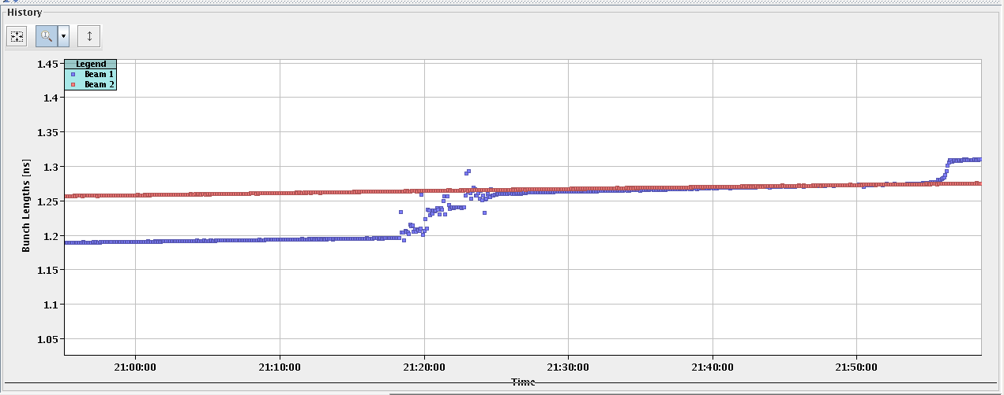
Bunch Length and abort gap filling
7E10 protons in abort gap
No Losses associated with second bunch lengthening

Slide 11
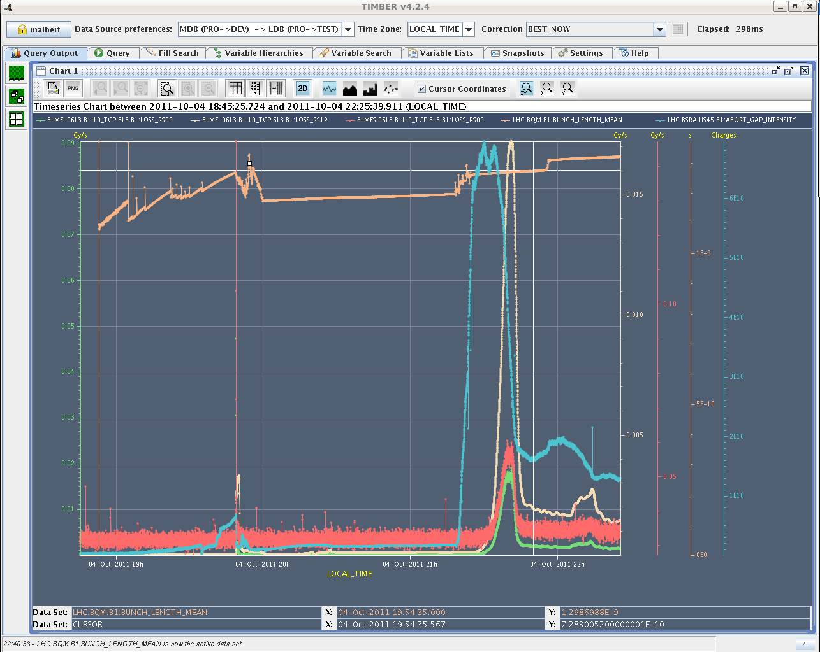

Slide 12
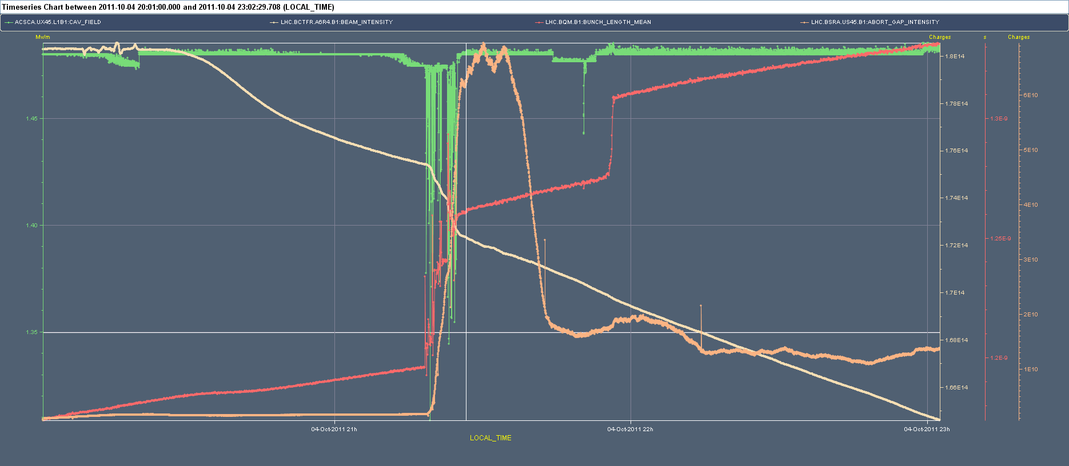

Slide 13
Present tentative planning week 40
Wed (day): Large pile-up MD (9h)
Wed (pm/night): Physics
Thu (day): 25 ns MD (12h)
Thu (night): Physics
Friday (day): Abort gap cleaning (6h)
Fr(night), Sa, Su: Physics
To be done:
ALICE test: solenoid to 0.2T (40% of nominal) at the end of a fill; stable beams for ½ - 1 hour
Loss map qualification for injection & physics

Slide 15
