Slide 1
Report Week 40 (R. Assmann & E.B. Holzer)
Highest peak luminosity: 3.4 10³³ cm⁻² s⁻¹
Most productive fill: 120 pb⁻¹ in 17 h
Week production: ~400 pb⁻¹
Total integrated: ~4.6 fb⁻¹
OP commissioning (6h): Abort gap cleaning
MD 25ns (12h + 3h): up to 700 bunches Pilot physics run
But could have been better: several problems...
Repair TI2 TED → 29h lost
Accidental switch off of all power convertes (incl. experiments)

Slide 2
Statistics
Red = potentially intensity/luminosity related
Fill (nb) | Length (h) | Int. L (pb-1) | Dump cause
2178 | 15h09 | 108 | Q4.R6 quench heater discharge
2180 | 0h14 | 3 | IR2 losses due to vacuum spike
2181 | 12h15 | 92 | EIC dump
2182 | 8h55 | 71 | Circuit breaker, QPS S78
2186 (25ns) | 2h53 | 0.0006 | RF trip
2194 | 0h37 | 7 | Circuit breaker, QPS rack S56
2195 | 17h17 | 120 | EIC dump
2197 | 7h10 | 65 | S56 trip
2199 | 0h31 | 6 | IREF of RQ4.R5 went to zero
2200 | 3h00… | 27 | …ongoing
Total |  | ~400
Integrated luminosity 400 pb⁻¹ in 1 week
Stable beams: ~52 h out of 168 h

Slide 3
History Peak Luminosity Week 40 (CMS)
3.3 × 10³³ cm⁻² s⁻¹
TI2
TED
Repair
25 ns
MD
&
Pilot
Run
Abort Gap Cleaning
Tevatron
LHC 2010

Slide 4
Integrated Luminosity Week 40 (CMS)

Slide 5
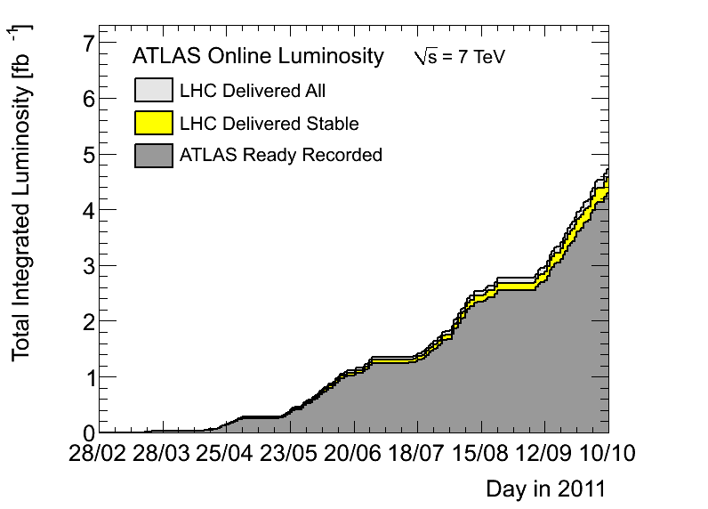
Comfortably above 4.5 fb-1

Slide 6
Time Spent (Status Sunday evening)
Stable beams = 49 h
Problems = 51 h
Commissioning = 6 h
MD = 12 h
Machine overhead = 38 h
Total = 156 h

Slide 7
Changes/improvements
BLM threshold change for 10 triplet monitors at IP1 and IP5.
Abort gap cleaning commissioning.

Slide 8
BLM Thresholds (Barbara & Eduardo)
BLM threshold change for 10 triplet monitors at IP1 and IP5 the RS10-12 were set to the same value (in Gy/s) as the RS09 to allow for luminosity induced loss signals (and avoid having the BLMs constantly at warning levels during physics collisions). Thresholds consequently increased by up to a factor of 2.6. See LHC-BLM-ECR-0026 for details.
Monitors concerned:
BLMQI.01R1.B1E30_MQXA BLMQI.01R5.B1E30_MQXA BLMQI.01L1.B2E30_MQXA BLMQI.01L5.B2E30_MQXA BLMQI.02L1.B1I23_MQXB BLMQI.02R1.B2I23_MQXB BLMQI.02R1.B1E30_MQXB BLMQI.02R5.B1E30_MQXB BLMQI.02L1.B2E30_MQXB BLMQI.02L5.B2E30_MQXB

Slide 9
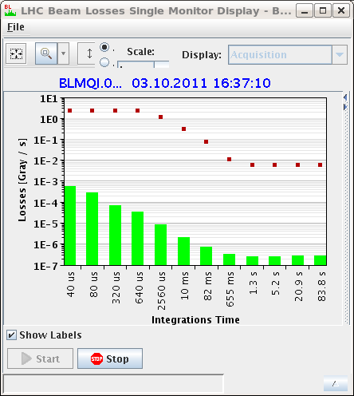
Modified BLM Thresholds

Slide 10
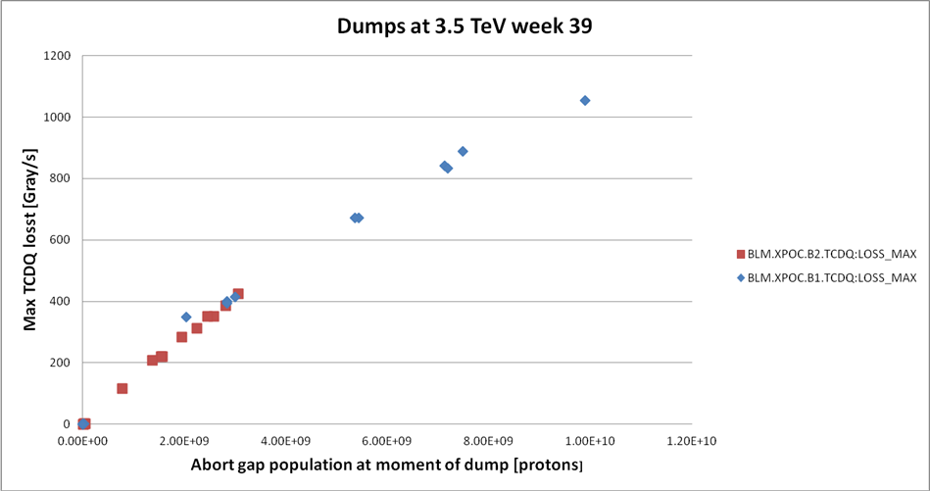
Abort Gap Cleaning: Motivation
J. Uythoven

Slide 11
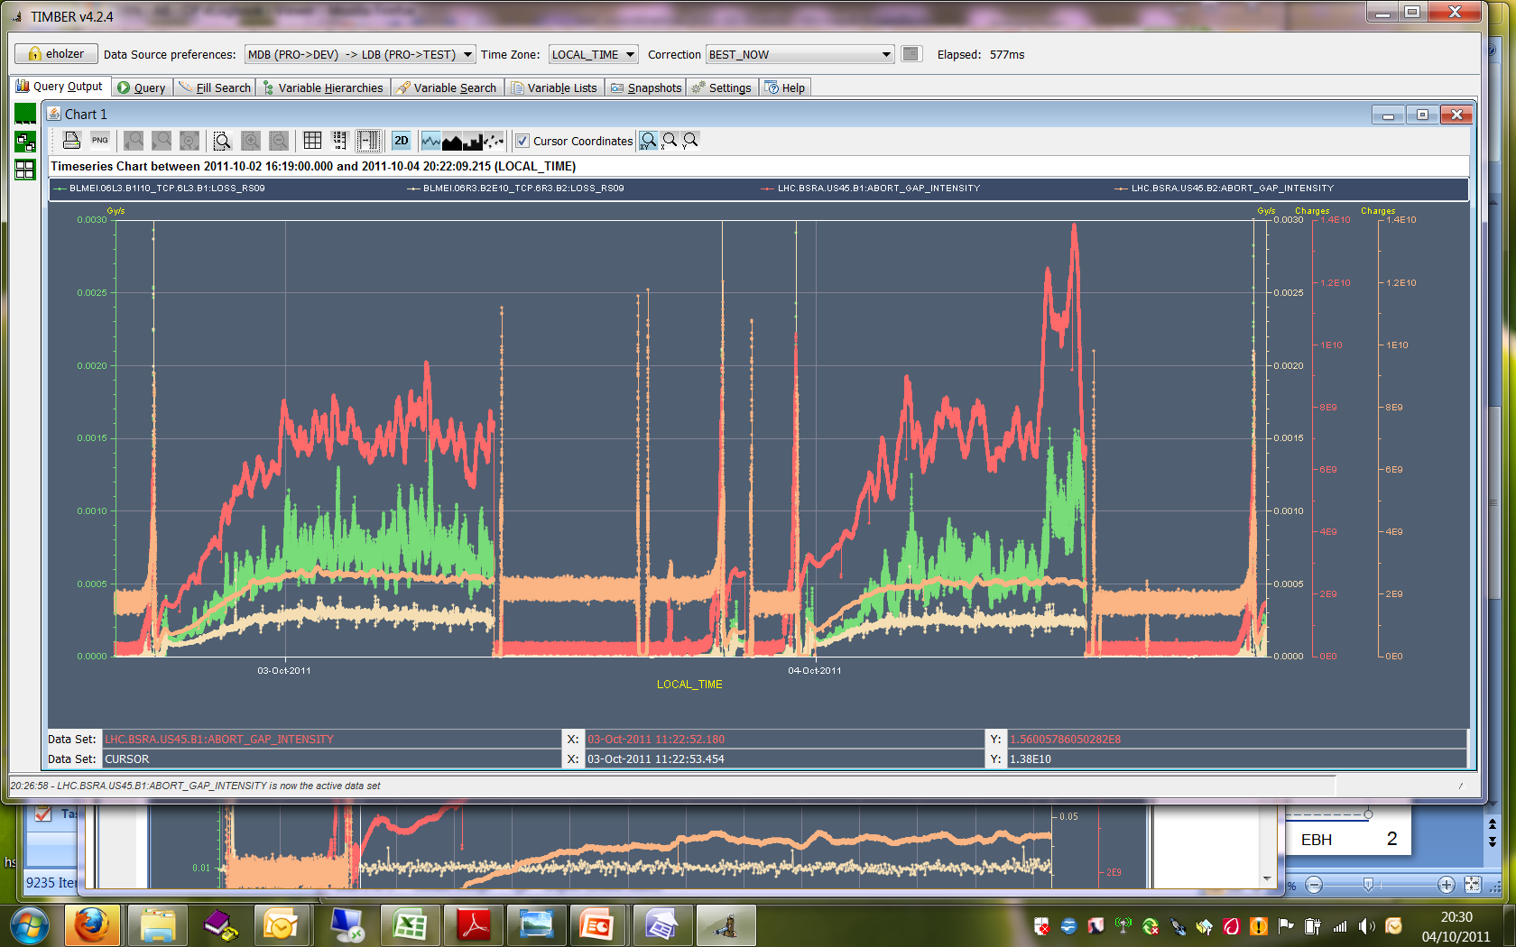
Fill #2180 and #2181
Abort Gap population up to 1.38E10 for B1 (red curve)
Correlated with losses in IP3 momentum cleaning B1 (green curve)

Slide 12
Debunching Problem (P. Baudrenghien)
Next fill (physics) showed large debunching, beam 1, ~ 1 hour after start physics, clearly due to RF noise.
John Molendijk and me came in ~ 23:00 and found noise on 1B1, caused by a so-called Klystron Polar Loop that reduces the RF noise and gain/phase changes due to klystron HV ripples and droop.
We switched loop off and physics fill continued till 6:00 on Wednesday. We made a series of observations with beam but could not “touch” the hdw until the end of the fill.
On Wednesday morning we went in the cavern, replaced the VME modulator card and found one SMC connector loose. The klystron loop is back on now.
Strong debunching beam 1 had already been observed for a short time on Sept 14th but not explained. It had disappeared since.
On Sept 20-21 we had another RF noise B1 episode that was traced to an intervention on 1B1 following change of a bad cable on Sept 9th….
Cables and loose connectors are the weak points of the LHC RF….
We will replace ALL SMC cables during shutdown 2011-2012. Our observations last night also suggest a potential problem with the loop in presence of strong power spikes (needed to compensate transient beam loading with high beam current). John will investigate off-line. All cavities are back, ready for beam.

Slide 13
Summary Abort Gap Cleaning (M. Meddahi et al)
Prepared beams with a special filling scheme
nominal bunches boardering the abort gap, pilot injected and kept elsewhere.
One injection with one train of 12 and one injection with two trains of 12 bunches, 50 ns spaced bunches.
Ramped to 3.5TeV collided.
Switched on abort gap cleaning
tune stepping in range of 0.29 to 0.33 (vertical plane), 2 second repeat cycle, 30 steps in tune.
The initially used cleaning pulse was ~1 microsecond long, located early in the abort gap, as for cleaning at 450 GeV.
An effect on the luminosity could be seen for this initial part, when switching on B1 cleaning, but not readily confirmed by wirescans done towards the end of the MD.
RF voltage was reduced in different steps and observed cleaning.

Slide 14
Summary Abort Gap Cleaning (M. Meddahi et al)
Length of the cleaning pulse was later increased
cover almost full abort gap (~2.5us), works well.
After three hours in collisions no more effect on lumi decay when cleaning is switched on/off
Recovered equal bunch length for both beams
lowering voltage to 6.5 MV (before different steps were done on both beams so bucket filling was different)
Moved tune…
range symmetric about tune of 0.32, not better.
Narrowed tune range to 0.31 to 0.33, cleaning is worse.
Best cleaning was for the initial choice of 0.29 to 0.33
Long cleaning pulse
with voltage drop of 2 MV (9.5 MV to 7.5 MV) cleaning was insufficient.
For smaller voltage drops the cleaning seemed to act as a barrier.

Slide 15
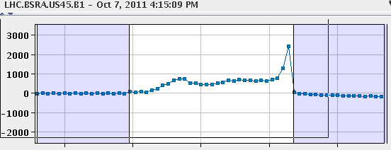
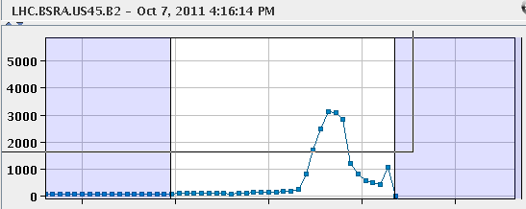
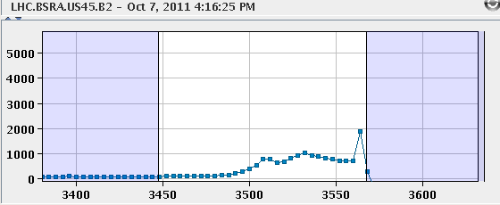
Abort Gap Population vs Time
4:15:09 PM → 0 s
4:16:14 PM → + 65 s
4:16:25 PM → + 76 s

Slide 16
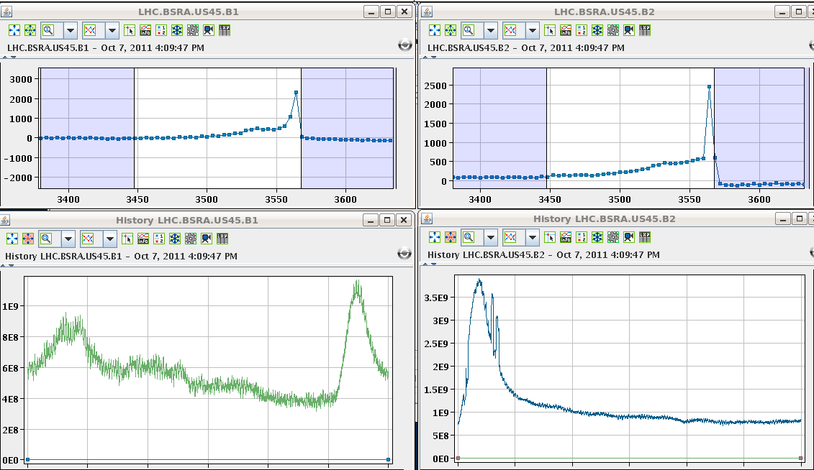
Abort Gap Cleaning example
RF voltage changed → leak of beam into abort gap
Transverse damper cleans out the gap (faster than synchrotron rad.)
Beam 1
Beam 2
Population in abort gap
Population in abort gap
cleaning
Time history
Time history
filling
cleaning
filling

Slide 17
Summary Abort Gap Cleaning (M. Meddahi et al)
Bunch by bunch lumi data to be looked at in detail.
The abort gap cleaning is operational if we want to use it, but effect on luminosity with full machine still needs to be checked in detail.
Propose to test it at an end of fill for a couple of hours, using the longer cleaning pulse, at the beginning of next week.

Slide 18
Problems
Beam-related issues, leading to beam dumps
IR2 vacuum spikes and losses
Collimator temperature
Problems encountered with approximate time lost:
TI2 TED bellow repair 29 h
QPS & ELQA 6 h
Injectors 6 h
RF issues 5 h
Transfer line steering 3 h
MKI8 faults 2 h
Total: ~ 51 h
Other important problems:
Accidental switch off of all power converters, including experimental magnets. Recovered in shadow of MD’s.

Slide 19
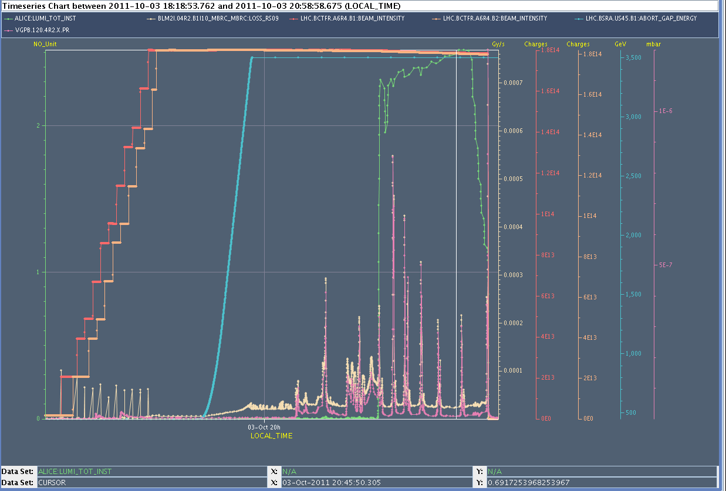
IR2 Vacuum Spikes

Slide 20
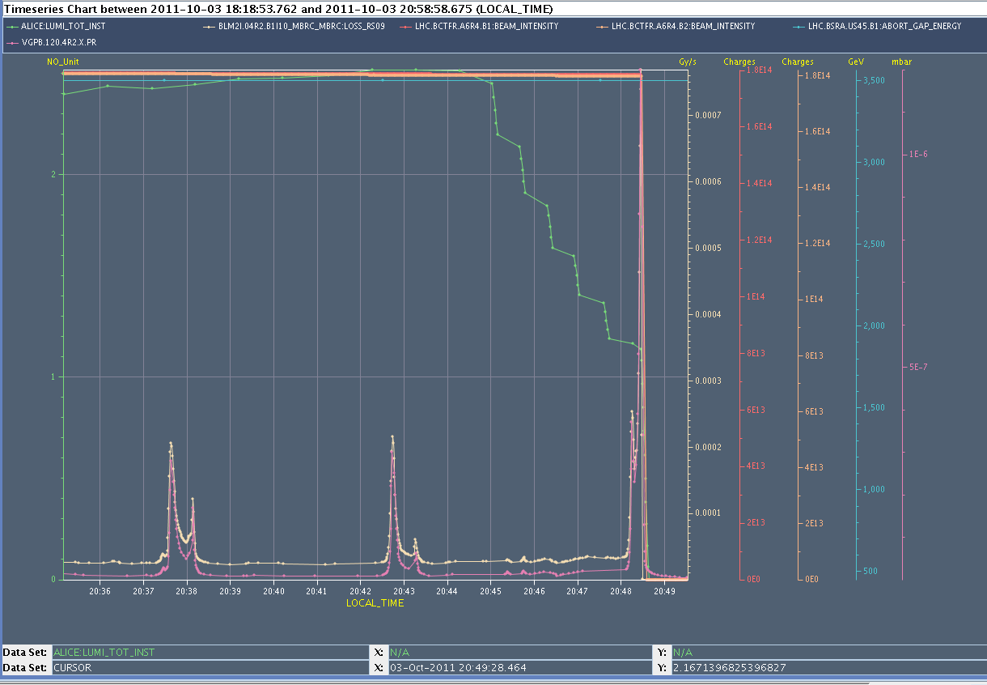
IR2 Vacuum Spikes

Slide 21
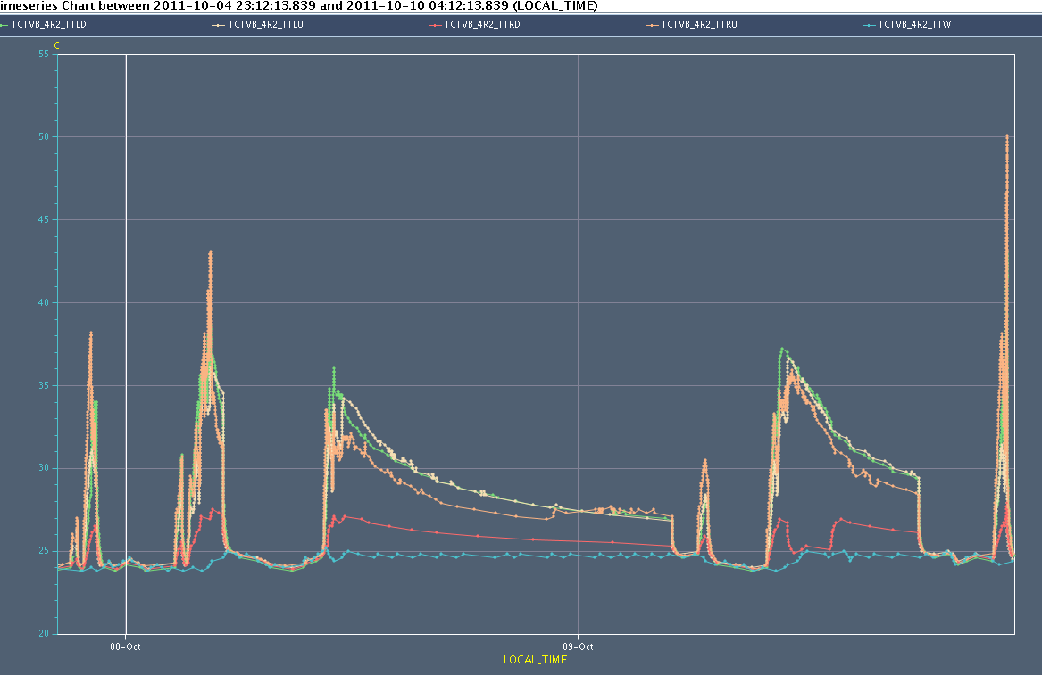
Temperature History TCTVB.4R2

Slide 22
Problems
Beam-related issues, leading to beam dumps
IR2 vacuum spikes and losses
Collimator temperature
Problems encountered with approximate time lost:
TI2 TED bellow repair 29 h
QPS & ELQA 6 h
Injectors 6 h
RF issues 5 h
Transfer line steering 3 h
MKI8 faults 2 h
Total: ~ 51 h
Other important problems:
Accidental switch off of all power converters, including experimental magnets. Recovered in shadow of MD’s.

Slide 23
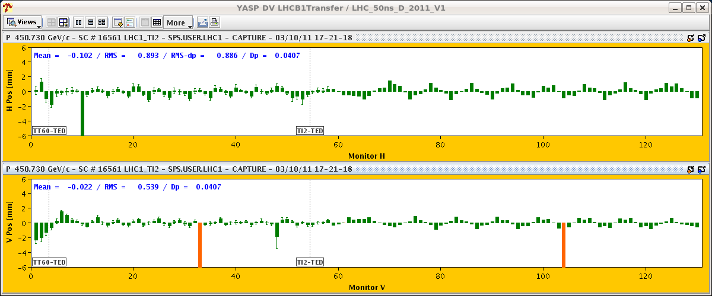
Transfer Line Issue: Oscillations

Slide 24
MKI (beam2) problems (E. Carlier)
Transient AGK (“abort gap keeper”) inhibition for injection of bucket 1 (probe beam) resulting in missing kick (beam on TDI):
Inhibition seems due to asynchronism between AGK 100MHz generation clock in LBDS and injection prepulse (end AGK window).
Shift of the AGK w.r.t the injection by -10ns improves the situation for injection of bucket 1 but induces transient inhibition on the injection of bucket 31181 (beginning of AGK window).
Roll back to original synchronisation settings.
AGK window length within tolerances (no interlock at LBDS level).
Phase offset between revolution frequency and injection prepulse w.r.t selected bucket appears to be OK (shift of the AGK results in inhibition of the bucket 31181 as foreseen)
Looks like as to be a drift within one timing module.
Access needed in UA87 to identified the faulty module
In case of similar failure (kicker in faulty state after injection of probe beam in bucket 1), installation can be restarted.
If the problem occurs again for the probe in bucket 1, we have to try again until it works. Switching the MKI to standby resets the fault.

Slide 25
Problems
Beam-related issues, leading to beam dumps
IR2 vacuum spikes and losses
Collimator temperature
Problems encountered with approximate time lost:
TI2 TED bellow repair 29 h
QPS & ELQA 6 h
Injectors 6 h
RF issues 5 h
Transfer line steering 3 h
MKI8 faults 2 h
Total: ~ 51 h
Other important problems:
Accidental switch off of all power converters, including experimental magnets. Recovered in shadow of MD’s.

Slide 26
Thursday Morning – All PC Switch Off
Vacuum recovery in TI2 after the repair of the vacuum leak at the TED ongoing
7:00 power glitch 400kV EDF; affected:
Injectors
LHC sectors 81 and 12, RF and collimators
Alice and LHCb dipoles
7:43 accidental switch off of LHC magnets including experiments; undulators took down cryo in MSL/R4.
Short summary by Valerie Montabonnet
Actions prepared by Stephen Page

Slide 27
2011-10-06 TE-EPC PIQUET BAD MANIPULATION
07:00 Alice dipole down. 400kV Glitch informed by TI operator [OP eLogBook].
07:15 TE-EPC Piquet called by the TI for analysing the alarm on EMT401 - ALICE Dipole mentioning also an electrical glitch
07:22 TE-EPC Piquet asked to the CCC a PO-LHC-Piquet token (RBAC) for analysis
PO-LHC-Piquet token gives the permission to get the status and control all the LHC converters (machine AND experiments)
He selected ALICE DIPOLE converter with FGCRun+ (TE-EPC Diagnostic Tool)
He used the get command to read the status
And reset ALICE Dipole converter remaining faults by the command ‘s pc of’ which has two functions (reset and put the converter OFF)
After finishing the analysis of ALICE dipole converter trip, TE-EPC Piquet wanted to check the status of all the LHC machine converters to see what was the impact of the electrical glitch
He selected all the LHC converters (machine AND experiments)
Instead of using again the ‘get status’, he applied the last command by error: ‘s pc of’ to all LHC converters
As consequence, all the converters ON were stopped including CMS and ATLAS converters

Slide 28
LHC MD Summary

Slide 29
Summary of 25 ns MD (Brennan, Gianluigi, …)
14:00 – 02:30
things went very well.
intensities around 1.05e11/b after scraping, emittances 2.5-2.7um
- RF setup (2h) and damper setup (4h) all OK
- increased chromas to about +17 units to keep beam stable
- clear signs of ecloud along batches
- vacuum and cryo activity apparent
- vacuum pressure rise seen in injection kickers to about 4.5e-9 in P8, 3e-9 in P2;
- reached nominal (!) length trains of 288b injected and stored for B2
- reached trains of 144b injected and stored for B1; 288b train was injected but lost after less than 1 s (losses at TCTH.4R2.B2)
- injection good; losses 30% of dump thresholds for 288b
- had 732b at 25ns circulating in B2 for some time with 5h lifetime.

Slide 30
Summary of ADT set-up for 25 ns
Wolfgang Hofle, Daniel Valuch, Tom Levens:
Completed this iteration of setting-up for 25 ns. Used beam transfer function done by network analyser with one train of 12 bunches spaced 25 ns and increased Landau octupoles to broaden response (|k|=12).
All 8 delays were set-up, changes were between 6.7 ns and 11.4 ns
All phase shifts for the pick-ups signals were checked and corrected where necessary: The maximum change necessary was 18 degrees (horizontal B2)
Settings will be incorporated for 450 GeV for Physics beams, too.
The settings for 3.5 TeV, should also be adapted to the new values.
Switching between 25 ns settings and 50 ns settings must be done by experts (for the time being), but can be quickly done.

Slide 31
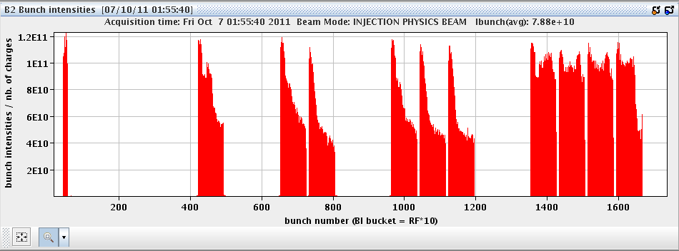
B2 bunch intensities – 732 bunches, 25ns
Last year with 50ns: Limited with 200 bunches!
25ns better than 50ns one year ago!

Slide 32
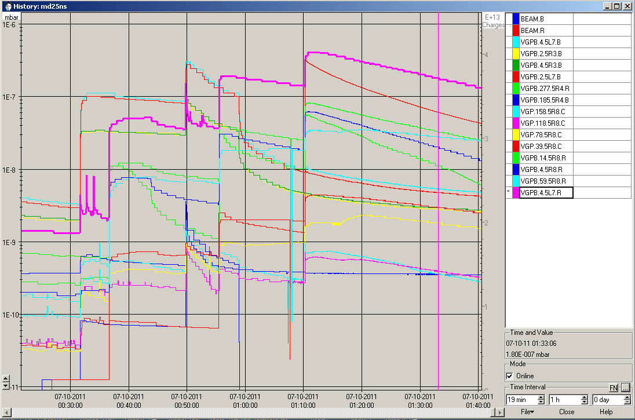
Vacuum Pressures

Slide 33
Physics with 25ns
02:30 prepare for physics with 25ns and 60 bunches
5:23 stable beams
Emittances in collisions calculated from luminosity: 3.2 – 3.3um ➔ loose factor ~1.5 compared to 50 ns
Bunch length: 1.32/1.38 ns (1.2 ns with 50 ns spacing)
Lifetimes: 125 hours

Slide 34
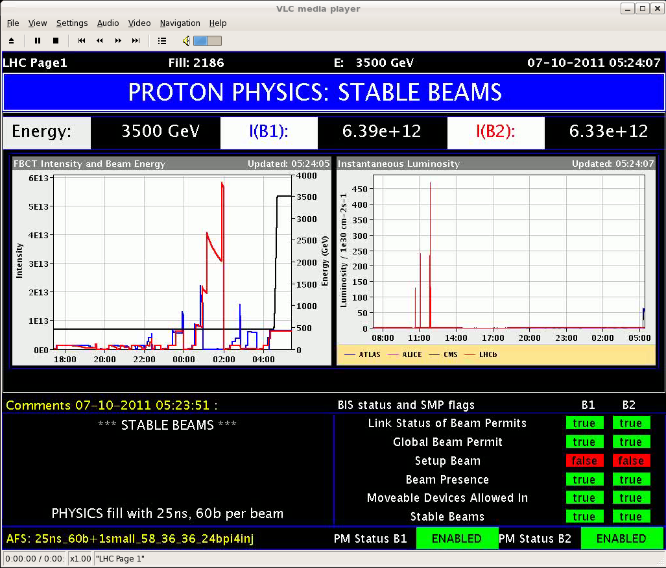
First LHC Physics with 25ns Beams

Slide 35
Tentative Plans
Now Physics fill
After fill MD: High Pile-Up (daytime…)
Wed – Thu Physics (SPS MD’s)
Fri 9h00 MD: 25 ns
Weekend Physics
To be done: Periodic loss map requalification.
→ Joerg and Gianluigi coordinate this week

Slide 36
High Pile-Up MD (Werner Herr et al…)
PS/SPS to prepare high intensity bunches for Wed morning.
Hope for two fills with single/few bunches.
Need RF, ADT, tune feedback experts.
Fill #1:
1b per beam. >2e11 p/bunch. Norm. emittance < 2.5 μm.
All interlock actives. Standard cycle.
Inject, ramp, squeeze, collide in ATLAS and CMS.
1-2h collision time – stable beams, depends on progress.
Fill #2:
Same bunch parameters. More bunches possible: additional collisions in LHCb/ALICE with low intensity bunches, 10 high pile-up collisions in CMS, …
Leave for collisions – stable beams, depending on progress.

Slide 37
High Pile-Up Parameter Space
50
40
30
20
10
Werner Herr

