Slide 1
Friday 7.10.
8:16 SB 25ns dumped by RF; integrated lumi 0.6 nb-1.
9:14 BIC problem in TI8 and CMS recovering their tracker
10:09 Abort gap cleaning commissioning.
16:29 End of abort gap cleaning. Dump. Rampdown and precycle.
16:58 RF lines 7B1, 7B2 and 8B2 have an error on the LL.
17:59 RF back. Checks for the new XPOC release.
18:32 Injection. Beam 2 injection problems. Transfer line steering. MKI8 faults. TI2 BPM LSS6 interlocks.
22:20 Machine filled. Start ramp.
22:29 Beams dumped. Trips 2 RF modules, arcs detected. Ramp down and precycle.
23h31 Injection.

Slide 2
Summary Abort Gap Cleaning (M. Meddahi et al)
Prepared beams with a special filling scheme
nominal bunches boardering the abort gap, pilot injected and kept elsewhere.
One injection with one train of 12 and one injection with two trains of 12 bunches, 50 ns spaced bunches.
Ramped to 3.5TeV collided.
Switched on abort gap cleaning
tune stepping in range of 0.29 to 0.33 (vertical plane), 2 second repeat cycle, 30 steps in tune.
The initially used cleaning pulse was ~1 microsecond long, located early in the abort gap, as for cleaning at 450 GeV.
An effect on the luminosity could be seen for this initial part, when switching on B1 cleaning, but not readily confirmed by wirescans done towards the end of the MD.
RF voltage was reduced in different steps and observed cleaning.

Slide 3
Summary Abort Gap Cleaning (M. Meddahi et al)
Length of the cleaning pulse was later increased
cover almost full abort gap (~2.5us), works well.
After three hours in collisions no more effect on lumi decay when cleaning is switched on/off
Recovered equal bunch length for both beams
lowering voltage to 6.5 MV (before different steps were done on both beams so bucket filling was different)
Moved tune…
range symmetric about tune of 0.32, not better.
Narrowed tune range to 0.31 to 0.33, cleaning is worse.
Best cleaning was for the initial choice of 0.29 to 0.33
Long cleaning pulse
with voltage drop of 2 MV (9.5 MV to 7.5 MV) cleaning was insufficient.
For smaller voltage drops the cleaning seemed to act as a barrier.

Slide 4
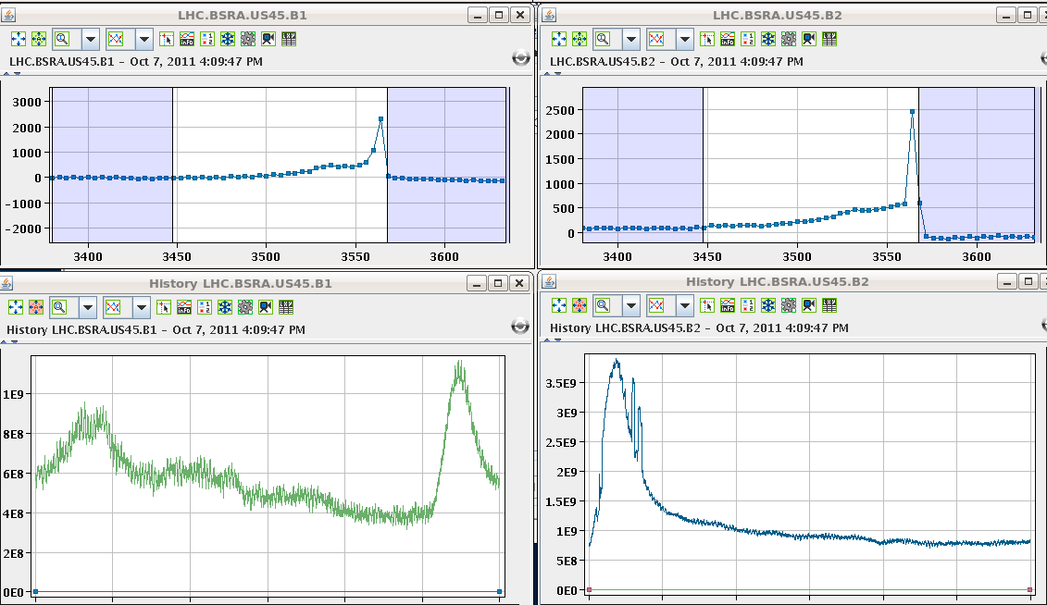
Abort Gap Cleaning example
RF voltage changed → leak of beam into abort gap
Transverse damper cleans out the gap (faster than synchrotron rad.)
Beam 1
Beam 2
Population in abort gap
Population in abort gap
cleaning
Time history
Time history
filling
cleaning
filling

Slide 5
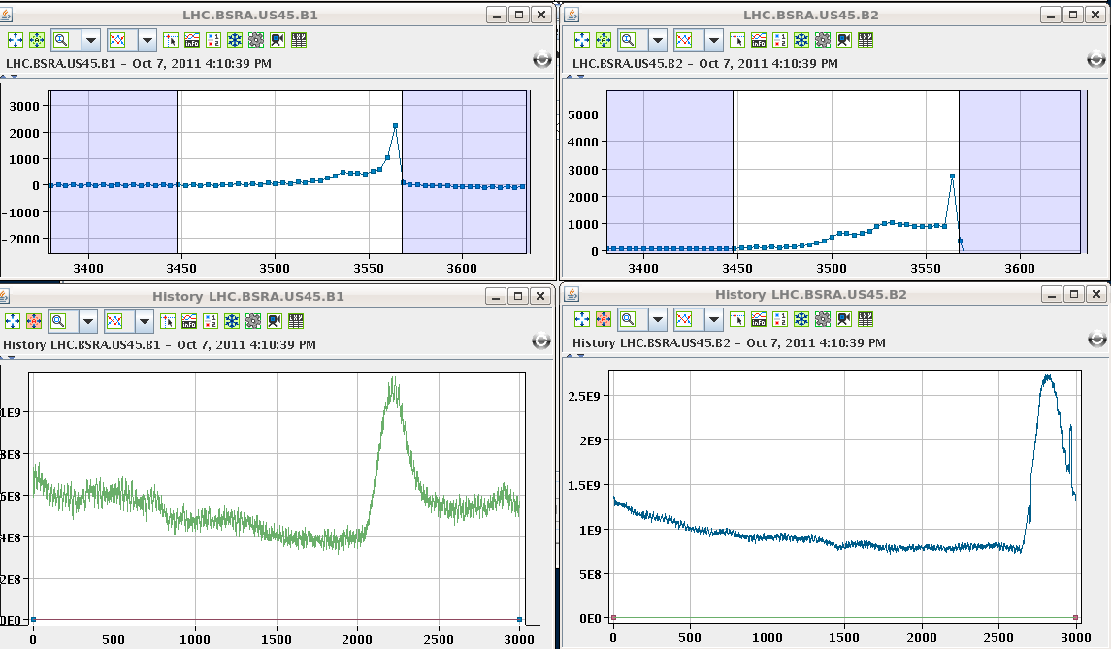
Abort Gap Cleaning example (52 s later)
RF voltage changed → leak of beam into abort gap
Transverse damper cleans out the gap (faster than synchrotron rad.)
Beam 1
Beam 2
Population in abort gap
Population in abort gap
cleaning
Time history
Time history
cleaning
filling
filling

Slide 6
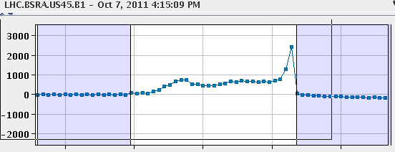
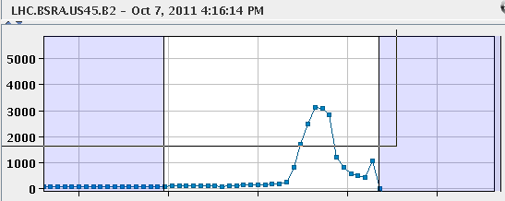
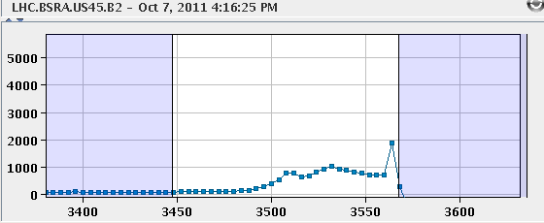
Abort Gap Population vs Time
4:15:09 PM → 0 s
4:16:14 PM → + 65 s
4:16:25 PM → + 76 s

Slide 7
Summary Abort Gap Cleaning (M. Meddahi et al)
Bunch by bunch lumi data to be looked at in detail.
The abort gap cleaning is operational if we want to use it, but effect on luminosity with full machine still needs to be checked in detail.
Propose to test it at an end of fill for a couple of hours, using the longer cleaning pulse, at the beginning of next week.

Slide 8
Fri/Sat 7/8.10.
23:31 Injection. Injection problems. SPS injection oscillations. MKI8 faults.
23:55 Called kicker expert for MKI8 problem.
The problem with the MKI is that now there is a shift between the prepulse and the abort gap keeper.
Expert comes to CCC to correct the shift.
RF checked that all OK from their side.
01:44 Injection for physics.
Kicker problem solved.
Injection efficiency is affected by a BPM interlock in SPS-LSS6 for B1. SPS problems.
Injected beam dumped by losses.
03:00 Injection for physics again.

Slide 9
MKI (beam2) problems (E. Carlier)
Transient AGK (“abort gap keeper”) inhibition for injection of bucket 1 (probe beam) resulting in missing kick (beam on TDI):
Inhibition seems due to asynchronism between AGK 100MHz generation clock in LBDS and injection prepulse (end AGK window).
Shift of the AGK w.r.t the injection by -10ns improves the situation for injection of bucket 1 but induces transient inhibition on the injection of bucket 31181 (beginning of AGK window).
Roll back to original synchronisation settings.
AGK window length within tolerances (no interlock at LBDS level).
Phase offset between revolution frequency and injection prepulse w.r.t selected bucket appears to be OK (shift of the AGK results in inhibition of the bucket 31181 as foreseen)
Looks like as to be a drift within one timing module.
Access needed in UA87 to identified the faulty module
In case of similar failure (kicker in faulty state after injection of probe beam in bucket 1), installation can be restarted.
If the problem occurs again for the probe in bucket 1, we have to try again until it works. Switching the MKI to standby resets the fault.

Slide 10
Saturday 8.10.
03:00 Injection for physics again.
03:51 Ramp.
04:33 Stable beams. Fill #2194. Initial luminosity: 3.2e33.
05:10 Beams dumped by trip of sector 56. MP3 investigating. Integrated lumi: 7pb-1. Ramp down and recycle.
07:41 Access to point 6 (QPS problem) and point 2 (ALICE).
08:45 QPS problem solved, pre-cycle starting
circuit breaker for whole QPS rack open – second time this happens
Expect beam back around 10h00.

Slide 11
Ahead
Friday pm/Sat/Sun: Physics
Monday day: High pile-up MD.
Tue – Thu: Physics
Friday: Floating MD 25ns

