Slide 1
Monday 3.10.
09:25 Operator dump fill #2178, integrated lumi 107/108/18 nb-1. Trip of RQ4.R6 (fire heaters discharged) just after the beam dump but the QPS gave no PM data.
10:27 Try to reset Q4.R6. Not possible. Access needed.
11:03 Prepare access to UA area in point 6.
12:17 Prepare tunnel access in point 6.
14:27 Lost cryo conditions in the MSR6.
14:53 Q4.R6 problem solved (~5h impact).
The firing of the heaters has somehow affected the current lead instrumentation. Could not reset the QPS of the Q4. Was issue with the ELQA proximity box, on the current lead side. The fault was cleared by de-plugging and re-connecting the cable but it is not clear what the source was. The QPS and ELQA teams are still working to try and understand more in details what happened.

Slide 2
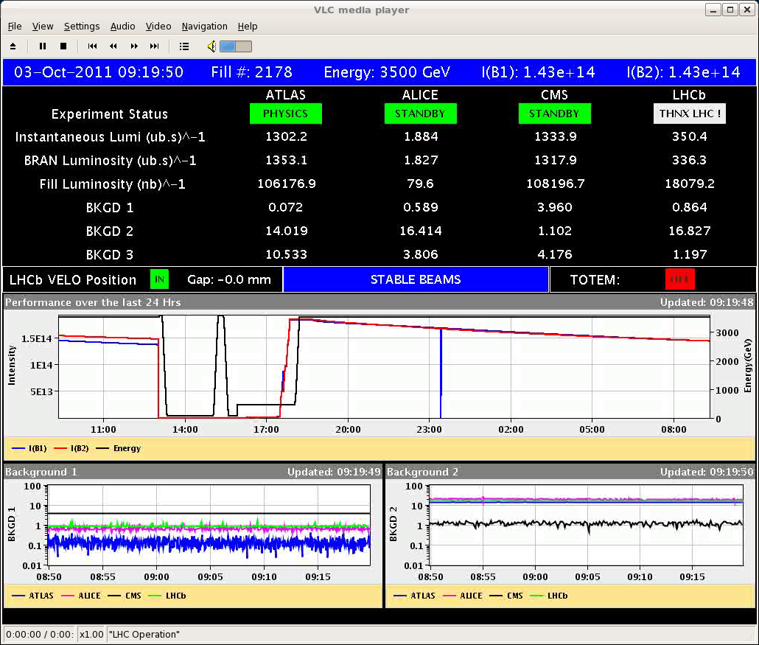
Fill #2178

Slide 3
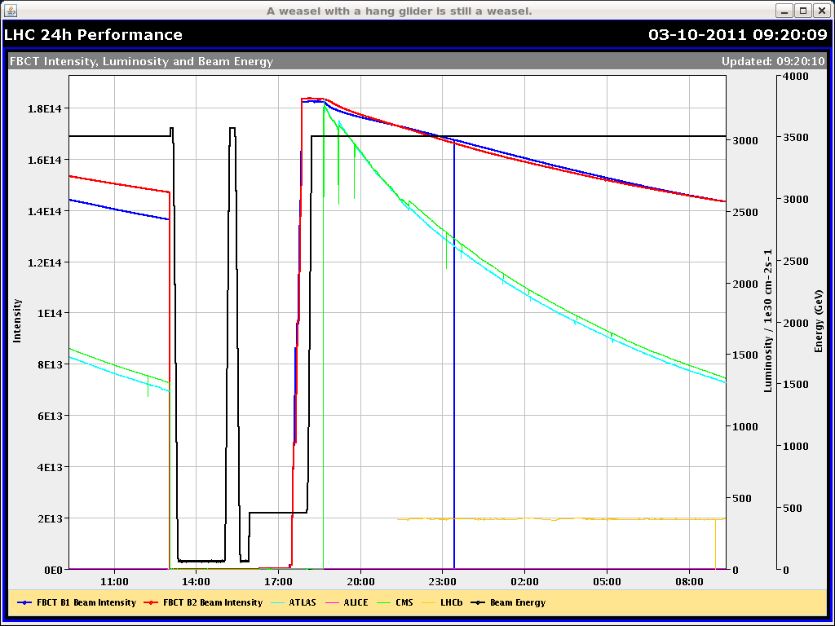
Fill #2178

Slide 4
Monday 3.10.
15:36 Pre-cycle. Some RF cavity studies (Philippe). Some BLM thresholds changed.
16:55 Injection.
17:28 Optimization of transfer line is required (~1h impact).
18:40 Injector beam optimization (~0.7h impact).
19:36 Filling complete.
19:45 Ramp.
20:34 Stable beams. Fill #2180. Peak lumi ~3.2e33 cm⁻² s⁻¹.
20:35 ALICE leveling started.
20:48 Beams dumped due to high losses in IR2 after vacuum spike.
21:41 Injection.
23:54 Stable beams. Fill #2181. Initial lumi 3.2e33 cm⁻² s⁻¹.

Slide 5
Last 24hours

Slide 6
BLM Thresholds (Barbara & Eduardo)
BLM threshold change for 10 triplet monitors at IP1 and IP5 the RS10-12 were set to the same value (in Gy/s) as the RS09 to allow for luminosity induced loss signals (and avoid having the BLMs constantly at warning levels during physics collisions). Thresholds consequently increased by up to a factor of 2.6. See LHC-BLM-ECR-0026 for details.
Monitors concerned:
BLMQI.01R1.B1E30_MQXA BLMQI.01R5.B1E30_MQXA BLMQI.01L1.B2E30_MQXA BLMQI.01L5.B2E30_MQXA BLMQI.02L1.B1I23_MQXB BLMQI.02R1.B2I23_MQXB BLMQI.02R1.B1E30_MQXB BLMQI.02R5.B1E30_MQXB BLMQI.02L1.B2E30_MQXB BLMQI.02L5.B2E30_MQXB

Slide 7
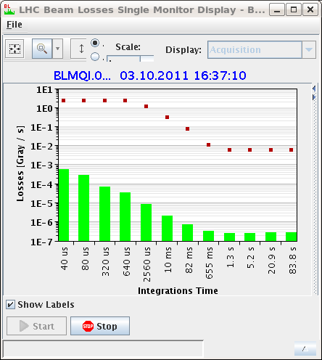
Modified BLM Thresholds

Slide 8
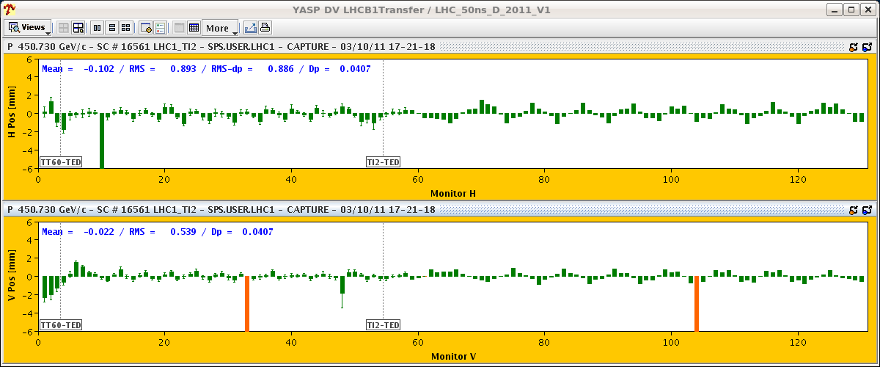
Transfer Line Issue: Oscillations

Slide 9
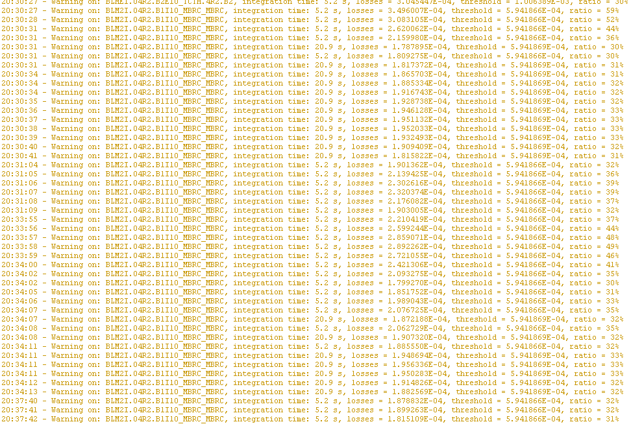
Losses in IR2 triplet

Slide 10
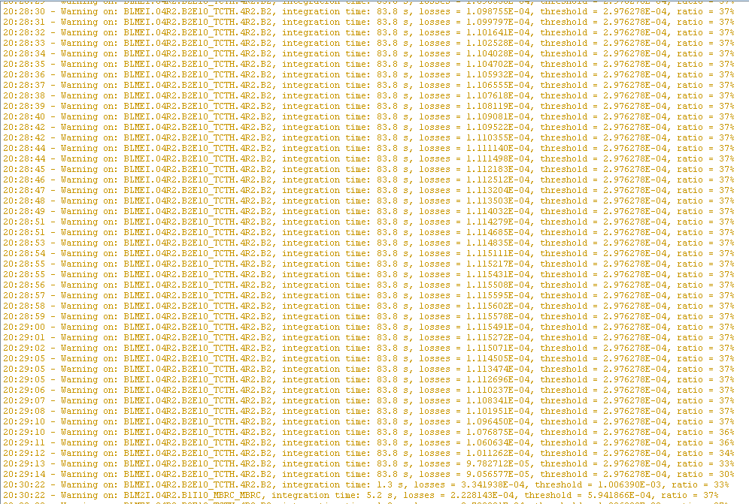
Losses in TCTH.4R2.B2

Slide 11
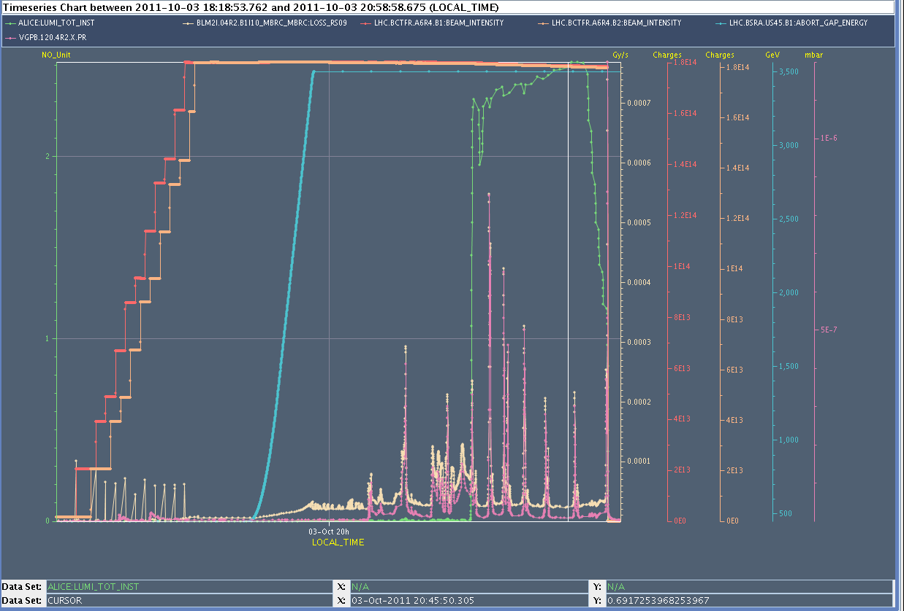
IR2 Behavior

Slide 12
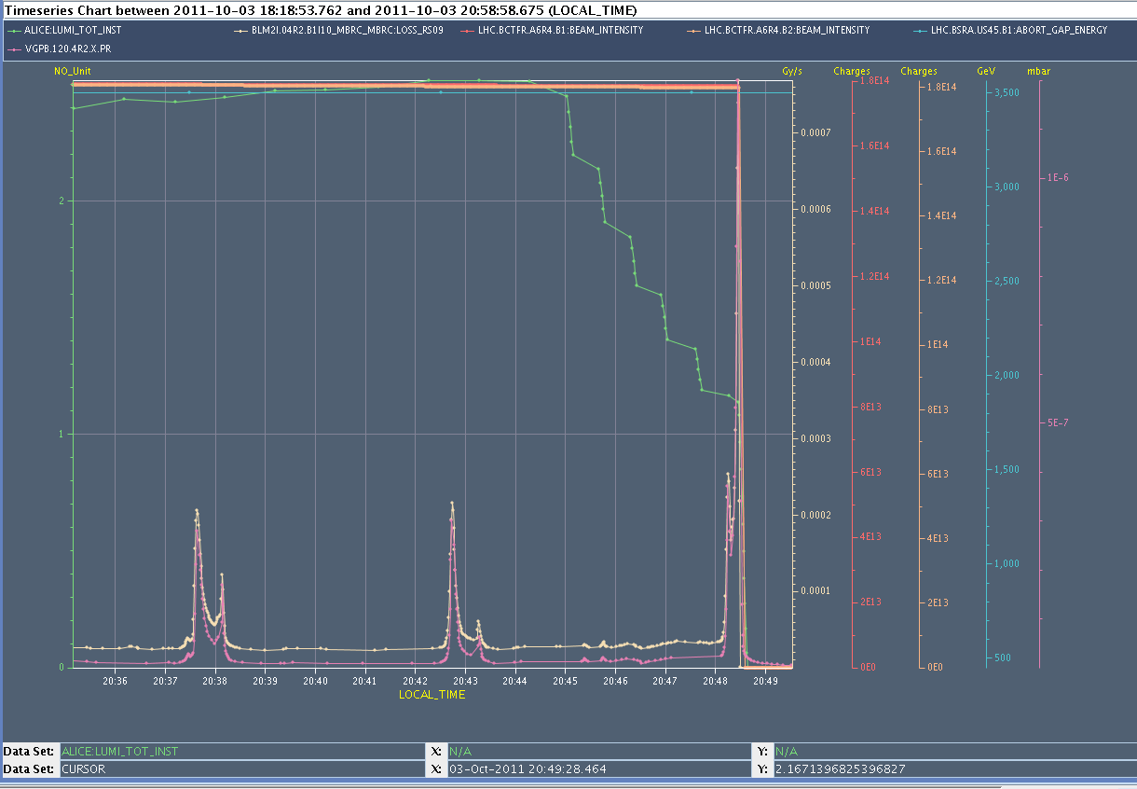
IR2 Behavior

Slide 13
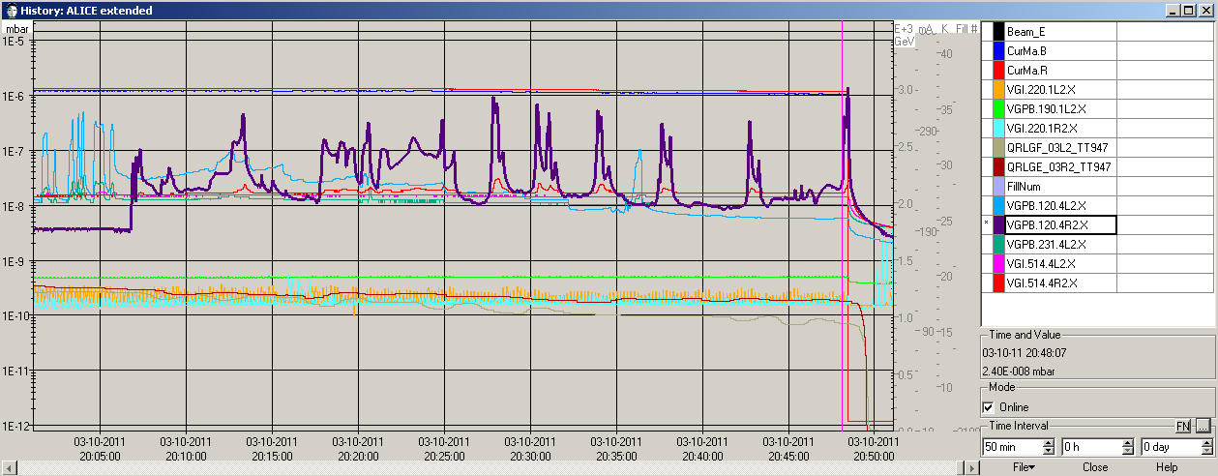
IR2 Vacuum

Slide 14
Stable beams

Slide 15
Present tentative planning week 40
Mon/Tue: Physics.
Tue (day): RF preparation for 25 ns & Abort gap cleaning (7h)
Tue (pm/night): Physics
Wed (day): Large pile-up MD (9h)
Wed (pm/night): Physics
Thu (day): 25 ns MD (12h)
Thu/Fri/Sat/Sun: Physics
To be done: Loss map qualification for injection & physics

Slide 16
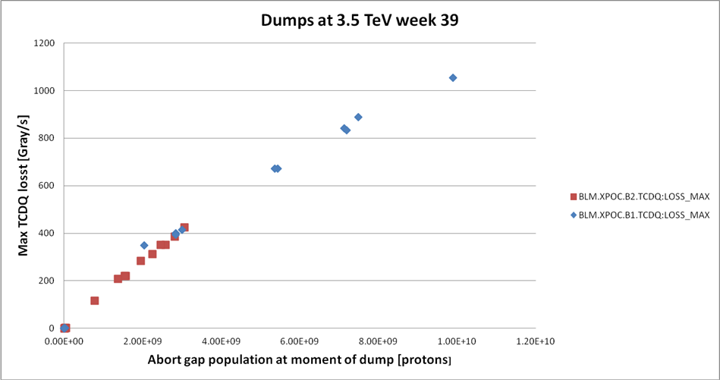
Abort Gap Cleaning
J. Uythoven

Slide 17
High Pile-Up MD (Werner Herr et al…)
PS/SPS to prepare high intensity bunches for Wed morning.
Hope for two fills with single/few bunches.
Need RF, ADT, tune feedback experts.
Fill #1:
1b per beam. >2e11 p/bunch. Norm. emittance < 2.5 μm.
All interlock actives. Standard cycle.
Inject, ramp, squeeze, collide in ATLAS and CMS.
1-2h collision time – stable beams, depends on progress.
Fill #2:
Same bunch parameters. More bunches possible: additional collisions in LHCb/ALICE with low intensity bunches, 10 high pile-up collisions in CMS, …
Leave for collisions – stable beams, depending on progress.

Slide 18
High Pile-Up Parameter Space
50
40
30
20
10
Werner Herr

Slide 19
25ns MD
MD plan (G. Arduini & B. Goddard):
08:00 - 10:00, beam setup and changeover in SPS and in transfer lines, injection of 12 and 24b trains to LHC.
10:00 - 12:00, RF setup (observation of transient and eventual tuner fine adjustments, 1h/beam)
12:00 - 16:00, damper setup with single bunch and 12b trains (4h beam time needed).
16:00 - 20:00, increase of injected intensity 24b, 48b, 72b (with 144b, 216b, 288b as options).
The objective is to be able to inject (and keep in) at least 1 train of 72b, for the subsequent MD sessions.
Exiting the MD, a ramp attempt will be made with (12+2x24)b at 25 ns, as the experiments would like some collisions - this could therefore be between 19:00 and 01:00 → stable beams.

Slide 20
25ns - Detailed MD plan (G. Arduini & B. Goddard)
to be done in SPS before MD (KC/JW/..)
establish 25 ns beam (1.1e11 p+/b, ~3 um) on cycle in SPS.
12b, 24b, 48b, 72b, 144b, 216b and 288b.
check characteristics for all beams (trans/long emittances, scraping settings, intensities)
if possible (when LHC off)
extract 12b onto upstream TEDs (based on 25 ns cycle settings) and first steering if needed
extract 12b onto downstream TEDs and check TL steering.
LHC RF preparation (PB)
Modification to tuner firmware (Wednesday 5th - no access needed)
Increase of klystron HT from 50 to 56 kV, and tests (1-2 h during rampdown or access)

Slide 21
25ns - Detailed MD plan (G. Arduini & B. Goddard)
beam setup and changeover to 25 ns (2h)
cycle change in SPS
LHC damper settings to 25 ns
12b to downstream TEDs, check of steering
inject with 12b at 25 ns and check steering and injection oscillations.
correction of injection oscillations and steering for beamloss at TCDIs if needed.
if required opening to +/-5 sig of most critical TCDI collimators in TI8.
if required basic re-setup of most critical TCDI collimators, plus change of interlocks (*** as a last resort! ***)
check losses with 12b injections for both beams
RF checks (1-2h)
when 12b injection OK for each beam, check of cavity voltage/klystron power transients
adjustment of tuner fine delays if needed
not possible in parallel with ADT (can start ADT work when first beam done for RF)

Slide 22
25ns - Detailed MD plan (G. Arduini & B. Goddard)
damper setup (4-5h)
detailed setup of damper (4 h beam time needed)
with RF and damper OK, accumulation of a few 24b batches in each beam to check losses etc.
increasing injected intensity (4h)
when 24b injection OK for each beam, for nominal chromaticity inject 48b batch;
if not OK due to instability, increase chromaticity to 15-20 units;
when 48b can be injected OK, inject additional 72b batch;
if OK, inject additional 144b batch;
preparation for ramp attempt
fill with (12+(2x24b)) scheme
recovery (after ramp attempt)
revert all settings to 50 ns ones (if needed)
revert all interlock thresholds to 50 ns ones, and make separate cross-check
test injection of 12b at 50 ns still OK.

