Slide 1
UPS – yesterday morning
07:01: informed LHC of perturbation at point 4. Whilst speaking with operator, viewed trip of sector 5.
07:02 cascade of alarms from EBS11/56.
Informed operator LHC and contacted EL piquet, in the meantime LHC has arranged RP piquet for access point 5.
07:45: EL piquet (B. Sollier, David Di Lazzaro) passed by CCC to check alarms and verify time for access.
07:50 On request of EL piquet contacted APC Schneider.
08:20 EL-OP descend into tunnel to investigate problem
10:40 Piquet APC Schneider arrives on site to assist in the investigation
08:09 Contacted EDF RTE to confirm if they saw a perturbation in their network (using current instructions, time given was T - 3min 21s) Nothing seen from their side.
14:53 EL-OP informed TI that the intervention will finish in a few minutes. One electronic card was changed so we have to test the "PIC Fault" before closing the machine
15:02 EL-OP tested the "PIC fault" with TI operator and with LHC operator ==> everything is OK and every alarm was acknoledged.
15:22 The UPS works again and the technicians gets out of the machine.

Slide 2
UPS
Bras mutateur en défaut
Causes:
l'IGBT (transistor de puissance) d'un bras mutateur a cassé. Une expertise plus profonde est en cours par APC/SCHNEIDER
Consequences:
Arrêt LHC par PIC de EBS11/56.
Actions:
Appel du piquet APC/SCHNEIDER intervention.
Diagnostique et dépannage: changement de 2 bras mutateurs, d'une carte alimentation et d'une carte mère.

Slide 3
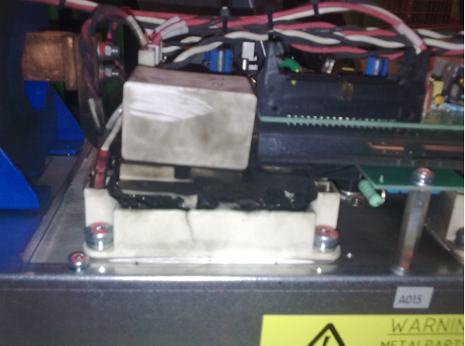
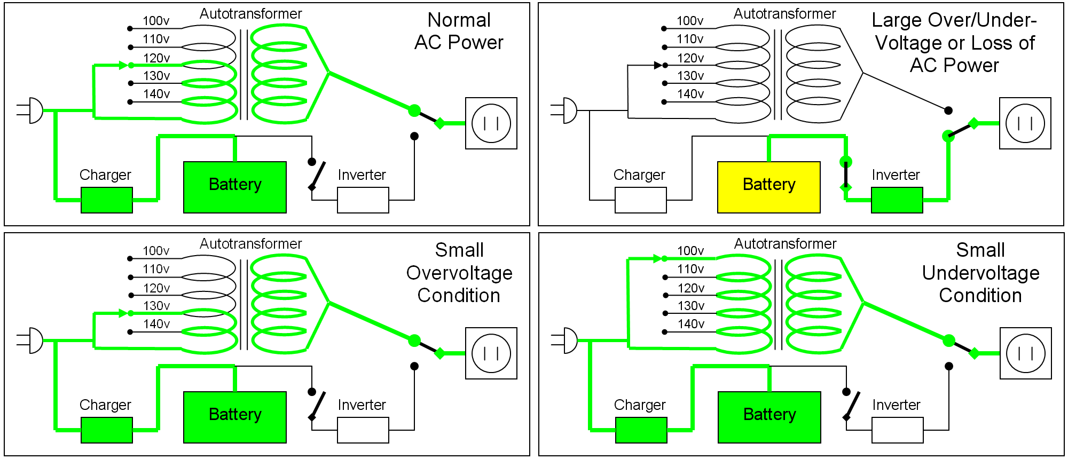
UPS

Slide 4
In the shadow
Water leak SPS

Slide 5
In the shadow
Cleared a few access requests
A DAB card has been changed in a BPM crate in point 8
QPS intervention on RB.A45 heater, plyus other QPS resets
BLM intervention at pt 7. Was found that the Diamond BLM monitor needed replacement. There was not time to do this in this access, so another intervention needs to be scheduled
CV in PM56/UJ56 for water leak from cooling circuit of ventilation of safe room has been done.
Vacuum team modified cabling for ion pumps at A4L8 and A4R8, to have a clearer view of pressure increases.
Also, coupler calibrations have been updating for cavities 5B2, 7B2 and 8B1.
(The calibrations giving the coupler position for a given cavity Q). A ramp of the RF was done to validate.
Some tests were done on TCTs for the 90m optics, but more work is needed

Slide 6
Thursday
Accesses in shadow of UPS repair
Pre-cycle
17:00 Injecting
Transfer line steering required
Halting injection – PS quadrupole problem
20:00 Stable beams #2171
Initial luminosity: 3.15e33, Ib = 1.31e11
Emittance from lumi: 2.2 micron
(Wire scan 144b: 1.4/1.2 1.5/1.8 micron)
06:00 Beams dumped
~75 pb⁻¹

Slide 7
Misc - overnight
Lost a temperature sensor on DFBX R5. Forced it for the time being and put valve in medium position. A remote reset was issued for the temperature sensor problem. Worked,
Error on the leveling applications keeps occurring. Forcing different values of the step size works for short times. Needs to be investigated tomorrow.

Slide 8
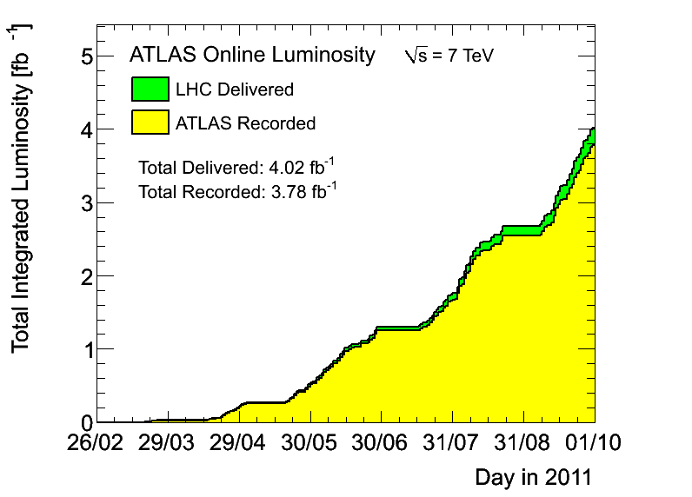
4 fb⁻¹

Slide 9
So long…

