Slide 1
Tuesday morning
Trip of the four circuits seems to be due to a SEU.
U-res of ROF.A56B1 is suddenly going to saturation and the circuit trips; the other circuits tripped by coupling.
08:05 lost S34 during “fix”
access for QPS
Electrical network re-configuration
Atlas cryogenics takes a hit
Ph.Baudringhien working on RF module M1B1

Slide 2
Tuesday afternoon
Pre-cycle
Switch LHCb polarity
12:30 beam 2 in but problem with BIS beam 1
Bruno Puccio: finally we could rearm the LBDS for B1, without a clear explanation. The BIS frequency was indeed well transmitted in simulation mode and we tried to rearm...
13:47
ALICE dipole tripped: “apparently the EPC expert did some bad manipulation in connecting an oscilloscope.”
14:30 – 17:00 test ramp with pilots
step through squeeze measuring and correcting coupling and chromaticity

Slide 3
Tuesday evening
Access for Atlas during ramp-down
Patrol lost – access finished 18:30
BPM crate power supply changed
Problem unresolved 
21:00 machine full
Had two shots at the beginning with high injection oscillations and then all below threshold. Average bunch intensity 1.34e+11. Vacuum not too bad.
21:30 lost in squeeze – LBDS self trigger
Similar fault has occurred last Thursday and this morning
Access required to change card

Slide 4
Overnight Tuesday - Wednesday
01:30 Injecting
when filling for fill 2164, beams dumped by a trip of RCBXH3.L2:
quench loop opened but no PM and communication witch crate was lost several minutes later. A power cycle was needed.
Refill. Injection OK, one latch on injection oscillation with 72 bunches, beam 1. The last but one injection of 144 bunches beam 1 was not seen by the IQC, neither by injection sequencer.

Slide 5
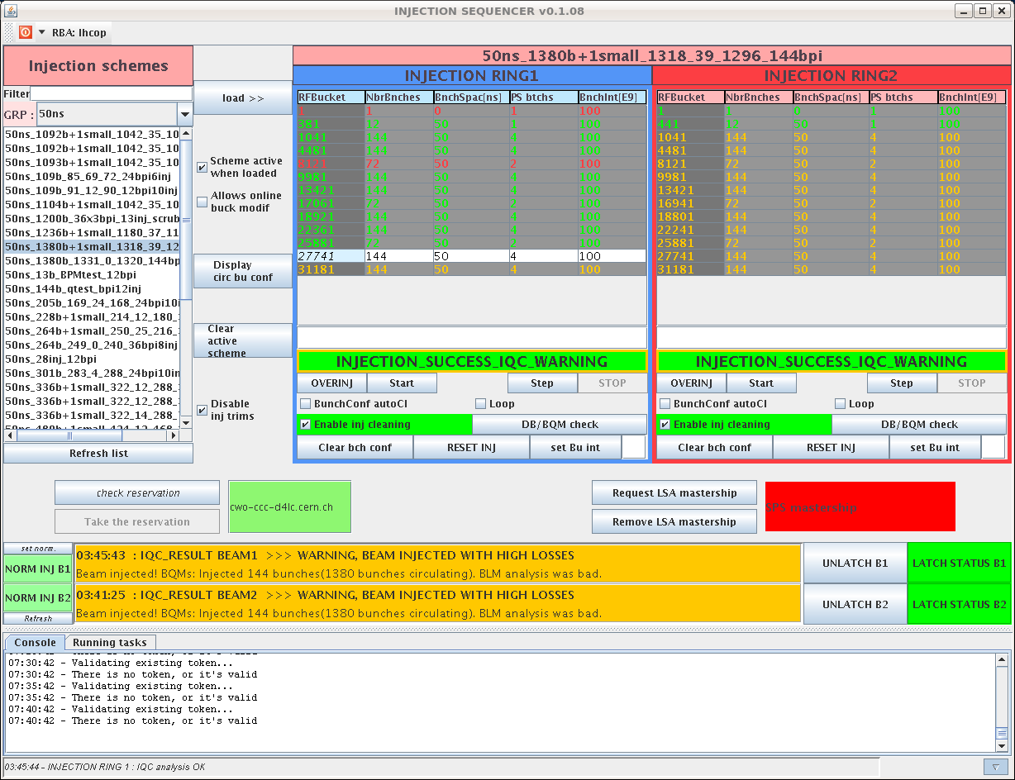
Missed injection

Slide 6
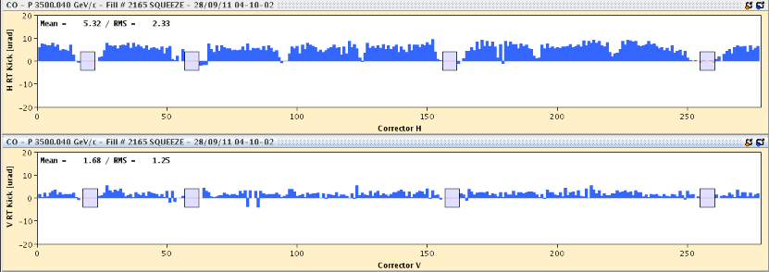
Overnight continued
RT orbit trims issue in ramp
2 dips in lifetime during the squeeze (40% of dump threshold).
Orbit was not very well controlled in step from 1.5-> 1m (maybe due to the missing BPM crate)
Tune feedback did not switch off during the squeeze
coupling correction looks to have helped

Slide 7
Overnight continued
04:30 Stable beam #2165
Initial luminosity 3.2e33
1.3e11 per bunch
Issues with Alice trigger/luminosity monitoring

Slide 8
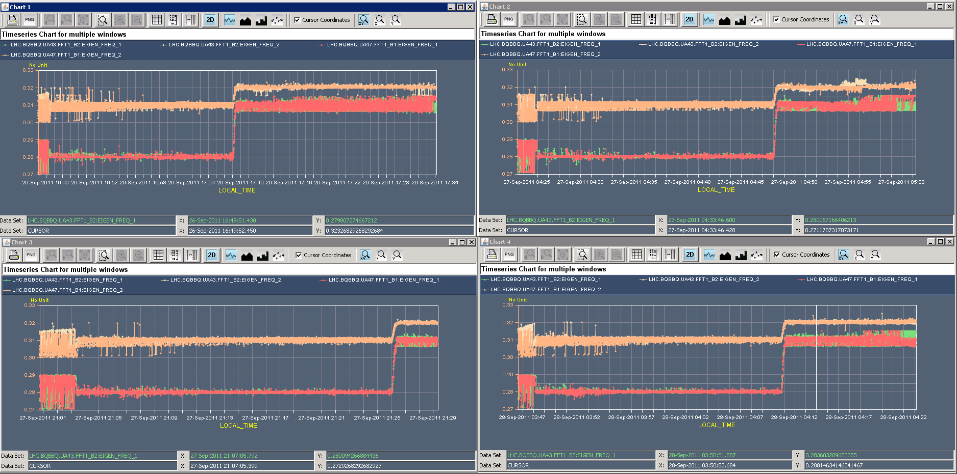
Tune fitting
Ralph Steinhagen
Adjusted BBQ tune fitter settings to the equivalent of "MEDIAN FITTER 2" assuming a broader peak rather than applying the refined ''MEDIAN FITTER 1" that assumes narrow peaks.
the changes are visible but are fairly small and not impressive hoped...

Slide 9
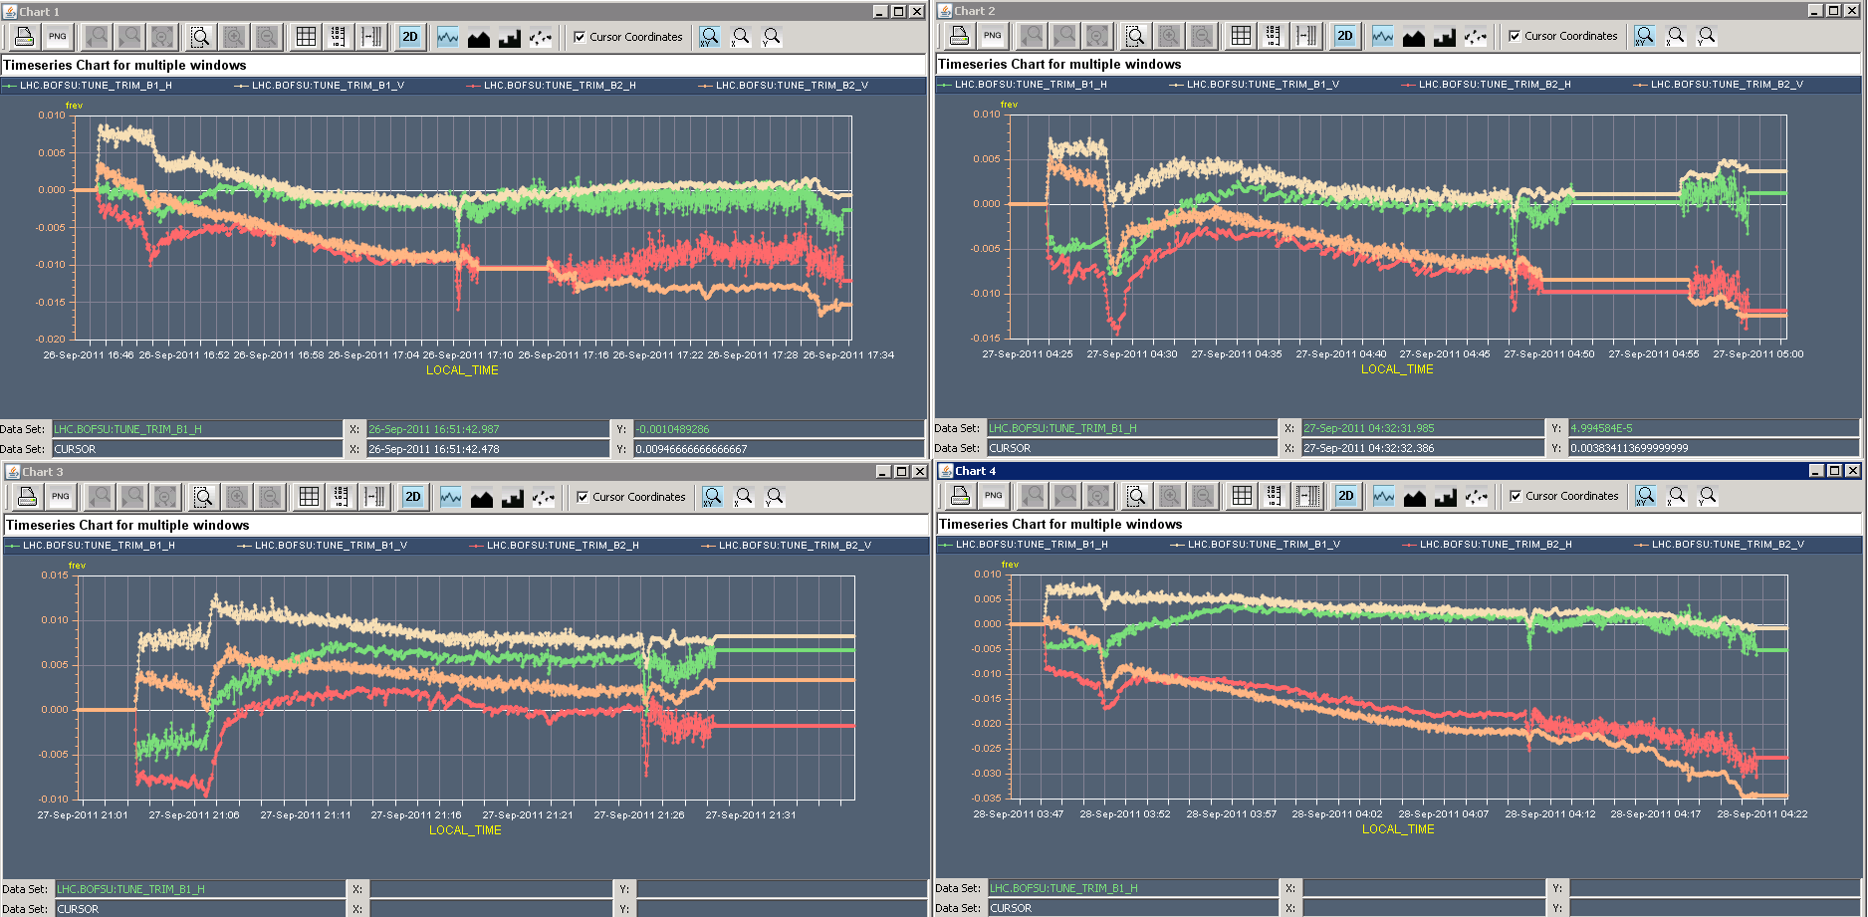
RT orbit feedback induced tune shifts

Slide 10
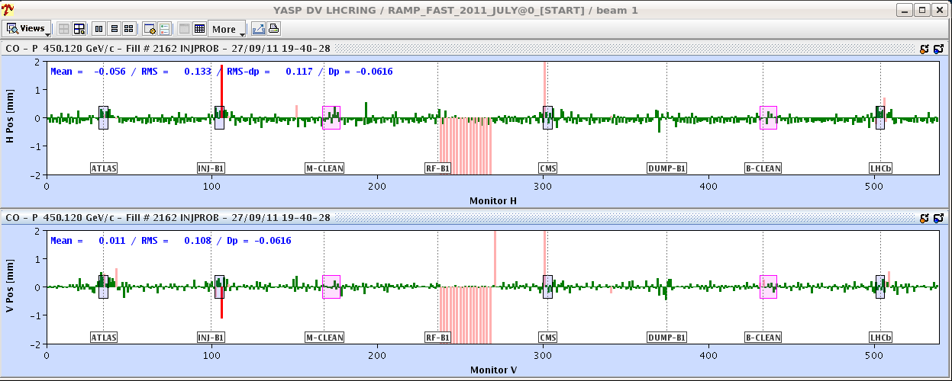
BPM crate - point 4
The power supply for BPM crate cfv-sx4-bpmb1rb was changed. It tripped however again shortly afterwards. Decided eventually to run without it. Will have to be fixed today.

Slide 11
Today
Stable beams
Abort gap cleaning at 3.5 TeV – 6 hours

