Slide 1
Saturday 1st October
03:05 UPS trip at point 5:
same UPS as Thursday – unit replaced
07:00 Visit
Her Excellency Pratibha Devisingh Patil
Access
UJ14 – ZDC, collimator resolver, UL55
Coming back problem various
access biometry UJ14, PAD PM25
patrol box YZBPC01=PM15
QPS controller for the 4 circuits in XL5
15:00 Access required again for UPS in UJ56
communication problem due to a bad contact in a relay

Slide 2
Saturday afternoon
17:30 Pilots in
Some delay:
SPS RF
SPS BQM
Transfer line steering while waiting for SPS
22:00 Stable beams #2177
3.1e33 cm⁻²s⁻¹
1.77 e14
1.28e11/bunch
emittance from lumi 2.1 microns
stables beams happily ongoing, and vacuum conditions well behaved.
It seems that the strip-line BPMs are less well calibrated since a temperature correction was applied (on Friday), and this perhaps should be checked by BI

Slide 3
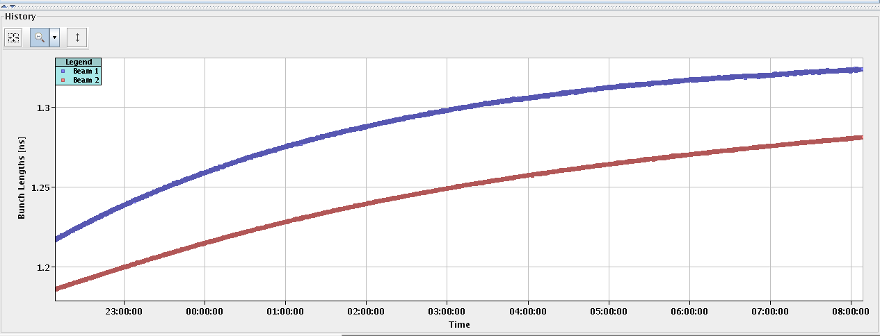
2177 bunch length
Markus Albert

Slide 4
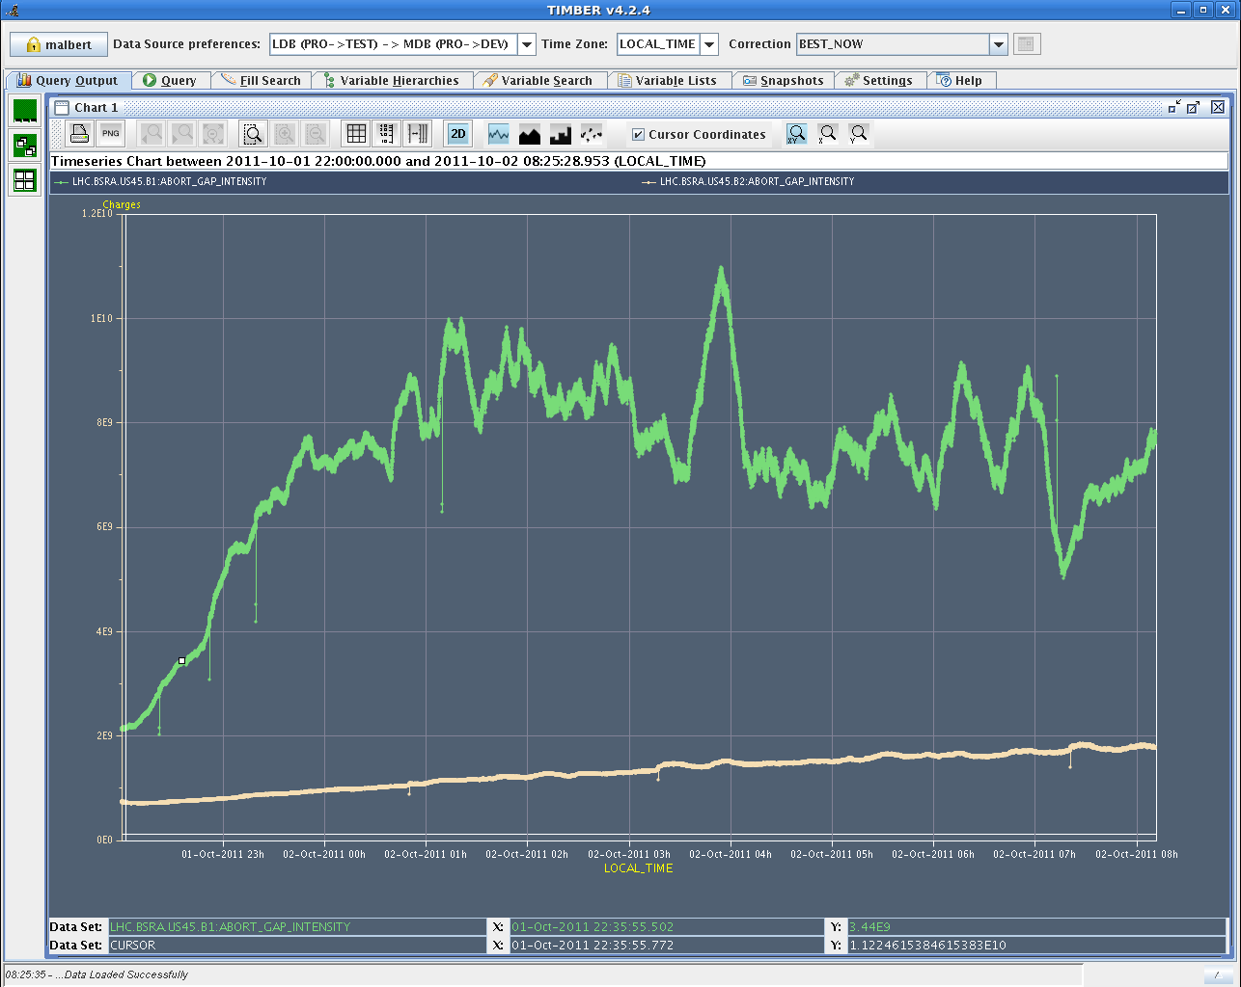
2177 abort gap population

Slide 5
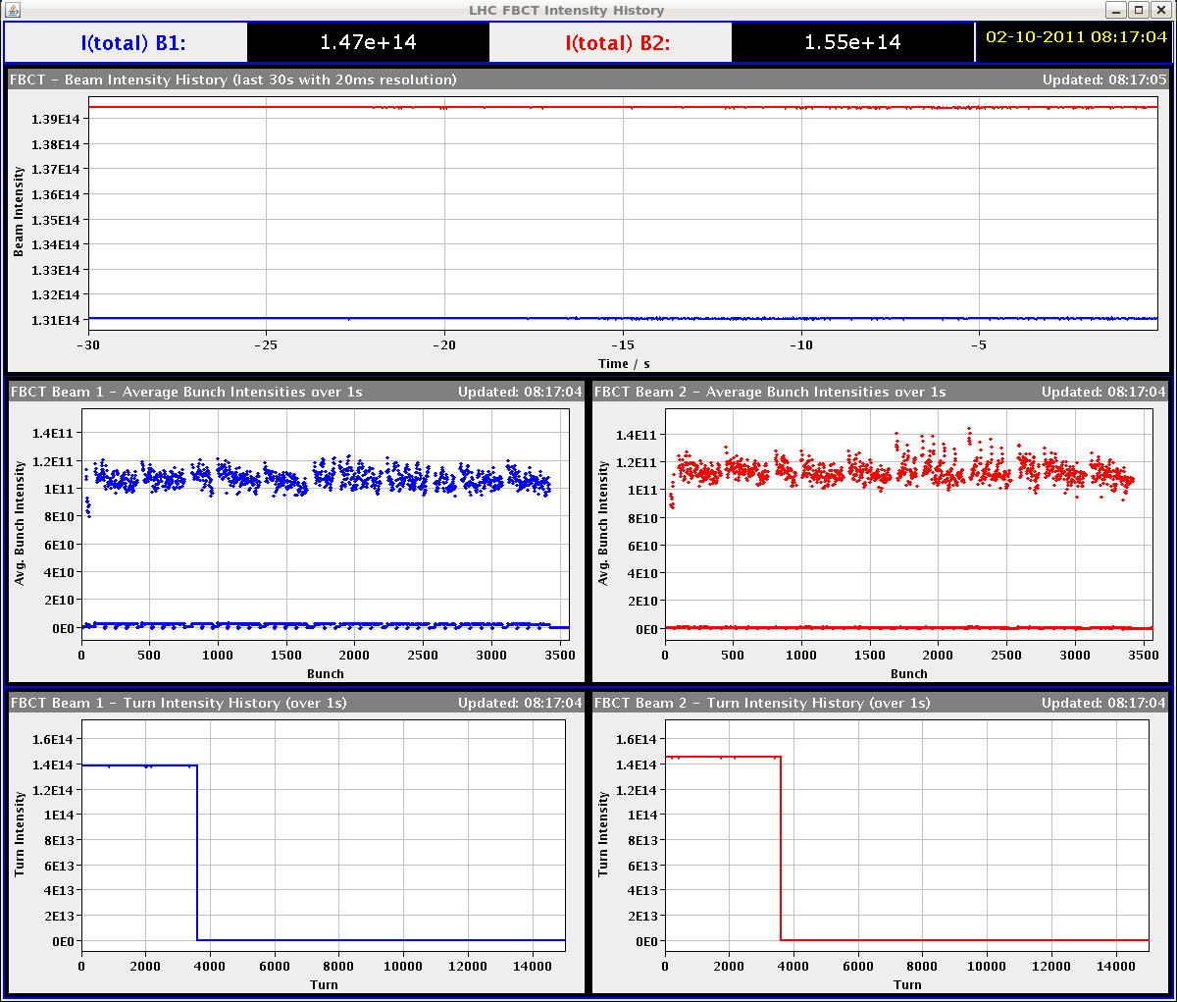
Bunch currents

Slide 6
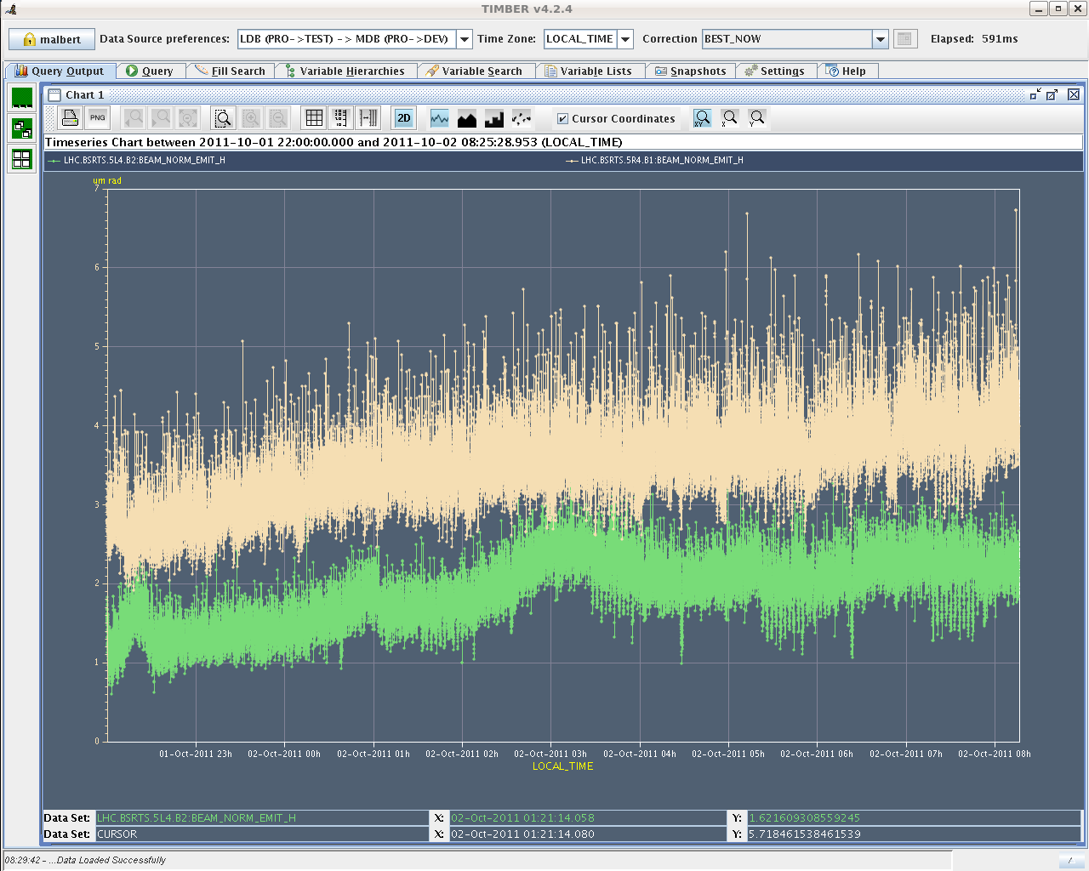
Horizontal emittance

Slide 7
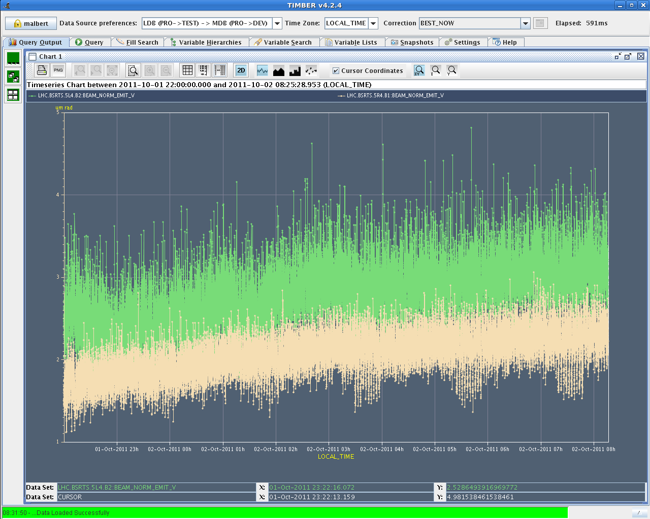
Vertical emittance

Slide 8
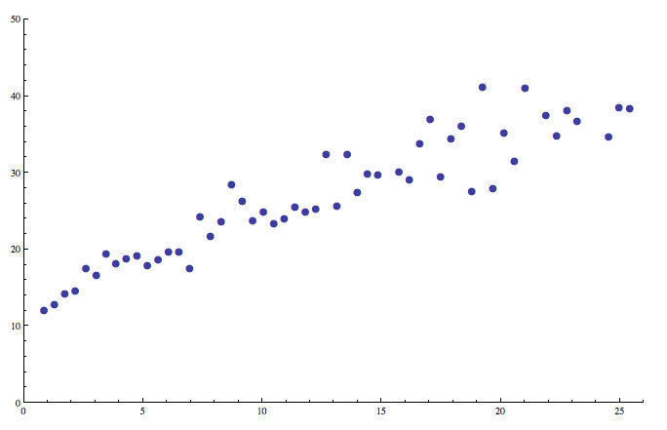
Luminosity lifetime #2105

